Slide 1
Neglected Tropical Diseases
Lymphatic Filariasis prediction

Slide 2
Current State
· WHO public 2021-2030 NYDs roadmap,the current gap in global diagnostics became painfully apparent.
· Lymphatic Filariasis (LF) is still endemic in over 50 countries, mainly in tropical and subtropical regions including Sub-Saharan Africa, South Asia, and parts of the Pacific. Over 860 million people are at risk, with more than 50 million already infected.[https://www.who.int/news-room/fact-sheets/detail/lymphatic-filariasis]
· The burden of the disease is heavier in Nigeria than in other endemic countries in Africa.[The burden of the disease is heavier in Nigeria than in other endemic countries in Africa]

Slide 3
Who is affected & What’s being done
the poorest communities with inadequate healthcare, sanitation, and education. It causes severe disability (e.g., elephantiasis), social stigma, and long-term suffering.
WHO launched the Global Programme to Eliminate LF (GPELF) using Mass Drug Administration (MDA) since 2000. Over 8.6 billion treatments have been delivered.

Slide 4
What’s the actual problem?
There is no early, localized outbreak detection system for Lymphatic Filariasis in at-risk communities.

Slide 5
Problem(Internal)
We reviewed WHO reports and LF program evaluations.
We analyzed data from WHO's Preventive Chemotherapy database, showing ongoing MDA campaigns with limited impact in hotspots.
Studies from countries like Tanzania and India show that areas lacking early warning systems face repeated transmission cycles, despite MDA.[https://pmc.ncbi.nlm.nih.gov/articles/PMC2879369/][https://doi.org/10.1371/journal.pntd.0001926]
delays in identifying high-transmission zones hinder effective intervention.

Slide 6
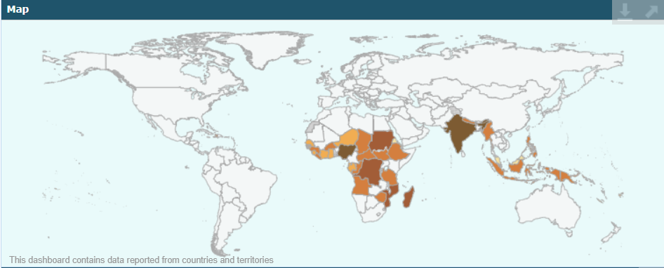
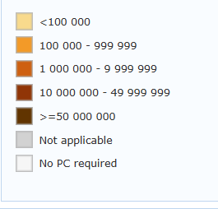
Population require PC

Slide 7
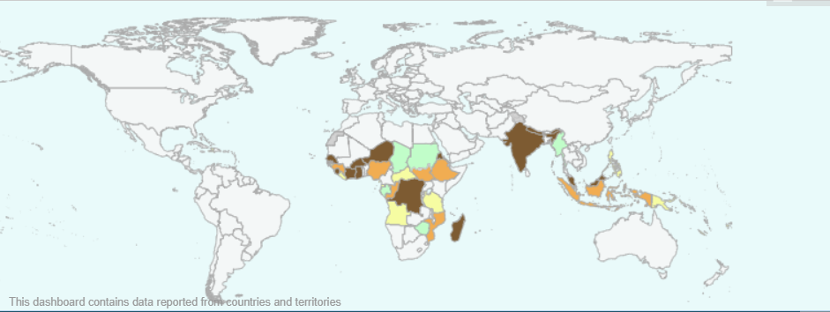
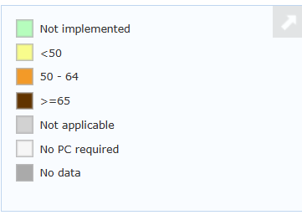
National coverage

Slide 8
Problem(External)
WHO's Global Programme to Eliminate Lymphatic Filariasis (GPELF)
reports show that despite over two decades of Mass Drug Administration (MDA), more than 50 countries remain endemic, indicating that current strategies are not sufficient.
A study published in PLOS Neglected Tropical Diseases highlights that the lack of timely surveillance systems is a critical barrier to the success of MDA, particularly in rural and hard-to-reach communities.
Evaluation reports from India and Tanzania reveal that in many villages, LF transmission persists despite multiple MDA rounds, primarily due to delayed outbreak detection and slow resource mobilization.

Slide 9
What other options did we consider
Vaccine development: Still under research; no approved human LF vaccine available yet.
Mobile health clinics: Useful for outreach, but not scalable or sustainable in remote regions without constant funding.
Community awareness campaigns: Improve participation short-term, but don’t help with targeted detection.
Improved sanitation: Important, but not a standalone solution due to complex vector transmission via mosquitoes.

