Slide 1

EyeSee
CityU-EE Gifted Education Fund Programme: AIoT Coding, Engineering and Entrepreneurial Skills Education for Gifted Students
Find Your Way
Team Members (Project ID)
23 Lee Pui Wing Adeline | 24 Lee Pui Yan Beatrice

Slide 2
Introduction
Use of object recognition to help elderly find directions or information needed

Slide 3
Background & Motivation
Aging population
From 2018 to 2038, the net size of the elderly population will be doubled (from 1.27 million and 17.9% to 2.44 million and 31.9% respectively); one in every three people will be elders in 2038
Around 15.7% of the elderly are living alone; over 70% of elders suffer from one or more chronic illness(es) and need to visit clinic/ hospital/health centers from time to time

Slide 4
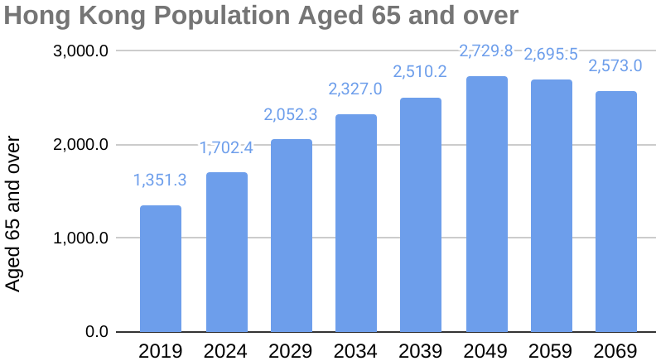
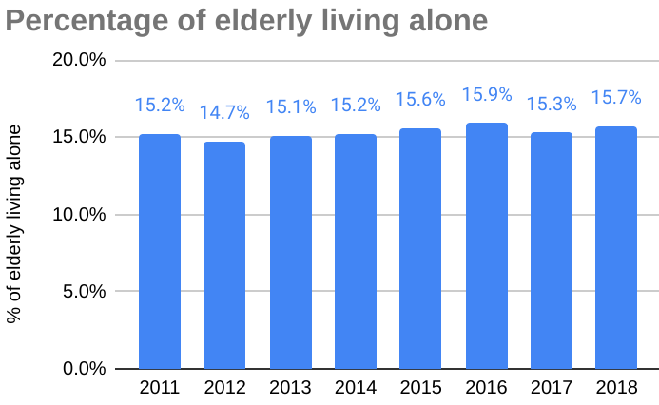
What is the target market?
¹ Office of the Government Economist – Economic Letter 2019/02
²https://www.socialindicators.org.hk/en/indicators/elderly/31.11
³ Thematic Household Survey Report No. 50, Census and Statistics Department

Slide 5
Target Market
Elderly people, especially those living alone and with chronic diseases (Estimated current size in Hong Kong: 1.43 million (65+), ⅔ with smartphone => 956,000)

Slide 6
Existing Solutions
Recognizes different objects
Applications: finding objects, detecting objects for the blind
Limitations: cannot read information on objects and has a low accuracy because the object is not viewed from different viewpoints
OCR
Recognizes the text on objects (both typed / handwritten words)
Applications: written text – > scanned document
Limitations: Can only recognize neat handwriting, limited to texts that have proper spacing

Slide 7
What is your solution?
Technology: Object identification tool + Optical character recognition
360 degrees detailed+full scan of surroundings
“Beeps” or notifies the user if any “wanted” objects/information are scanned
Any road signs, bus stop stands, taxi stand signs or direction boards will be considered as “wanted objects”
Elderly will be able to find directions or information needed with this tool
Solves limitations of some existing solutions (i.e. objects are only observed from one angle)

Slide 8
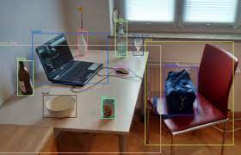

What is your solution?
Object detection (360 deg full scan of surroundings to observe any signs/direction boards)
Optical character recognition (to recognize text on signboards)

Slide 9
Timeline
January
Early February
Mid-
February
March
Define detailed product specifications
Technical Development
Product testing
Product trial run
User feedback
Refine Product Prototype

Slide 10
Future work
Future enhancement:
(i) Capture voice instruction on destination / wanted objects
(ii) Voice projection to indicate direction of destination / wanted objects
Plan to deploy and market the product:
(i) collaborate with elderly centers and community offices to market the products to elderly
(ii) engage volunteer workers to handhold elderly to trial the product

Slide 11
Thanks!
Any questions?
Contact details:
adelinelee0220@gmail.com
beatricelee0220@gmail.com

