Slide 1


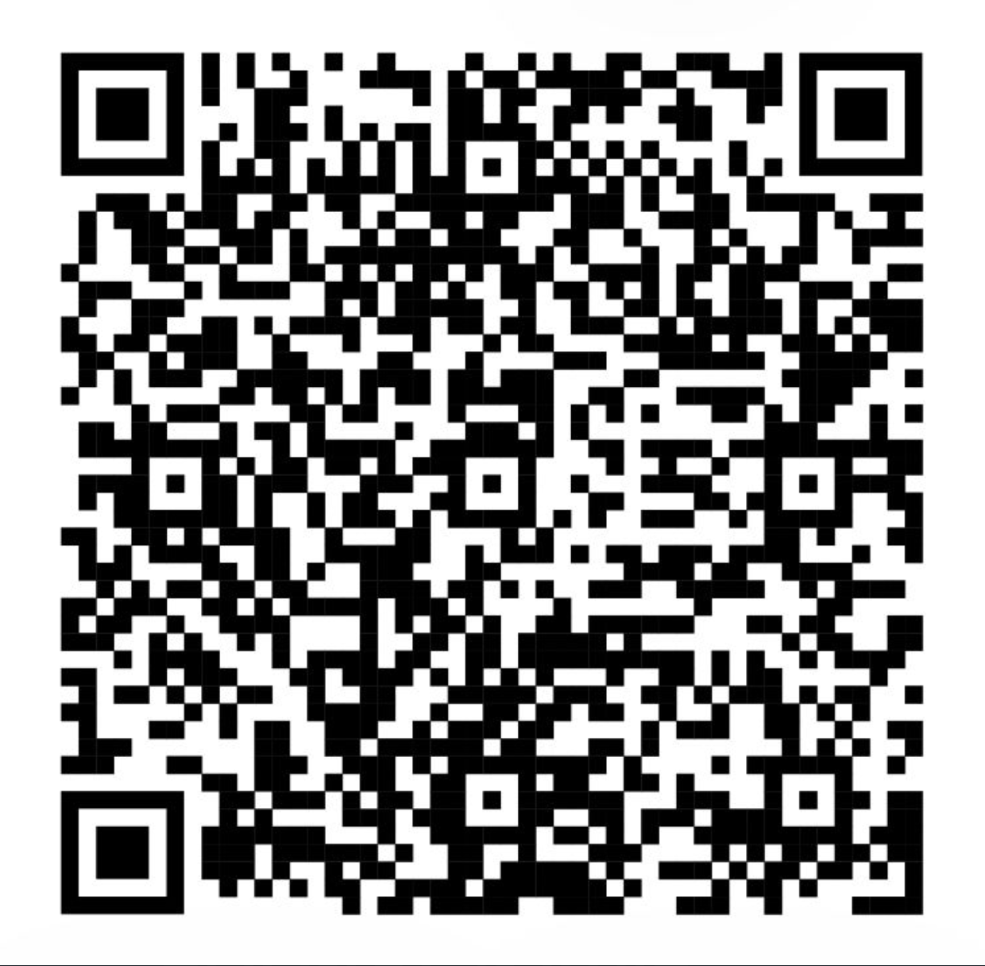
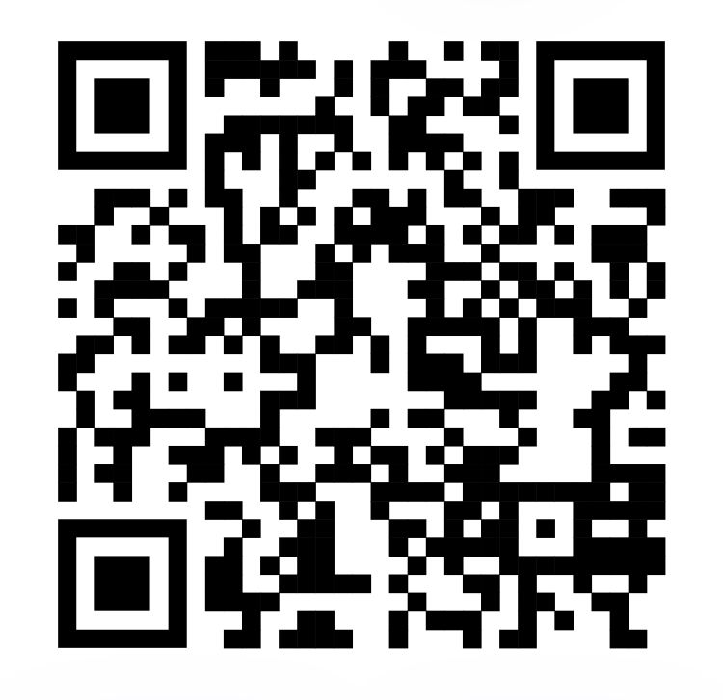

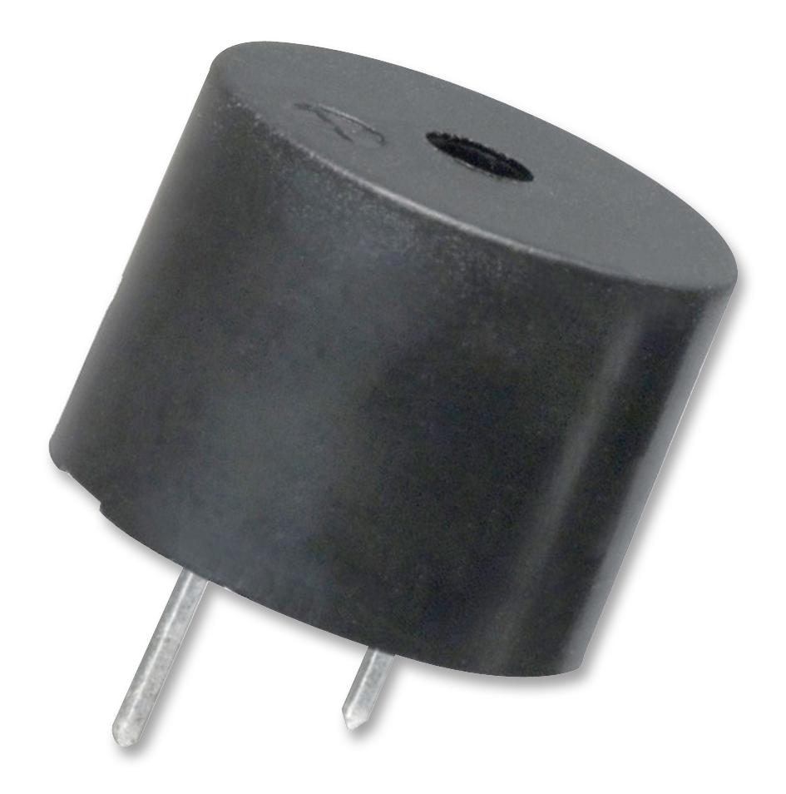
AIoT Coding, Engineering and Entrepreneurial Skills Education for Gifted Students
iSee
Student(s): 23 Lee Pui Wing Adeline, 24 Lee Pui Yan Beatrice Project ID: P9
Abstract
Results/Application
Elderly’s mobility and eyesight tend to deteriorate over the years which results in constant accidental trips and falls. We aim to improve the situation by designing “iSee” with collision avoidance technologies.
When the device is placed near an obstacle, a buzzing sound is heard
When the device is not placed near any object, nothing happens
Most useful for the elderly (living alone) and the visually impaired
Objective/Background/Motivation
About 36 million falls are reported among older adults each year
Visually-impaired individuals and elderly tend to have low mobility and may bump into objects/obstacles easily
Having noticed how common this phenomenon is, we hope to improve the situation
Alerts users of nearby obstacles
Ultimately prevents accidental trips
https://github.com/Adelinelee0220/cityu-gef-23-24-final-project
https://youtu.be/9FUy_fxGrRI
Methodology
Discussion/Conclusion
Collision avoidance and obstacle detection device
A tiny webcam attached onto a mobile device
Includes a buzzer that goes off when the user is near to an object/obstacle
Technologies used: object detection, python, arduino sensors
Testing was done repeatedly on a microsoft tablet device in early stages
In conclusion, we have understood how to utilise different technologies to form creative solutions to solve problems. We have achieved a greater understanding of collision avoidance technologies and arduino, as well as object detection technologies. Some possible improvements or amendments include a broader usage of our device (e.g. object detection technology is still usable even in foggy/dim/humid environment) and an improved accuracy of obstacle detection. All in all, “iSee” was successful and we have learnt a lot from it.

