Slide 1
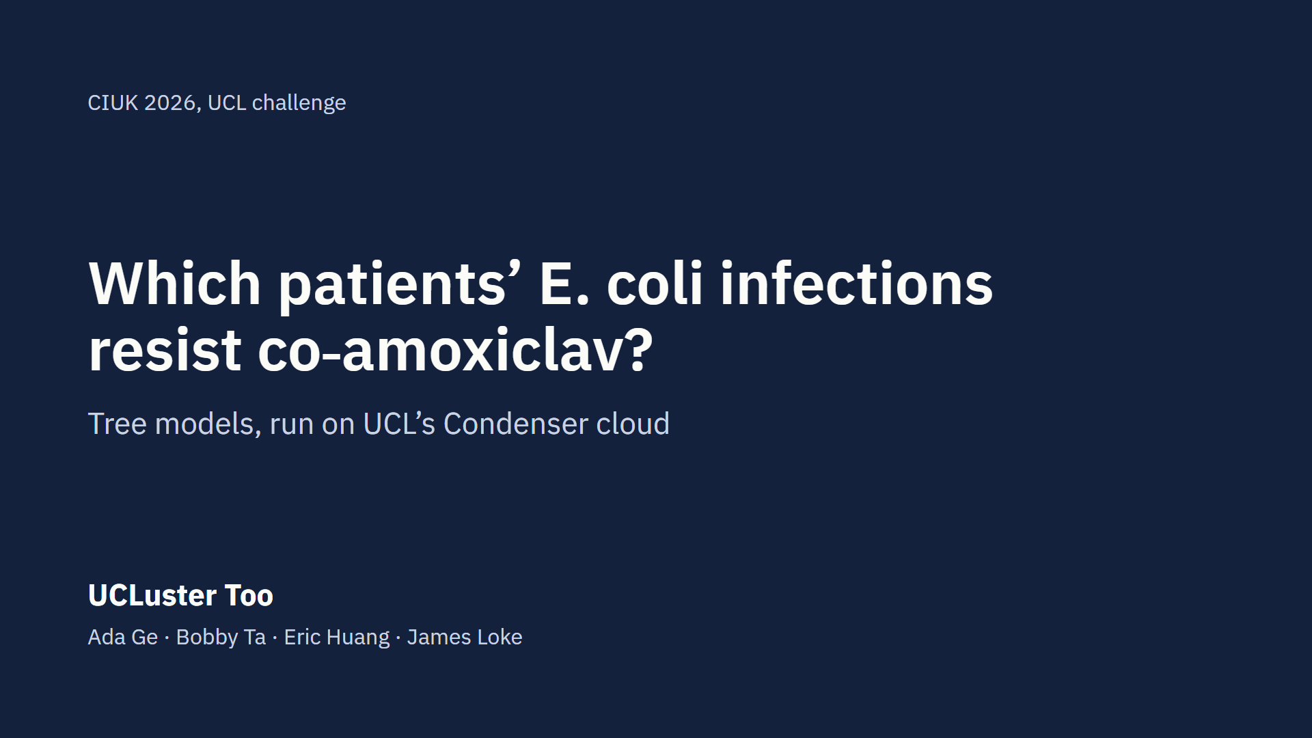
Notes:
Intro, Eric, about 13 seconds. We’re UCLuster Too: Ada, Bobby, Eric and James. We used tree models to predict which patients’ E. coli infections resist the antibiotic co-amoxiclav, and ran them on UCL’s Condenser cloud.

Slide 2
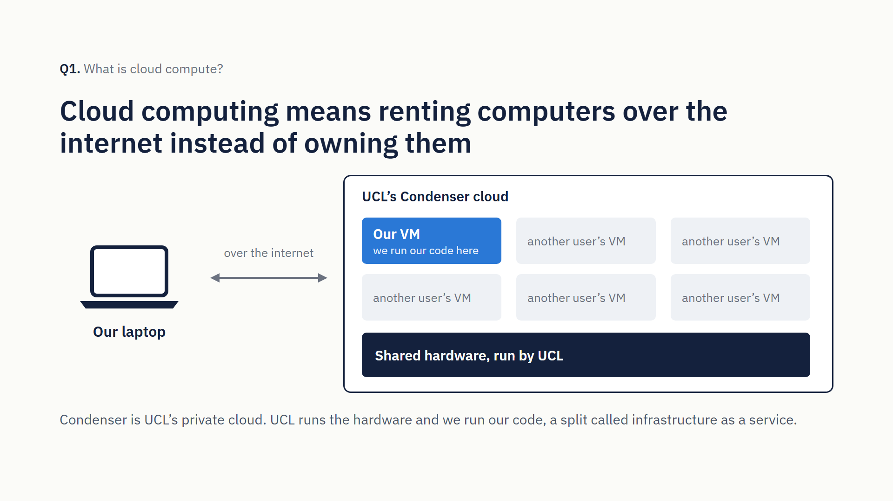
Notes:
Q1, Eric, about 21 seconds. If Bobby captured lscpu, cut to the “Hypervisor vendor” line partway through. Cloud computing means renting computers over the internet, on demand, instead of owning them. Condenser is UCL’s private cloud. It gave us a virtual machine: a computer made in software, running on hardware shared with other users. That’s infrastructure as a service: UCL runs the hardware, we run our code.

Slide 3
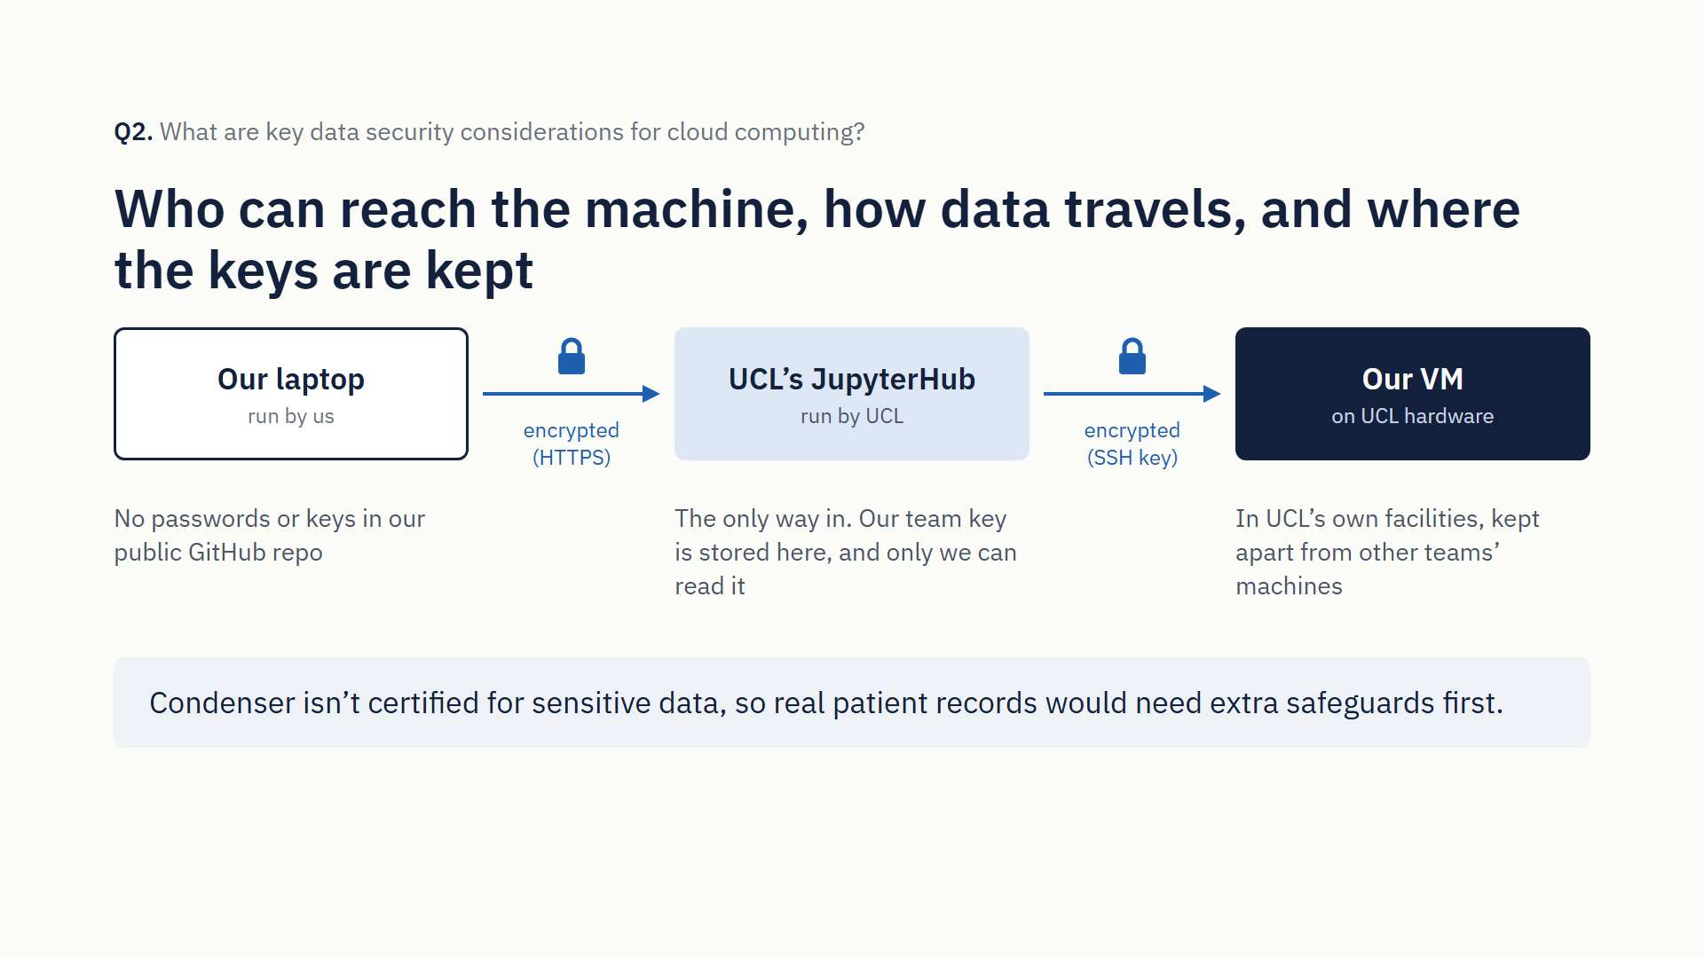
Notes:
Q2, Eric, about 26 seconds. Cloud security is shared. UCL keeps the hardware in its own facilities and walls each team’s machines off from other teams’. Access goes only through UCL’s JupyterHub with an SSH key, our connections are encrypted, and no passwords or keys go in our public repository. And Condenser isn’t certified for sensitive data, so real patient records would need extra safeguards first.

Slide 4
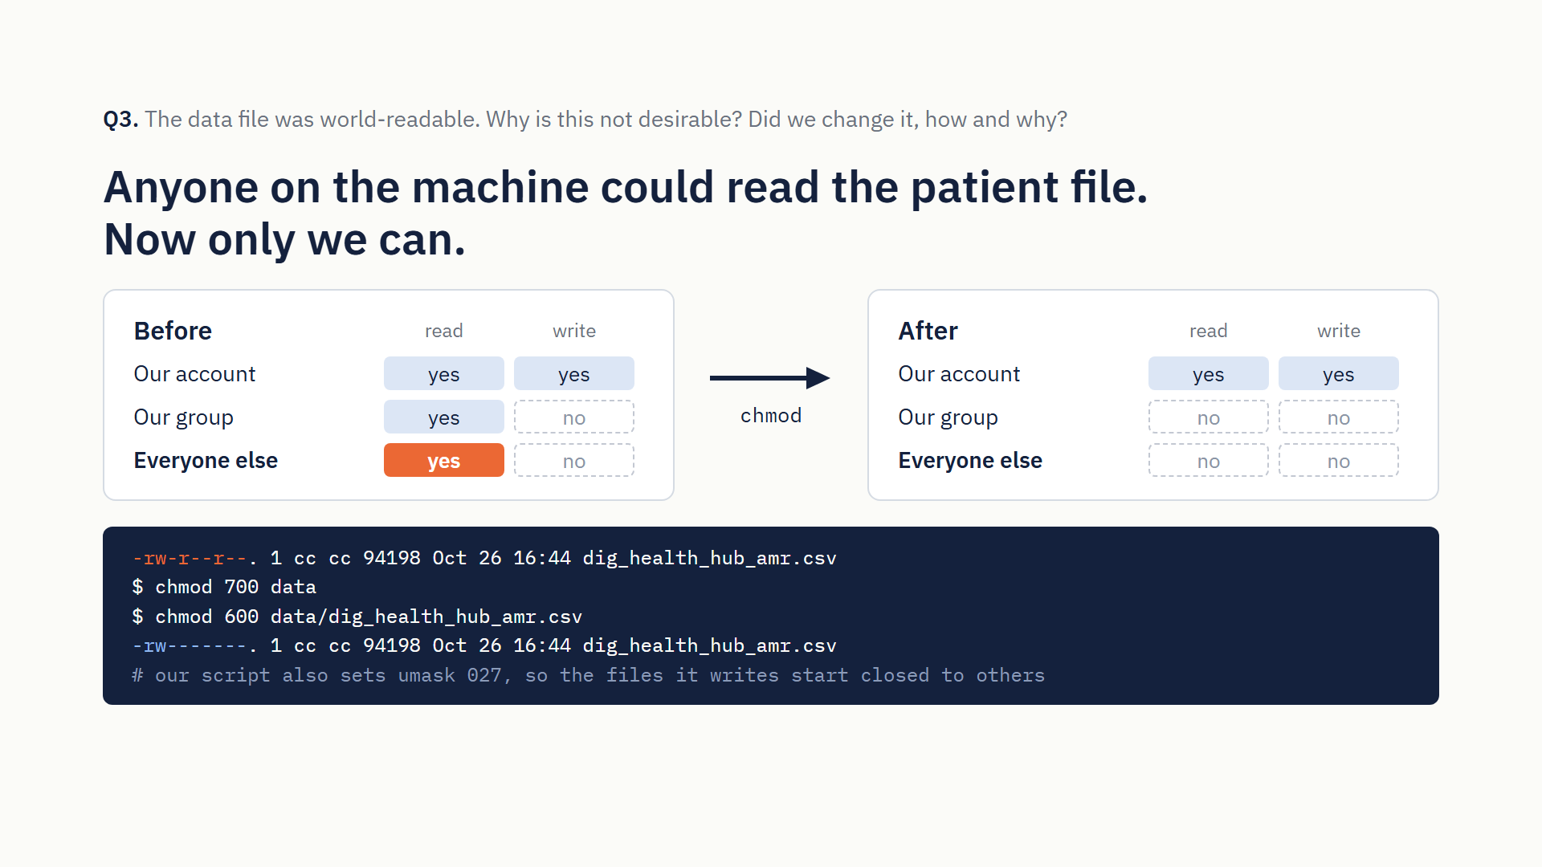
Notes:
Q3, Bobby (or Eric over Bobby’s screen recording), about 28 seconds. When the data file landed on our machine, any user could read it. On a shared machine, that exposes patient-style records to anyone with an account. Ours is synthetic, but we treated it as real: we moved it into a folder only we can open and ran chmod 600, so only our account can read it. Our script’s outputs are closed to other users too.

Slide 5
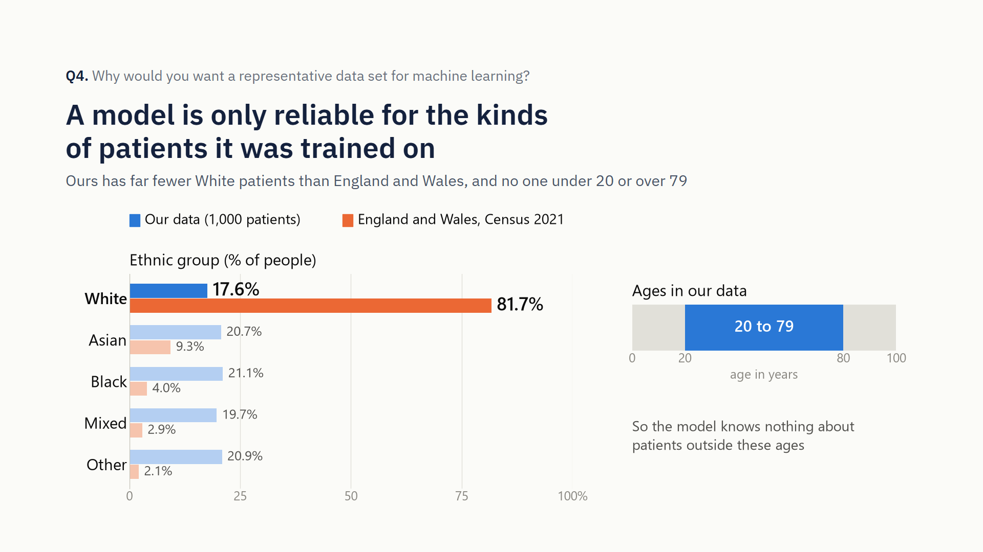
Notes:
Q4, Ada, about 32 seconds. A model only learns the patients it’s shown, so training data should match the people it will be used on. Ours covers only ages 20 to 79. Each ethnic group is about a fifth of it, yet about 82% of people in England and Wales are White, so most real people belong to our data’s smallest group. A model can score well in testing and still do badly for them, and that’s algorithmic bias.

Slide 6
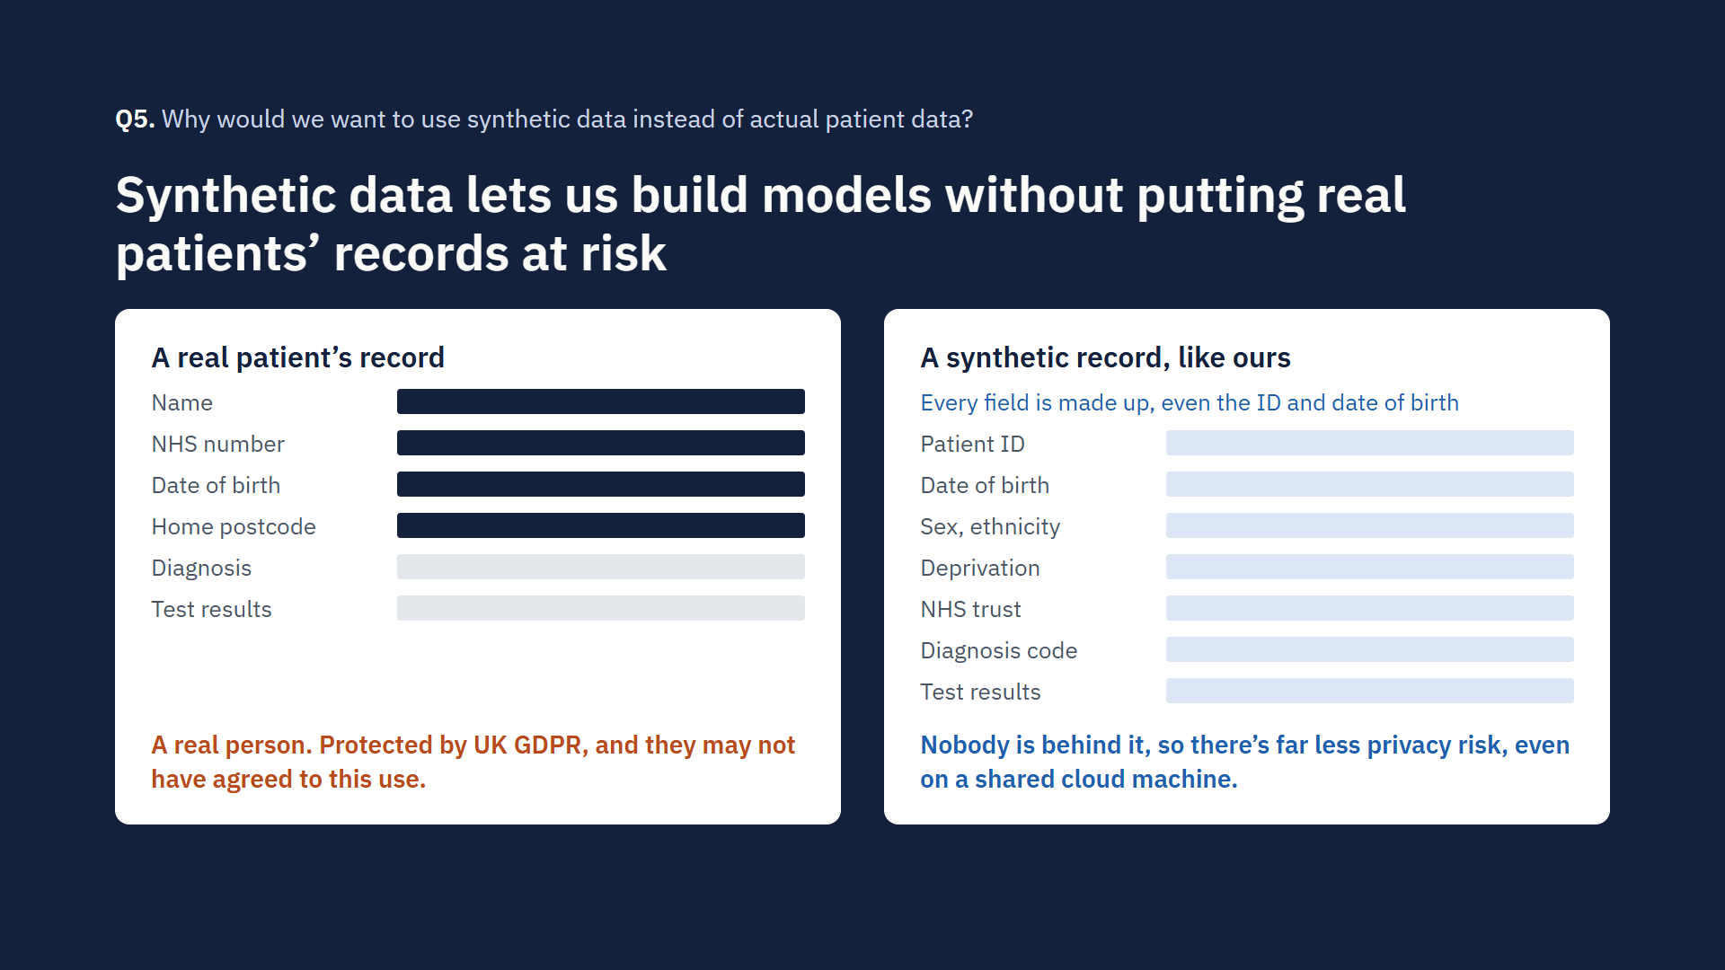
Notes:
Q5, Ada, about 22 seconds. Real patient records are sensitive health data, tightly protected by UK GDPR, and patients may not have agreed to this use. Synthetic data is designed to mimic real data without containing any real people, so we can build and test models, even on a shared cloud machine, with far less privacy risk.

Slide 7
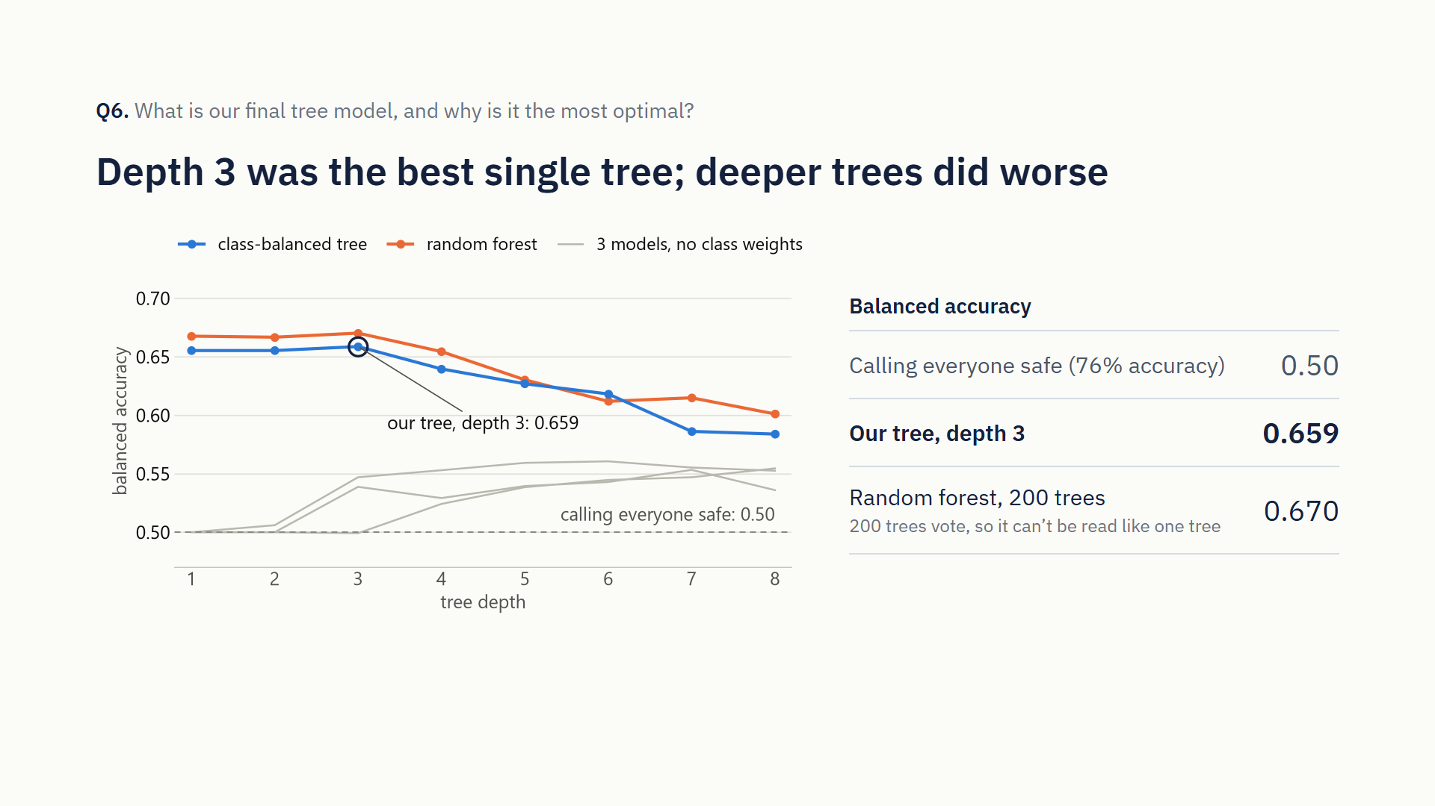
Notes:
Q6, James, part 1 of 3 (the whole of Q6 is about 45 seconds). Only about a quarter of patients are resistant, so plain accuracy is misleading: calling everyone safe scores 76% but misses every resistant patient. So we weighted resistant cases more heavily and ranked models on balanced accuracy, which gives both groups equal weight.

Slide 8
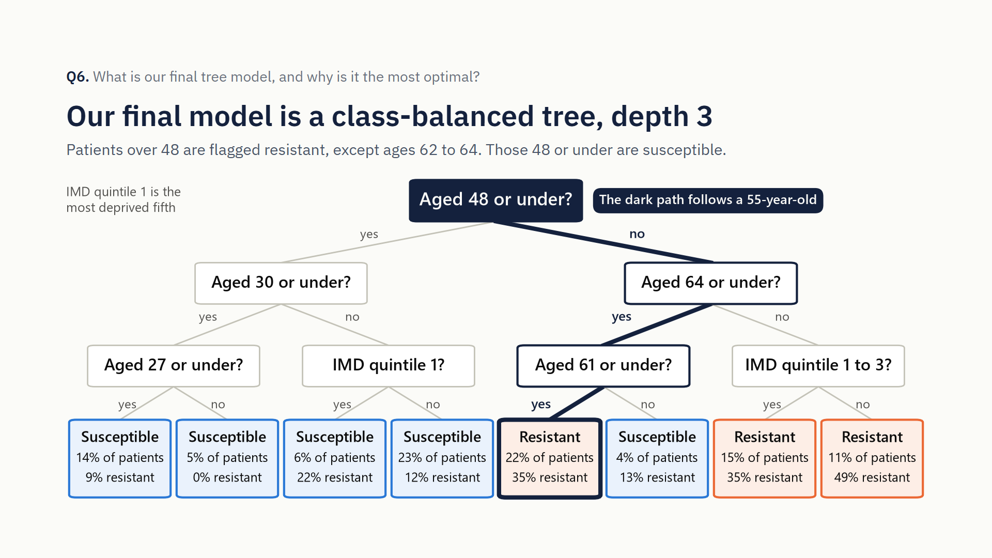
Notes:
Q6, James, part 2 of 3. Random forests scored slightly higher, but that’s two hundred trees voting, which you can’t read like a single tree. Our depth-3 tree scored best of the single trees, a doctor can read it, and deeper trees overfit.

Slide 9
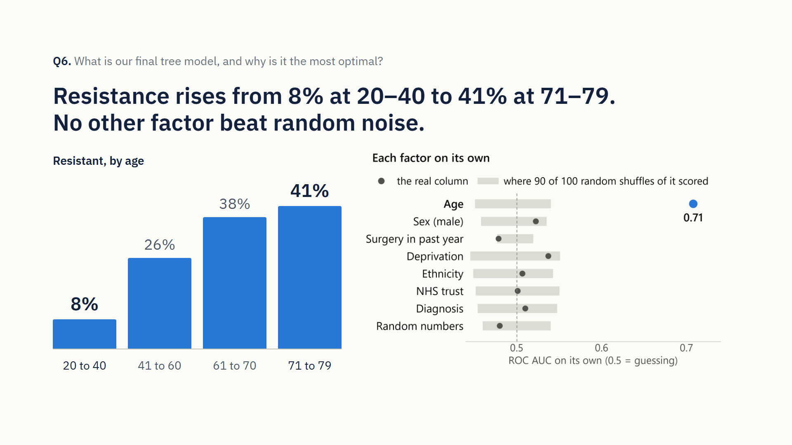
Notes:
Q6, James, part 3 of 3. Older patients are most at risk: resistance is 8% at ages 20 to 40, but 41% over 70. No other factor we tested beat random noise.

Slide 10
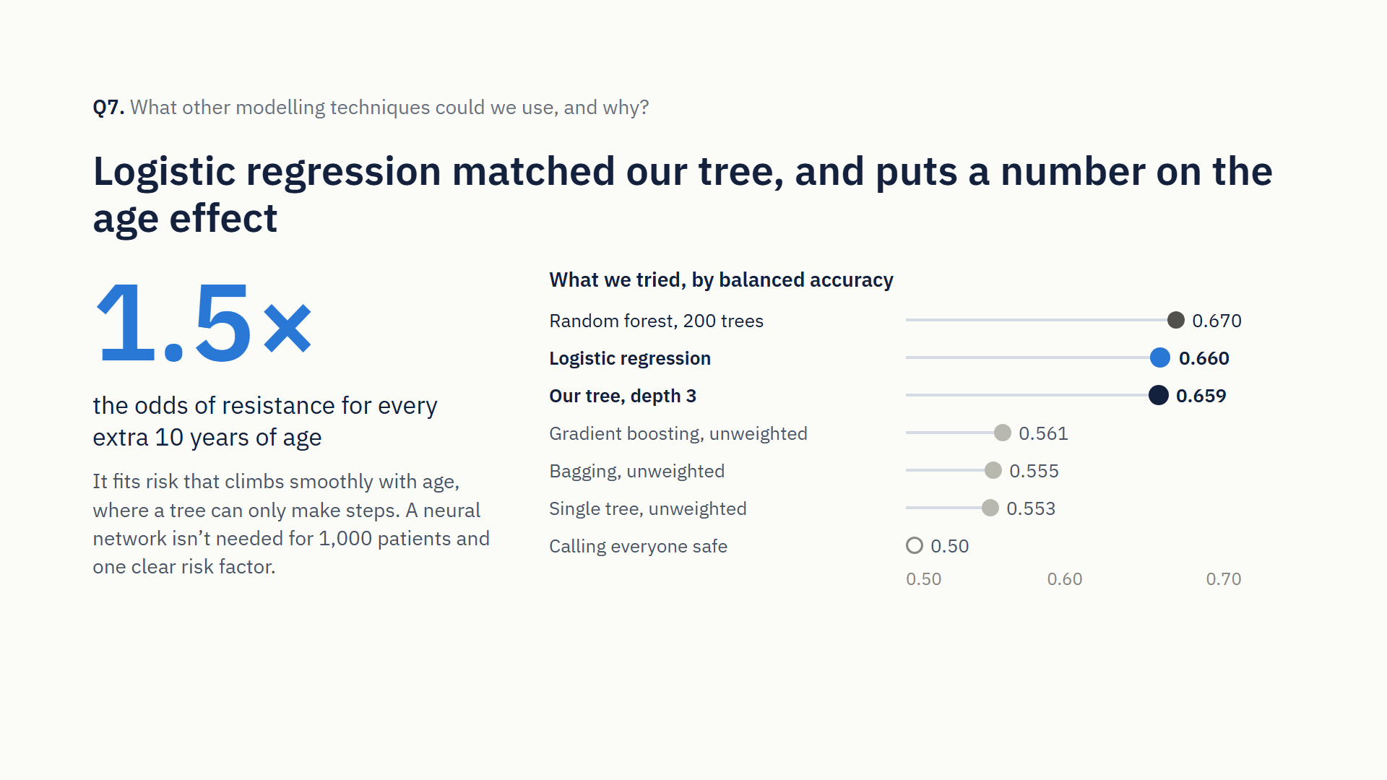
Notes:
Q7, Ada, about 28 seconds. Logistic regression suits this data. It fits risk rising smoothly with age, where a tree can only make steps, and it gives odds ratios, which clinicians already use. We tried it and it matched our tree, with the odds of resistance rising by more than half per decade of age. We didn’t need a neural network for a thousand patients and one clear risk factor.

Slide 11
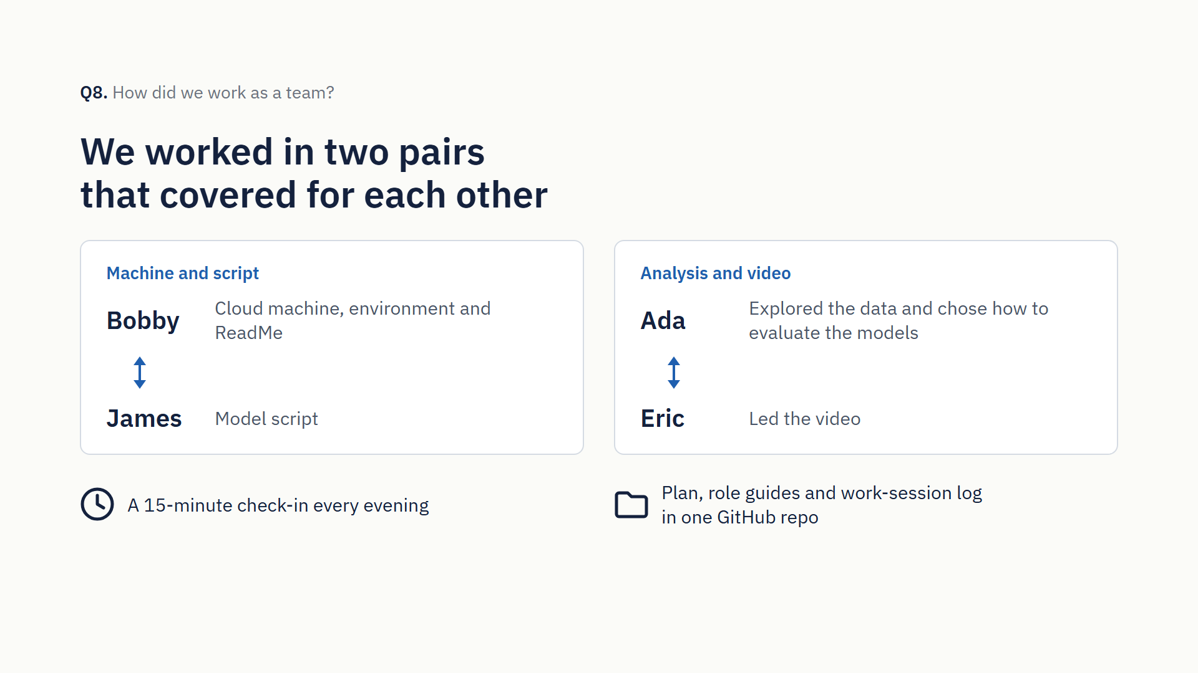
Notes:
Q8, Eric, part 1 of 2 (the whole of Q8 is about 57 seconds). Show PLAN.md’s roles table or the teamwork log on GitHub here if you prefer. We split the work into four roles. Bobby ran the cloud machine, the environment and the ReadMe; James wrote the model script; Ada explored the data and chose how to evaluate the models; and Eric led the video. We paired up to cover each other and checked in for fifteen minutes each evening. A shared GitHub repository held our plan, role guides and a log of our work sessions.

Slide 12
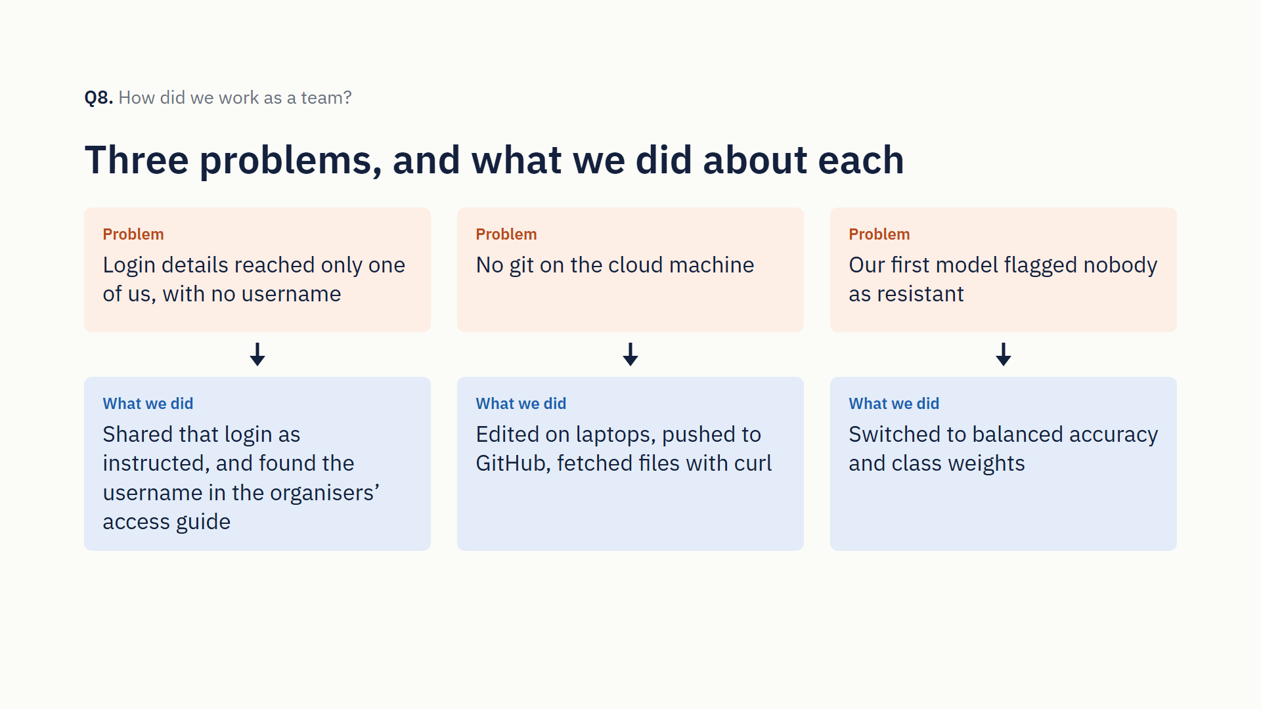
Notes:
Q8, Eric, part 2 of 2. We hit a few problems. Login details reached only one of us, with no username, so we shared that login as instructed and found the username in the organisers’ access guide. The machine has no git, so we edited on laptops, pushed to GitHub and fetched files with curl. And our first model flagged nobody as resistant, which is why we switched to balanced accuracy.

Slide 13
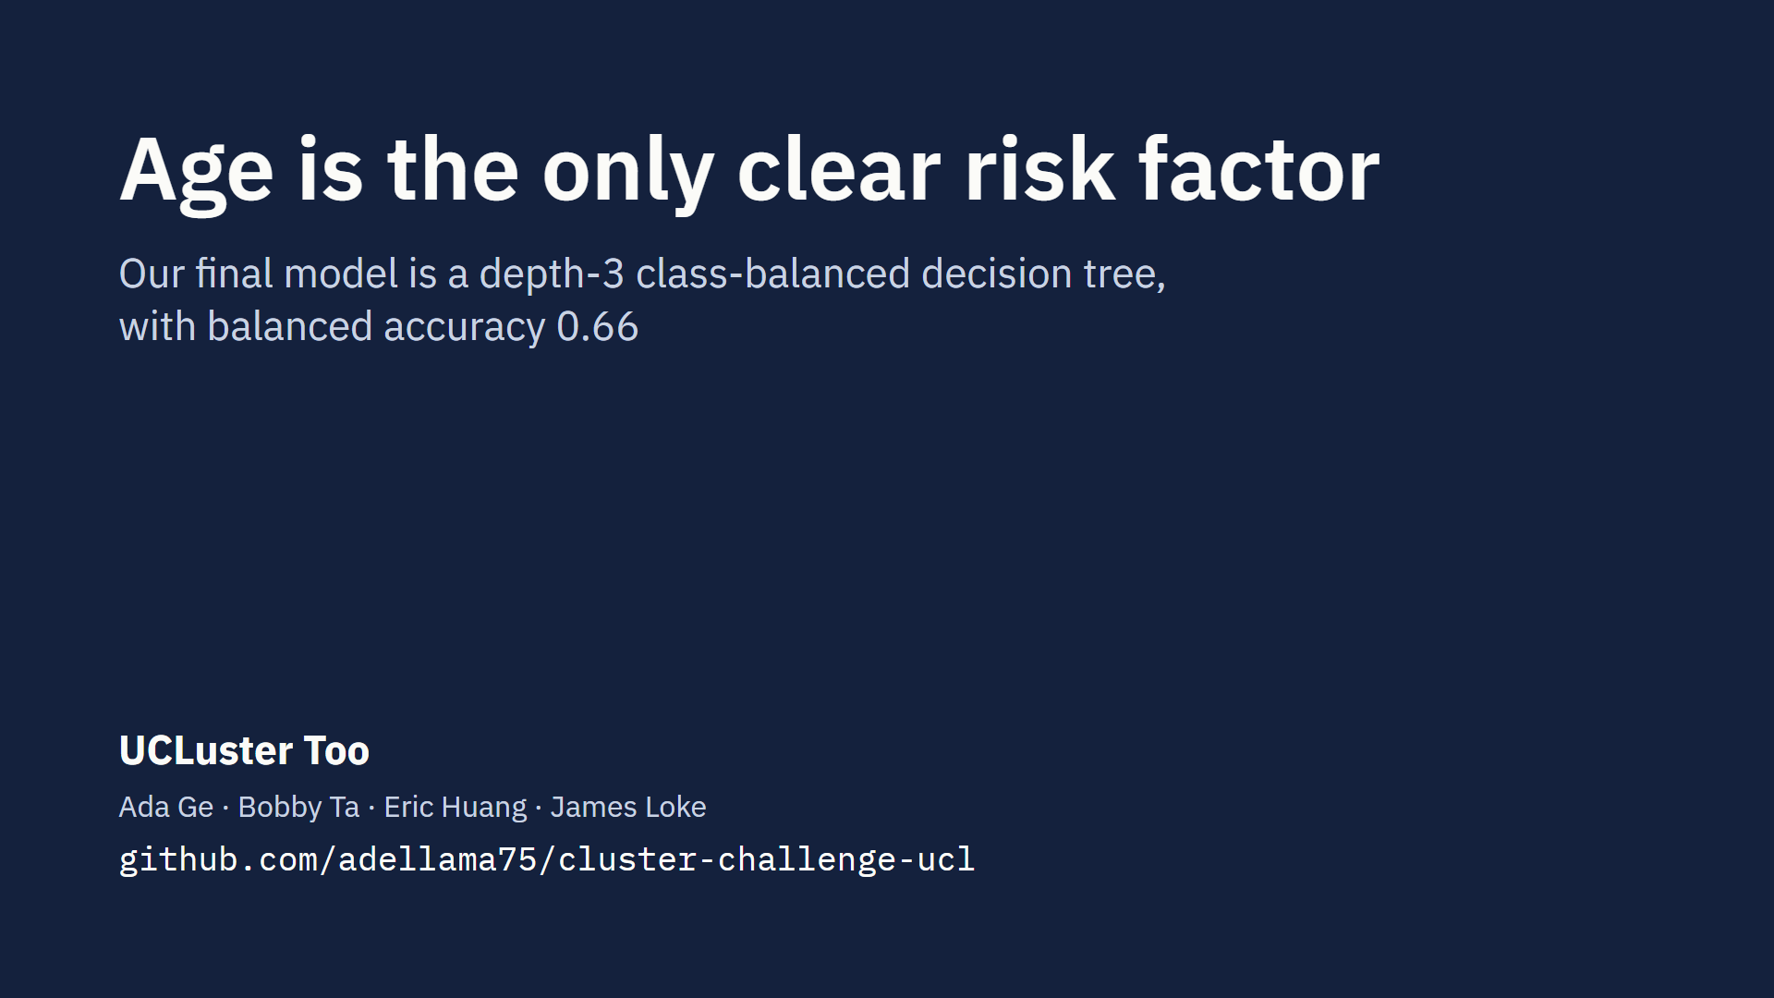
Notes:
Outro, Eric, about 10 seconds. In short: our final model is a depth-3 class-balanced tree, and age is the only clear risk factor. Thanks for watching, from UCLuster Too.

