Slide 1

House Price Prediction using Multiple Regression Analytics
Prepared by: Adelore Similoluwa Gloria.

Slide 2

Visualizations

Slide 3
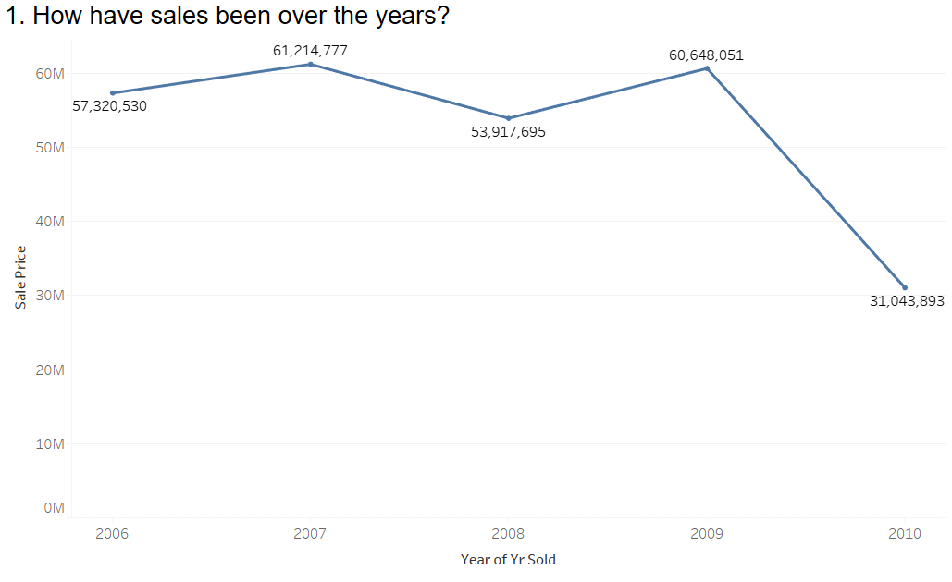
Visualizations: Answering important Questions.
In this section we would try to answer some of the other questions the Real Estate Company would like to answer.
2007 recorded the highest sale over the years, 61,214,777 million dollars. We also see that sales dropped by almost 50% from the last year in 2010, this could be a result of incomplete data or some other economic factors.

Slide 4
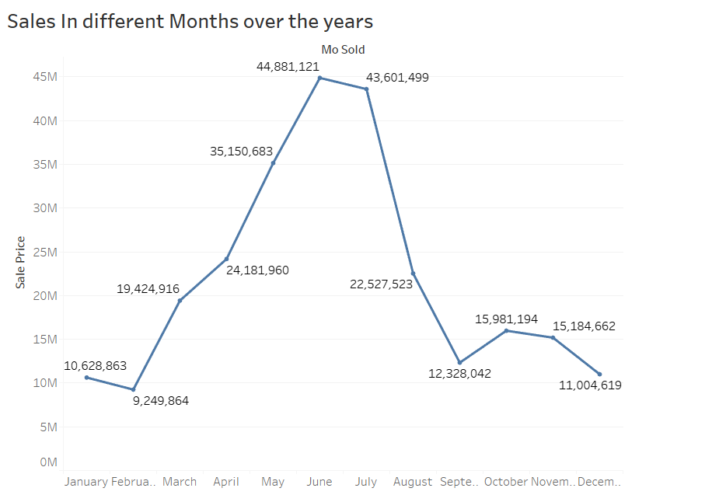
Visualizations: Answering important Questions.
Checking the seasonality of aggregated sales from 2006 to 2010, we can observe that sales did best all through the summer period till the beginning of fall.

Slide 5
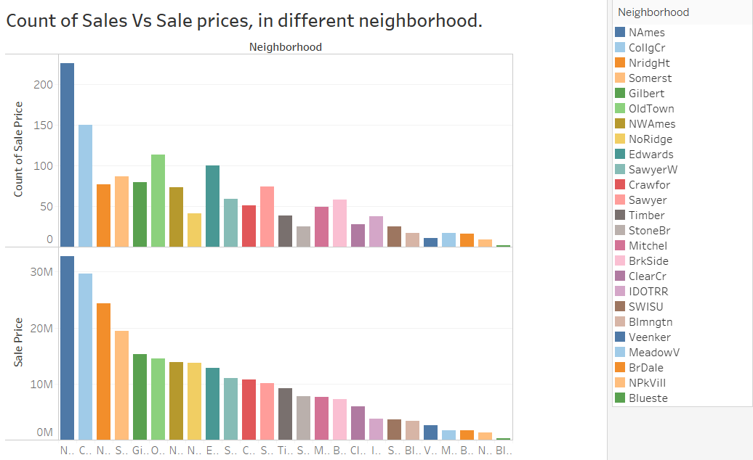
Visualizations: Answering important Questions.
From the graph, one can see the Neighborhood with the best amount in sales and count of sales is North Ames. From the graph I also observed that more sales count doesn’t necessarily mean more Sales like Old Town had more sales count than Northridge Heights, Somerset and Gilbert and that might be a consequence of the quality of houses sold, economics , space,etc.

Slide 6
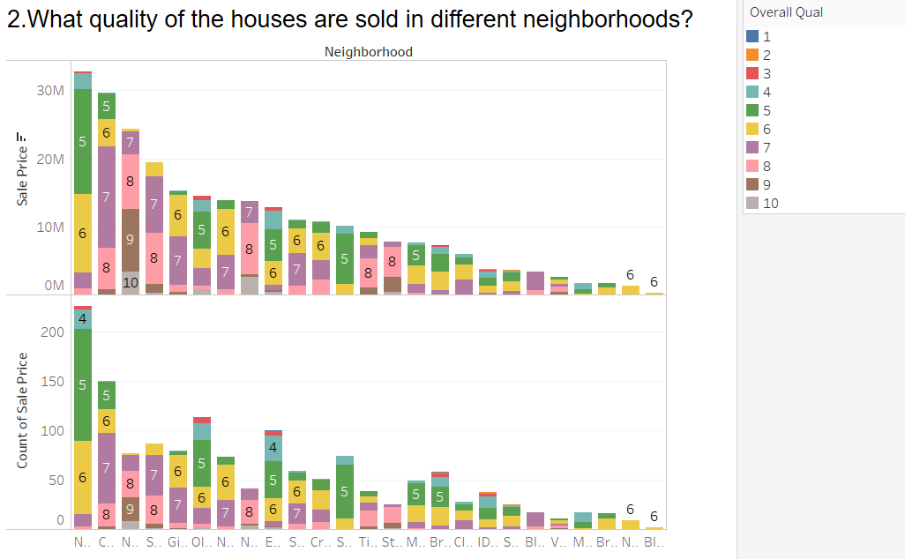
Visualizations: Answering important Questions.
Most neighborhoods sold house with their qualities in the range of 4 to 10. Now the company can have an idea what quality of houses they can build in the different neighborhoods. We can also validate what the descriptive statistics showed;, in almost all the neighborhoods there is at least one house with a quality of 6.

Slide 7
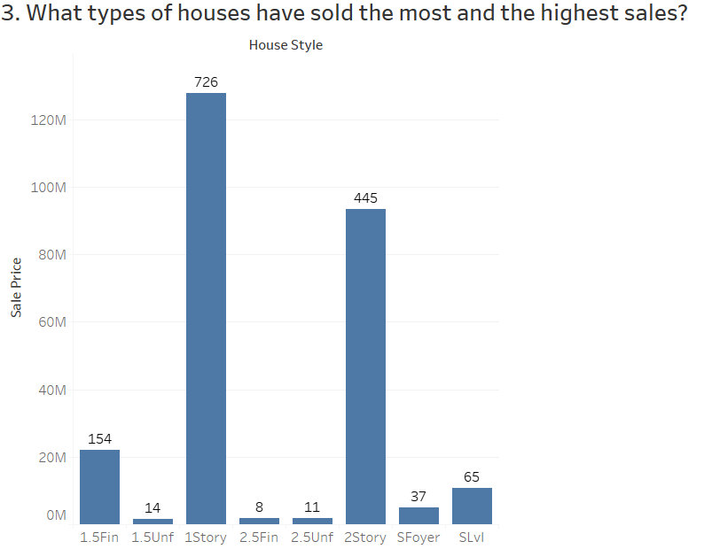
Visualizations: Answering important Questions.
Most houses sold were 1st story buildings with a count of 761 and then 2 story buildings with 445. With this information the company can either follow the way things have been or look for opportunities for better sales by increasing the sales of other house types too.
The houses styles are classified into:
1Story: One story
1.5Fin: One and one-half story: 2nd level finished
1.5Unf:One and one-half story: 2nd level unfinished
2Story: Two story
2.5Fin: Two and one-half story: 2nd level finished
2.5Unf:Two and one-half story: 2nd level unfinished
SFoyer: Split Foyer
SLvl: Split Level

Slide 8
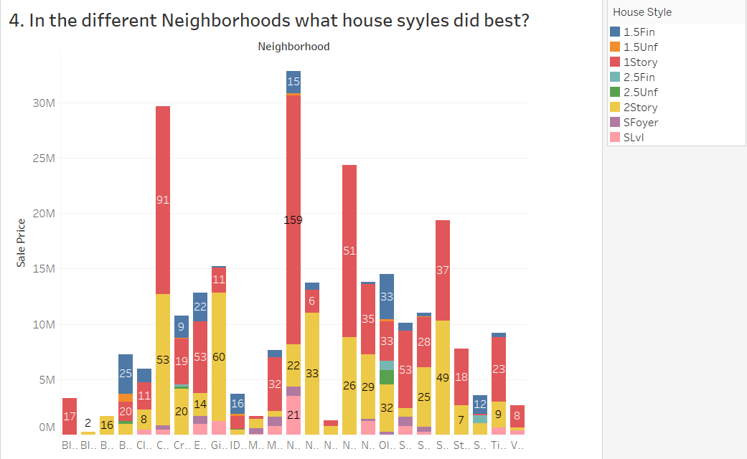
Visualizations: Answering important Questions.
Most of the houses in the neighborhood are 1 story and 2 story buildings. The company can either follow the way its been done by look into neighborhoods with very little Sales to build the common house types or try different other house types for experimentation.

Slide 9
Answering important Questions.
6. Give an estimate of factors/features that best describe the quality of a house.
Although one cannot clearly state that these variables are the only factors to be examined to determine the quality of a house, looking at the correlation matrix we can infer that the following variables have a strong impact on the quality of a house and are considered as estimated causal variables:
1. SalePrice 0.790982
2. GarageCars 0.600671
3. GrLivArea 0.593007
4. YearBuilt 0.572323
5. GarageArea 0.562022
6. YearRemodAdd 0.550684
7. FullBath 0.550600
8. GarageYrBlt 0.547766
9. TotalBsmtSF 0.537808
This would give them an idea of what makes up an excellent house and what makes a poor house and how to divide their resources accordingly.

