Slide 1
UNIVERSITY INNOVATION SUMMIT
Research in the Age of Capable AI
Adel Samir
Notes:
One line intro, then: 'This talk is not about my research. It's about YOUR research — and how AI just rewrote the rules.'

Slide 2

Adel Samir ElZemity
Computer Engineer · AI Security Researcher
AI Product Builder
PhD — University of Kent
AI Security @ Queen Mary University of London
Notes:
30 seconds max. Egyptian who did the journey they're dreaming of: Nile University → exchanges → PhD in the UK → QMUL. 'And I build things with AI — more on that later.'

Slide 3
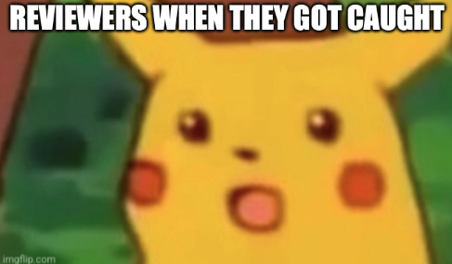
ICML 2026
506
reviewers caught letting AI do their reviewing
Notes:
Pause after the number. 'This year, the world's biggest AI conference hid secret messages inside papers — and caught 506 reviewers letting AI do their reviewing.'

Slide 4
One of them might review your paper.
Notes:
Slow, one line: 'And one day, one of them might be reviewing YOUR paper.'

Slide 5
HANDS UP
Have you used AI in your project?
100% AI
Less than 50% AI
No AI
100% AI
Less than 50% AI
No AI
Early 2023
Today
Notes:
Hands up: used AI in your project? Keep them up — 'keep it up if you'd say so publicly'. Watch hands drop. That gap is the talk.

Slide 6
NEXT 20 MINUTES
✍️ Writing → 🔍 Reviewing → 💰 Funding → 🎓 My PhD → 🧰 Toolkit
Notes:
Ten seconds: 'Four stops, then a toolkit you take home.'

Slide 7
PART 1
✍️ Writing
Notes:
'Start where every paper starts: writing.'

Slide 8
THE GOOD
A student in Cairo can now write like one in Cambridge.
Notes:
THE positive that lands here: 'For the first time ever, a student in Cairo can write like a student in Cambridge. English is no longer the gatekeeper — ideas are.'

Slide 9
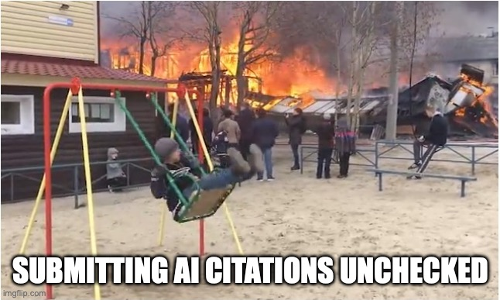
THE BAD
AI invents papers that don't exist.
Notes:
'But AI invents references that don't exist — confidently, with page numbers. People submitted them. Retractions happened.'

Slide 10
QUIZ — YOU VOTE
Which abstract was written by AI?
We introduce Nova, a novel AI model designed to address the limitations of existing models in terms of performance, efficiency, and generalisation. Nova combines adaptive learning with an efficient architecture to improve performance across a range of tasks. Extensive experiments demonstrate that Nova achieves state-of-the-art results while reducing computational requirements. Furthermore, the model demonstrates strong robustness across diverse datasets and challenging scenarios. These findings highlight the potential of Nova as an effective and scalable solution for next-generation AI applications.
We introduce Nova, a new AI model built to get better results without simply making the model bigger. We tested it on several common benchmarks and compared it with existing models using similar compute budgets. Nova performs better on most tasks and is noticeably more efficient at inference. The improvements aren’t consistent everywhere, though, particularly on simpler tasks. We also found that the model’s adaptive design matters more for reasoning-heavy problems than for straightforward classification.
A
B
Notes:
Audience votes A or B. Reveal, then: 'If you can't tell — neither can your reviewers.'

Slide 11
DO THIS
Critic, not ghostwriter.
Verify every citation.
Notes:
'AI is your critic, not your ghostwriter. Prompt: attack my argument. And verify every citation — no exceptions.'

Slide 12
PART 2
🔍 Reviewing
Notes:
'Now the other side of the table: what happens after you submit.'

Slide 13
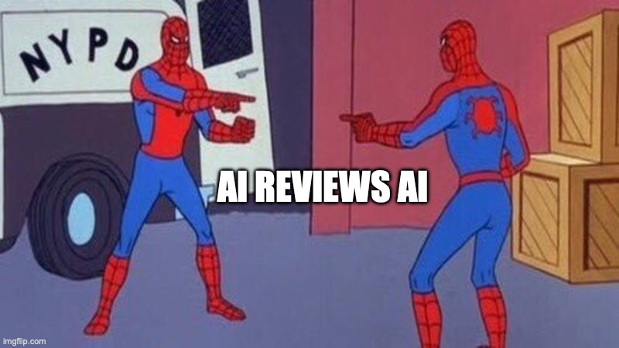
THE CRISIS
AI reviewing AI-written papers.
15.8% of ICLR reviews were LLM-assisted.
Notes:
15.8% of ICLR 2024 reviews were LLM-assisted. Hivemind effect: AI reviewers converge on one opinion. If everyone uses the same model, diversity of thought dies.

Slide 14
THE COUNTER-STORY
The same AI caught the cheaters.
398 flagged · 83% of top journals now have AI rules.
Notes:
Counter-story: same tech caught 398 cheating reviewers across 10,000 papers. 83% of top journals now have AI policies. The system adapts.

Slide 15
VOTE
Would you trust an AI review of your work?
Notes:
Most will say no. 'So don't let it review for you — use it to attack your draft before humans do.'

Slide 16
DO THIS
Run an AI pre-review.
At 2am, before any human sees it.
Notes:
'Before any human sees your draft, AI plays the harsh reviewer. It finds holes at 2am. YOU decide what to fix.'

Slide 17
PART 3
💰 Funding & 🌍 Abroad
Notes:
'Writing and reviewing are the paper. Funding is the fuel. And many of you want to go abroad.'

Slide 18
THE GOOD · ONE RULE
A grant proposal in < 1 week.
Disclose — funders check.
Notes:
True story: Alan Turing Institute grant co-written in under a week. Small teams compete with big labs now. BUT: funders require disclosure — hiding AI use is the career risk, not using it.

Slide 19
GOING ABROAD
Ask any lab: “How do you verify AI output?”
Scholarships · GTA/RA · exchanges
Notes:
'Ask any lab: how do you verify AI output? Their answer tells you everything.' Routes: scholarships, GTA/RA, exchanges — 'I did all of them. Ask me how in Q&A.'

Slide 20
PART 4
🎓 My PhD: 2023 → 2026
Notes:
'The honest part. My PhD — exactly the years AI became capable.'

Slide 21
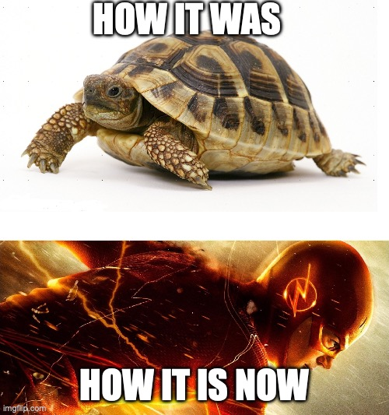
2 0 2 3
Lit review by hand.
2 0 2 6
AI agents training other AIs.
Notes:
2023: lit review by hand. 2026: AI agents that train other AIs. 'The tool changed. The researcher didn't — I still choose the questions.'

Slide 22
WHAT STAYED TIMELESS
The question · The writing · The supervisor
Notes:
'Three things AI never touched: the question, the writing, the supervisor. Invest there.'

Slide 23
🧰 THE WALK-AWAY TOOLKIT
1 Own the question
2 Verify everything
3 Critic, not ghostwriter
4 Disclose & document
5 Protect your ideas & data
6 Build proof, not just papers
Notes:
Read each rule slowly. These six rules are the whole talk on one slide.

Slide 24
STARTER PACK — ALL FREE
Find · Semantic Scholar, Elicit, Consensus
Read · AI explains, you verify
Build · Colab / Kaggle free GPUs
Write · you draft → AI edits
Notes:
All free. Find: Semantic Scholar/Elicit. Read: AI explains, you verify. Build: Colab free GPUs. Write: you draft, AI edits.

Slide 25
ONE-WEEK CHALLENGE
Pick one rule. Use it this week.
Notes:
Commitment: 'Pick ONE rule. Hands up — who takes rule 2? Rule 6? Apply it to your summit project this week.'

Slide 26
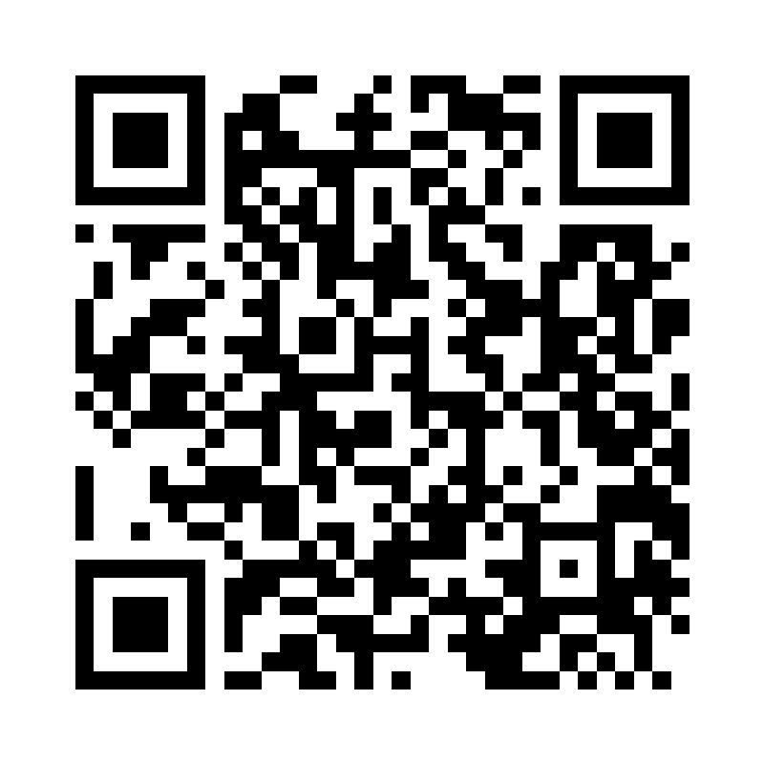
MY AI SIDE QUESTS
I built an entire social gaming app with AI. 30 games. Alone.
Notes:
Max 30 seconds: 'Rule 6 is my favourite — here's my proof. 27 games, chat, matchmaking — built entirely with AI, alone. Scan, play your neighbor, top score tonight wins [prize].'

Slide 27
Questions?
While you think — challenge the person next to you. 🏆
Notes:
Leave up for ALL 10 minutes. The QR keeps working while you answer.

