Slide 1
KAPPA · KNOWLEDGE-GUIDED PHYTO-PHARMACOGENOMIC ASSESSMENT
Make the evidence chain visible.
KAPPA
PLANT
Curcuma longa
MOLECULE
From medicinal plant context to testable molecular hypotheses.
Curcumin
BIOACTIVITY
Human PTGS2
An evidence-aware research workbench for natural-product discovery—not a treatment recommender.
MODEL
Scaffold-held-out ML
ETHNOHACK 2026 · NATURAL PRODUCTS FOR DRUG DISCOVERY
Research prototype · computational hypotheses only · 05 NOV 2026
01/10

Slide 2
KAPPA · ETHNOHACK 2026
The challenge is disconnected evidence.
Botanical records, compound structures, target assays and human genetics live in different systems—with different identifiers, evidence standards and reuse rules.
Occurrence
Chemistry
Where botanical evidence appears
What structure the identifier means
Bioactivity
Pharmacogenomics
Which assay measured what
What variants may or may not support
A plant occurrence is not a medicinal-use claim. A biochemical activity is not clinical efficacy.
KAPPA makes those boundaries explicit while creating a reproducible path between datasets.
Research prototype · computational hypotheses only · 05 NOV 2026
02/10

Slide 3
KAPPA · ETHNOHACK 2026
Reproducible hand-offs, not another mega-database.
LOTUS, IMPPAT, ChEMBL, Open Targets and NP-KG already provide valuable data and integration capabilities.
01
Live, attributable assay acquisition
02
RDKit features + duplicate controls
KAPPA’s bounded contribution: connect a traceable occurrence context to a measured target-specific dataset, a scaffold-aware baseline, an applicability check, and evidence-tiered interpretation.
03
Scaffold-held-out RF vs baseline
04
Evidence-separated graph + applicability gate
05
Interactive research workbench
Integration/reproducibility work—not a claim to be the first AI, knowledge graph or medicinal-plant database.
Research prototype · computational hypotheses only · 05 NOV 2026
03/10

Slide 4
KAPPA · ETHNOHACK 2026
One pipeline. Provenance at every hand-off.
ChEMBL
Curate
RDKit
Split
Benchmark
Explore
7,482 target IC50 rows
→
3,164 structures
→
7 descriptors + 512 bits
→
Stratified scaffold groups
→
RF + logistic
→
API + graph + UI
Observed assay records → computed molecular features → held-out predictions
Wikidata occurrence and one secondary ethnobotanical report are distinct plant-level evidence. A verified CYP2C19–clopidogrel guideline is a disconnected PGx demo; no link to curcumin/PTGS2.
Research prototype · computational hypotheses only · 05 NOV 2026
04/10

Slide 5
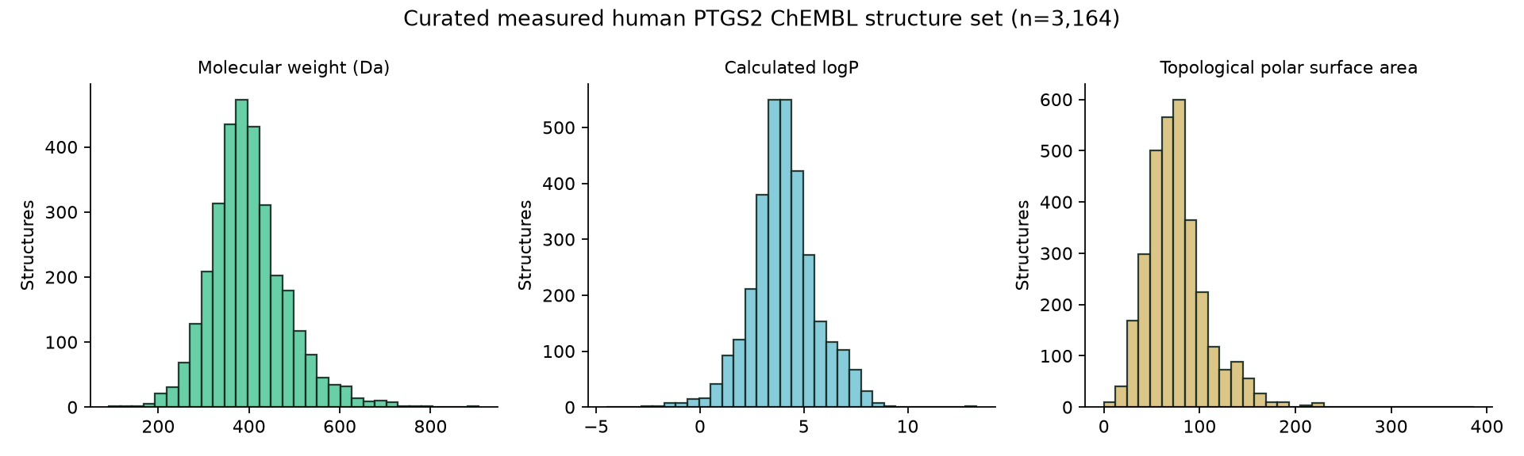
KAPPA · ETHNOHACK 2026
Real data. Narrow, predeclared labels.
RAW RECORDS
CURATED
ACTIVE BAND
INACTIVE BAND
7,482
3,164
2,505
659
ChEMBL CHEMBL230 · human PTGS2
canonical structures · duplicate-collapsed
IC50 ≤ 1 µM
IC50 ≥ 10 µM
STRICT FILTERS
Exact standard relation · nM units · single-protein assay · Homo sapiens · no duplicate/validity flags.
1–10 µM grey band omitted—not relabelled inactive.
Research prototype · computational hypotheses only · 05 NOV 2026
05/10

Slide 6
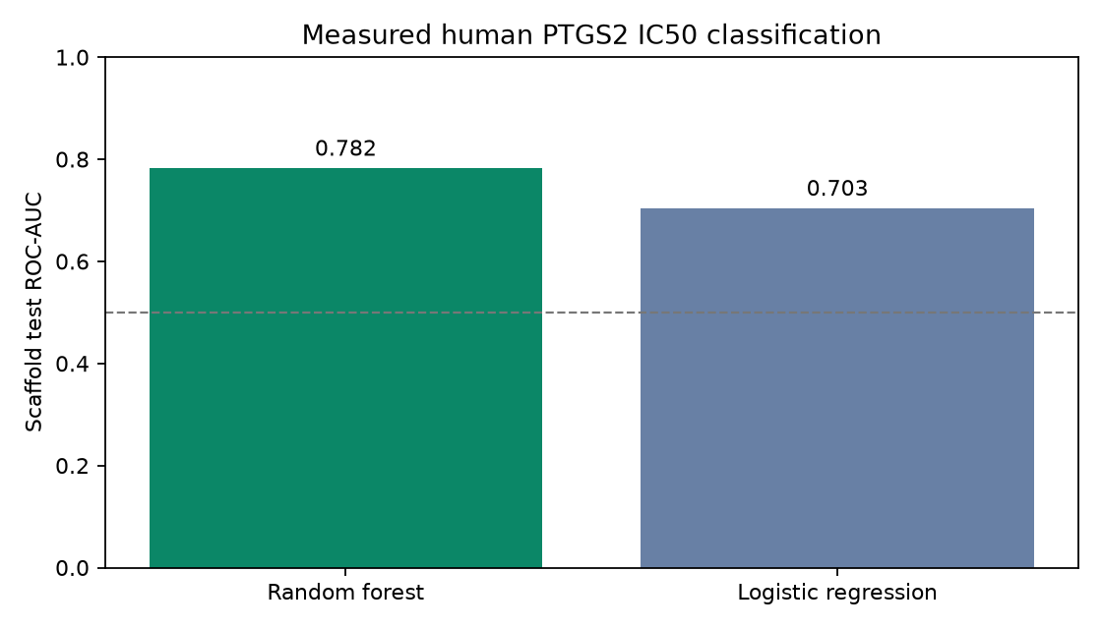
KAPPA · ETHNOHACK 2026
A genuine benchmark—with a visible caveat.
Random Forest
ROC-AUC 0.782 · PR-AUC 0.940
Logistic baseline
ROC-AUC 0.703 · PR-AUC 0.907
3-fold scaffold CV
Mean ROC 0.810 · PR 0.935
Test prevalence 82.6% (PR baseline); balanced accuracy 0.637. Strong imbalance; internal data only, not external validation.
An earlier 0.832/0.966 pair is withdrawn: 7 protocols fail to reproduce it.
Research prototype · computational hypotheses only · 05 NOV 2026
06/10

Slide 7
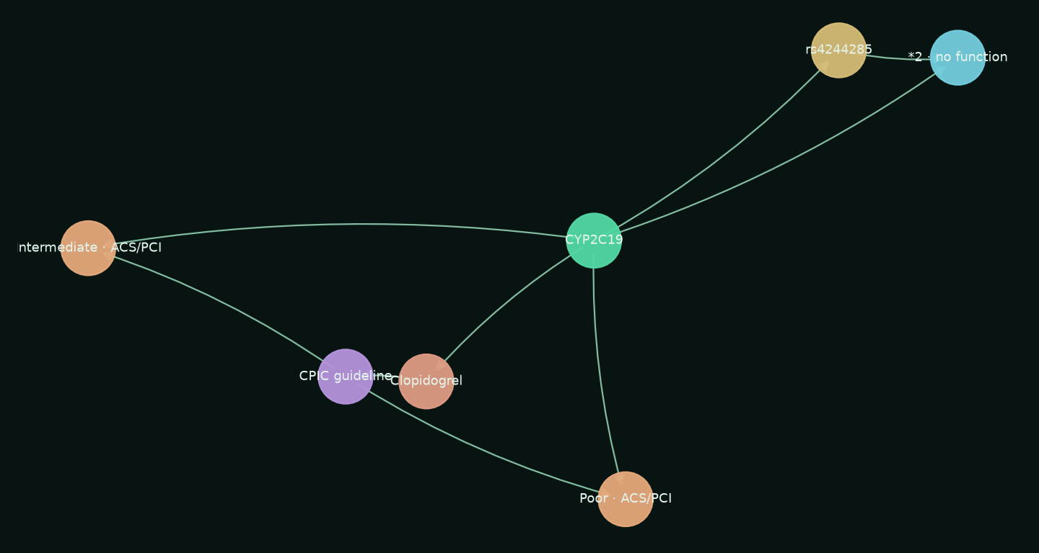
KAPPA · ETHNOHACK 2026
A graph that distinguishes identifiers from inference.
Pharmacogenomic example: verified, contextual, separate.
CYP2C19 *2 and clopidogrel are tied to CPIC guideline 100411 (CPIC A / ClinPGx 1A), with phenotype- and ACS/PCI-conditioned records only.
No patient genotype and no link to curcumin or PTGS2. ClinVar supplies variant identity only: its “Likely benign; other” label covers an unspecified disease trait, not drug-metabolizer function.
Missing evidence ≠ negative biology.
Research prototype · computational hypotheses only · 05 NOV 2026
07/10

Slide 8
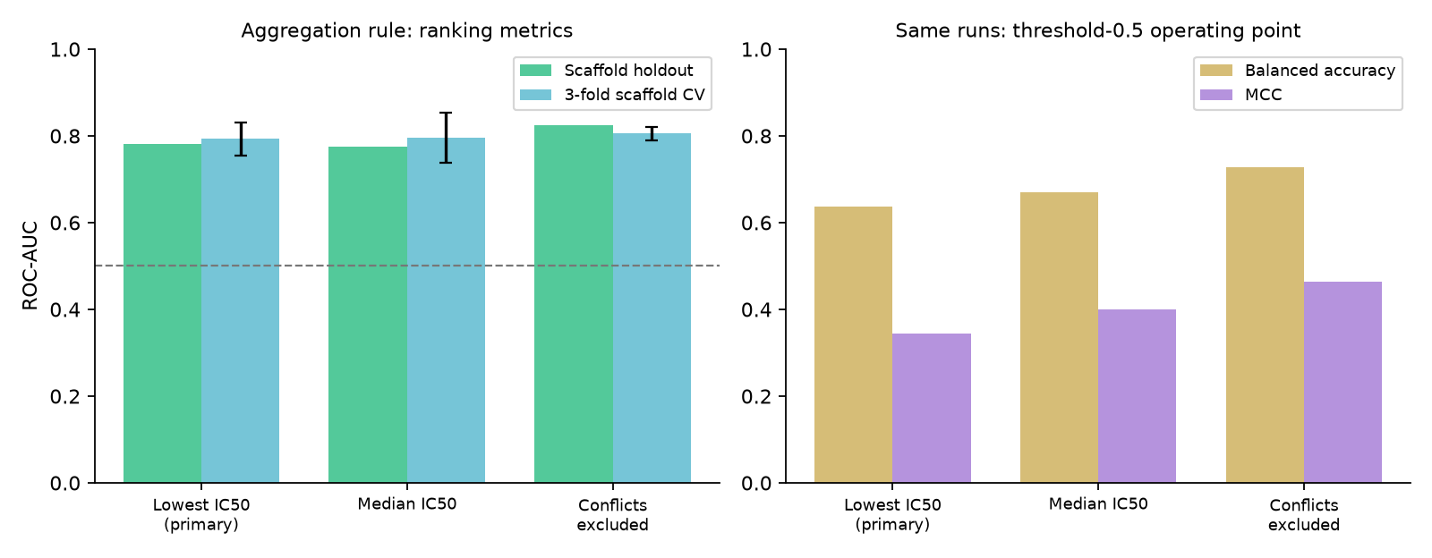
KAPPA · ETHNOHACK 2026
No composite ranking. Keep the prediction in scope.
CURCUMIN · RETROSPECTIVE
Exact training-structure overlap
Uncalibrated model-only output
Applicability cutoff 0.324 is a training-only similarity diagnostic—not a calibrated confidence guarantee. No evidence-axis average.
NOT CLAIMED
• No blended evidence score or evidence-axis weighting
• No calibrated probability and no validated domain boundary
• No external, prospective, wet-lab or clinical validation
• No individual treatment or pharmacogenomic prediction
Duplicate rule matters: 32 structures conflict. ROC 0.774–0.825, balanced accuracy 0.637–0.729 — ranking stable, threshold operating point not. Hyperparameter and time/document tests are internal ChEMBL, not external validation.
Research prototype · computational hypotheses only · 05 NOV 2026
08/10

Slide 9
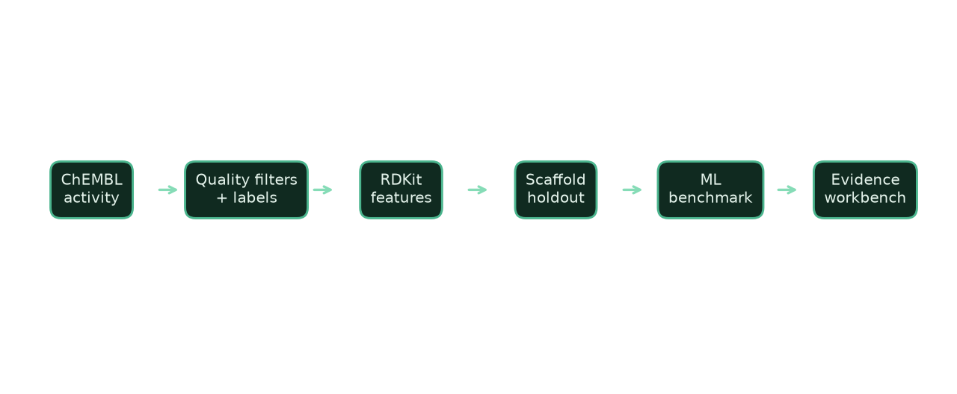
KAPPA · ETHNOHACK 2026
A working workbench—not a screenshot.
Explore
Measured structures and descriptors
Inspect
Activity bands, assays and source IDs
Predict
SMILES + similarity + overlap flag
Traverse
Typed graph with evidence notes
Export
Curated CSV and reproducible metrics
Live demo: plant context → compound table → model card → graph → methods/provenance.
Research prototype · computational hypotheses only · 05 NOV 2026
09/10

Slide 10
KAPPA · ETHNOHACK 2026
Useful now. Clear about what comes next.
DELIVERED
NEXT VALIDATION
Working API + UI (local)
3,164-record data pipeline
Scaffold benchmark + 21 tests
Out-of-domain refusal + ethnobotany validator
Evidence graph + audit docs
10-slide deck + rendered PDF
Primary-source ethnobotanical evidence + permission
Independent assay/database evaluation
Clinical PGx update + indication checks
Probability calibration and domain review
Prospective experimental follow-up
KAPPA turns fragmented evidence into a traceable research question—not a therapeutic promise.
Research prototype · computational hypotheses only · 05 NOV 2026
10/10

