Slide 1
WEEK 4 — ANALYTICS
COVID-19
GLOBAL DASHBOARD
Data Visualization & Dashboarding | AnalystLab Africa Internship — Batch C
TOOL
DATA
PERIOD
Power BI
Johns Hopkins CSSE
Jan 2020 – Mar 2023

Slide 2
Dataset Overview
🦠
📉
💊
Confirmed Cases
Deaths
Recovered
Daily cumulative confirmed COVID-19 cases per country from Jan 22, 2020 to Mar 9, 2023
Daily cumulative COVID-19 deaths per country across the same time period
Daily cumulative recoveries — tracking stopped by JHU in mid-2021, so post-2021 data is unavailable
201
1,143
676M+
6.8M+
Countries
Days of Data
Total Cases
Total Deaths
Source: Johns Hopkins University CSSE — github.com/CSSEGISandData/COVID-19

Slide 3
Business Problem & KPIs
The Problem
Key KPIs Tracked
How did COVID-19 spread globally over time?
662M
7M
Total Confirmed Cases
Total Deaths
Which countries were hit hardest by cases and deaths?
What was the true death rate across the pandemic?
137M
1.03%
Total Recovered
Death Rate
How did recoveries compare to deaths over time?
20.70%
201
Which regions showed the most concentrated impact?
Recovery Rate
Countries Tracked

Slide 4
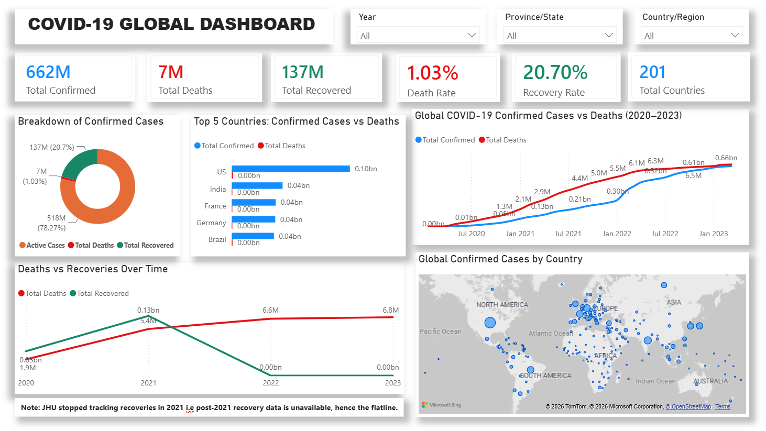
Dashboard Overview
Full interactive dashboard — Power BI Desktop
[INSERT FULL DASHBOARD SCREENSHOT HERE]

Slide 5
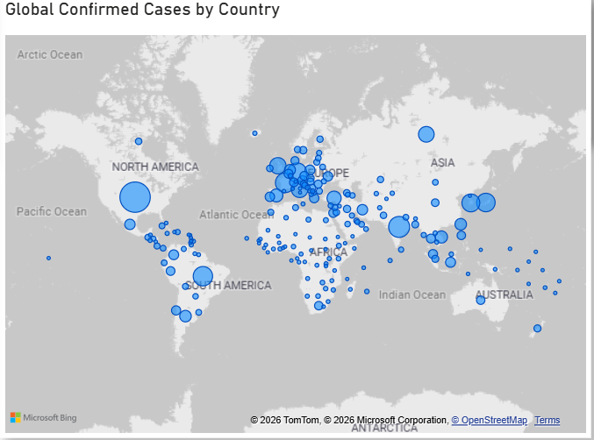
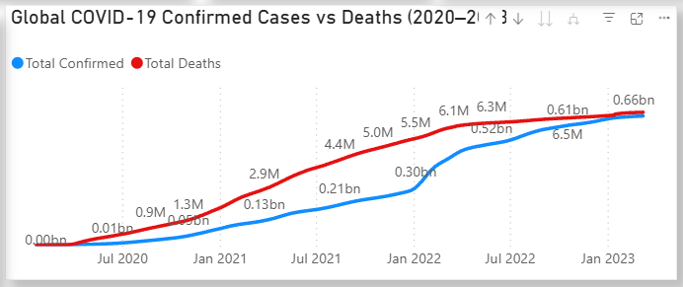
Key Visuals Spotlight
Close-up of trend analysis and geographic impact

Slide 6
Key Insights
01
US Led Global Cases
02
Omicron Surge in 2022
The United States recorded the highest confirmed case count (104M), more than double India's total, making it the most affected country in the dataset.
A sharp increase in confirmed cases is observed during early 2022, corresponding to one of the largest global waves of COVID-19 during the study period.
03
Death Rate Stayed Low
04
Recovery Data Gap
Despite more than 662 million confirmed cases, the global death rate remained approximately 1.03%, indicating that deaths represented a relatively small proportion of reported cases during the study period.
Johns Hopkins ceased tracking recoveries in mid-2021, so the recovery figure of 137M significantly understates real-world recoveries. This is a key data limitation to flag in any analysis.
05
Europe Densely Affected
The geographic map shows Europe packed with medium-to-large bubbles across nearly every country, confirming it was the most uniformly affected region despite no single country matching US case totals.

Slide 7
Recommendations
🌍
Strengthen Global Disease Surveillance
💉
Improve Recovery Data Reporting
Strengthen global disease surveillance by improving standardized reporting systems, particularly in countries with limited data availability, to support timely monitoring during future outbreaks.
Ensure consistent collection of recovery data across reporting agencies to improve the quality and reliability of future analyses.
📊
Maintain Comprehensive Public Health Data
⚡
Maintain Outbreak Preparedness
The gap left by JHU stopping recovery tracking in 2021 makes it impossible to calculate true active cases. Future data collection standards should mandate complete recovery reporting
Health authorities should maintain surge capacity plans and rapid-response protocols to better manage future disease outbreaks and sudden increases in cases.

Slide 8
Challenges & Conclusion
⚠️ Challenges Faced
✅ Conclusion
Wide-format data
This dashboard brings together three separate datasets into one unified view of the COVID-19 pandemic — covering 201 countries across more than three years of data.
The final dashboard provides an interactive overview of global COVID-19 trends, helping stakeholders monitor case growth, compare countries, and identify data limitations affecting interpretation.
Key skills applied this week include Power Query data transformation (unpivoting wide-format data), DAX measure design for cumulative datasets, and data storytelling through a mix of KPI cards, maps, trend lines, and comparative charts.
Working with a real-world public health dataset — complete with its inconsistencies and gaps — was the most practical learning experience of the internship so far.
All three CSV files had 1,143 date columns that needed unpivoting in Power Query before any analysis was possible.
Cumulative vs daily
The data shows cumulative totals, not daily new cases — DAX measures needed careful design using MAX per country, not SUM.
Incomplete recovery data
JHU stopped tracking recoveries in mid-2021, making recovery metrics unreliable for the second half of the pandemic.
Merge step order
Getting the Power Query steps in the right order (headers first, then unpivot) took some troubleshooting to get right.
AnalystLab Africa — Batch C | Week 4 Submission

