Slide 1
Protein levels in cortex in Down Syndrome model respond
to learning task
Eleanor Fraser
Springboard Capstone 1 Project

Slide 2
Down Syndrome
Caused by additional copy of Chromosome 21
Symptoms include intellectual disability and learning problems
Memantine: a drug with modest effects in Alzheimer's Disease, later found ineffective in Down Syndrome

Slide 3
Experimental Setup
Wildtype
Mice
No Learning
(Shock - Context)
Control (Saline)
DS Model (Ts65Dn)
Learning
(Context - Shock)
Memantine
treatment
Collect brains
Measure proteins from cell nuclei in cortex

Slide 4
Candidate proteins/modifications in dataset
Genes on the human Chromosome 21 (and therefore with extra copies in DS)
Proteins related to Alzheimer’s Disease
MTOR pathway
MAPK pathway
Glutamate receptors and proteins they interact with
Proteins involved in apoptosis or inflammation
Immediate early gene proteins (markers of neuronal activation)
Histone modifications

Slide 5
Goals
Use classification to look at how protein levels in the nuclei of the mouse cortex respond to a learning task in normal and Down Syndrome mice
Identify proteins that may be involved in learning deficits: possible targets for future treatments

Slide 6
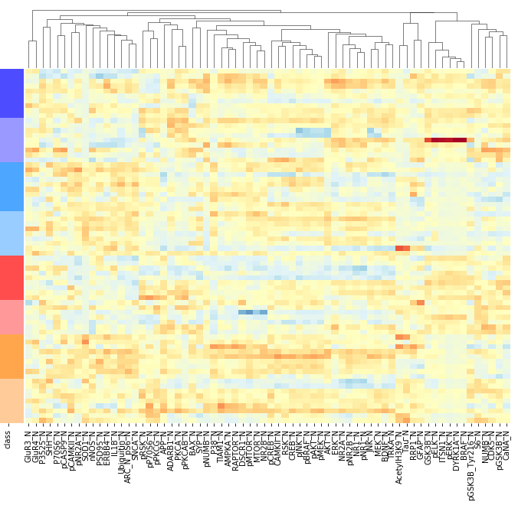
Many proteins are strongly affected by learning
Control
Learning
Treated
Untreated
Control
Treated
Untreated
Down Syndrome
Learning
Treated
Untreated
Control
Treated
Untreated
Notes:
By visual inspection - clusters of proteins that form blocks matching learning/control
Left cluster - down with learning. Next to that, cluster up with learning; far right as well

Slide 7
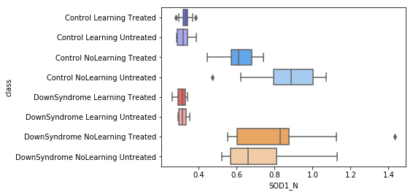
SOD1, a protein whose level decreases with learning
Control
Learning
Treated
Untreated
Control
Treated
Untreated
Down Syndrome
Learning
Treated
Untreated
Control
Treated
Untreated

Slide 8
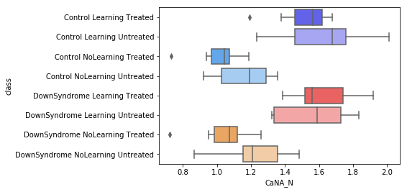
CaNA, a protein whose level increases with learning
Control
Learning
Treated
Untreated
Control
Treated
Untreated
Down Syndrome
Learning
Treated
Untreated
Control
Treated
Untreated

Slide 9
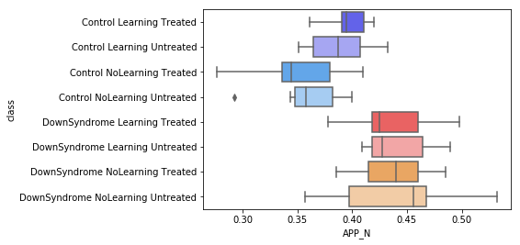
Amyloid precursor protein, precursor to the peptide found in Alzheimer’s plaques, is increased
in the Down Syndrome Model
Control
Learning
Treated
Untreated
Control
Treated
Untreated
Down Syndrome
Learning
Treated
Untreated
Control
Treated
Untreated

Slide 10
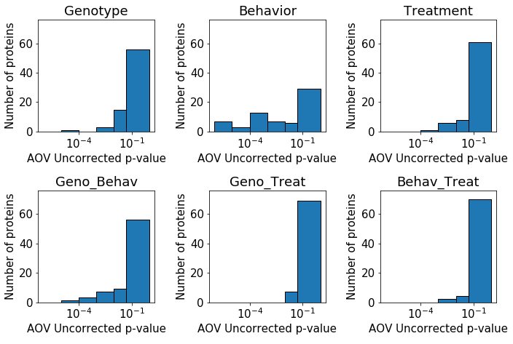
More proteins are significantly affected
by Behavior than by other variables.
Single variables
2-way interactions
Notes:
As expected from visual analysis
Uncorrected p-values - right bar is >= 0.05

Slide 11
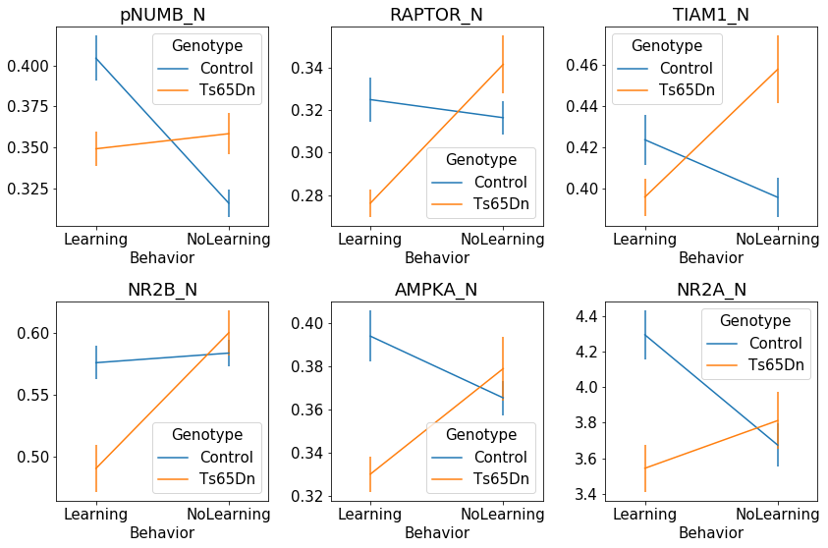
Proteins showing most significant interaction
between Genotype and Behavior

Slide 12
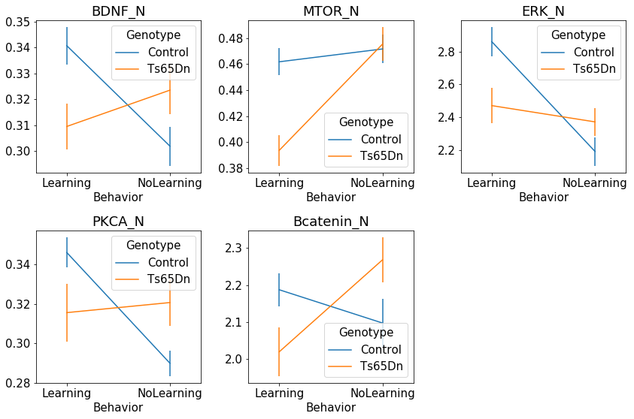
Proteins showing significant interaction
between Genotype and Behavior

Slide 13
Proteins showing significant interaction
between Genotype and Behavior
2 Members of MTOR pathway
2 subunits of NMDA receptors
Proteins involved in BDNF signaling

Slide 14
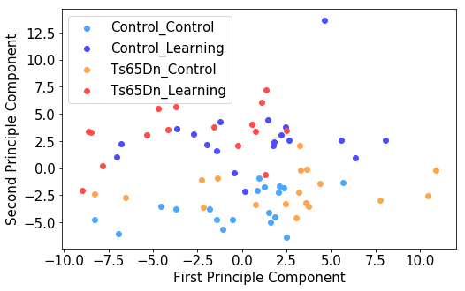
PCA analysis shows strong separation by Behavior

Slide 15
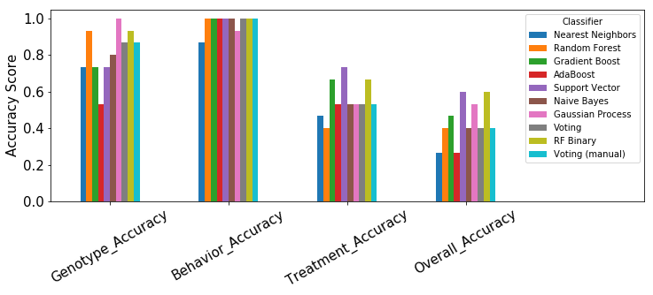
8 Group supervised classification: poor accuracy
Notes:
Treatment - not much effect on these protein levels

Slide 16
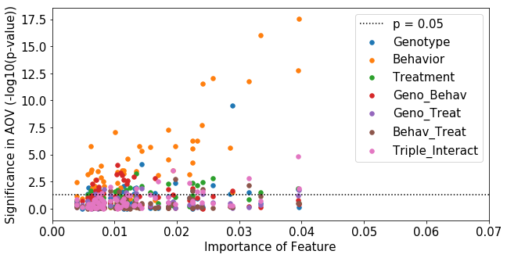
8 Group supervised classification:
driven by Behavior

Slide 17
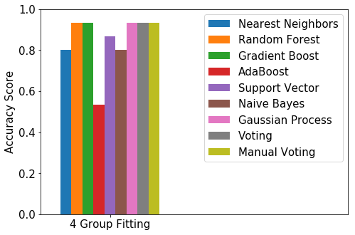
4 Group supervised classification: good accuracy
with many classifier types

Slide 18
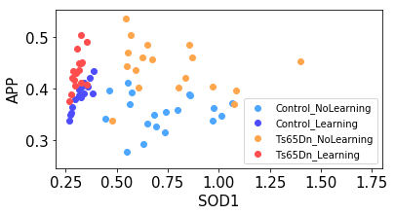
Most important proteins and modifications for categorizing by Genotype and Behavior
SOD1
APP
ITSN1
DYRK1A
CaNA
pERK
P38
pGSK3B
ARC or pS6
BRAF
Notes:
Remember - APP is strongly related to genotype; the other 9 are all strongly related to Behavior (BRAF also 3-way interact)

Slide 19
Conclusions
Nuclear levels of many proteins change in the cortex after a learning task
There are fewer differences between wildtype and Down Syndrome mice, but enough to distinguish between all 4 groups.

