Slide 1




Byte-Breakers
UNLOCKING SALES TRENDS TO DRIVE SUCCESS

Slide 2







Meet Our Team
Adeyemi E. Adenuga
Adijat O. Layode
Aishat Balogun
Member
Member
Member
Nelson Ifeanyi
2
Team Lead
Ibrahim M. Iyanda
Adeola Bello
Precious Ese
Member
Member
Member
Byte-Breakers

Slide 3
Analysis Approach
01
06
Introduction
Dashboard and Explanation
02
07
Problem Statement
Key Metrics
03
08
Objectives
Results and Discussion
04
09
Literature Review
Insights and Recommendations
05
10
Methodology
Conclusion
Byte-Breakers

Slide 4
“Every organisation Year-End Focus is to Boost Profits, Satisfy customers, Drive Growth!”
Introduction
Byte-Breakers

Slide 5

Uneven profits across regions and product lines
Problem Statement
Lack of information on key problem areas
Need for data-driven solutions to boost profitability.
Byte-Breakers

Slide 6
Objectives
01
Analyze sales trend, profit patterns and customer behaviour to inform strategy
02
Assess the impacts of discounts on profitability
03
Develop actionable recommendations to improve business performance
Byte-Breakers

Slide 7

Literature Review
Similar retail businesses were reviewed
Example: Amazon and McDonald’s (Tavor et al., 2023)
Thus, effective sales strategies enhance profitability and customer satisfaction.
Byte-Breakers

Slide 8
Methodology
Approach
Data Collection
Data Cleaning and Transformation
Data Analysis and Visualization
Historical sales data (2014–2017)
Filtering and organizing using power query
Exploratory Analysis was done using Excel and Power BI.
Byte-Breakers

Slide 9
DASHBOARD & EXPLANATION
Byte-Breakers

Slide 10






Byte-Breakers
793
38K
Total Customers
Total Quantity Sold
$1.56K
Key
Metrics
Total Discount
2.30M
Total Sales Revenue
$286.04K
Total Profit
$87.00bn
Net Sales
12.47%
Gross Profit

Slide 11
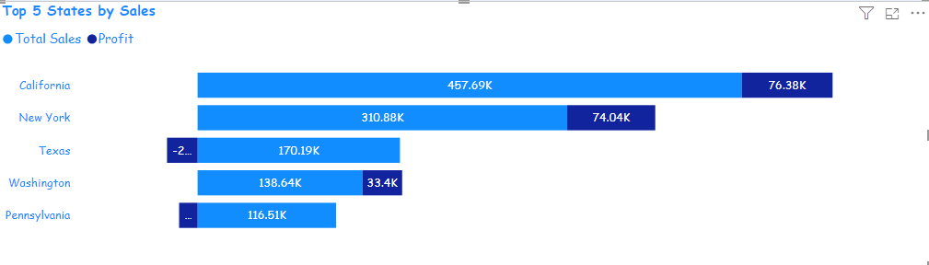
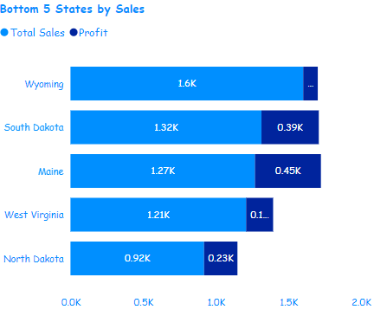
Sales Performance by States
Byte-Breakers

Slide 12
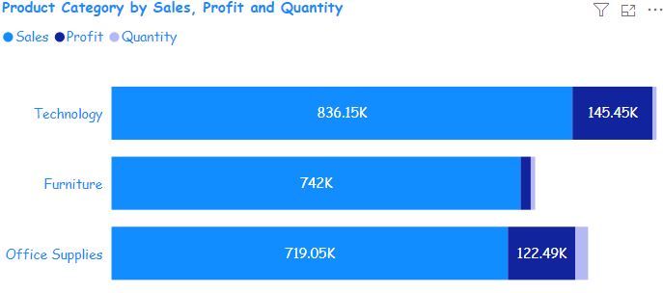
Sales Performance by Product Category
Observations:
Technology has the highest sales of $836,154.03, with Profit of $145,454.95; followed by Office Supplies has the sales of $719,047.03, and Profit of $122,490.80 and Furniture has the least sales with $741,999.80, and the Profit made was $18,451.27
Byte-Breakers

Slide 13
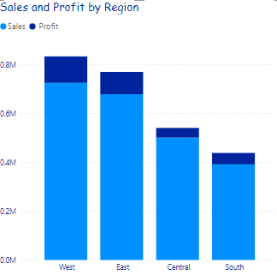
Sales Performance by Region
Observations
West has $725,457.82, followed by East $678,781.24, Central has $501,239.89, while South region has $391,721.91
Byte-Breakers

Slide 14
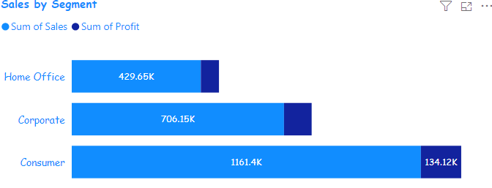
Sales Performance by Segment
Byte-Breakers

Slide 15
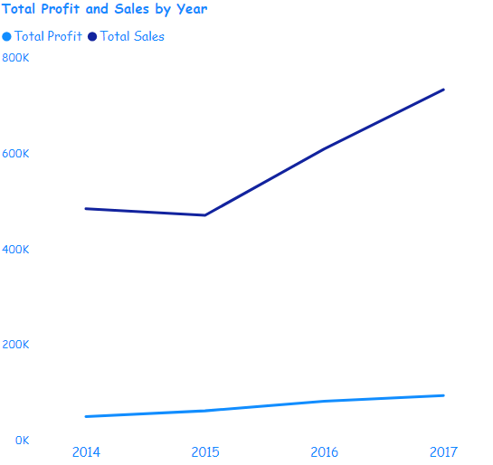
Sales Performance by Year
Byte-Breakers

Slide 16
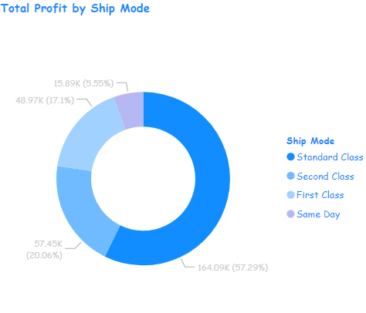
Sales Performance by Ship Mode
Observations
Byte-Breakers

Slide 17
INSIGHTS &
RECOMMENDATIONS
Byte-Breakers

Slide 18

Insights
Byte-Breakers
Sales performance varies by region, product, and consumer segments.
Office supplies underperform, while tech products excel
Consumer segments show low revenue, risking profit imbalances.
Standard Class is the top customer-preferred shipping mode.

Slide 19




Recommendations
Targeted Marketing
Swift Supply Chain
Cross-Selling
Sales Strategies
Re-evaluate sales strategies for low profit Sub-categories.
Invest in targeted marketing for high-value customers to enhance retention
Optimize supply chain and reduce delivery delays in underperforming regions
Encourage cross-selling opportunities by bundling high underperforming products.
Byte-Breakers

Slide 20
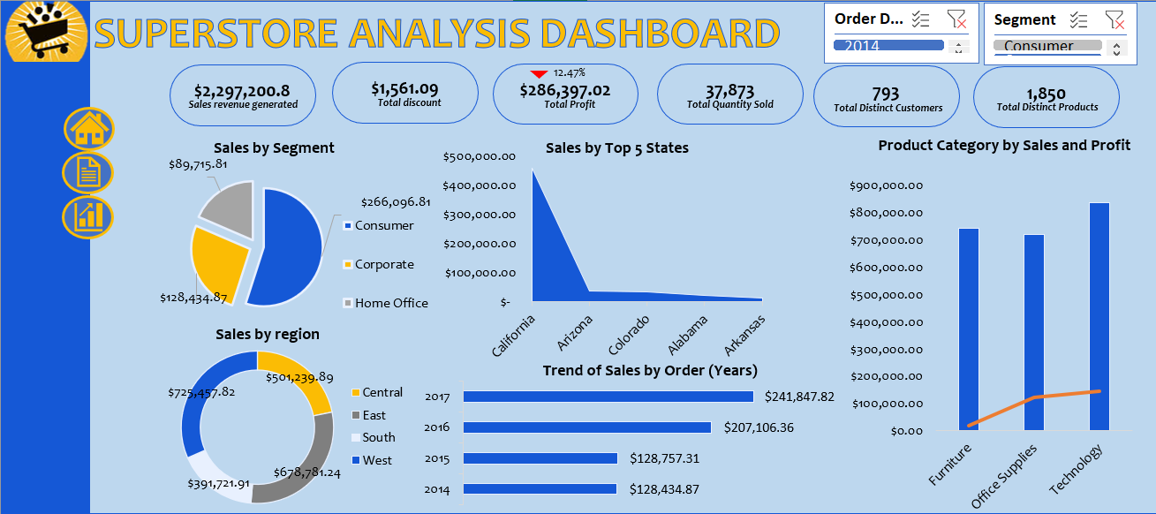

Slide 21
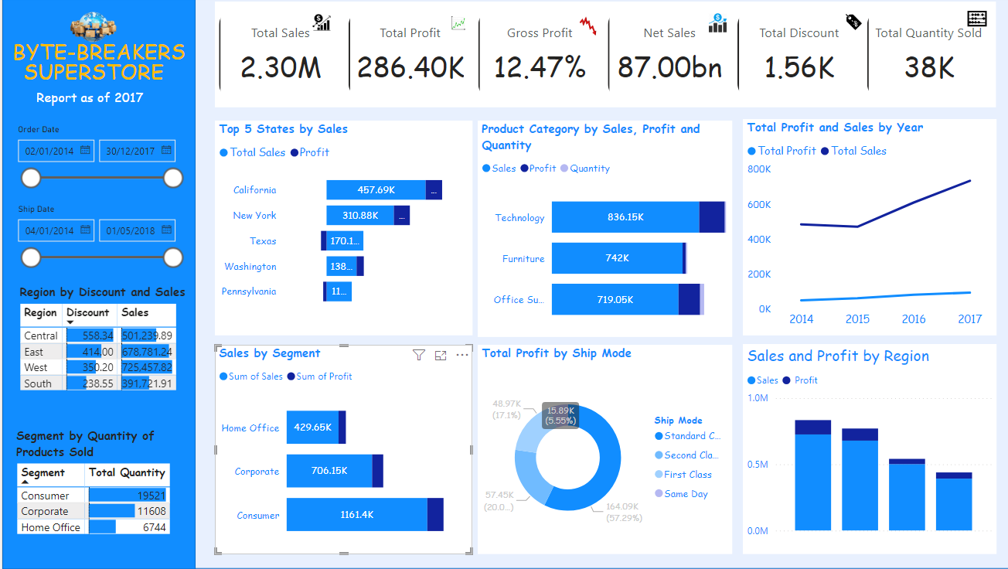

Slide 22
Thank You!!!
Byte-Breakers

