Slide 1

Tenant Retention Analysis
Presented
Presented by
Nwakama Eniola David
Adenuga Oreoluwa Angel
Egberongbe Oluwapelumi Eriayo
Salun Teryila John

Slide 2

OBJECTIVES
1
PROBLEM STATEMENT
2
CONTENT
KPI REQUIREMENT
3
CHART REQUIREMENT
4
KEY FINDINGS
5
INSIGHT
6
RECOMMENDATION
7

Slide 3

The objective of this project is to design and develop a dynamic and interactive Tenant Retention Dashboard using Power BI. The dashboard will visualize critical KPIs related to tenant retention, enabling better understanding of tenant churn, satisfaction, and lease performance for strategic decision-making.
OBJECTIVES

Slide 4
HomeVibe Properties is experiencing high tenant churn rates, resulting in increased operational costs and revenue loss. Limited insight into tenant behavior and inefficient lease renewal processes further complicate efforts to improve retention. A lack of trend identification also prevents proactive strategy development.
PROBLEM STATEMENT

Slide 5
KPI REQUIREMENT
Churn Rate: % of tenants who did not renew leases.
Occupancy Rate: % of occupied units.
1
3
Rent Collection Rate: % of total rent collected.
5
Average Satisfaction Score: Tenant satisfaction rating.
Average Rent: Mean rent per tenant.
2
4

Slide 6
- Monthly Churn Trends: Line chart.
- Tenant Satisfaction by Property: Bar chart.
- Churn vs Satisfaction: Combo chart.
- Lease Term Frequency: Distribution chart.
- Renewed vs Expired Leases: Pie chart.
- Rent Collection Trends: Line chart.
CHART REQUIREMENT

Slide 7
1. Churn Rate: 23% of tenants did not renew leases.
2. Average Satisfaction Score: 3.02 out of 5.
3. Occupancy Rate: 89%, indicating stable property usage.
4. Average Rent: $1,700 per unit.
5. Rent Collection Rate: 7%, highlighting inefficiency.
6. Longer lease terms result in higher tenant retention.
7. Churn spikes seasonally, indicating need for targeted retention strategies.
KEY FINDINGS

Slide 8
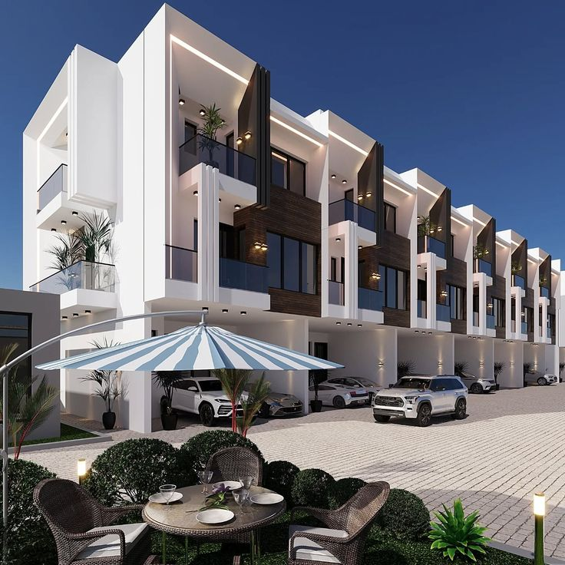
✅ High Satisfaction = Low Churn: Tenant satisfaction directly correlates with retention.
✅ Seasonal Churn Trends: Churn peaks during specific months.
✅ Lease Term Impact: Longer leases improve retention.
⚠️ Rent Collection Issues: Only 7% collection rate, affecting financial stability.
⚠️ Ineffective Renewal Strategies: Mixed success indicates need for better targeting.
✅ Operational Efficiency Matters: Financial and service efficiency drive satisfaction.
INSIGHTS

Slide 9
- Implement targeted retention programs during high-churn periods.
- Offer flexible lease terms to match tenant preferences.
- Improve tenant satisfaction through better maintenance and communication.
- Optimize rent collection with automated systems or incentives.
- Analyze and enhance lease renewal strategies.
- Introduce value-added services to increase tenant loyalty.
RECOMMENDATION

Slide 10
- Analyze retention rates by property type, location, and lease length.
- Identify high-performing properties and replicate success.
- Use predictive analytics to forecast future churn and satisfaction trends.
- Tailor services based on tenant segment behavior and needs.
SEGMENTED PERFORMANCE DEEP DRIVE

Slide 11
- Real-time visibility into retention metrics.
- Enables data-driven decisions.
- Identifies trends and risk areas.
- Facilitates proactive tenant engagement.
- Supports continuous process improvement
DASHBOARD BENEFITS

Slide 12
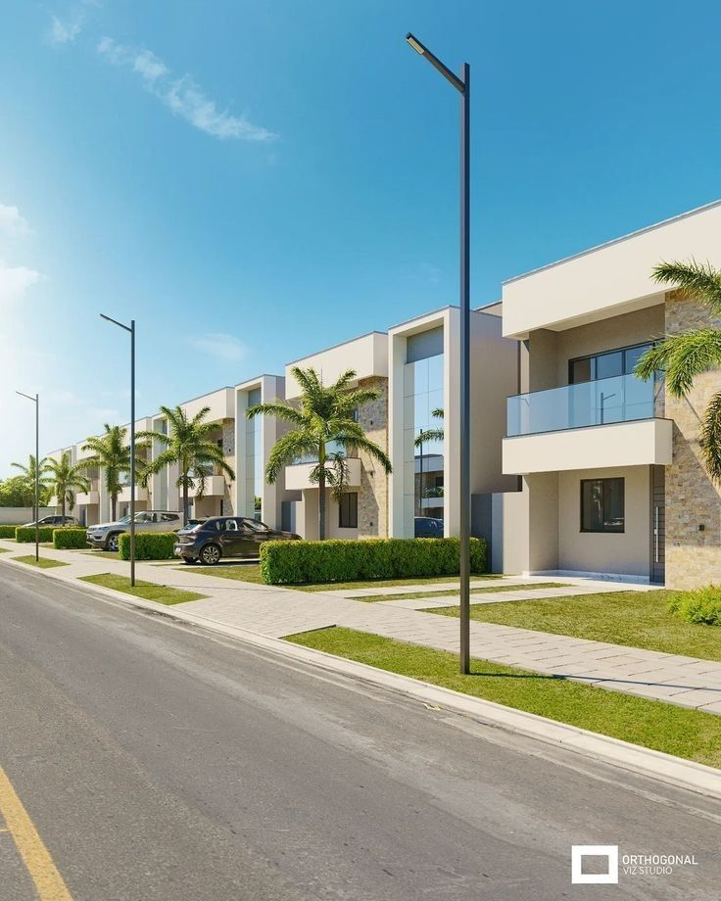
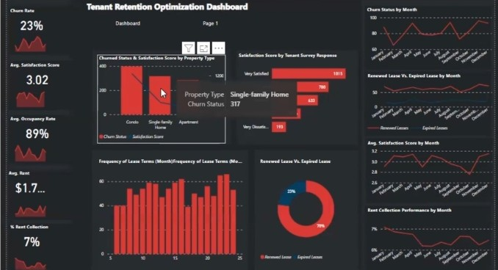
CONCLUSION

Slide 13
- Real-time visibility into retention metrics.
- Enables data-driven decisions.
- Identifies trends and risk areas.
- Facilitates proactive tenant engagement.
- Supports continuous process improvement
CONCLUSION

Slide 14
THANK YOU

