Slide 1


Relational vs. Non-Relational Databases
Discover the fundamental differences, use cases, and advantages of relational and non-relational databases.
by Oshifeko Adeolu

Slide 2
Introducing Databases: The Data Guardians
What are Databases?
Two Main Types
Organized storage for easy data access and analysis.
Relational (structured, table-based) and Non-Relational (flexible, schema-less)

Slide 3
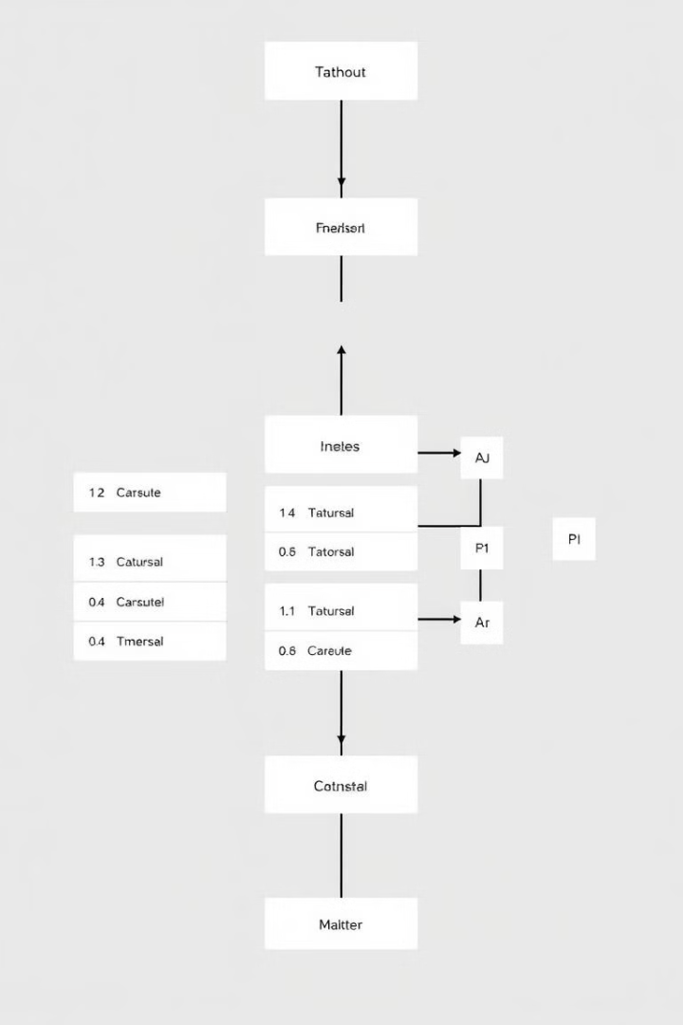
Relational Databases: Structured Data
Structured Data
Predefined Schema
Organized into tables with rows and columns.
Data types and relationships are defined upfront.
ACID Compliance
Examples
Ensures data integrity and reliability.
MySQL, PostgreSQL, Oracle Database.

Slide 4
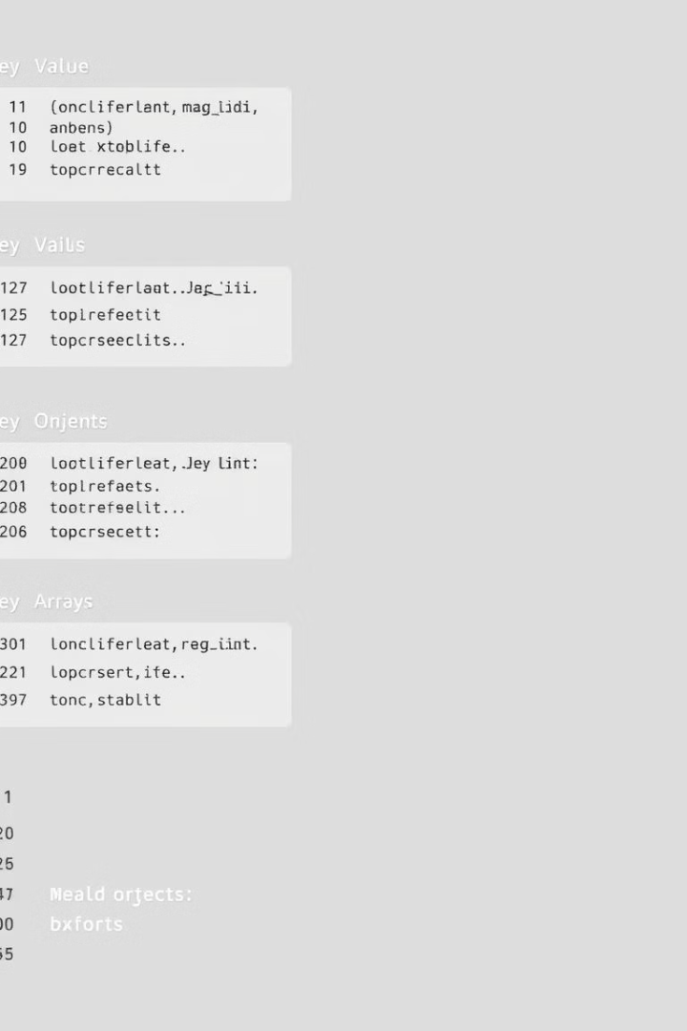
Non-Relational Databases: Flexible Data
Flexible Data
Dynamic Schema
Store data in various formats: key-value pairs, documents, graphs, or columns.
Allows data structure to evolve with application needs.
CAP Theorem
Examples
Focuses on Consistency, Availability, or Partition tolerance.
MongoDB, Cassandra, Redis.

Slide 5
Key Differences: Structure and Schema
Relational Databases
Non-Relational Databases
Structured, table-based data with a fixed schema.
Unstructured or semi-structured data with a flexible schema.

Slide 6


Key Differences: Scalability and Performance
Relational Databases
1
Vertical scaling (adding more resources to a single server).
Non-Relational Databases
2
Horizontal scaling (adding more servers).

Slide 7
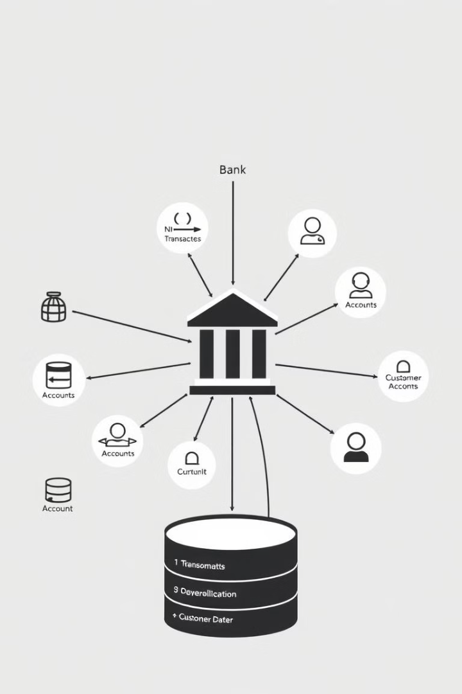



Advantages of Relational Databases
Data Integrity
Strong consistency and reliability.
Complex Queries
Support for joins and other advanced operations.
Mature Ecosystem
Wide range of tools and resources.

Slide 8
Advantages of Non-Relational Databases
Flexibility
1
Adaptable to evolving data structures.
High Scalability
2
Handle massive datasets with ease.
Distributed Systems
3
Well-suited for distributed environments.

Slide 9

When to Choose Relational Databases
1
2
Structured Data
Data Integrity
Applications with well-defined data relationships.
Scenarios requiring strict data consistency.

Slide 10

When to Choose Non-Relational Databases
High Scalability
Distributed Systems
Applications needing to handle massive data volumes.
Applications requiring high availability and fault tolerance.
1
2
3
Unstructured Data
Flexible handling of diverse data formats.

