Slide 1
Student Placement Prediction System
BY - Adersh Mohan Puthiyedath
Data Science Project

Slide 2
Problem Statement
Campus placements depend on multiple academic and demographic factors.
There is a need for a data-driven system to analyze and predict placement outcomes.

Slide 3
Objectives
Analyze historical student placement data
Identify key factors influencing placement
Build machine learning models for prediction
Compare model performance
Visualize insights using Python and Power BI

Slide 4
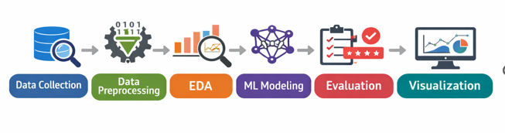
Project Workflow

Slide 5
Dataset Description
Dataset: Campus Placement Dataset
Total Records: 215 students
Key features:
Gender
SSC, HSC, Degree, MBA percentages
Specialization
Work Experience
Placement Status

Slide 6
Data Preprocessing
Removed irrelevant columns
Handled missing values
Encoded categorical variables
Converted target variable into binary format
Exported cleaned dataset for Power BI

Slide 7
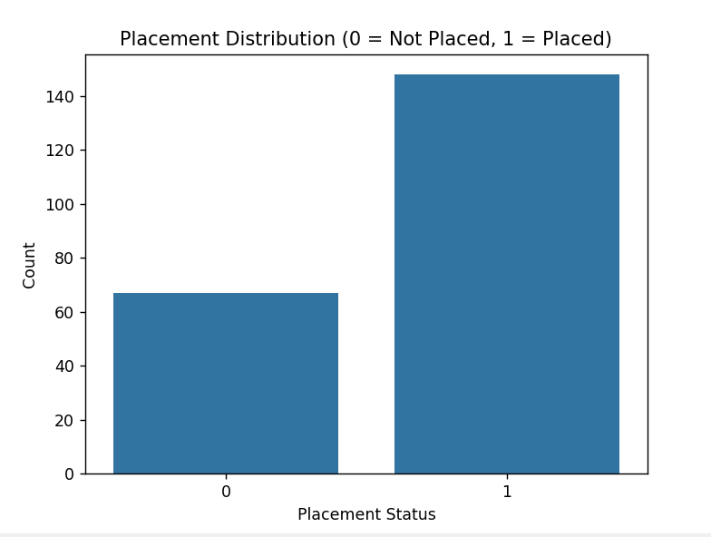
Target Variable Distribution
Placed: 148
Not Placed: 67

Slide 8
Exploratory Data Analysis
EDA was performed to understand patterns and relationships between features and placement outcomes.
Focus areas:
Academic performance
Gender and specialization
Work experience impact

Slide 9
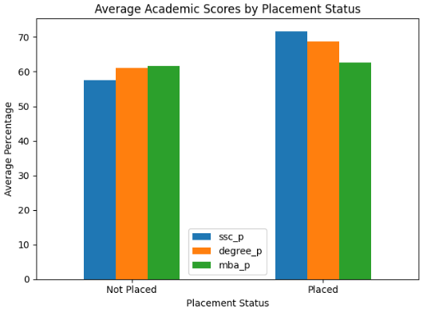
Academic Performance Analysis
Placed students generally have higher academic scores

Slide 10
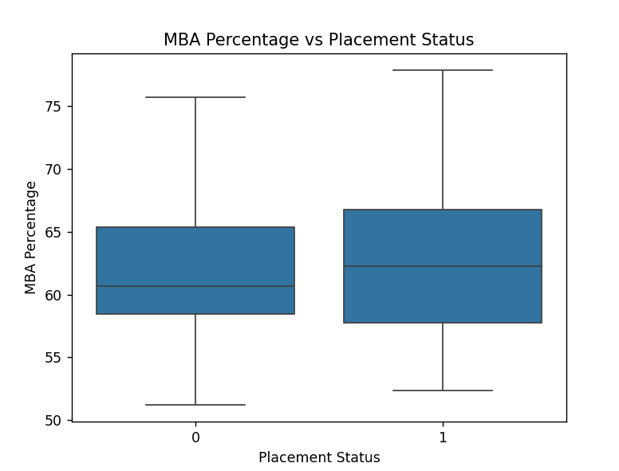
MBA & Degree Analysis
MBA and Degree percentages show strong correlation with placement

Slide 11
Feature Engineering
Features encoded:
Gender
Specialization
Work Experience
Numerical features scaled where required for model training.

Slide 12
Machine Learning Models
Models implemented:
Logistic Regression
Random Forest Classifier
Reason for selection:
Logistic Regression for interpretability
Random Forest for non-linear feature interactions

Slide 13
Model Training
Dataset split into training and testing sets
Models trained using scikit-learn
Hyperparameters tuned where required

Slide 14
Evaluation Metrics
Metrics used:
Accuracy
Precision
Recall
F1 Score
These metrics help evaluate both correctness and class prediction quality

Slide 15
Model Performance
Logistic Regression:
Accuracy ≈ 86%
Best overall performance
Random Forest:
Slightly lower performance
Conclusion: Logistic Regression selected as final model.

Slide 16
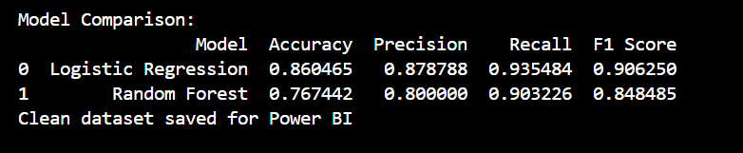
Model Comparison

Slide 17
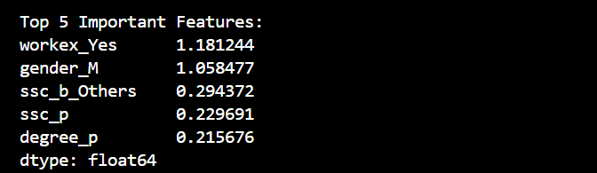
Feature Importance
Top influencing features:
Work Experience
Gender
SSC Percentage
Degree Percentage
Specialization
Insight: Practical exposure and academic consistency strongly impact placement.

Slide 18
POWER BI DASHBOARD COMPONENTS
Dashboard includes:
Total Students, Placed, Not Placed, Placement %
Placement Distribution
Gender-wise Placement Analysis
Academic Performance Comparisons
Specialization-wise Placement Rate

Slide 19
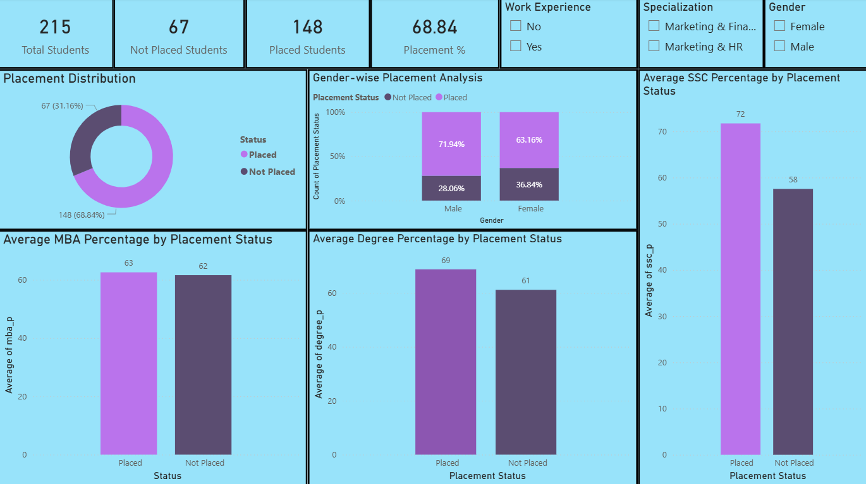
Power BI Dashboard

Slide 20
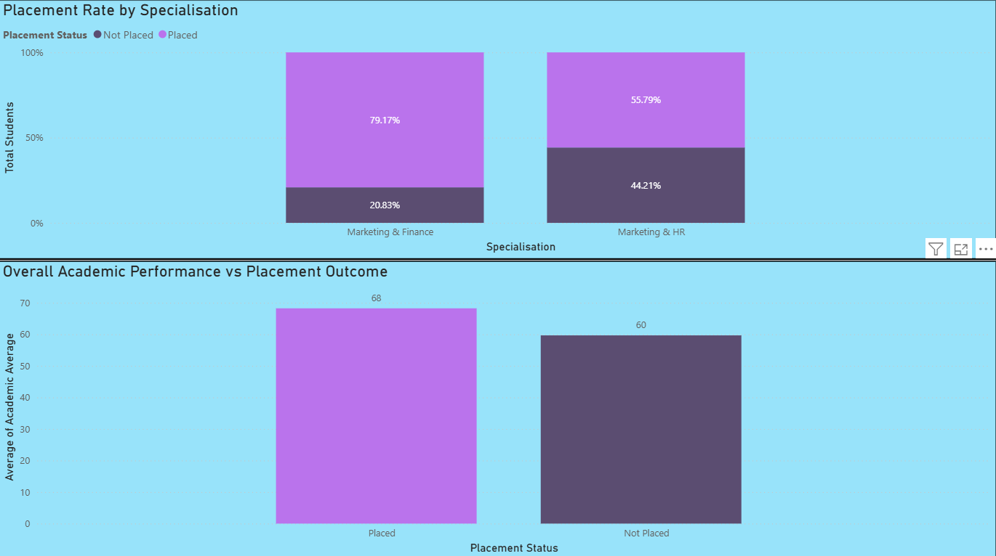
Power BI Dashboard 2

Slide 21
Dashboard Insights
Placement rate is approximately 69%
Students with work experience have higher placement chances
Marketing and Finance specialization shows better placement rates
Academic scores strongly correlate with placement success

Slide 22
Conclusion
The project successfully demonstrates how:
Data science techniques can predict placement outcomes
Machine learning models assist decision-making
Power BI dashboards provide actionable insights
The system can support institutions in improving placement strategies.

Slide 23
Future Scope
Include real-time student data
Add internship and skill-based features
Deploy as a web-based analytics system
Use advanced ensemble or deep learning models

Slide 24
THANK YOU!!!
ANY QUESTIONS???

