Slide 1

STACK OVERFLOW ANALYSIS
LEARNER NAME: ADERSH MOHAN PUTHIYEDATH
DATE: 09/07/2025

Slide 2



OUTLINE
Executive Summary
Introduction
Methodology
Results
Visualization – Charts
Dashboard
Discussion
Findings & Implications
Conclusion
Appendix

Slide 3

EXECUTIVE SUMMARY
The analysis highlights current and emerging technology trends in programming, databases, platforms, and web frameworks.
The study is based on global developer survey data and presents insights into preferences and usage patterns.
Programming languages like JavaScript, Python, and SQL remain dominant .
PostgreSQL and MySQL are the most used databases, with growing interest in Redis and MongoDB.
React and Node.js are among the most preferred web frameworks.
The data was visualized using Looker Studio, enabling interactive insights.
The findings help recruiters, educators, and tech leaders plan skill development and hiring strategies.
The dashboard helps compare current usage vs future interest across technologies.

Slide 4

INTRODUCTION
Understanding developer trends is critical to tracking the evolution of software development.
This project focuses on identifying and visualizing trends in programming languages, databases, platforms, and frameworks.
The insights can help businesses, educators, and learners align with industry demands.
Data was sourced from a global developer survey conducted by Stack Overflow.
Visualizations were created using Looker Studio.
The dashboard includes multiple tabs for different tech categories.

Slide 5

METHODOLOGY
.
Survey data was pre-processed and cleaned using Python (Pandas).
Technology trends were analyzed by comparing current usage with future desire metrics.
The data was aggregated to rank technologies based on popularity.
The dashboard was built in Looker Studio using bar, treemap, and scatter plots.
Data was grouped by frequency of responses.
Top 10 items in each category were displayed for clarity.

Slide 6
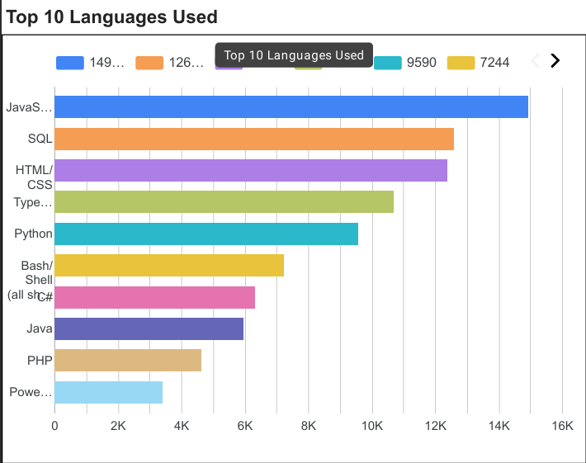
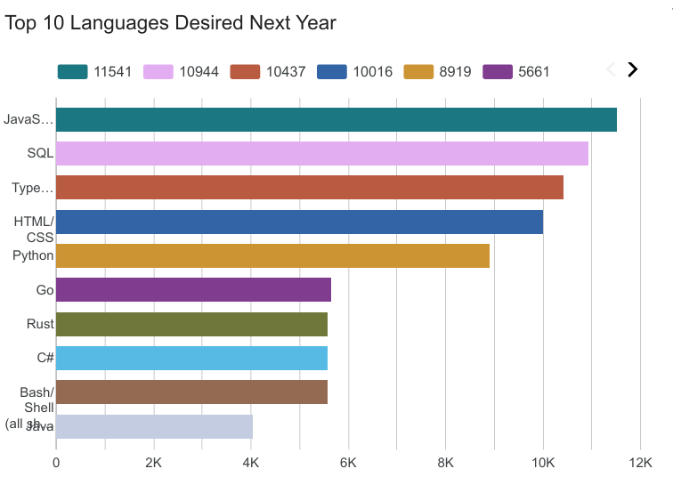
PROGRAMMING LANGUAGE TRENDS
Current Year
Next Year

Slide 7
PROGRAMMING LANGUAGE TRENDS - FINDINGS & IMPLICATIONS
Findings
JavaScript is the top language in both usage and future demand.
SQL, TypeScript, HTML/CSS, Python remain consistently popular.
Go, Rust, C# are rising in demand but not yet widely used.
Implications
Continue focusing on the
JavaScript ecosystem.
Upskill in emerging
languages
like Go and Rust.
Strong need for data and
scripting skills (SQL,Python,
Bash).

Slide 8
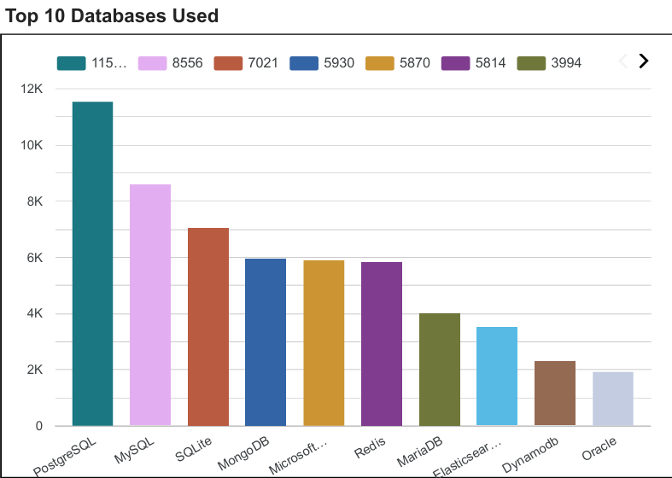
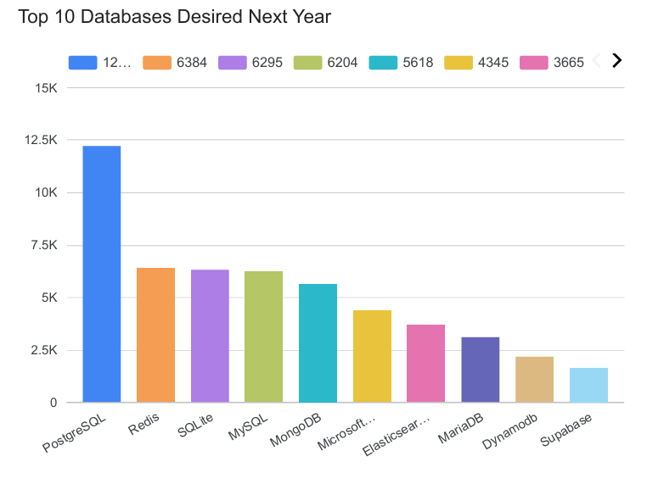
DATABASE TRENDS
Current Year
Next Year

Slide 9
DATABASE TRENDS - FINDINGS & IMPLICATIONS
.
Findings
PostgreSQL is the most used and most desired database by a wide margin.
Redis and SQLite are seeing increased demand for future use.
SupaBase appears in future trends but is not yet widely used.
Implications
Focus on PostgreSQL skills for both current and future roles.
Explore Redis and SQLite for lightweight, high-performance use cases.
Keep an eye on emerging platforms like SupaBase in modern app development.

Slide 10

DASHBOARD
DASHBOARD OVERVIEW
The following slides present interactive dashboards created using Looker Studio, showcasing insights across:
Current Technology Usage
Future Technology Trends
Demographics
These dashboards highlight key patterns in technology adoption, future demand, and user distribution.

Slide 11
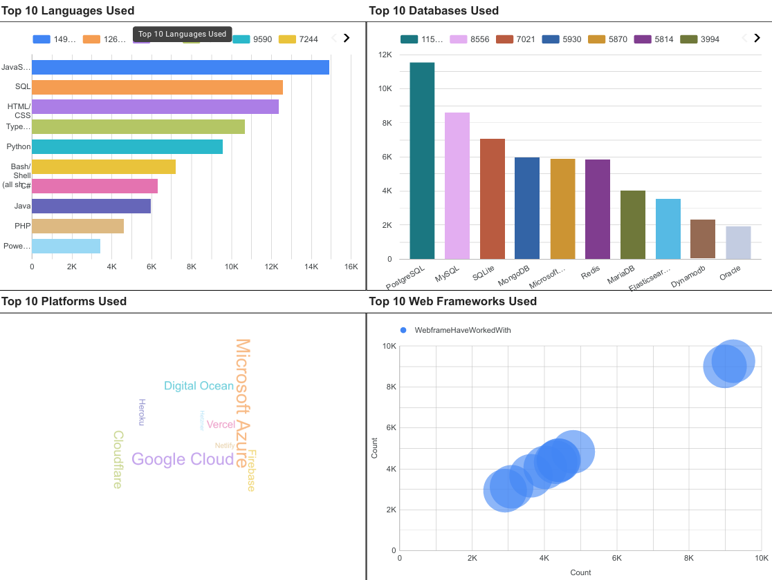
CURRENT TECHNOLOGY USAGE

Slide 12
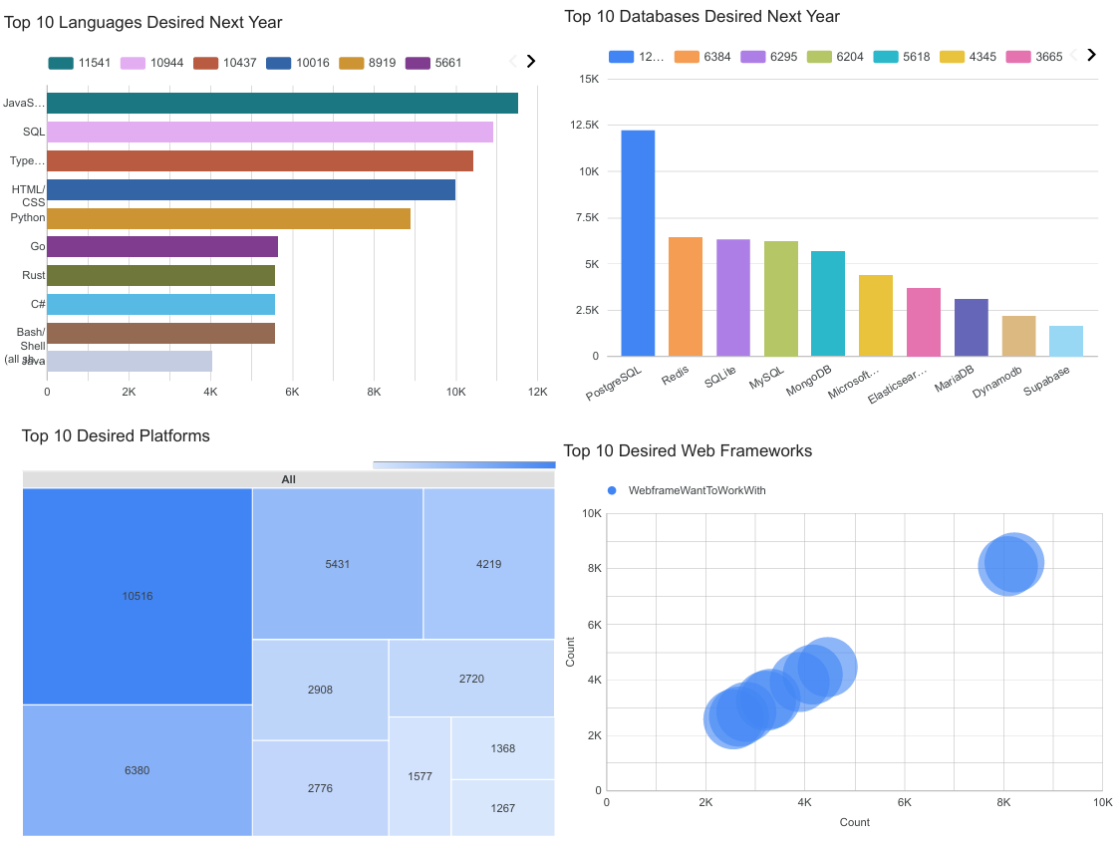
FUTURE TECHNOLOGY TRENDS
Screenshot of dashboard tab 2 goes here

Slide 13
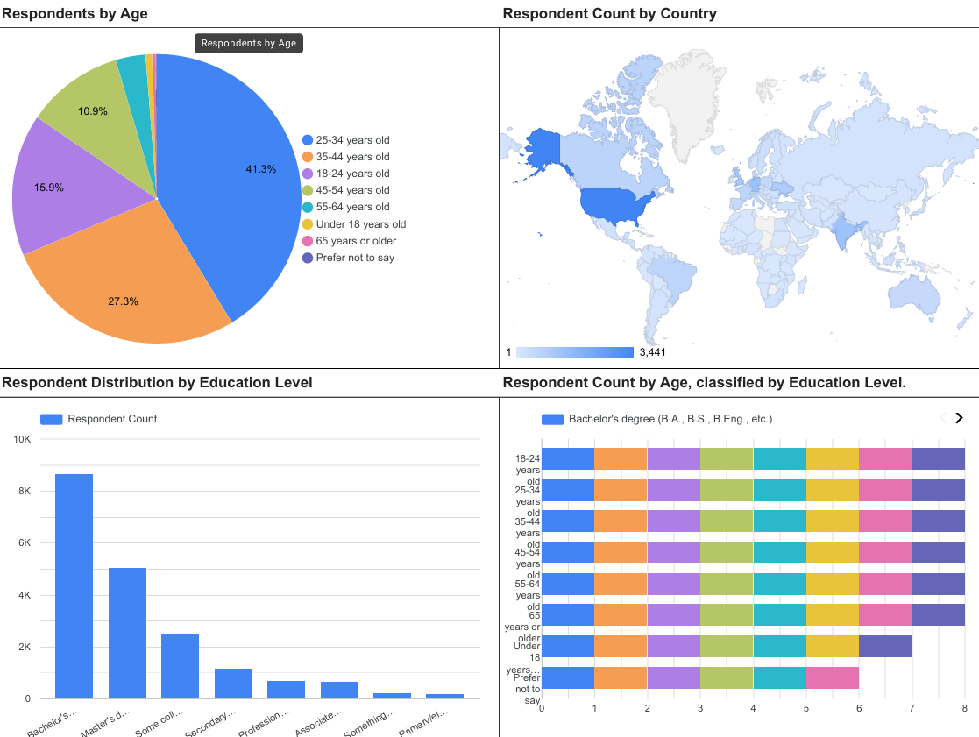
DEMOGRAPHICS
Screenshot of dashboard tab 3 goes here

Slide 14
DISCUSSION

Slide 15
OVERALL FINDINGS & IMPLICATIONS
Findings
Clear difference between current usage and future interest in technologies.
Strong shift toward full-stack frameworks and cloud platforms.
Growing interest in newer, performance-focused tools like Rust and Redis
Implications
Developers must constantly update their skillsets.
Recruiters should assess both experience and interest areas.
Product teams should evaluate tech stacks based on community trends

Slide 16

CONCLUSION
.
The dashboard effectively visualizes key technology trends among developers.
Insights highlight the alignment (or mismatch) between usage and aspiration.
These trends can inform hiring, education, and product development decisions.
Continuous monitoring of such trends is essential for staying competitive

Slide 17
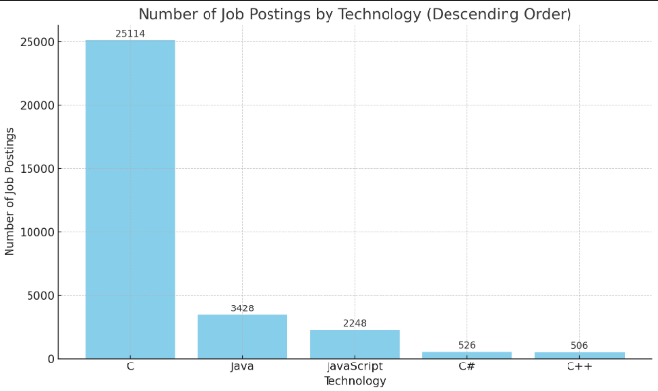
JOB POSTINGS

Slide 18
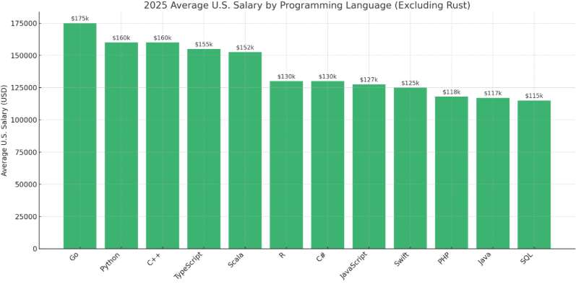
POPULAR LANGUAGES
In Module 1 you have collected the job postings data using web scraping in a file named “popular-languages.csv”. Present that data using a bar chart here. Order the bar chart in the descending order of salary.

