Slide 1
CCSP QUESTION 1
______ can often be the result of inadvertent activity.
Response:
DDoS
Phishing
Sprawl
Disasters

Slide 2
CCSP QUESTION 2 –
What can tokenization be used for?
Responses:
Encryption
Compliance with PCI DSS
Enhancing the user experience
Giving management oversight to e-commerce functions

Slide 3
EW QUESTION 3
DLP can be combined with what other security technology to enhance data controls?
DRM
SIEM
Kerberos
Hypervisors

Slide 4
CCSP QUESTION 4
Which of the following is characterized by a set maximum capacity?
A secret-sharing-made-short (SSMS) bit-splitting implementation
A tightly coupled cloud storage cluster
A loosely coupled cloud storage cluster
A public-key infrastructure

Slide 5
CCSP QUESTION 5
When an organization implements SIEM solution and begins aggregating event data, the configured event sources are only valid at the time it was configured. Application modifications, patching, and other upgrades will change the events generated and how they are represented over time. What process is necessary to ensure events are collected and processed with this in mind?
A. Continual review
B. Continuous optimization
C. Aggregation updates
D. Event elasticity

Slide 6
CCSP QUESTION 6
Which of the following should occur at each stage of the SDLC?
Added functionality
B. Management review
C. Verification and validation
D. Repurposing of any newly developed components

Slide 7
CCSP QUESTION 7:
Which of the following statements best characterizes SAML?
A standard for developing secure application management logistics
A standard for exchanging authentication and authorization data between security domains
A standard for exchanging usernames and passwords across devices
A standard used for directory synchronization

Slide 8
CCSP QUESTION 8 :
Which document will govern the cloud customers and cloud provider's uptime and availability requirements?
Contract
Operational level agreement
Service level agreement
Regulation

Slide 9
CCSP QUESTION 9:
Which of the following is a file server that provides data access to multiple, heterogeneous machines/users on the network?
Storage area network (SAN)
B. Network-attached storage (NAS)
C. Hardware security module (HSM)
D. Content delivery network (CDN)

Slide 10
CCSP QUESTION 10
Which of the following is not a factor an organization might use in the cost-benefit analysis when deciding whether to migrate to a cloud environment?
Pooled resources in the cloud
B. Shifting from capital expenditures to support IT investment to operational expenditures
C. The time savings and efficiencies offered by the cloud service
D. Branding associated with which cloud provider might be selected

Slide 11
CCSP QUESTION 7
Which of the following is a risk in the cloud environment that is not existing or is as prevalent in the legacy environment?
Legal liability in multiple jurisdictions
Loss of productivity due to DDoS
Ability of users to gain access to their physical workplace
fire

Slide 12
CCSP QUESTION 12
_____ is the legal concept whereby a cloud customer is held to a reasonable expectation for providing security of its users’ and clients’ privacy data in their control.
Response:
A. Due care
B. Due diligence
C. Liability
D. Reciprocity
>> Due diligence is the research or exercise of care that a reasonable business or individual is required to perform before entering into an agreement or contract with another party or performing an act with a specific degree of care.

Slide 13
CCSP QUESTION 13
You are the security manager of a small firm that has just purchased a DLP solution to implement in your cloud-based production environment. In order to get truly holistic coverage of your environment, you should be sure to include ______ as a step in the deployment process.
Response:
Getting signed user agreements from all users
B. Installation of the solution on all assets in the cloud data center
C. Adoption of the tool in all routers between your users and the cloud provider
D. All of your customers to install the tool

Slide 14
CCSP QUESTION 14
You work for a government research facility. Your organization often shares data with other government research organizations. You would like to create a single sign-on experience across the organizations, where users at each organization can sign in with the user ID/authentication issued by that organization, then access research data in all the other organizations. Instead of replicating the data stores of each organization at every other organization (which is one way of accomplishing this goal), you instead want every user to have access to each organization’s specific storage resources. If you don’t use cross-certification, what other model can you implement for this purpose?
Response:
Third-party identity broker
B. Cloud reseller
C. Intractable nuanced variance
D. Mandatory access control (MAC)

Slide 15
CCSP QUESTION 15
At which phase of the SDLC process should security begin participating?
Requirements gathering
B. Requirements analysis
C. Design
D. Testing

Slide 16
CCSP QUESTION 16
Which of the following tools might be useful in data discovery efforts that are based on content analysis?
A. DLP
B. Digital Rights Management (DRM)
C. iSCSI
D. Fibre Channel over Ethernet (FCoE)

Slide 17
CCSP QUESTION 17
Because PaaS implementations are so often used for software development, what is one of the vulnerabilities that should always be kept in mind?
Response:
A. Malware
B. Loss/theft of portable devices
C. Backdoors
D. DoS/DDoS
Software developers often install backdoors as a means to avoid performing entire workflows when adjusting the programs, they're working on; they often leave backdoors behind in production software, inadvertently or intentionally.

Slide 18
CCSP QUESTION 18
Every cloud service provider that opts to join the CSA STAR program registry must complete a ______.
SOC 2, Type 2 audit report
B. Consensus Assessment Initiative Questionnaire (CAIQ)
C. NIST 800-37 RMF audit
D. ISO 27001 ISMS review

Slide 19
CCSP QUESTION 19
What sort of legal enforcement may the Payment Card Industry (PCI) Security Standards Council not bring to bear against organizations that fail to comply with the Payment Card Industry Data Security Standard (PCI DSS)?
Response:
Fines
B. Jail time
C. Suspension of credit card processing privileges
D. Subject to increased audit frequency and scope

Slide 20
CCSP QUESTION 20
Which of the following types of organizations is most likely to make use of opensource software technologies?
Government agencies
B. Corporations
C. Universities
D. Military

Slide 21
CCSP QUESTION 21
DAST checks software functionality in ______.
Response:
The production environment
B. A runtime state
C. The cloud
D. An IaaS configuration

Slide 22
CCSP QUESTION 22
Which of the following practices can enhance both operational capabilities and configuration management efforts?
Response:
Regular backups
B. Constant uptime
C. Multifactor authentication
File hashes
File hashes, also known as file checksums, are values calculated using a variety of special cryptographic algorithms based on the data contained within the file. There are numerous hashing algorithms available, including MD5, RIPEMD, SHA-1, Whirlpool, Tiger, and others. These hashes can be used to see if the contents of the files have changed.

Slide 23
CCSP QUESTION 23
Each of the following are dependencies that must be considered when reviewing the BIA after cloud migration except:
Response:
The cloud provider’s suppliers
B. The cloud provider’s vendors
C. The cloud provider’s utilities
The cloud provider’s resellers
The cloud provider's resellers are a marketing and sales mechanism, not an operational dependency that could affect the security of a cloud customer.

Slide 24
CCSP QUESTION 24
Which of the following top security threats involves attempting to send invalid commands to an application in an attempt to get the application to execute the code?
Response:
Cross-site scripting
B. Injection
C. Insecure direct object references
Cross-site request forgery
During an injection attack, untrusted inputs or unauthorized code are “injected” into a program and interpreted as part of a query or command. Injection is involved in four prevalent attack types: OGNL injection, Expression Language Injection, command injection, and SQL injection.

Slide 25
CCSP QUESTION 25
Open Web Application Security Project (OWASP) Top Ten is a list of web application security threats that is composed by a member-driven OWASP committee of application development experts and published approximately every 24 months. The 2013 OWASP Top Ten list includes “sensitive data exposure.” Which of these is a technique to reduce the potential for a sensitive data exposure?
Response:
Extensive user training on proper data handling techniques
B. Advanced firewalls inspecting all inbound traffic, to include content-based screening
C. Ensuring the use of utility backup power supplies
D. Roving security guards

Slide 26
CCSP QUESTION 26
What does nonrepudiation mean?
Response:
Prohibiting certain parties from a private conversation
B. Ensuring that a transaction is completed before saving the results
C. Ensuring that someone cannot turn off auditing capabilities while performing a function
Preventing any party that participates in a transaction from claiming that it did not
Non-repudiation is the assurance that someone cannot deny the validity of something. Non-repudiation is a legal concept that is widely used in information security and refers to a service, which provides proof of the origin of data and the integrity of the data.

Slide 27
CCSP QUESTION 27
Using one cloud provider for your operational environment and another for your BC/DR backup will also give you the additional benefit of ______.
Response:
Allowing any custom VM builds you use to be instantly ported to another environment
B. Avoiding vendor lock-in/lockout
C. Increased performance
D. Lower cost

Slide 28
CCSP QUESTION 28
Cloud Security Alliance (CSA) publishes the Notorious Nine, a list of common threats to organizations participating in cloud computing. According to the CSA, an organization that suffers a data breach might suffer all of the following negative effects except ______.
Response:
Cost of compliance with notification laws
B. Loss of public perception/goodwill
C. Loss of market share
D. Cost of detection

Slide 29
CCSP QUESTION 29
A honeypot should contain data______.
Response:
Raw
B. Production
C. Useless
D. Sensitive
A honeypot looks like a real computer system, with applications and data, fooling cybercriminals into thinking it's a legitimate target. For example, a honeypot could mimic a company's customer billing system - a frequent target of attack for criminals who want to find credit card numbers. Once the hackers are in, they can be tracked, and their behavior assessed for clues on how to make the real network more secure.

Slide 30
CCSP QUESTION 30
Impact resulting from risk being realized is often measured in terms of ______.
Amount of data lost
B. Money
C. Amount of property lost
D. Number of people affected

Slide 31
CCSP QUESTION 31
Cloud Security Alliance (CSA) publishes, the Notorious Nine, a list of common threats to organizations participating in cloud computing. According to the CSA, all of the following activities can result in data loss except ______ .
Misplaced crypto keys
B. Improper policy
C. Ineffectual backup procedures
D. Accidental overwrite

Slide 32
CCSP QUESTION 32
At which layer does the IPSec protocol operate to encrypt and protect communications between two parties?
Response:
Network
B. Application
C. Transport
D. Data link

Slide 33
CCSP QUESTION 33
When using transparent encryption of a database, where does the encryption engine reside?
Response:
At the application using the database
B. On the instance(s) attached to the volume
C. In a key management system
D. Within the database

Slide 34
CCSP QUESTION 34
Which of the following characteristics is associated with digital rights management (DRM) solutions (sometimes referred to as information rights management, or IRM)?
Response:
Mapping to existing access control lists (ACLs)
B. Delineating biometric catalogs
C. Preventing multifactor authentication
D. Prohibiting unauthorized transposition

Slide 35
CCSP QUESTION 35
What are the six components that make up the STRIDE threat model?
Response:
Spoofing, Tampering, Repudiation, Information Disclosure, Denial of Service, and Elevation of Privilege
B. Spoofing, Tampering, Non-Repudiation, Information Disclosure, Denial of Service, and Elevation of Privilege
C. Spoofing, Tampering, Repudiation, Information Disclosure, Distributed Denial of Service, and Elevation of Privilege
D. Spoofing, Tampering, Repudiation, Information Disclosure, Denial of Service, and Social

Slide 36
CCSP QUESTION 36
What is the intellectual property protection for the logo of a new video game?
Response:
Copyright
B. Patent
C. Trademark
D. Trade secret

Slide 37
CCSP QUESTION 37
Which cloud service category brings with it the most expensive startup costs, but also the lowest costs for ongoing support and maintenance staff?
Response:
IaaS
B. SaaS
C. PaaS
D. DaaS

Slide 38
CCSP QUESTION 38
A process for ______ can aid in protecting against data disclosure due to lost devices.
Response:
User punishment
B. Credential revocation
C. Law enforcement notification
D. Device tracking

Slide 39
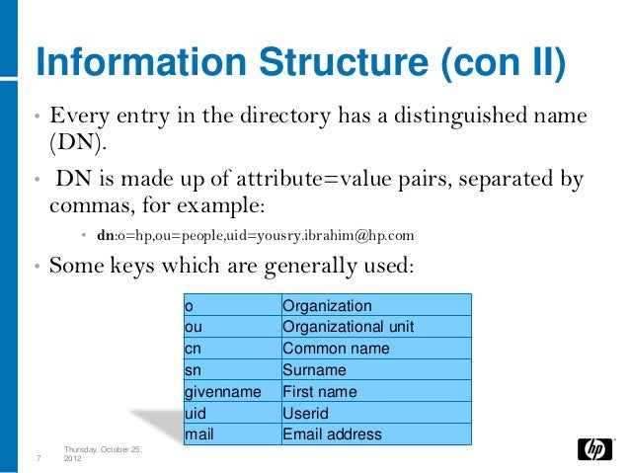
CCSP QUESTION 39
In a Lightweight Directory Access Protocol (LDAP) environment, each entry in a directory server is identified by a ______.
Response:
Domain name (DN)
B. Distinguished name (DN)
C. Directory name (DN)
D. Default name (DN)

Slide 40
CCSP QUESTION 40
Which SSAE 16 audit report is simply an attestation of audit results?
Response:
SOC 1
B. SOC 2, Type 1
C. SOC 2, Type 2
D. SOC 3
Service Organizational Control 3 Report (SOC 3) is a more concise and high-level version of the SOC 2 meant to be released publicly as marketing material. An organization cannot get a SOC 3 report without completing its SOC 2 Type II, but a SOC 3 can be issued with a SOC 2 for an additional cost.

Slide 41
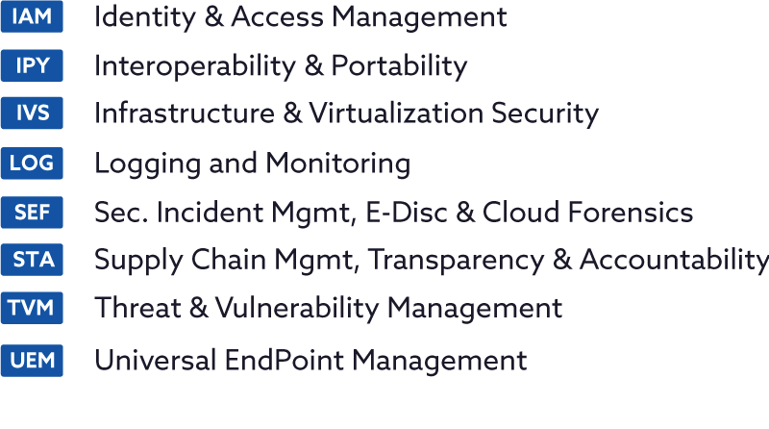
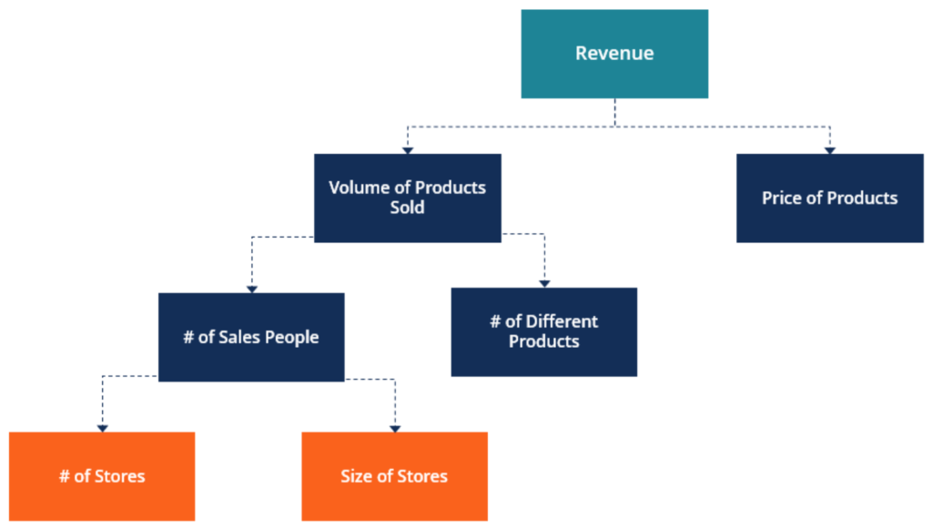
CCSP QUESTION 42
Cloud Security Alliance’s (CSA’s) Cloud Controls Matrix (CCM) addresses all the following security architecture elements except ______.
Response:
Physical security
B. IaaS
C. Application security
D. Business drivers

Slide 42
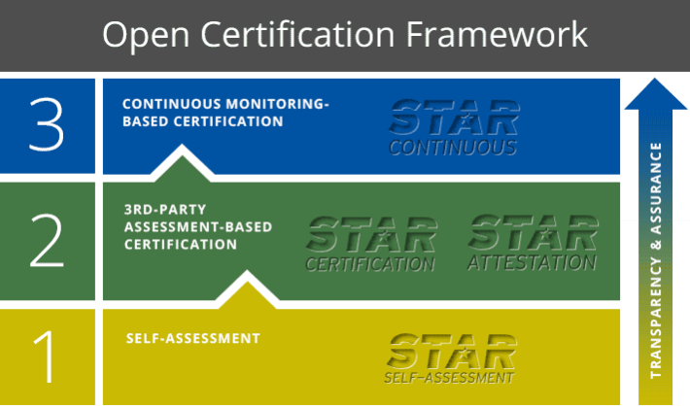
CCSP QUESTION 43
Cloud Security Alliance (CSA) Security, Trust, and Assurance Registry (STAR) program has ______ tiers.
Response:
Two
B. Three
C. Four
D. Eight
1. STAR Entry – Self Assessment: Self-assessment results must be disclosed by the CSA Consensus Assessment Initiative (CAI) or Cloud Control Matrix (CCM) questionnaire.
2. STAR Certification/Attestation: Assessment results must be disclosed by 3rd Party using CCM and ISO27001 or AICPA SOC2.
3. STAR Continuous: Continuously disclose the results of their cloud security audits and assessments using the Cloud Trust Protocol (CTP).

Slide 43
CCSP QUESTION 43
Which one of the following is not one of the three common threat modeling techniques?
Response:
A. Focused on assets
B. Focused on attackers
C. Focused on software
D. Focused on social engineering
A typical threat modeling process includes five steps: threat intelligence, asset identification, mitigation capabilities, risk assessment, and threat mapping. Each of these provides different insights and visibility into your security posture.
There are eight main methodologies you can use while threat modeling: STRIDE, PASTA, VAST, Trike, CVSS, Attack Trees, Security Cards, and hTMM. Each of these methodologies provides a different way to assess the threats facing your IT assets.

Slide 44
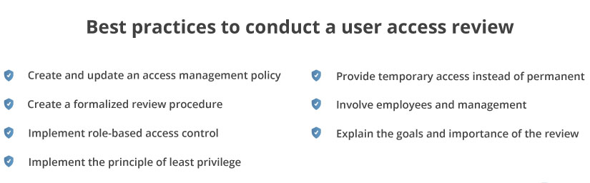
CCSP QUESTION 44
Who should be involved in review and maintenance of user accounts/access?
A. The user’s manager
B. The security manager
C. The accounting department
D. The incident response team

Slide 45
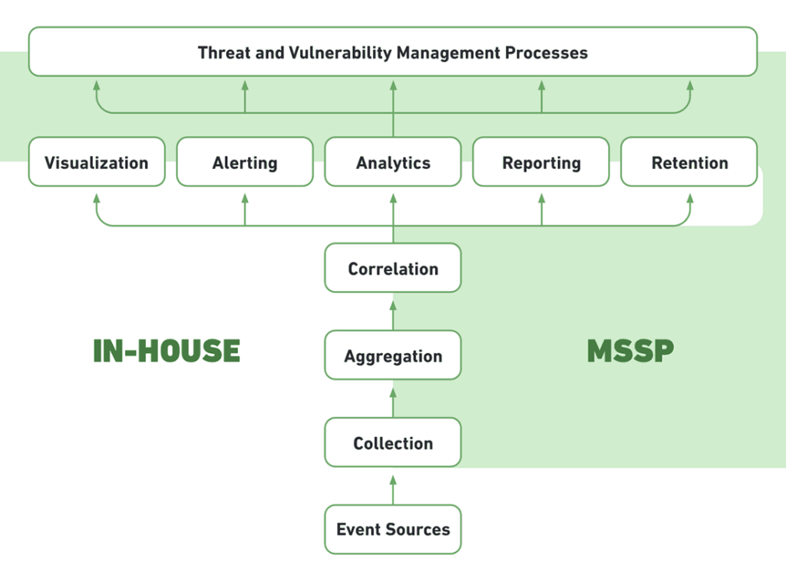
CCSP QUESTION 45
Which of the following is NOT a core component of an SIEM solution?
Correlation
B. Aggregation
C. Compliance
D. Escalation
12 Components and Capabilities in a SIEM Architecture
*Threat Intelligence * Threat Intelligence Feeds.
* Correlation and Security Monitoring * Analytics * Alerting * Dashboards * Compliance * Retention * Forensic Analysis * Threat Hunting * Incident Response * SOC Automation

Slide 46
CCSP QUESTION 46
Which of the following is a method for apportioning resources that involves setting maximum usage amounts for all tenants/customers within the environment?
Response:
A. Reservations
B. Shares
C. Cancellations
D. Limits
Example: limits.cpu: "4" limits.memory: "2Gi"

Slide 47
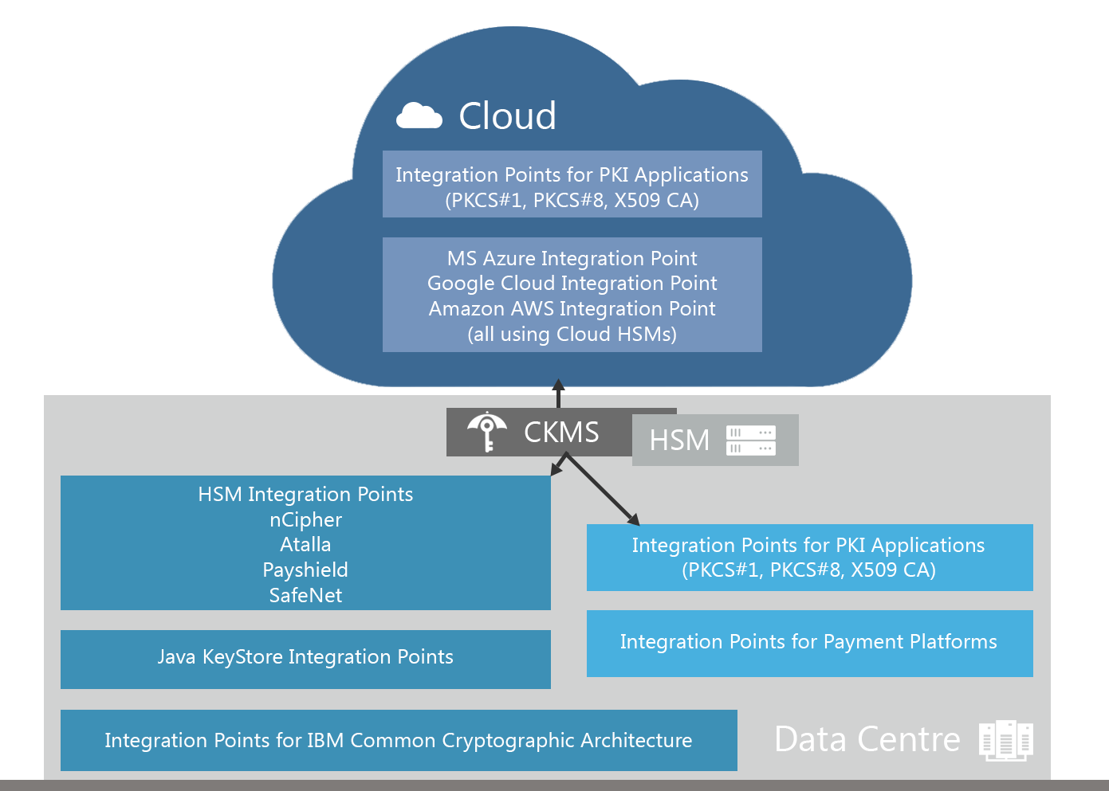
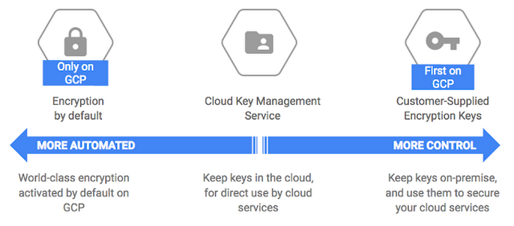
CCSP QUESTION 47
Cloud data encryption situation where the cloud customer retains control of the encryption keys, and the cloud provider only processes and stores the data could be considered a ______.
Response:
Threat
B. Risk
C. Hybrid cloud deployment model
D. Case of infringing on the rights of the provider

Slide 48
CCSP QUESTION 48
What is the risk to the organization posed by dashboards that display data discovery results?
Response:
A. Increased chance of external penetration
B. Flawed management decisions based on massaged displays
C. Higher likelihood of inadvertent disclosure
D. Raised incidence of physical theft

Slide 49
CCSP QUESTION 49
An organization could have many reasons that are common throughout the industry to activate a BCDR situation. Which of the following is NOT a typical reason to activate a BCDR plan?
Response:
A. Natural disaster
B. Utility outage
C. Staff loss
D. Terrorist attack

Slide 50
CCSP QUESTION 50
Although performing BCDR tests at regular intervals is a best practice to ensure processes and documentation are still relevant and efficient, which of the following represents a reason to conduct a BCDR review outside of the regular interval?
Response:
A. Staff changes
B. Application changes
C. Regulatory changes
D. Management changes

Slide 51
CCSP QUESTION 51
Resolving resource contentions in the cloud will most likely be the job of the ______.
Response:
A. Router
B. Emulator
C. Regulator
D. Hypervisor

Slide 52
CCSP QUESTION 52
Before deploying a specific brand of virtualization toolset, it is important to configure it according to ______ .
Response:
A. Industry standards
B. Prevailing law of that jurisdiction
C. Vendor guidance
D. Expert opinion

Slide 53
CCSP QUESTION 53
What is the most secure form of code testing and review?
Response:
A. Open source
B. Proprietary/internal
C. Neither open source nor proprietary
D. Combination of open source and proprietary

Slide 54
CCSP QUESTION 54
In application-level encryption, where does the encryption engine reside?
Response:
A. In the application accessing the database
B. In the OS on which the application is run
C. Within the database accessed by the application
D. In the volume where the database resides

Slide 55
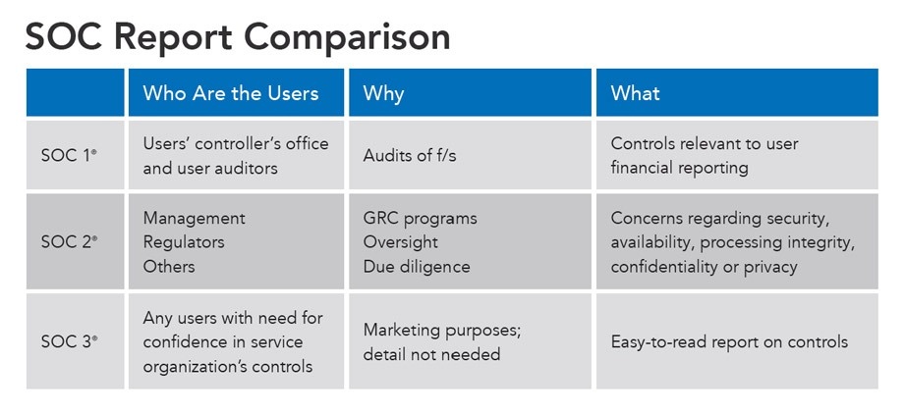
CCSP QUESTION 55
SOC 2 reports were intended to be ______.
Response:
A. Released to the public
B. Only technical assessments
C. Retained for internal use
D. Nonbinding

Slide 56
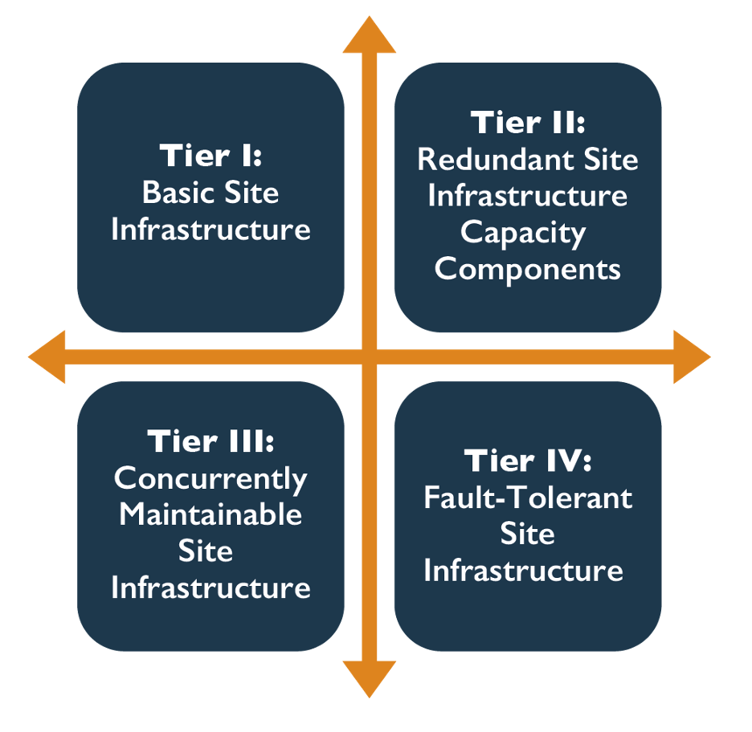
CCSP QUESTION 56
Which of the following is the correct name for Tier II of the Uptime Institute Data Centre Site Infrastructure Tier Standard Topology?
Response:
Concurrently Maintainable Site Infrastructure
B. Fault-Tolerant Site Infrastructure
C. Basic Site Infrastructure
D. Redundant Site Infrastructure Capacity Components

Slide 57
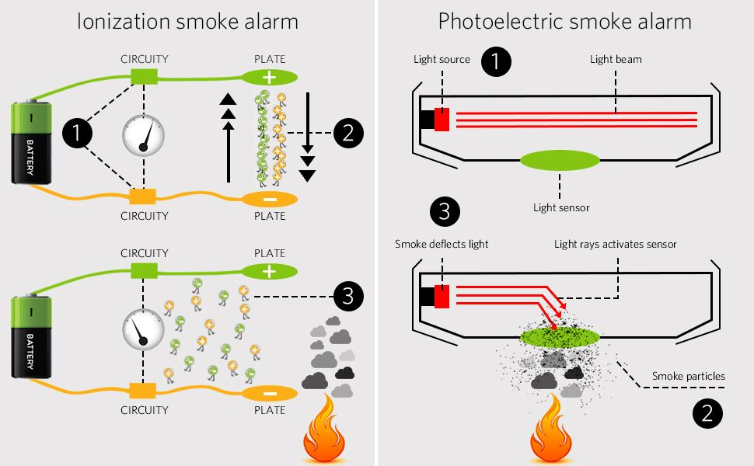
CCSP QUESTION 57
There are two general types of smoke detectors. Which type uses a small portion of radioactive material?
Response:
Photoelectric
B. Ionization
C. Electron pulse
D. Integral field

Slide 58
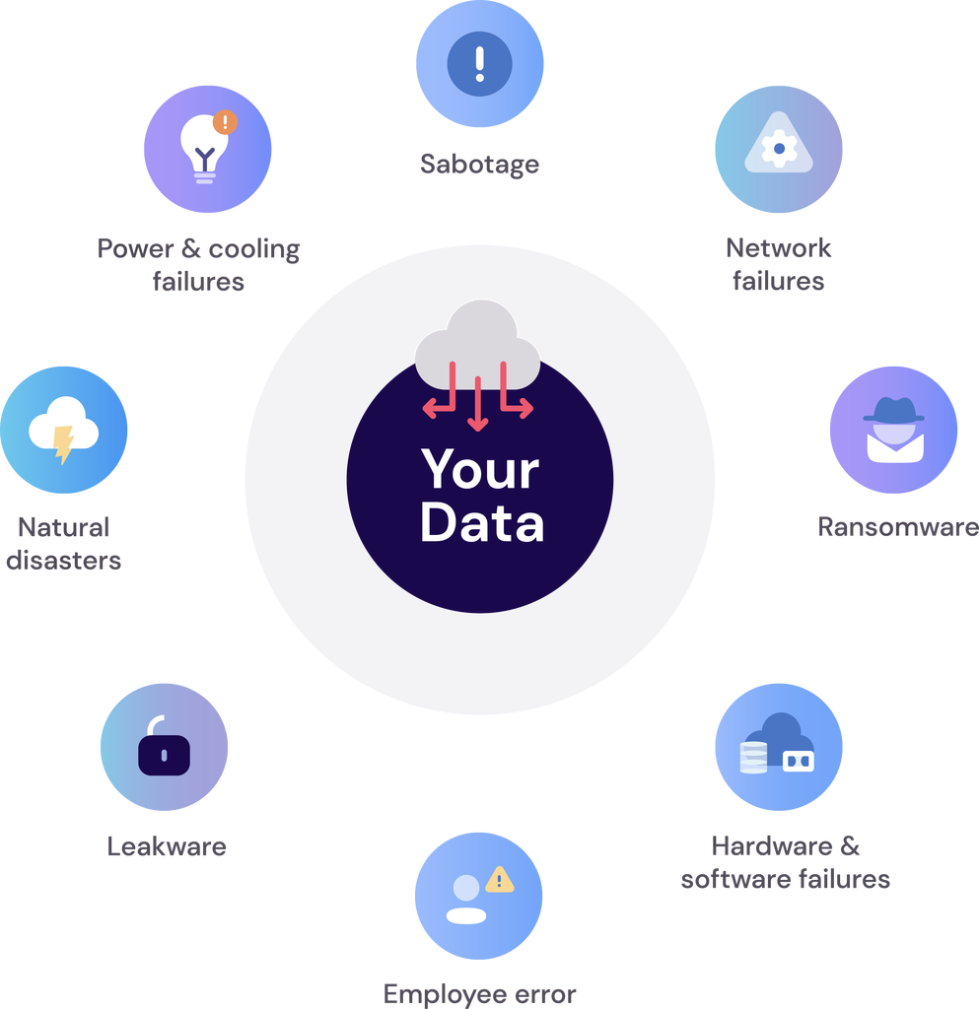
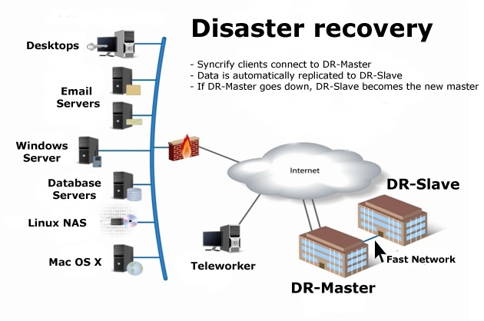
CCSP QUESTION 58
Which of the following is not typically included in the list of critical assets specified for continuity during BCDR contingency operations?
Response:
A. Systems
B. Data
C. Cash
D. Personnel

Slide 59
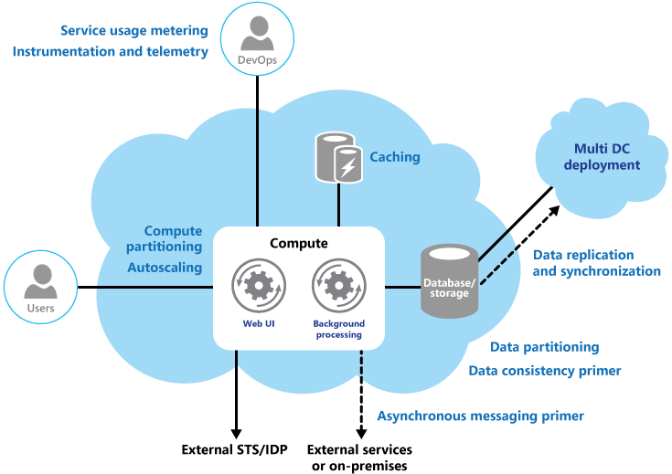
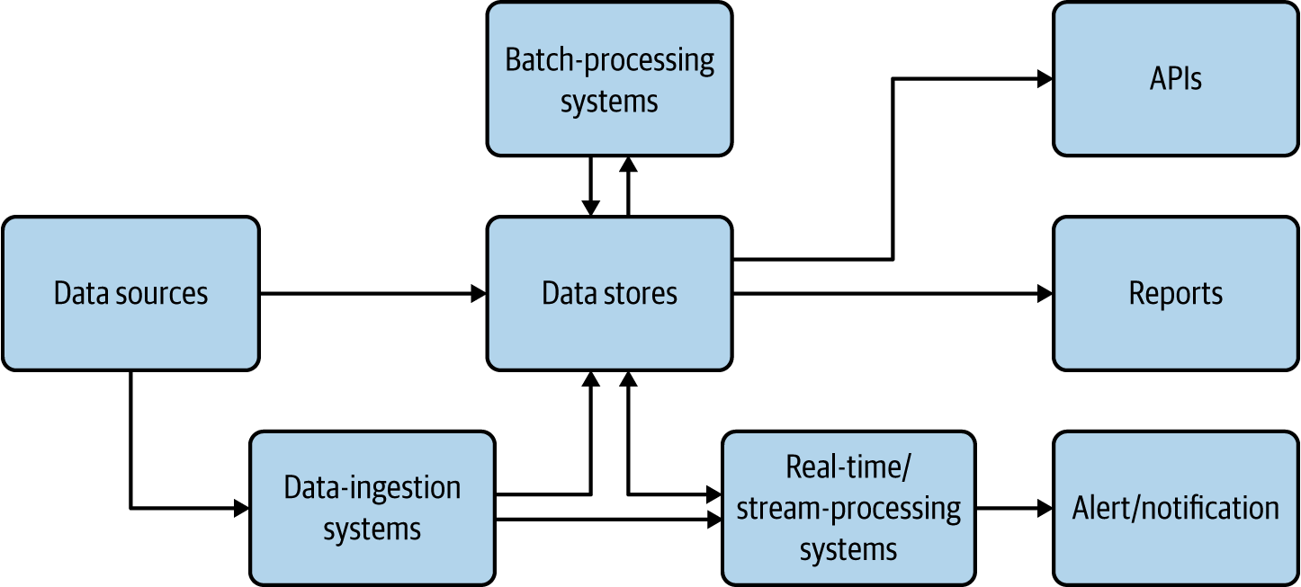
CCSP QUESTION 59
In the cloud motif, the data processor is usually:
Response:
The party that assigns access rights
B. The cloud customer
C. The cloud provider
D. The cloud access security broke
In legal terms, when "data processor" is defined, it refers to anyone who stores, handles, moves, or manipulates data on behalf of the data owner or controller. In the cloud computing realm, this is the cloud provider.

Slide 60
CCSP QUESTION 59
Data transformation in a cloud environment should be of great concern to organizations considering cloud migration because ______ could affect data classification processes/implementations.
Response:
A. Multitenancy
B. Virtualization
C. Remote access
D. Physical distance

