Slide 1
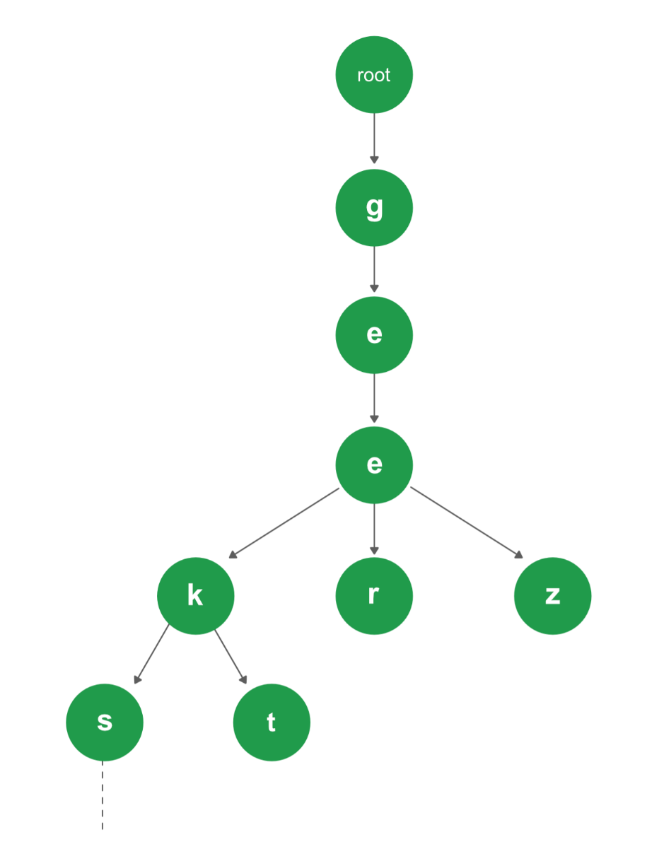
Dictionary
DSA-II Mini Project
Mentor: Srida Kalamkar Ma'am
Adesh Shahadeo Choudhar
MIS: 111903008

Slide 2
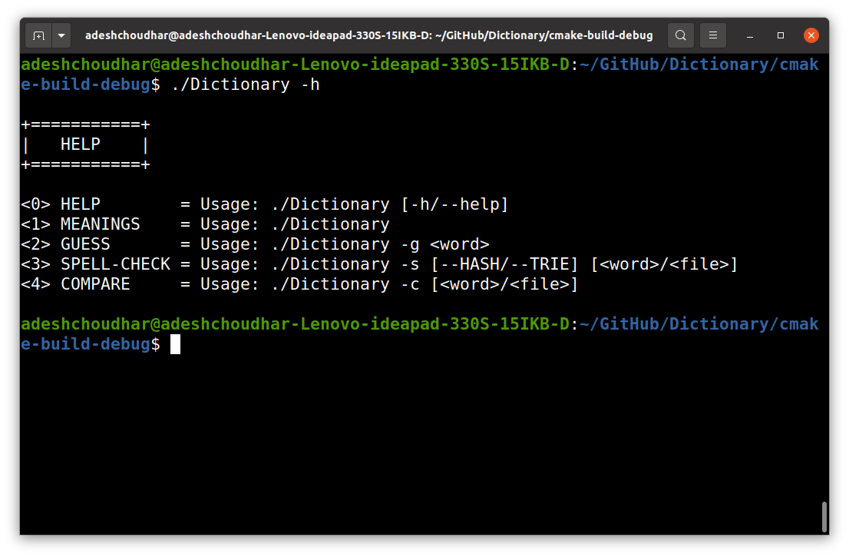
Features
2 Important DS: HASH and TRIE
Meaning(s) of a word
Guessing/Suggesting words
Spell-Checking a word/file
Listing all misspelled words and Text Correctness (in %)
Elaborate Time-Memory Analysis
Comparison between two data structures using graphs for spell-checking process

Slide 3
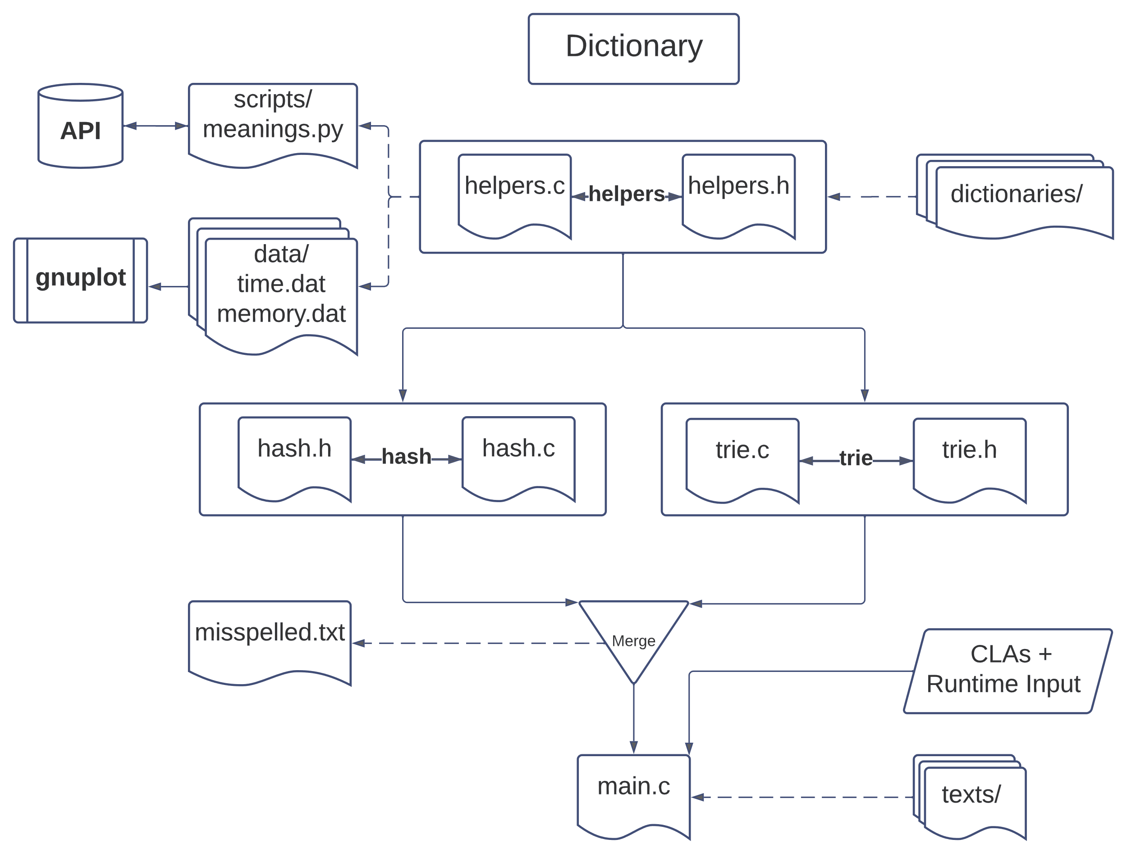
Structure of Project

Slide 4
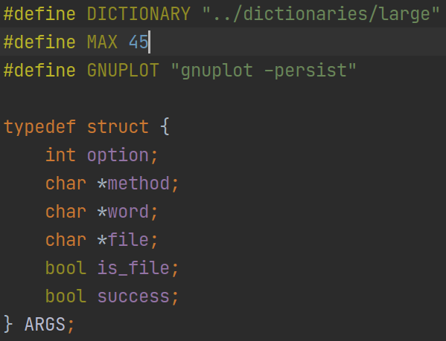
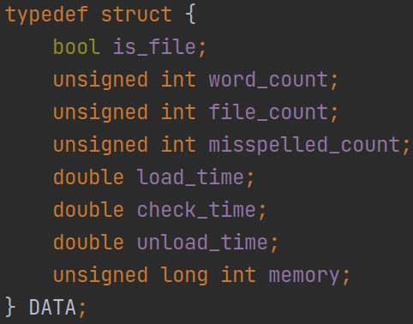
ARGS & DATA
DICTIONARY: Path to dictionary file
MAX: Maximum length of word is 45 (pneumonoultramicroscopicsilicovolcanoconiosis)
GNUPLOT: gnuplot pipeline

Slide 5
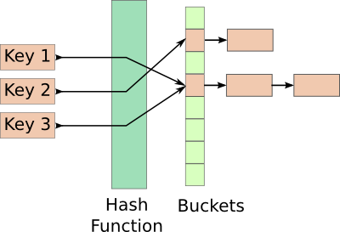
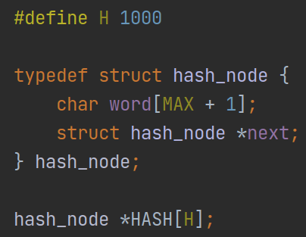
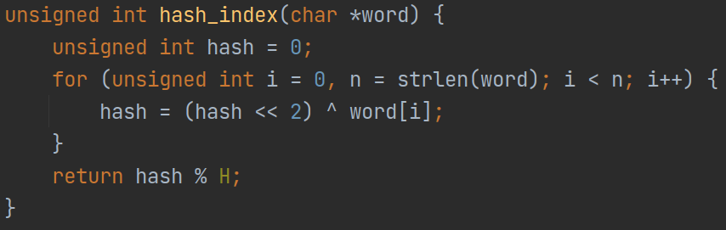
HASH
Hash table (HASH) is an array of 1000 elements (hash_node)
word: char array to store value
next: pointer to next node in linked list
Node
Hash function (hash_index) returns a value between 0 to 999 which is essentially will be the index for our hash table (HASH)

Slide 6
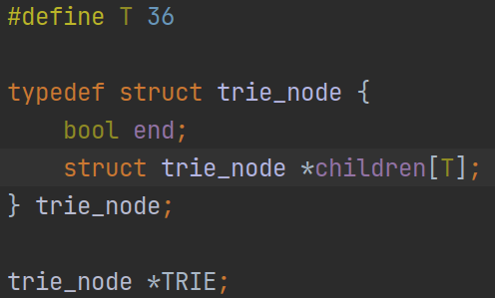
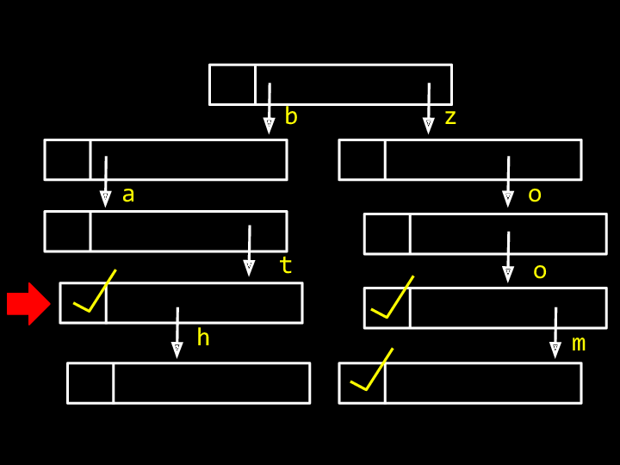
TRIE
T is number of children for each node; 26 [a-z] + 10[0-9] = 36
TRIE is the root node of the whole structure of dictionary
TRIE
NODE
end: a boolean value to tell us whether a word is complete or not
children: array of pointers to nodes (trie_node) beneath them

Slide 7

Let’s ahead over to see some actual code …

Slide 8
More interesting points...
No memory leak: Both HASH and TRIE passes valgrind memory checks
Input: Alphanumeric input [A-Z, a-z, 0-9], cleans & validates input
Extra Validation Checks: AlphaNumeric, Numbers, Ordinals, etc
Consistent: Both HASH and TRIE give exact same output
Diverse: DS, Algorithms, API, hash functions, gnuplot, pipelining, files, valgrind, etc
Full Proof (maybe): Invalid inputs, stack smashing, errors, corner-cases are handled

Slide 9
Research & Resources & Links
https://cs50.harvard.edu/x/2020/psets/5/speller/
https://dictionaryapi.dev/
https://www.geeksforgeeks.org/data-structure-dictionary-spell-checker/
https://www.techiedelight.com/trie-implementation-insert-search-delete/
http://www.gnuplot.info/links.html
Extras:
https://curl.se/libcurl/c/example.html
https://www.geeksforgeeks.org/ternary-search-tree/

Slide 10

Thank You!

