Slide 1

FILTER
RPP-OOP Project
Mentor: Sheetal RAthod Ma'am
Aakanksha Sonawane : 111903001
Adesh Choudhar: 111903008
Akanksha Desai: 111903011

Slide 2
FEATURES
Various Types of Filters
Important Algorithms of ML/AI
Explored various programming paradigms
3 Phase Work: Terminal, OOP, Django

Slide 3
Filters we are using…
Basic:
Color (Grayscale, Sepia, Sketch, Inversion)
Rotation (Left, Right)
Advanced:
Blur (Box Blur)
Edges (Sobel Algorithm)
Reflection (Mirror, Water)

Slide 4
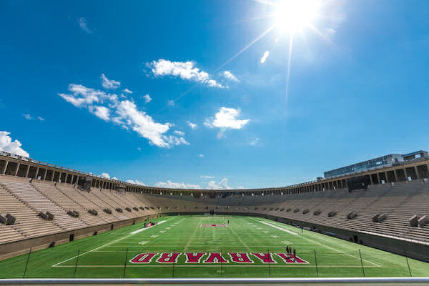
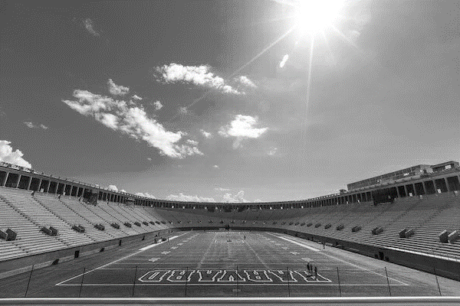
EXPECTED RESULT(S)
Normal
BLACK & WHITE

Slide 5
TERMINAL
Basic Terminal Application
Filters taken as Command-Line Arguments
OpenCV, Numpy are used
Python

Slide 6
OOP
Python Library
Classes within Classes
Same functions as Terminal
Python (OpenCV, Numpy)

Slide 7

Let’s go to see some code …

Slide 8
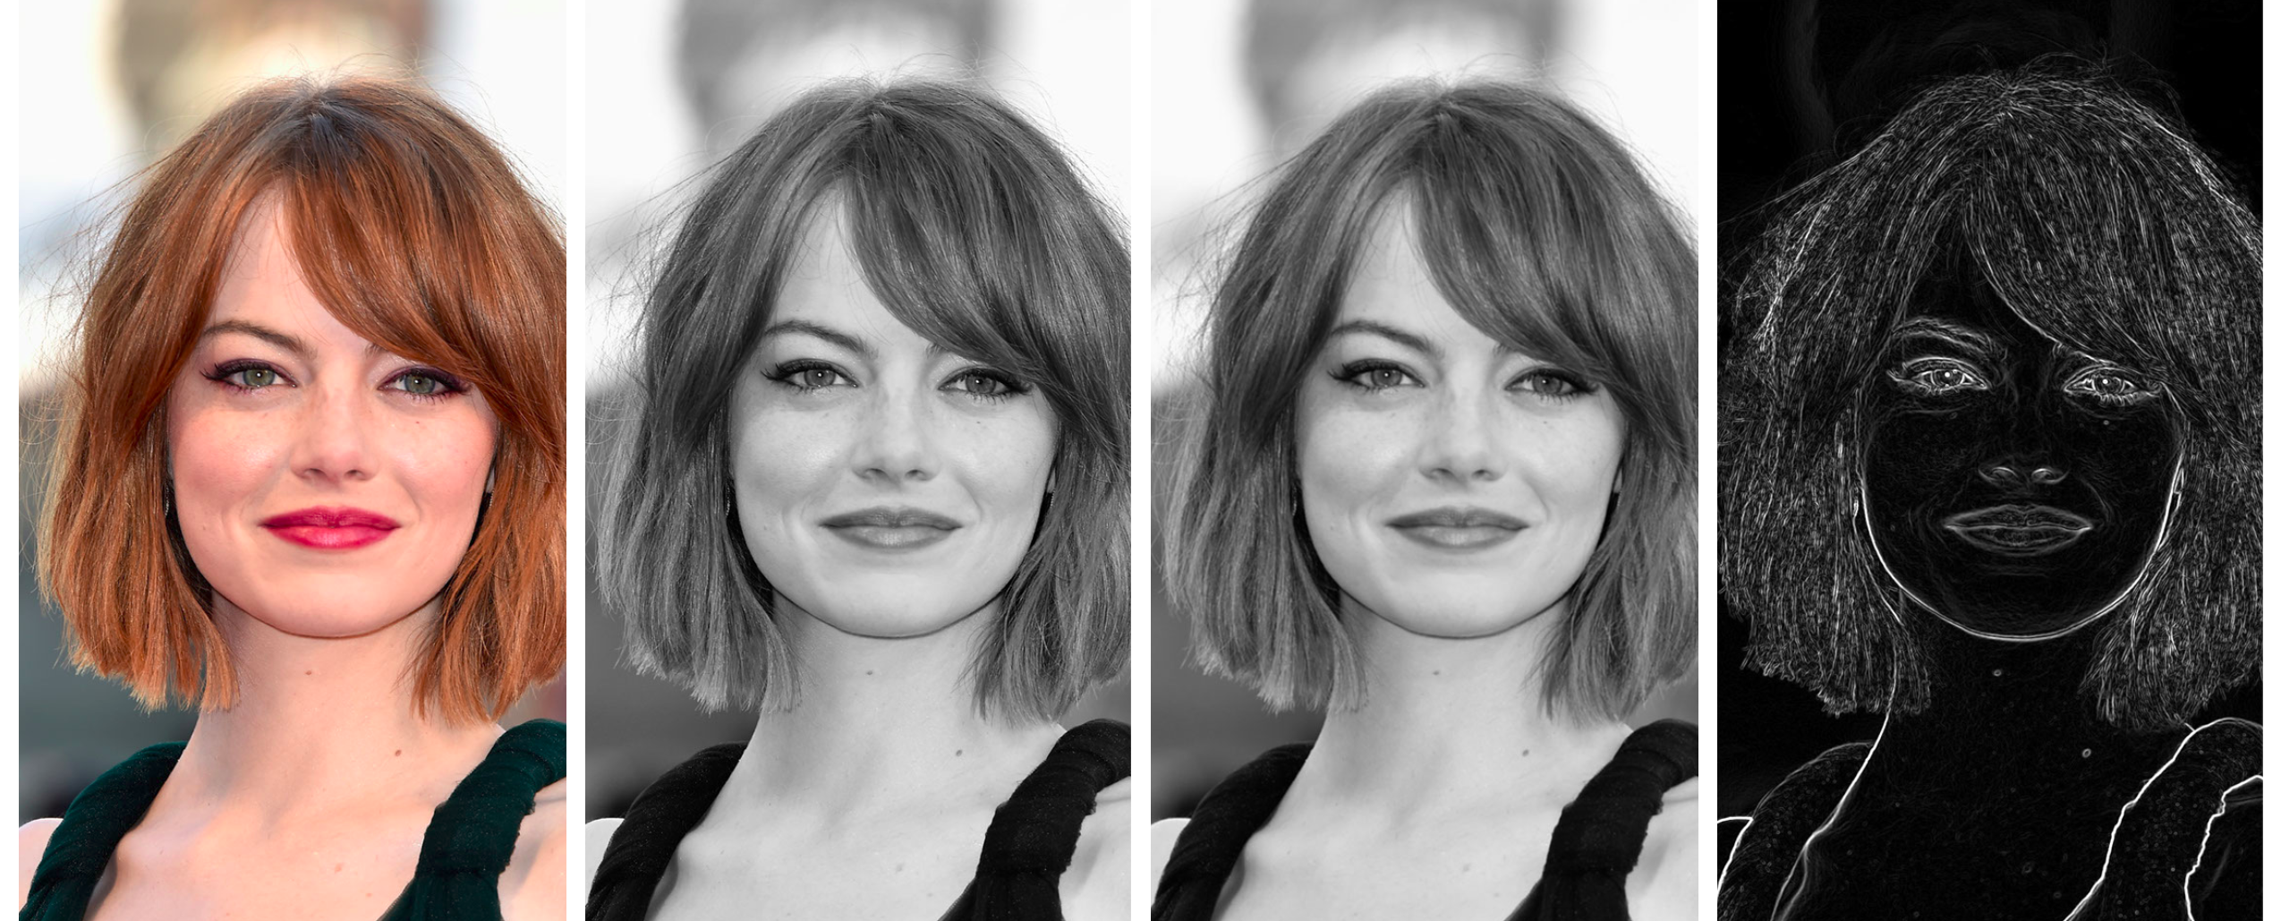
Example: Canny Edge Detection

Slide 9
REFERENCES
https://cs50.harvard.edu/x/2021/psets/4/filter/more/
https://www.youtube.com/watch?v=Nn7EX3zkGUo&list=PLhQjrBD2T380xvFSUmToMMzERZ3qB5Ueu
https://medium.com/analytics-vidhya/how-to-create-a-python-library-7d5aea80cc3f
https://getbootstrap.com/docs/5.0/getting-started/introduction/

Slide 10

Thank You!

