Slide 1

Siddaganga Institute of Technology
An autonomous Institute ,Affiliated to VTU Belagavi ,Approved by AICTE
B.H.Road ,Tumkur – 572103 ,Karnataka ,India
Mini Project – Battery Monitoring System
Adesh Sinha (1SI19EE003)
Abhineet Kamal (1SI19EE001)
Ayush Raj (1SI19EE008)
Mousam Kumar (1SI19EE030)
Guide : K.C.Rupesh
Assistant Professor ,Department of Electrical and Electronics
SIT ,TUMKUR – 572103
DEPARTMENT OF ELECTRICAL AND ELECTRONICS ENGINEEGING
2021 - 2022
Department of Electrical and Electronics Engineering

Slide 2
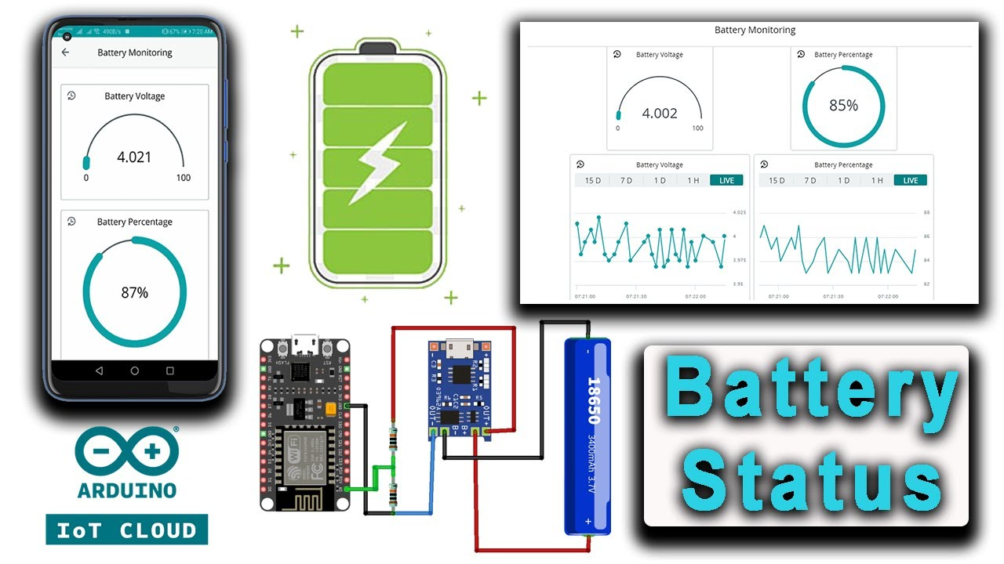
Siddaganga Institute of Technology
An autonomous Institute ,Affiliated to VTU Belagavi ,Approved by AICTE
B.H.Road ,Tumkur – 572103 ,Karnataka ,India
Mini Project Presentation
Battery
Monitoring
System
Department of Electrical and Electronics Engineering

Slide 3
Siddaganga Institute of Technology
An autonomous Institute ,Affiliated to VTU Belagavi ,Approved by AICTE
B.H.Road ,Tumkur – 572103 ,Karnataka ,India
Content
INTRODUCTION
NEED OF BATTERY MONITORING SYSTEM
LITRATURE SURVEY
BLOCK DIAGRAM
REQUIREMENT
WORK COMPLETED
RESULT
WORK TO BE DONE
Department of Electrical and Electronics Engineering

Slide 4
Siddaganga Institute of Technology
An autonomous Institute ,Affiliated to VTU Belagavi ,Approved by AICTE
B.H.Road ,Tumkur – 572103 ,Karnataka ,India
INTRODUCTION
Battery Monitoring System (BMS) is enhanced to provide a better performance and to monitor the operational system, performance and battery life such as charge and discharge process.
It consists of measuring devices to measure parameters such as battery voltage, current, efficiency, rate of charging and discharging and temperature. These parameters can be processed to estimate the state of charge and state of health of the battery.
The BMS sends alerts of battery parameters during exigencies, battery summary through E-mail/SMS. It also provides warnings of impending malfunction of voltage, current and temperature and displays the status of system on screen.
Department of Electrical and Electronics Engineering

Slide 5
Siddaganga Institute of Technology
An autonomous Institute ,Affiliated to VTU Belagavi ,Approved by AICTE
B.H.Road ,Tumkur – 572103 ,Karnataka ,India
NEED OF BATTERY MONITORING SYSTEM
To prevent battery failure and mitigate potential hazardous situations, there is a need for a supervising system that ensures that batteries function properly in the final application. This supervising system is referred to as a Battery Monitoring System (BMS).
Battery Monitoring System is an analogue and/or digital electronic hardware device complemented with specific software, that is added to a battery system.
The primary function of a BMS is to fulfil safety requirements. But there's more to it. Objectives related to the more efficient usage of battery cells and a prolongation of their lifetime are also being increasingly integrated into the design of BMS.
Department of Electrical and Electronics Engineering

Slide 6
Siddaganga Institute of Technology
An autonomous Institute ,Affiliated to VTU Belagavi ,Approved by AICTE
B.H.Road ,Tumkur – 572103 ,Karnataka ,India
LITRATURE SURVEY
Name of the paper | Year of publication | Conclusion
1 . Efficient Battery Monitoring System for E-Vehicles | 2021 | This battery monitoring system for electric vehicles can be used to monitor the real time health of the batteries present in electric cars, bikes or trucks.
2 . Experimental Battery Monitoring System Design for Electric Vehicle Applications . | 2018 | This paper presents a detailed experimental design for a BMS with applications in electric vehicles. The functionality and the accuracy of sensors, processor and communications are discussed.
3 . Research on Li-ion Battery Management System . | 2010 | This paper centers on measurement of battery voltage, temperature , voltage and battery current.
Department of Electrical and Electronics Engineering

Slide 7
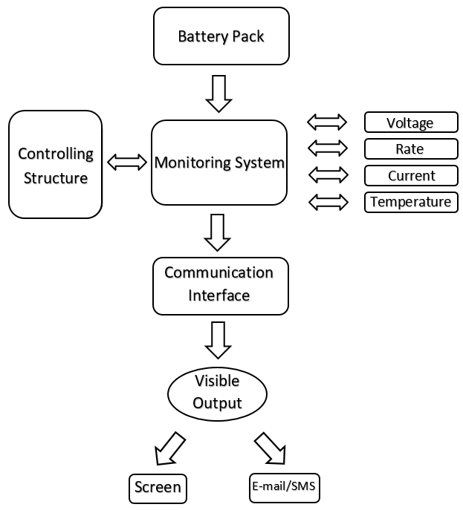
Siddaganga Institute of Technology
An autonomous Institute ,Affiliated to VTU Belagavi ,Approved by AICTE
B.H.Road ,Tumkur – 572103 ,Karnataka ,India
BLOCK DIAGRAM
Department of Electrical and Electronics Engineering

Slide 8
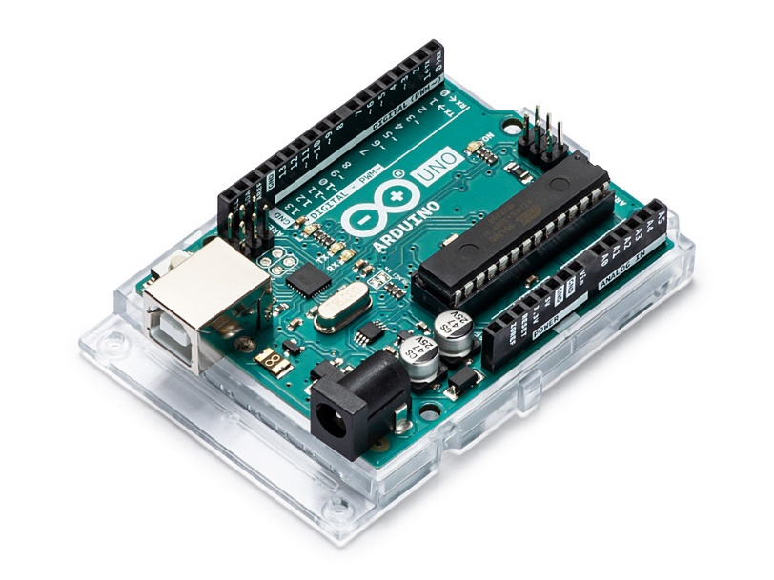
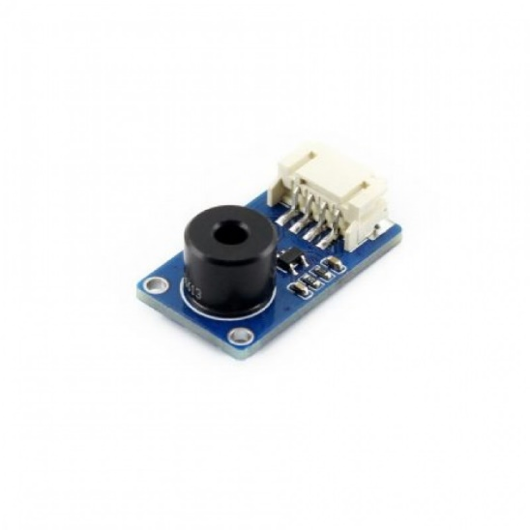
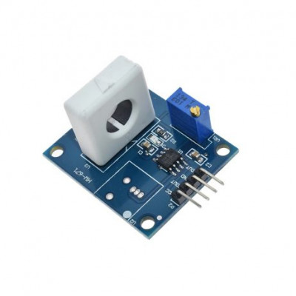
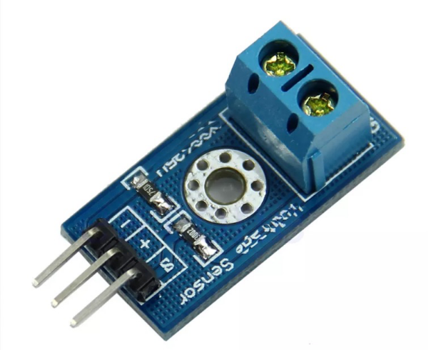
Siddaganga Institute of Technology
An autonomous Institute ,Affiliated to VTU Belagavi ,Approved by AICTE
B.H.Road ,Tumkur – 572103 ,Karnataka ,India
REQUIREMENT
Arduino
Current sensor
Voltage sensor
Temperature sensor
Department of Electrical and Electronics Engineering

Slide 9
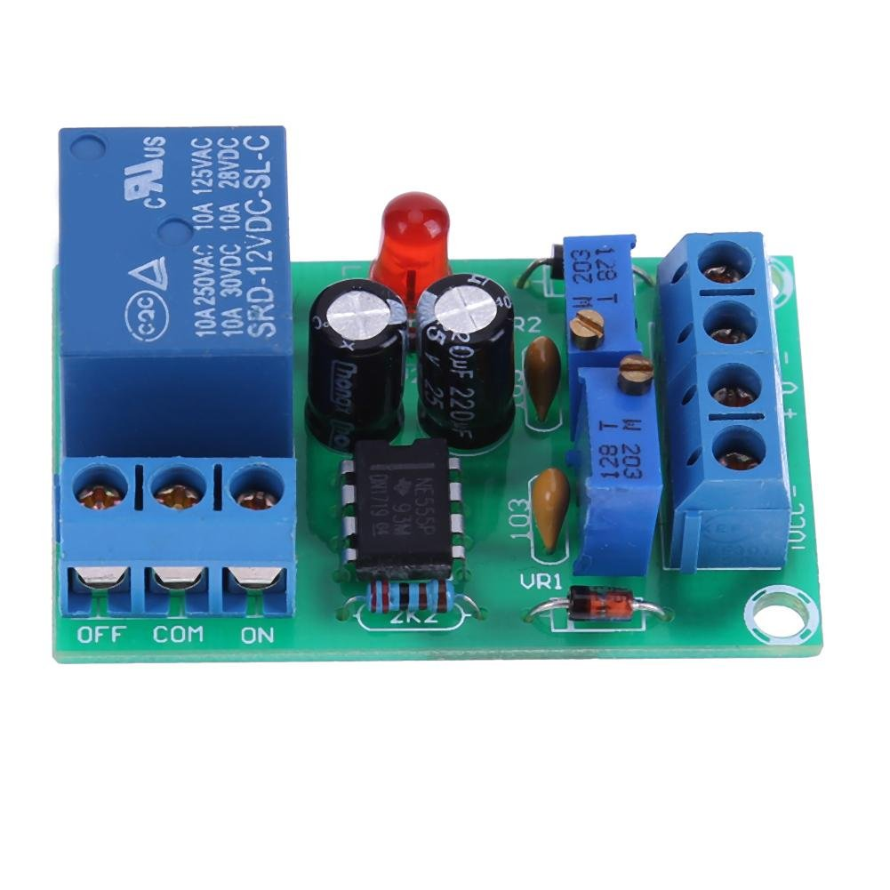
Siddaganga Institute of Technology
An autonomous Institute ,Affiliated to VTU Belagavi ,Approved by AICTE
B.H.Road ,Tumkur – 572103 ,Karnataka ,India
The battery protection relay’s main function is to protect the battery from getting damaged or damaging the other battery of the battery bank .As soon as the condition of the battery gets to undesirable change the supply is cut off of the battery and from the battery thus saving the battery from any damage.
Department of Electrical and Electronics Engineering

Slide 10
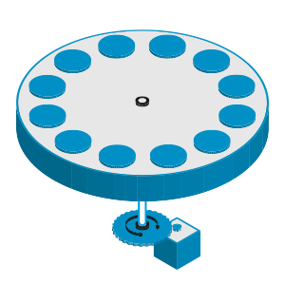
Siddaganga Institute of Technology
An autonomous Institute ,Affiliated to VTU Belagavi ,Approved by AICTE
B.H.Road ,Tumkur – 572103 ,Karnataka ,India
The circular rotating disk is specific to the electronic cars .Here the battery bank utilizes the battery and as soon the battery hits the specified usage mark it gets switched by another battery from the battery bank .The used battery now gets to charging position and another battery gets to utilization .
Department of Electrical and Electronics Engineering

Slide 11
Siddaganga Institute of Technology
An autonomous Institute ,Affiliated to VTU Belagavi ,Approved by AICTE
B.H.Road ,Tumkur – 572103 ,Karnataka ,India
WORK COMPLETED :
Circuit designing completed.
Measurement of parameter(voltage , current, temperature, state of health , state of charge(discharging rate)).
Changing the position of the battery.
Department of Electrical and Electronics Engineering

Slide 12
Siddaganga Institute of Technology
An autonomous Institute ,Affiliated to VTU Belagavi ,Approved by AICTE
B.H.Road ,Tumkur – 572103 ,Karnataka ,India
RESULT :
The battery monitoring system presents the required parameters on the serial monitor screen, further helping in calculation of SOC (State of Charge), SOH (State of Health) and the
SOA (Safe Operation Area)
Department of Electrical and Electronics Engineering

Slide 13
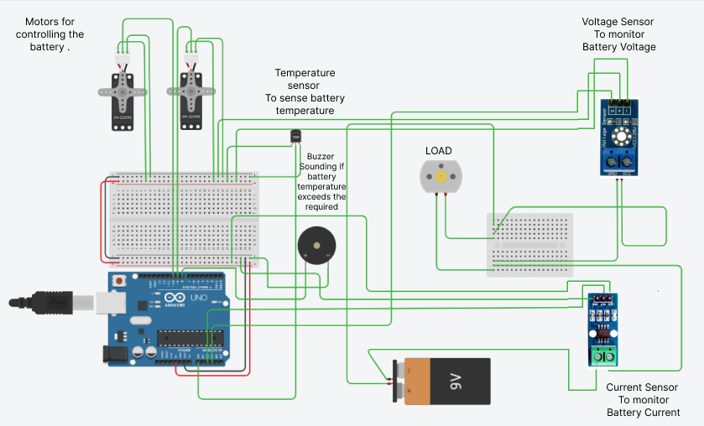
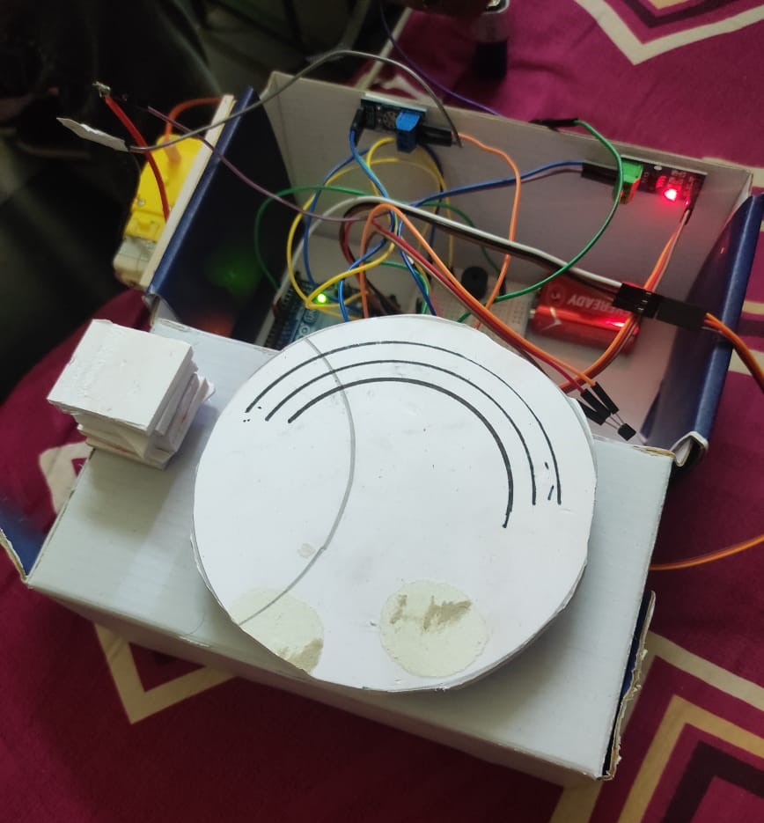
Siddaganga Institute of Technology
An autonomous Institute ,Affiliated to VTU Belagavi ,Approved by AICTE
B.H.Road ,Tumkur – 572103 ,Karnataka ,India
Fig circuit diagram
Working Model diagram
Department of Electrical and Electronics Engineering

Slide 14
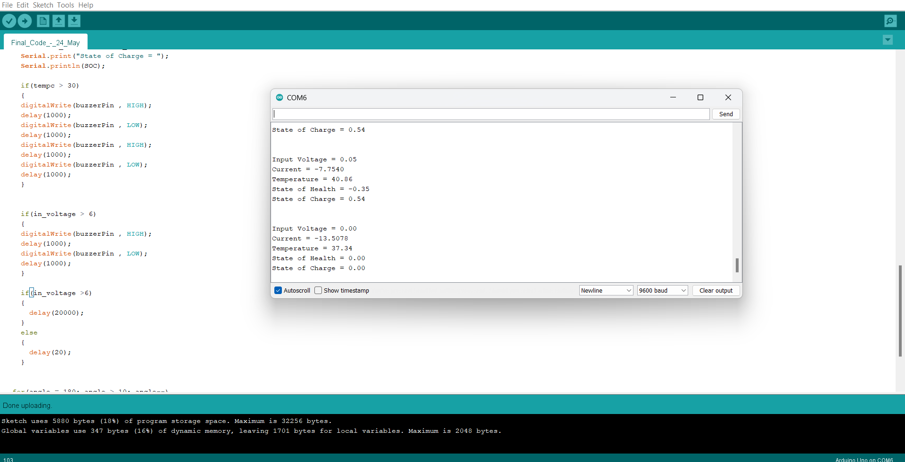
Siddaganga Institute of Technology
An autonomous Institute ,Affiliated to VTU Belagavi ,Approved by AICTE
B.H.Road ,Tumkur – 572103 ,Karnataka ,India
Serial Monitor
Screen-shot
Department of Electrical and Electronics Engineering

Slide 15
Siddaganga Institute of Technology
An autonomous Institute ,Affiliated to VTU Belagavi ,Approved by AICTE
B.H.Road ,Tumkur – 572103 ,Karnataka ,India
SOH (State of Health) :
State of health (SOH) is a figure of merit of the condition of a battery (or a cell, or a battery pack), compared to its ideal conditions. The units of SOH are percent points (100% = the battery's conditions match the battery's specifications).
Typically, a battery’s SOH will be 100% at the time of manufacture and will decrease over time and use.
SOH = Total Capacity (Ah) / BOL Capacity (Ah)
( BOL – Beginning of life )
Alternatively battery Impedance can also be used for SOH calculation.
Department of Electrical and Electronics Engineering

Slide 16
Siddaganga Institute of Technology
An autonomous Institute ,Affiliated to VTU Belagavi ,Approved by AICTE
B.H.Road ,Tumkur – 572103 ,Karnataka ,India
Capacity (Ah)
Impedance
Charge Cycles
Department of Electrical and Electronics Engineering

Slide 17
Siddaganga Institute of Technology
An autonomous Institute ,Affiliated to VTU Belagavi ,Approved by AICTE
B.H.Road ,Tumkur – 572103 ,Karnataka ,India
SOC (State of Charge) :
State of charge (SOC) is the level of charge of an electric battery relative to its capacity. The units of SOC are percentage points (0% = empty; 100% = full). An alternative form of the same measure is the depth of discharge (DOD), the inverse of SOC (100% = empty; 0% = full).
SOC is normally used when discussing the current state of a battery in use, while DOD is most often seen when discussing the lifetime of the battery after repeated use.
SOC = Capacity Remaining (Ah) / Total Capacity of battery (Ah)
Alternatively open circuit voltage can also be used for SOC calculation.
Department of Electrical and Electronics Engineering

Slide 18
Siddaganga Institute of Technology
An autonomous Institute ,Affiliated to VTU Belagavi ,Approved by AICTE
B.H.Road ,Tumkur – 572103 ,Karnataka ,India
Voltage (Volts)
Ah
Department of Electrical and Electronics Engineering

Slide 19
Siddaganga Institute of Technology
An autonomous Institute ,Affiliated to VTU Belagavi ,Approved by AICTE
B.H.Road ,Tumkur – 572103 ,Karnataka ,India
SOA (Safe Operation Area) :
For battery, the safe operating area (SOA) is defined as the voltage and temperature conditions over which the battery can be expected to operate without self-damage and best output performance.
SOA
Voltage (Volts)
Temperature
Department of Electrical and Electronics Engineering

Slide 20
Siddaganga Institute of Technology
An autonomous Institute ,Affiliated to VTU Belagavi ,Approved by AICTE
B.H.Road ,Tumkur – 572103 ,Karnataka ,India
WORK TO BE DONE :
Analysis of the parameter.
Showing the parameter through cloud computing.
Adding the relay to the circuit.
Department of Electrical and Electronics Engineering

Slide 21
Siddaganga Institute of Technology
An autonomous Institute ,Affiliated to VTU Belagavi ,Approved by AICTE
B.H.Road ,Tumkur – 572103 ,Karnataka ,India
Thank you
Department of Electrical and Electronics Engineering

