Slide 1

Seasonal Agriculture Performance Analysis
Analysing Crop Yield, Environmental Conditions, Farm Inputs & Resource Efficiency
ADESH V
Hindustan Institute of Technology and Science
AICTE STU ID : STU6a6053ffcdac21784697855

Slide 2

PROBLEM STATEMENT
Agricultural productivity varies across crops, seasons, locations and farming practices. This analysis aims to identify the key factors associated with higher yield and better resource efficiency.
Objectives:
Compare agricultural performance across seasons and crops
Identify high- and low-yield segments
Analyse environmental and farm-management factors
Evaluate irrigation methods and water efficiency
Generate evidence-based recommendations

Slide 3
Project Description Seasonal Agriculture Performance Analysis is a data analytics project focused on evaluating agricultural productivity across different crops, seasons, states, environmental conditions, farm inputs, irrigation methods, and resource-efficiency measures. Using a dataset of 4,000 farm records, the project analyses yield patterns, identifies high and low-performing farms, examines relationships between agricultural factors and yield, and evaluates irrigation and water-use efficiency. The analysis uses data cleaning, exploratory data analysis, statistical analysis, correlation analysis, yield segmentation, and comparative techniques to generate data-driven insights and practical recommendations for improving agricultural productivity and resource management.

Slide 4

WHO ARE THE END USERS?
Farmers & Farm Managers – To improve crop productivity, irrigation, and resource utilization.
Agricultural Consultants – To provide data-driven recommendations for crop and farm management.
Agribusiness & Input Companies – To understand crop performance and optimize agricultural inputs.
Government & Agricultural Departments – To support regional and seasonal agricultural planning.
Agricultural Researchers & Analysts – To identify yield patterns and study factors influencing farm performance.
Business Objective
Identify the major factors associated with agricultural yield and resource efficiency to support better crop, irrigation, and farm-management decisions.

Slide 5

Technology Used
Python – Data analysis and processing
Jupyter Notebook – Interactive analysis and documentation
Pandas – Data cleaning, manipulation, and aggregation
NumPy – Numerical computations
Matplotlib – Data visualization
Seaborn – Statistical charts and visualizations
VS Code – Development and project environment
Microsoft Excel/CSV – Dataset storage and initial data handling
Analysis Methodology
Data Loading → Data Cleaning → EDA → Statistical Analysis → Outlier Analysis → Correlation → Segmentation → Comparative Analysis → Insights → Recommendations

Slide 6
Dataset Overview
Parameter | Details
Records | 4,000 farms
Variables | 28 columns
States | 8
Crops | 8
Seasons | 3
Irrigation Methods | 4
Target Variable | Yield (Tonnes/Ha)

Slide 7
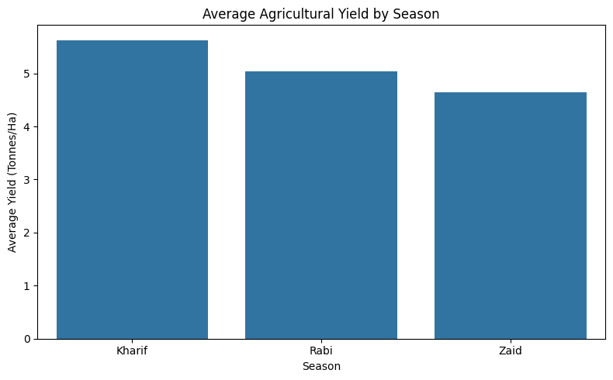
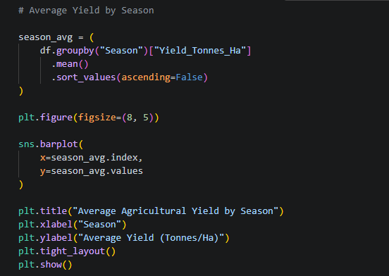
Seasonal Performance
Average Yield by Season
Season | Avg. Yield
Kharif | ~5.63 t/ha
Rabi | ~5.08 t/ha
Zaid | ~4.64 t/ha
Key Insights
Kharif recorded the highest average yield, while Zaid recorded the lowest, indicating seasonal variation in agricultural productivity.

Slide 8
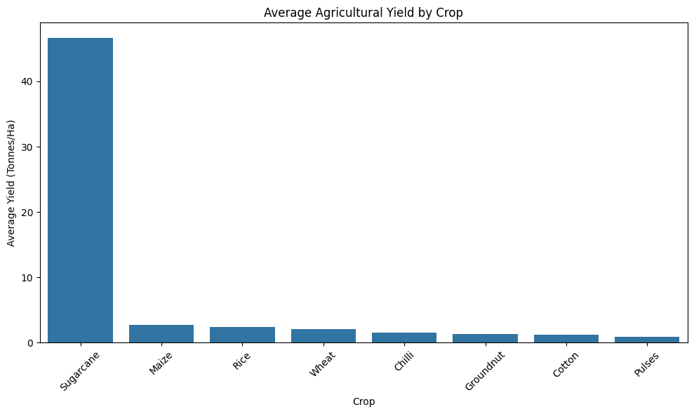
Crop Performance
Average Agricultural Yield by Crop
Key Findings
Sugarcane has the highest average yield, significantly exceeding all other crops.
Maize and Rice follow at much lower yield levels.
Pulses and Cotton record comparatively lower average yields.
Crop type is a major source of variation in agricultural productivity.
Sugarcane recorded a median yield of approximately 47.88 t/ha, substantially higher than the other crops. Crop yields naturally vary by crop type, so comparisons should be interpreted within crop context.

Slide 9
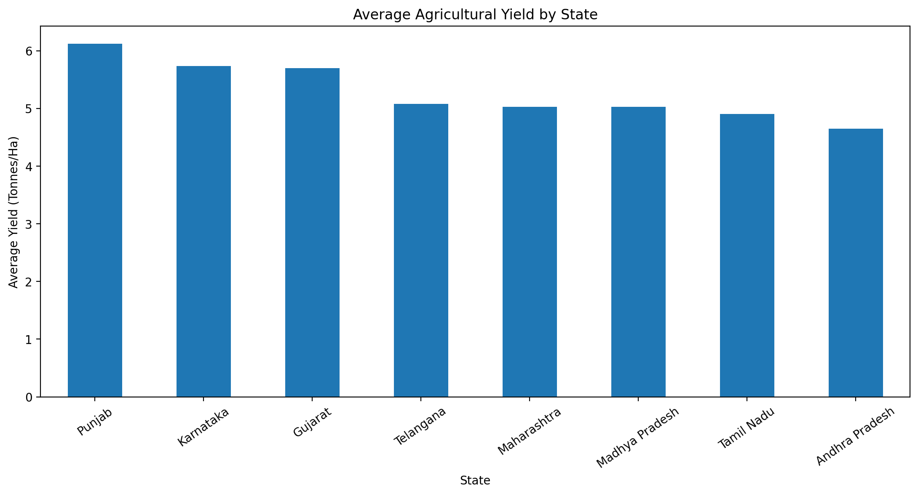
Yield Segmentation & High vs Low Yield
Yield Performance Segmentation: Low Yield → Medium Yield → High Yield
Factor | Low Yield | High Yield
Rainfall | 556.59 mm | 644.11 mm
Soil Moisture | 25.78% | 27.38%
Nitrogen | 116.81 kg/ha | 122.86 kg/ha
Water Used | 4,719.62 m³ | 8,257.30 m³
Water Efficiency | 1.70 | 10.81
Key Insight
High-yield farms experienced higher rainfall and soil moisture and showed substantially higher water-use efficiency than low-yield farms.

Slide 10
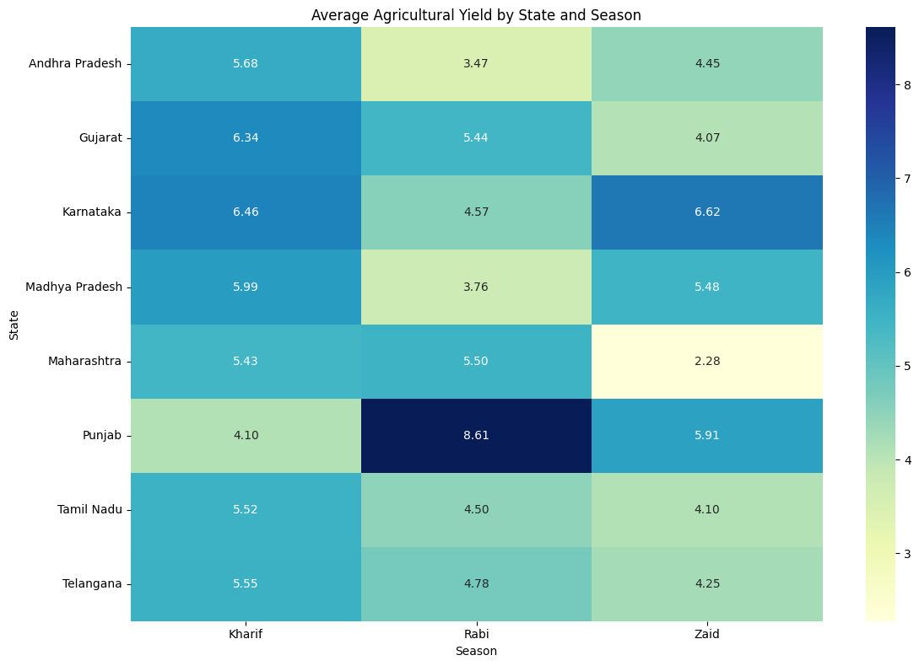
State × Season Analysis
State & Season heatmap

Slide 11
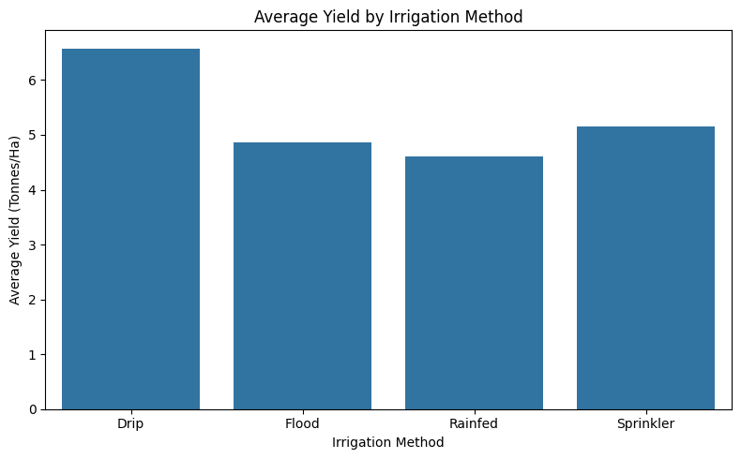
Irrigation Analysis
Irrigation Method vs Agricultural Performance
Method | Avg. Yield | Water Efficiency
Drip | 6.58 | 6.27
Sprinkler | 5.16 | 4.67
Flood | 4.86 | 3.44
Rainfed | 4.60 | 7.56
Key Insight
Drip irrigation achieved the highest average yield, while rainfed farming achieved the highest water efficiency, highlighting a productivity–efficiency trade-off.

Slide 12
Student-Designed Analysis
1. Seed Quality vs Yield
Category | Avg. Yield
Low | 5.12
Medium | 6.19
Good | 4.64
Excellent | 5.03
Finding:
Seed quality did not show a consistent positive relationship with yield.
2. Disease/Pest Risk vs Yield
Risk | Avg. Yield
Low | 4.93
Medium | 5.10
High | 5.85
Very High | 5.09
Finding:
Disease/pest risk showed a non-linear relationship with yield.

Slide 13
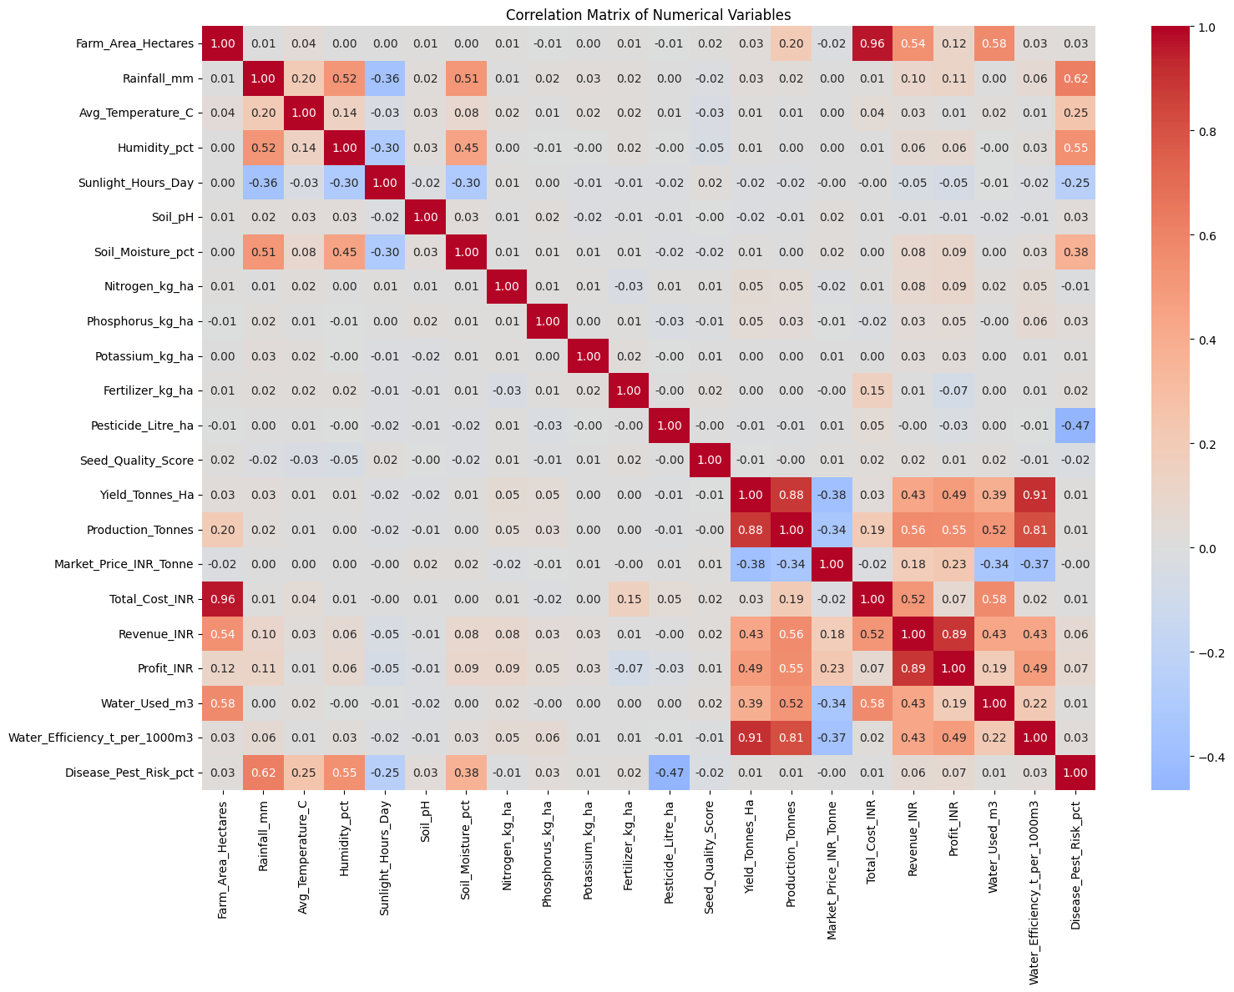
Correlation Analysis
Correlation Heatmap
Category | Avg. Yield
Low | 5.12
Medium | 6.19
Good | 4.64
Excellent | 5.03
Important Interpretation
Water efficiency shows a strong association with yield in the dataset. however, correlation does not establish causation.
Production, revenue and profit are outcome/business variables and should not automatically be interpreted as independent yield drivers.

Slide 14
CONCLUSION
Recommendations
Promote efficient irrigation, particularly drip irrigation where appropriate.
Optimize water allocation according to crop and soil requirements.
Develop crop- and season-specific farming strategies.
Focus on balanced nutrient management rather than simply increasing fertilizer.
Strengthen preventive pest and disease management.
Monitor soil moisture for better irrigation decisions.
Key Insights
Kharif achieved the highest seasonal yield.
Crop type creates substantial differences in yield.
High-yield farms had higher rainfall and soil moisture.
Drip irrigation produced the highest average yield.
Rainfed farming achieved the highest water efficiency.
Fertilizer quantity alone did not distinguish high- and low-yield farms.
Seed quality did not show a consistent relationship with yield.
Disease/pest risk showed a non-linear relationship with yield.
Agricultural performance is influenced by a combination of crop, seasonal, environmental and management factors. The analysis highlights drip irrigation, appropriate water management, seasonal planning and crop-specific strategies as important areas for improving productivity and resource utilization.

Slide 15
Future scope
Predictive Yield Modeling: Develop machine-learning models to forecast crop yield using weather, soil, irrigation, and farming inputs.
Real-Time Weather Integration: Incorporate live rainfall, temperature, and humidity data for better seasonal planning.
Precision Irrigation: Build recommendations for optimal water usage based on crop and soil conditions.
Crop & Season Optimization: Identify the best crop–season–location combinations to maximize productivity.
Risk Prediction: Develop models to predict disease and pest risks before they significantly affect yield.
Profit Optimization: Extend the analysis from yield to profitability, considering input costs, market prices, and resource efficiency.
IoT & Sensor Data: Integrate real-time soil-moisture and environmental sensor data for precision farming.
Larger Multi-Year Dataset: Use historical data across more years and regions to improve the reliability and generalizability of findings.

Slide 16
GitHub Link
https://github.com/AdeshVijayan/Seasonal-Agriculture-Performance-Analysis

Slide 17
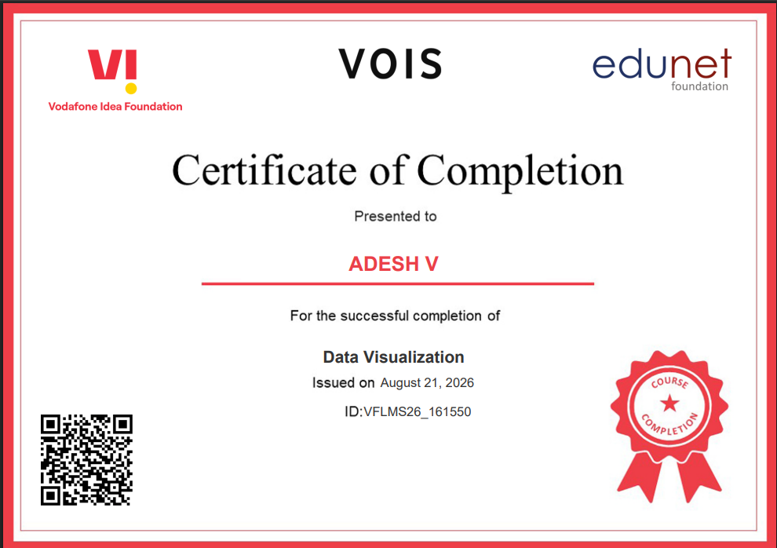
VOIS Course completion certificate - Course name- Data Visualization

Slide 18
Thank you
.
.

