Slide 1
Non-Deterministic Push Down Automata
Prof. Ritesh Upadhyay
Assistant Professor, Dept. of Computer Engineering.
UVPCE, Ganpat University

Slide 2
Previously Completed Topic
Formal Grammar & it’s Type
Grammar to Language
Language to Grammar
Simplification of Grammar
Normal Form of Grammar
Push Down Automata
Construction of PDA

Slide 3
Push Down Automata(PDA)
Pushdown Automata is a finite automata with extra memory called
stack which helps Pushdown automata to recognize Context Free
Languages. A Pushdown Automata (PDA) can be defined as :
Q is the set of states
∑is the set of input symbols
Γ is the set of pushdown symbols (which can be pushed and popped from stack)
q0 is the initial state
Z is the initial pushdown symbol (which is initially present in stack)
F is the set of final states
δ is a transition function which maps Q x {Σ ∪ ∈} x Γ into Q x Γ*. In a given state, PDA will read input symbol and stack symbol (top of the stack) and move to a new state and change the symbol of stack.

Slide 4
Example : Define the pushdown automata for language {a^{n}b^{n} | n > 0}
Solution : M = where Q = { q0, q1 } and Σ = { a, b} and Γ = { A } and delta(δ) is given by :
δ( q0, a, Z ) = { ( q0, AZ ) }
δ( q0, a, A) = { ( q0, AA ) }
δ( q0, b, A) = { ( q1, ∈) }
δ( q1, b, A) = { ( q1, ∈) }
δ( q1, ∈, Z) = { ( q1, ∈) }

Slide 5
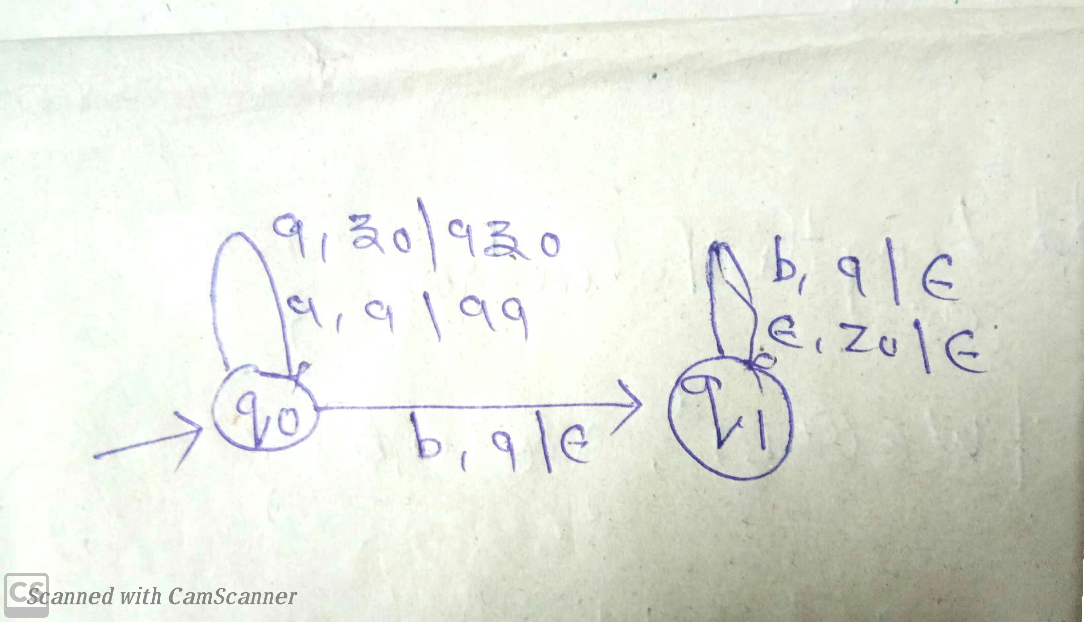

Slide 6
Previously Question of PDA
L = { x_{(a)}=x_{(b)}|x € (a+b)* }
L = { x|x € (a+b)* where n_{(a)} >n_{(b)} }
L = {a^{m} b^{n} |m>n}
L ={ a^{m} b^{n} c^{n} |m ,n >=1}
L = {a^{m+n} b^{n} c^{n} | m ,n >=1}
L = { a^{m} b^{m+n} c^{n} | m ,n >=1}
L = { Balanced parentheses of a programming language}
L ={ a^{n} b^{2n} |n>=1}
L ={ a^{n} b^{3n} |n>=1}
L = {WCW^{R}|W € (a+b)*}

Slide 7
Types of PDA
Deterministic push down automata
PDA is called non-deterministic if there exist
Exactly one possible transitions from a
Particular situation (current state q, input
symbol ∑ and stack symbol x).
if δ( q0, a, Z ) = { ( q0, AZ ) } is Allowed then
if δ( q0, a, Z ) = { ( q0, € ) } is NOT Allowed

Slide 8
Non-deterministic push down automata
The formal definition of a PDA allows non-determinism
A PDA is called non-deterministic if there exist at least two possible transitions from a particular situation (current state q, input symbol ∑ and stack symbol x).
if δ( q0, a, Z ) = { ( q0, AZ ) } is Allowed and
if δ( q0, a, Z ) = { ( q0, €) } is also Allowed

Slide 9
L = {WW^{R}|W € (a+b)*}
For this problem Deterministic PDA is not possible because in DPDA , it can not able to differentiate W and W^{R} .
So for this problem we can construct NPDA

Slide 10
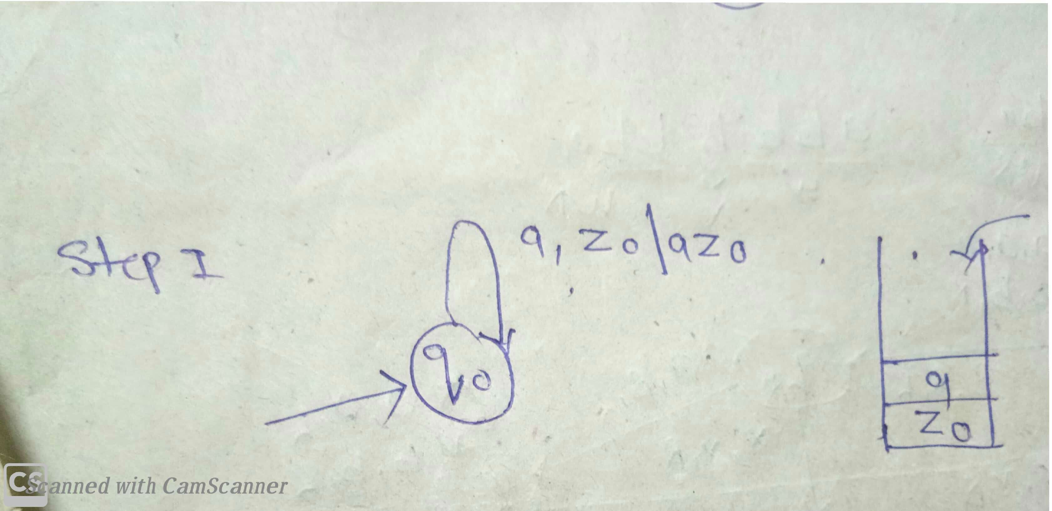

Slide 11
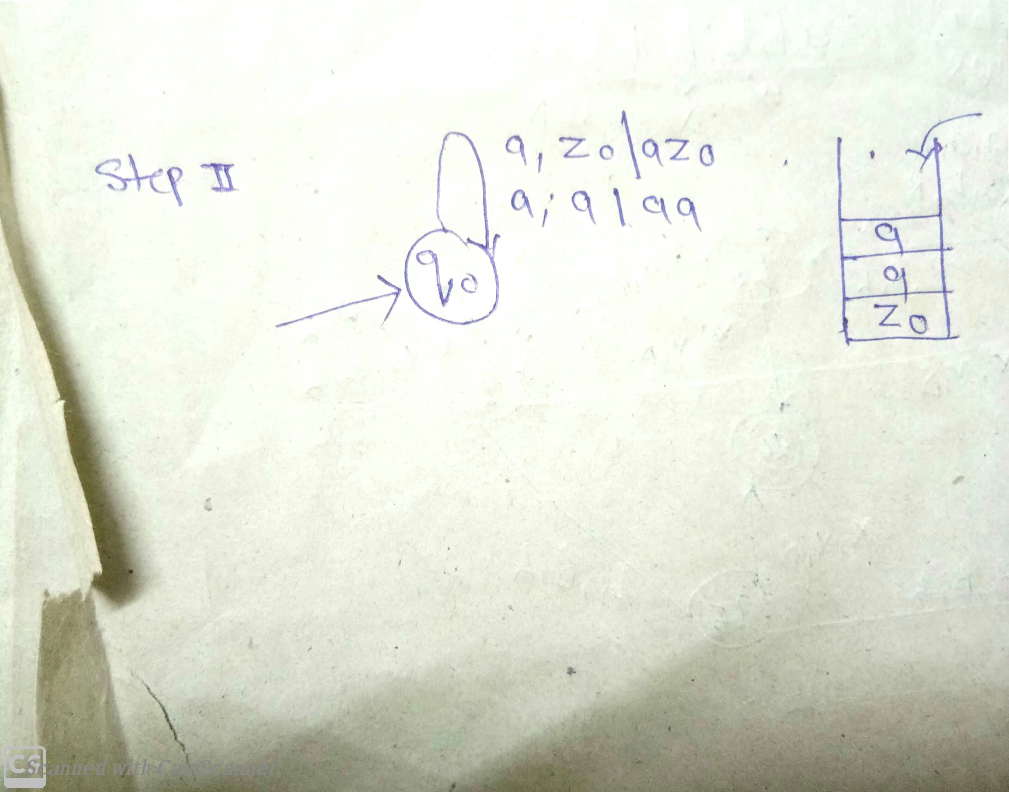

Slide 12
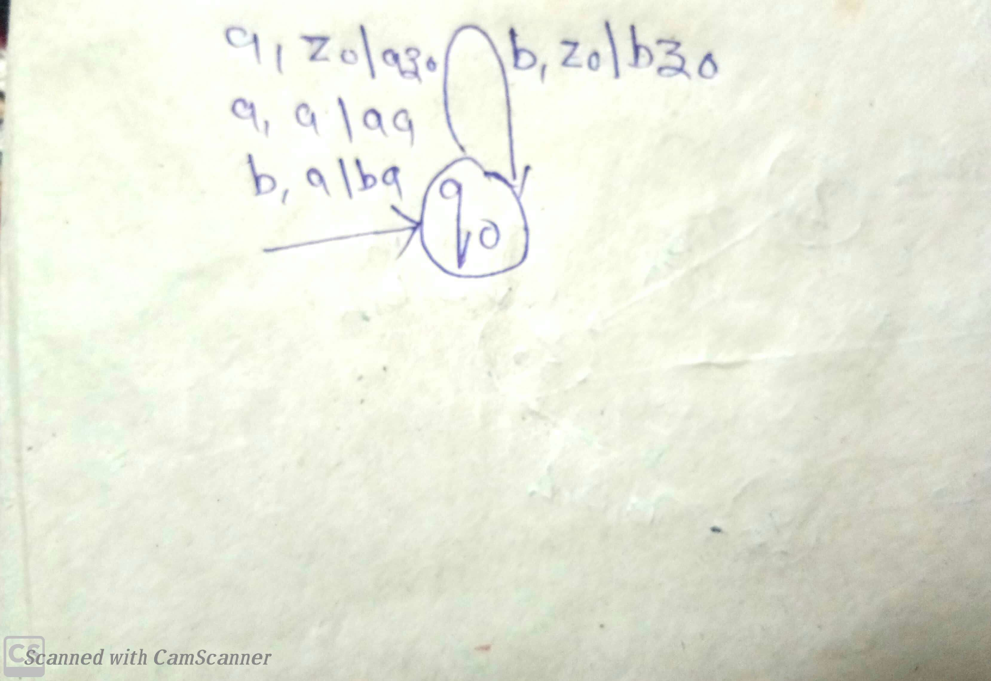

Slide 13
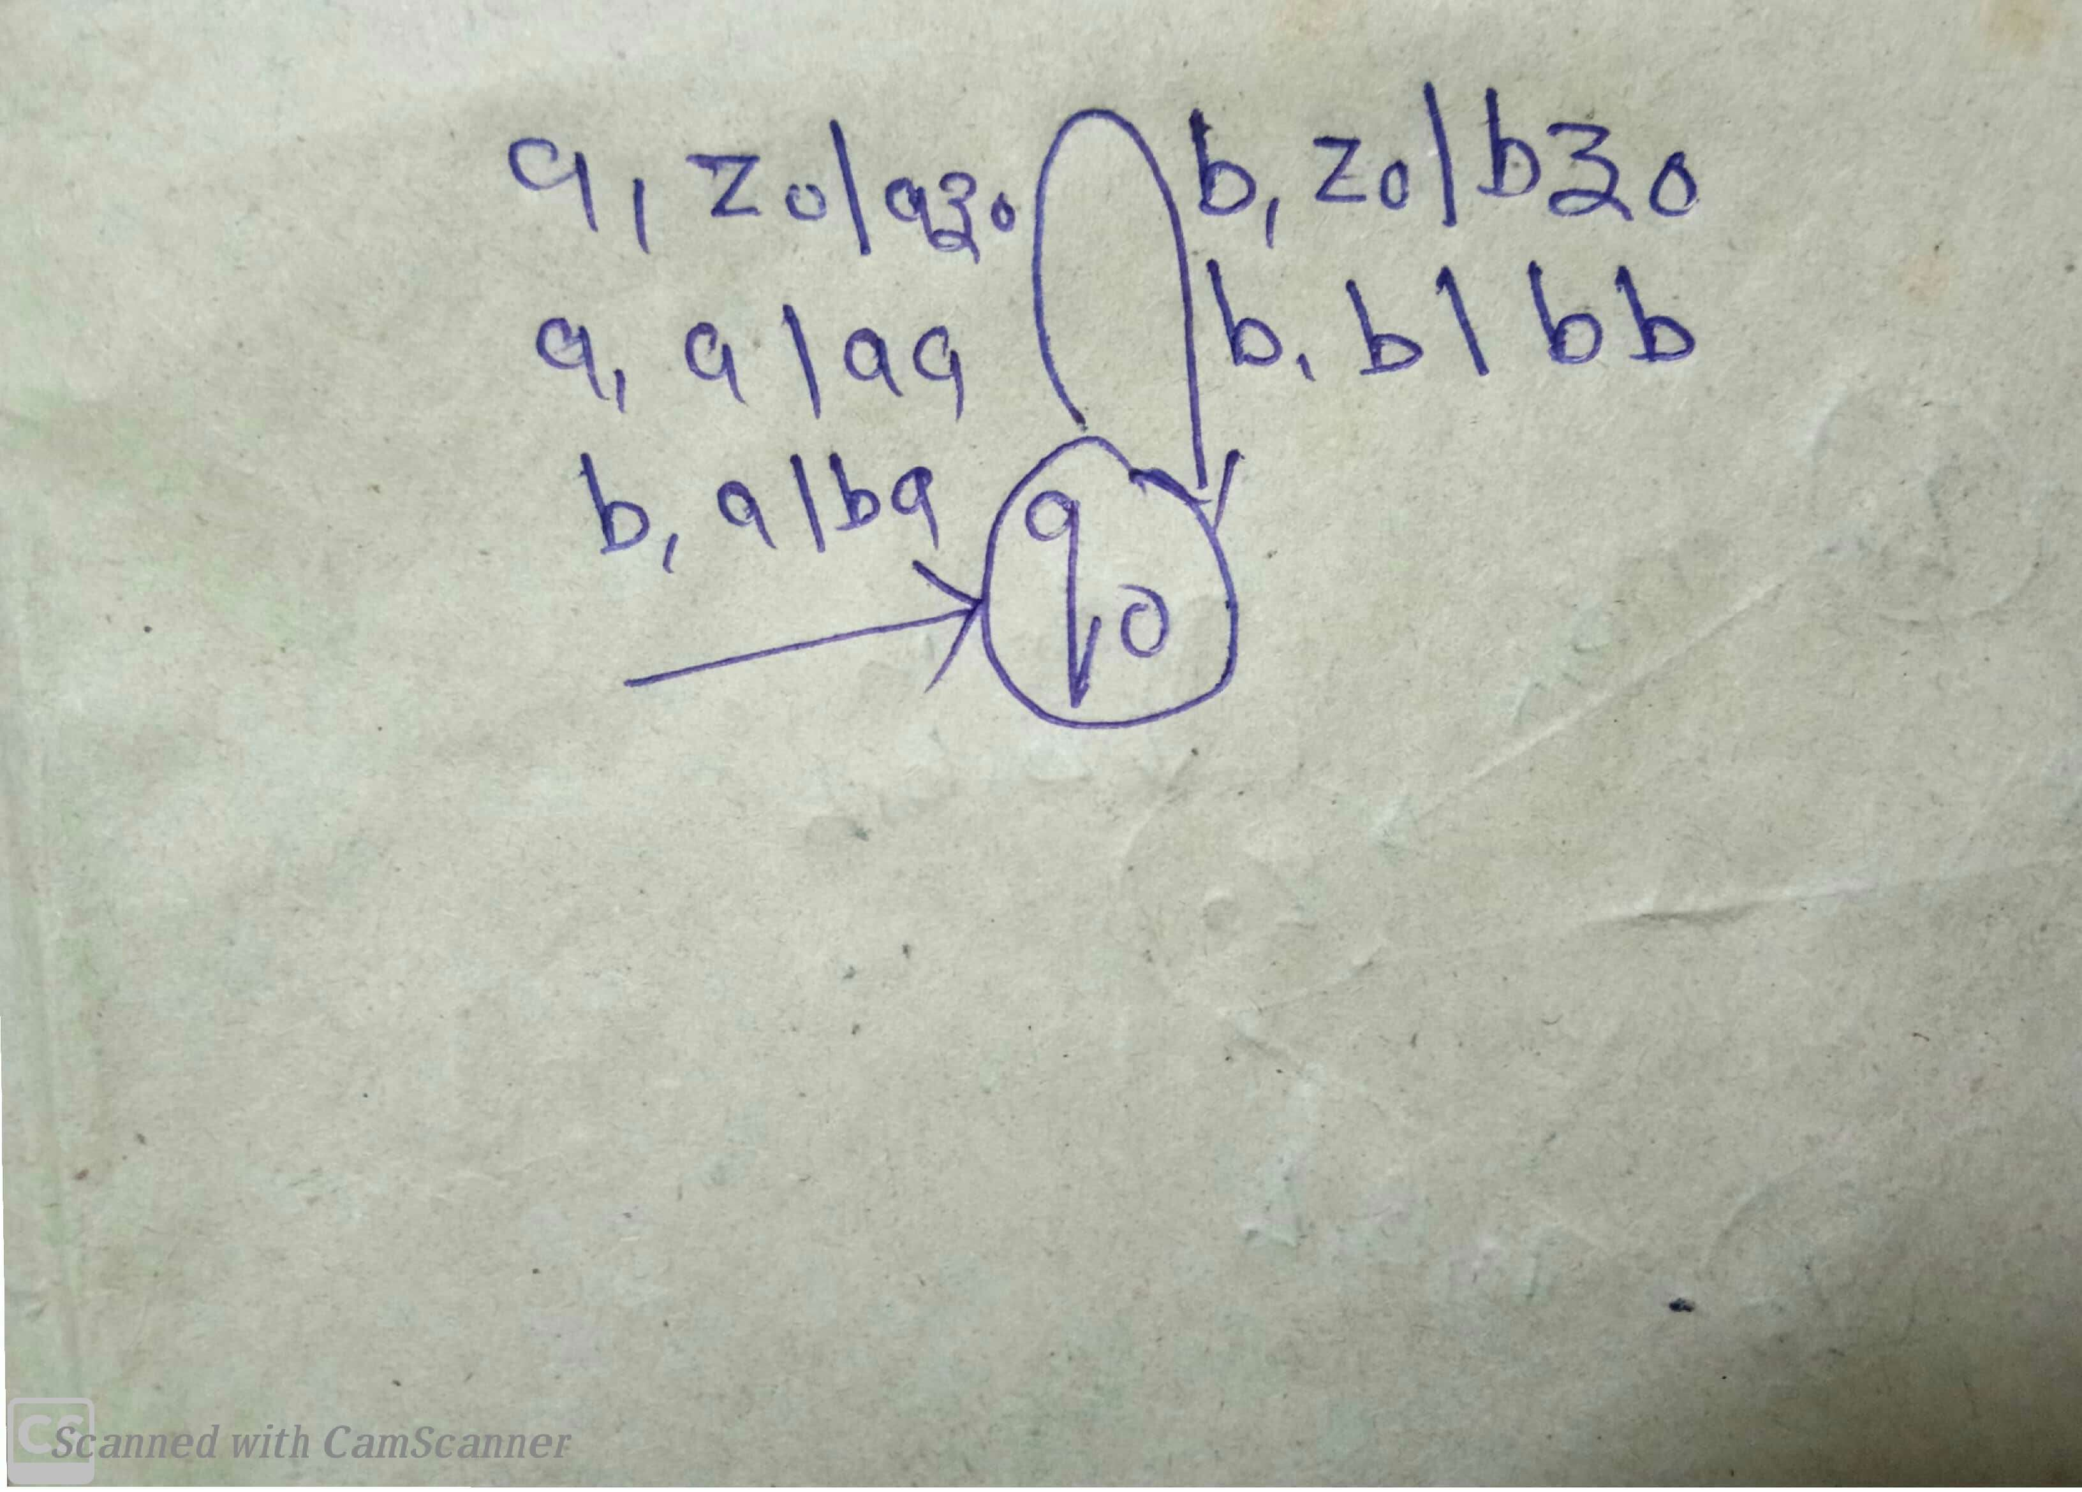

Slide 14
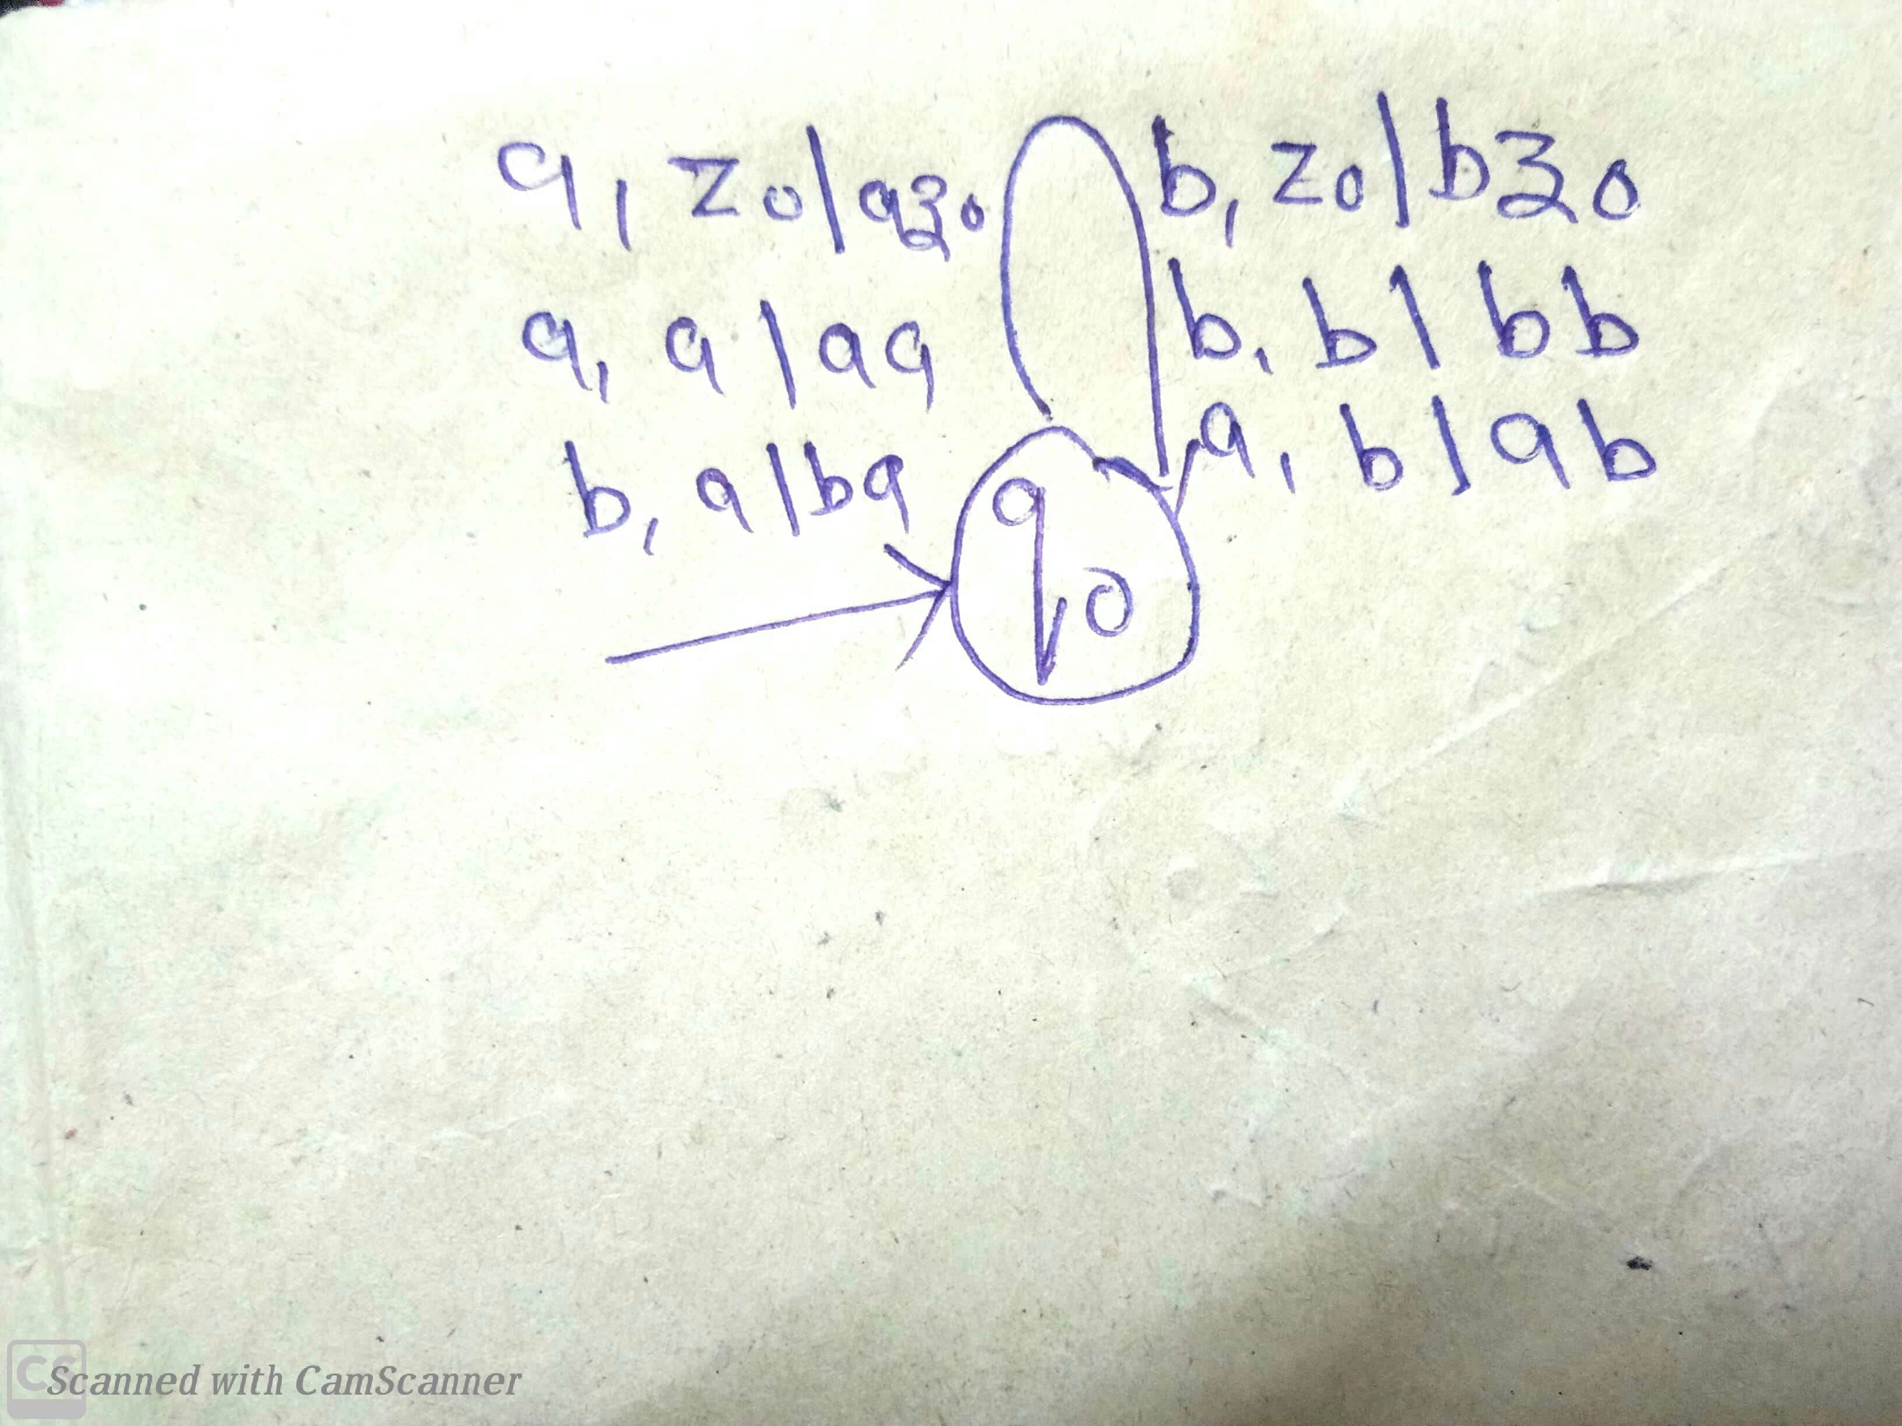

Slide 15
