Slide 1
MOAT ACADEMY
WEB APPLICATION DEVELOPMENT TRAINING
Nested Loop, Array, Traversing array using Loop and Other DOM Methods
DAY 6

Slide 2
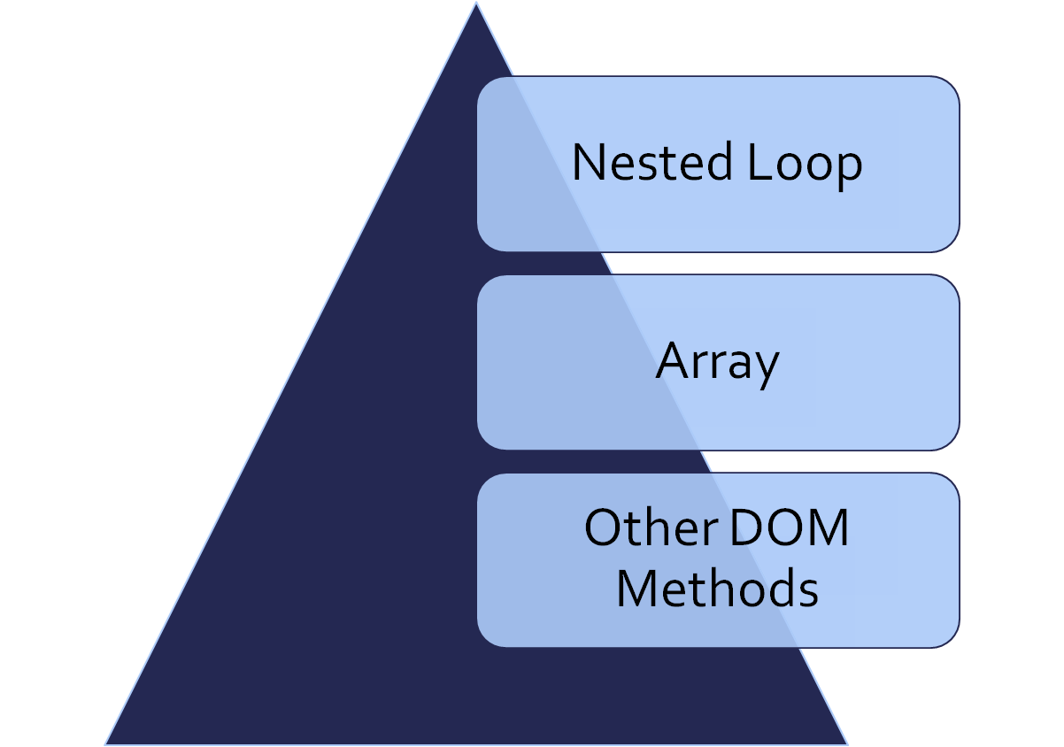
Outline

Slide 3
Exercise
Using JavaScript For Loop, document.write() or otherwise to create a drop down box with option from 1970 to 2017
Notes:
If this exercise has already been done, try display in a table and go FURTHER ! By displaying serial number too

Slide 4
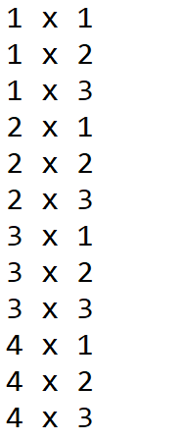
Nested Loop
A loop can be placed within another loop to repeat patterns.
Example: in generating a multiplication table similar to the below:
Notice that there is a major repetition, from 1 … 2… 3..4
while we are on ‘1’, we count from 1 to 3, same with 2, 3 and 4
We will need 2 loops, one to move from 1 … 4 another to generate 1,2,3 while on each step:

Slide 5
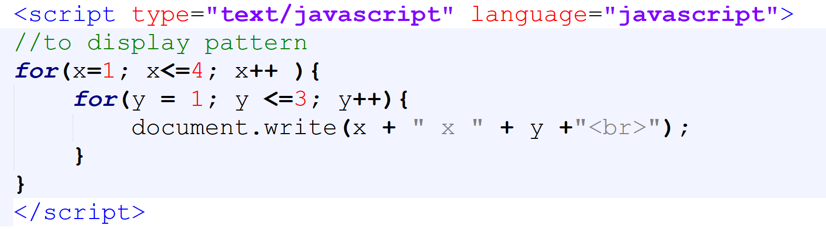
SOLUTION

Slide 6
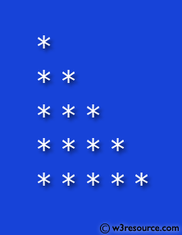
Exercise: Achieve the following pattern:

Slide 7
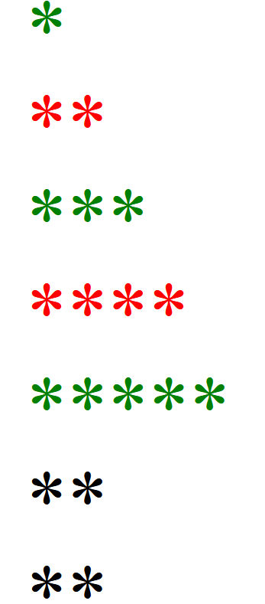
Go Further!
A Christmas tree for you this season!

Slide 8
Ternary Operator
It can also be called a conditional operator and works the same way. It is used as shorthand for if....else statement.
Why Ternary Operator?
Syntax

Slide 9
Ternary operator
A ternary operator is written with the syntax of a question mark (?) followed by a colon (:)
(condition) ? 'expression on true' : 'expression on false’

Slide 10
Classwork
Following the syntax, convert the following function to one that uses ternary operator in the section highlighted
function campaign(party){
if(party ==‘apc’){
alert(“we are running the change”)
}else{
alert(“Change the change”)
}
}

Slide 11
JAVASCRIPT ARRAY
Arrays and other DOM Methods
Arrays with Loop

Slide 12
QUIZ
What are variables?
Based on your current knowledge of programming, how many things can you store in a variable at a time?
Consider this:
You have a garage that can contain one car at a time, the garage is your variable (memory location) and the particular car is the value (what we are storing in the garage).
In programming, this would be written as:
  var garage = ‘Honda’

Slide 13
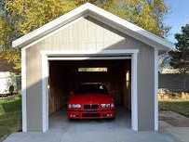
var garage=‘honda’ var fullname = ‘Olusegun Obasanjo’
In the same vein, if your program wants to store the fullname of a student, you will write :
var fullname = ‘Olusegun Obasanjo’;
For all the students in the class, you would have:
  var fullname2 = ‘Ibrahim Babangida’
  var fullname3 =‘Segun Odegbami’ and so on

Slide 14

Arrays
What if you want to store many cars? Then you could have a garage of this design

Slide 15
Arrays
Array is a variable that can be used to store multiple values
It stores a collection of elements of the same type
When you need a single variable to store the fullname of all the students in a class, you need an Array
Arrays can be created with the new keyword. Example: var fullname = new Array(“Olusegun Obasanjo”, ”Ibrahim Babangida”);

Slide 16
Arrays
You can also create array by simply assigning values as follows −var fullname =[“Olusegun Obasanjo”, ”Ibrahim Babangida”]; (recommended method of array creation)
To access the values in the array, make use of the variable name followed by the index in a square bracket [ ], index starts from 0. Example: fullname[1] refers to the second item

Slide 17
Classwork
Using Javascript, create an array that stores 3 names, 1 of the names should be yours and the other 2 your friends’
Alert your own name (using the location)
Do you still remember loop? If Yes,
Using your favourite loop, alert 1 to 5
Notes:
Using array, create a variable that stores the names of everybody in this cohort.

Slide 18
Classwork
Again, display all the names in the array

Slide 19
Sample Solution
var participants = [‘Ade’, ‘John’, ‘Deft’]
alert(participants[0]);
alert(participants[1]);
alert(participants[2]);
Do you notice a trend? Check how the array locations are specified…
What if there are 100 elements in the array? It will go from 0 to 99 - 100 lines!

Slide 20
Sample Solution
var participants = [‘Ade’, ‘John’, ‘Deft’]
alert(participants[0]);
alert(participants[1]);
alert(participants[2]);
Is there any thing that can help us generate numbers from 0 – 99 ??

Slide 21
Classwork
Now, Using loop.. Go through the array and display the names of everybody in the array
Again, display all the names but skip your own name (using continue or break as appropriate)

Slide 22
Array Methods
Javascript array join() method joins all the elements of an array into a string. The syntax is: array.join(separator);
separator − Specifies a string to separate each element of the array. If omitted, the array elements are separated with a comma.
var myarray = ["Jamiu","Fisayo","Tessy","Ola"];
var arraystr = myarray.join("-") ; alert(arraystr);

Slide 23
Common Array Methods
toString() method returns a string representing the specified array and its elements
Syntax is array.toString();
Array.sort() works for string
Javascript array pop() method removes the last element from an array and returns that element.
Syntax is : array.pop();
Javascript array push() method appends the given element(s) in the last of the array and returns the length of the new array. Syntax is array.push(element1, ..., elementN);
array.sort(); arranges the elements of the array
Array.isArray(array_variable) : checks if array_variable is an array

Slide 24
Example application of the array methods

Slide 25
Example
Using prompt, request your user to supply 3 of their best fruits one after the other.
Then display everything to them in ascending order with an alert (or document.write())

Slide 26
Discussion
If you receive these inputs into an individual variable like this:
  var fruit1 = prompt(“enter a fruit you like”)
  var fruit2 = prompt(“enter a fruit you like”)
  var fruit3 = prompt(“enter a fruit you like”)
sorting it in ascending order may not come easy. But we already know that array has the sort method that can be used to arrange items. Put all into an array!
  var fruit1 = prompt("enter a fruit")
  var fruit2 = prompt("enter a fruit");
  var fruit3 = prompt("enter a fruit");
  var fruits = [fruit1,fruit2, fruit3] ;
.. then use .sort() method to arrange them.
  document.write(fruits.sort())
If there were 100 fruits to be added? See the notes for a more concise method (loop)
Notes:
var fruits = []
for(var i = 1; i<=3; i++){
var fav = prompt("enter a fruit")
fruits.push(fav);
}
document.write(fruits.sort())

Slide 27
Exercise
Create an array of 5 elements
Using a While Loop , display* all the elements of the array except the element on location ‘2’
Hint: *
  you can use console.log(), alert or document.write() to display
  Remember break/continue statement

Slide 28
The DOM and HTML Element Selector
Document.getElementsByTagName, document.getElementsByClassName etc

Slide 29
The DOM and HTML Element Selector
All the HTML tags are treated as objects which has properties and methods and can respond to events.
The document object represents your web page and is the owner of all other objects.
If you want to access any element in an HTML page, you always start with accessing the document object.
document.method.property_of_the_element
Method represents what you can do on the object (action) while property represents what you can change about the object
The HTML tags (objects) on a webpage can be referenced (or picked) using four methods namely:

Slide 30
The DOM and HTML Element Selector
You will observe the plural “s” at the end of getElementsByTagName and getElementsByClassName.
This is because there are many element results that will be fetched – Remember many tags can belong to the same class, the same for Tag (there can be several <p > tags on the page

Slide 31
The DOM and HTML Element Selector
You will observe the plural “s” at the end of getElementsByTagName and getElementsByClassName. This is because there are many element results that will be fetched – Remember many tags can belong to the same class, the same for Tag (there can be several <p > tags on the page
var x = document. getElementsByTagName(“p”) will return many p’s stored in x as x[0], x[1], x[2] etc
You can then apply the formating to each of them like x[0].style.color=“red”;
You can also apply loop to go through the array one after the other

Slide 32
QUIZ
Using Loop, set the background color of all the p tags on your page to red;
Using document.getElementsByClassName or document.getElementsByTagName and loop. Create a function that calculates the sum of the scores in your last mini-project

Slide 33
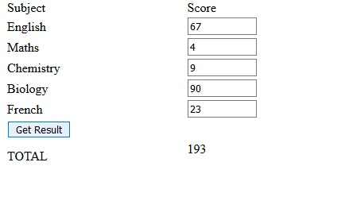
Using a loop and getElementByClassName() let’s do it together

Slide 34
The DOM and HTML Element Selector
  document.getElementById(id)
  document.getElementsByTagName(name)
  document.getElementsByClassName(name)
  document.getElementsByName(name)
After picking the HTML tags, you can change their properties using any of:
  element.innerHTML = new html content element.attribute = new value element.setAttribute(attribute, value) element.style.property = new style

Slide 35
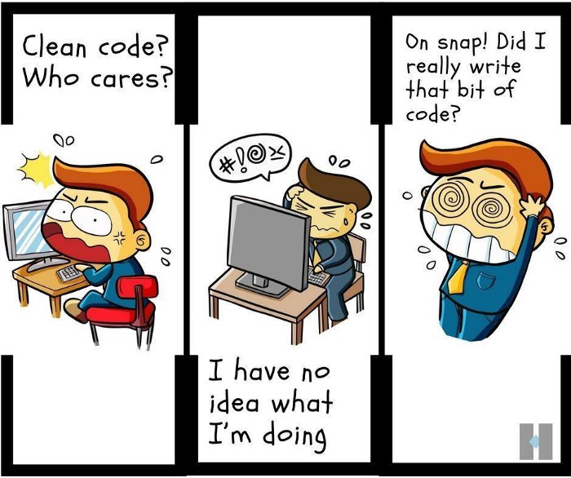
Pro Tip:
Clean and well-commented codes save you a lot
Moat Academy for Developers
Notes:
Source: techindustan

