Slide 1
MOAT ACADEMY
WEB APPLICATION DEVELOPMENT TRAINING
Introduction to Cascading Style Sheet- Day1

Slide 2
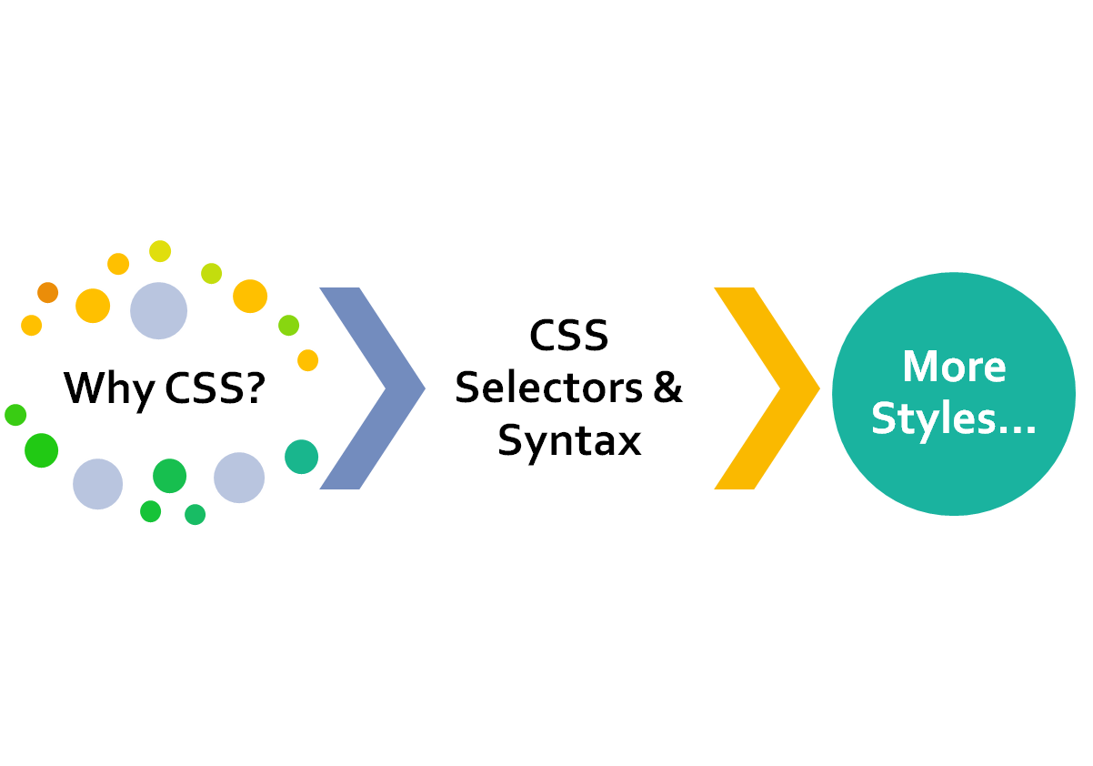
CLASS
OUTLINE

Slide 3
Outline
Introduction to CSS - Why CSS?
CSS Placement: Inline, Internal and External
Inline Placement: The Style Attribute
CSS Syntax
CSS Selector - ID and Class
More CSS Syntax

Slide 4
Introduction to CSS
Check out HTML page with and without CSS
CSS stands for Cascading Style Sheets
CSS is used to define styles for your web pages, including the design, layout and variations in display for different devices and screen sizes.
Created to solve the problem of HTML formatting on large websites (remember HTML formatting tags? They are limited with large websites)
CSS saves a lot of work. It can control the layout of multiple web pages all at once
They are referred to as rules

Slide 5

Why CSS?
We simply don’t want to accept the browser’s default for displaying/rendering the HTML tags
Compare default way of displaying a <p>…</p> and <a href=‘#’>Link </a>
The rule cursor: pointer and other rules can turn <p> to an <a>

Slide 6
CSS Placement
In HTML modules, you learnt different tags for placing web page contents, in CSS module, you will be learning different rules:
Where do you specify these rules?
  Inline
  Internal
  External

Slide 7
CSS Placement:
Inline Style Sheet
Here, the rules are given within the opening tag of the element [tag]
An inline style may be used to apply a unique style for a single element.
To use inline styles, add the style attribute to the relevant element. The style attribute can contain any CSS property.
An inline style loses many of the advantages of a style sheet (by mixing content with presentation).
<h1 style="color:blue;margin-left:30px;">This is a heading.</h1>
QUIZ: Create up to 3 paragraph on your page. Using Inline CSS, write a rule that makes all the paragraph red color

Slide 8
CSS Placement:
Internal Style Sheet
An internal stylesheet is where you don't have an external CSS file, but instead place your CSS inside a <style> element, contained inside the HTML head.
May be used if one single page has a unique style.
Internal styles are defined within the <style> element, inside the <head> section of an HTML page:

Slide 9
Internal Style Sheet
<head>
<style type=‘text/css’>
/* css rules here */
</style>
</head>

Slide 10
CSS Comments
Comments are used to explain the code, and may help when you edit the source code at a later date.
Comments are ignored by browsers.
A CSS comment starts with /* and ends with */
Comments can also span multiple lines:

Slide 11
CSS Comments
Example
/* This is a single-line comment */
/* This is
a multi-line
comment */

Slide 12

CSS Syntax
Web browsers apply CSS rules to a document to affect how they are displayed.
A CSS rule-set consists of a selector and a declaration block
The selector points to the HTML element you want to style.
The declaration block contains one or more declarations separated by semicolons.

Slide 13
CSS Syntax
Each declaration includes a CSS property name and a value, separated by a colon.
Property could be “Let all the elements on this webpage have background color of red”
A CSS declaration always ends with a semicolon, and declaration blocks are surrounded by curly braces.

Slide 14
CSS Selectors
The selector represents the means through which CSS tells the browser which element to apply the CSS rule(s) to:
Selectors may be: Tags, Id, Class, attribute

Slide 15
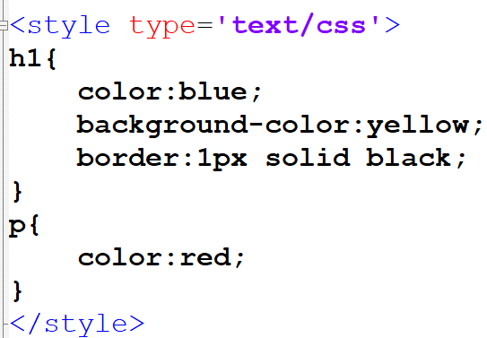
CSS Selectors: Tag
There are 4 rules in the CSS directed at 2 tags:
The first rule starts with an h1 selector, which means that it will apply its property values to all the <h1> elements on the page. It contains three properties and their values.
The first one sets the text color to blue.
The second sets the background color to yellow.
The third one puts a border around the header that is 1 pixel wide, solid and colored black.
The second rule starts with a p selector, which means that it will apply its property values to ALL the <p> elements on the page. It contains one declaration, which sets the text color to red.

Slide 16
Attribute selectors
This matches elements based on their attributes and attribute values.
Their generic syntax consists of square brackets ([]) containing an attribute name followed by an optional condition to match against the value of the attribute.
[attr] : This selector will select all elements with the attribute attr, whatever its value.
[attr=val] : This selector will select all elements with the attribute attr, but only if its value is val.

Slide 17
Exercise
Given the following elements on a HTML page:
<input type='text’ size=‘40’ name=‘user’>
<input type='password’ size=‘40’ name=‘pwd’>
<input type='button' value=‘Sign Up’>
Write a CSS rule that gives all input elements of type password a red border
Let the signup button have an orange background and font size of 60px
DO NOT USE INLINE CSS (Don’t use style attribute)
Notes:
[value]{
border:1px solid red
}

Slide 18
The Id Selector
This uses the id attribute of an HTML element to select a specific element.
The id of an element should be unique within a page, so the id selector is used to select one unique element!
To select an element with a specific id, write a hash (#) character, followed by the id of the element.
<span> This is my favorite color</span>
<span id=‘test’>I really love this one </span>
Notes:
#test{color:blue; font-weight:bold;}

Slide 19
CSS Class Selector
The class selector selects elements with a specific class attribute.
To select elements with a specific class, write a period (.) character, followed by the name of the class.
Helps you apply the same style to a group of elements at once!
.test2 {text-align: center; color: red;}

Slide 20
Exercise – 12 mins
On your page, create:
  4 p tags under the heading 'Profile'
  1 image tag (img)
  2 Lists
  3 span ...
  1 iframe with pdf content
Style as follows:
The image and the iframe are to have the same width and height
The first list and the p tags should be color blue and should have black border.
The heading tag and all the span should have yellow background

Slide 21
GROUPINGS AND MORE
Specific element
Element within another
Grouping of Tags

Slide 22
Specific class Element
Helps you specify specific HTML elements that should be affected by a class.
In the example below, only <p> elements with class="center" will be center-aligned:
p.center {
text-align: center;
color: red;
}
Note that there is no space between the p tag and the class (.center)

Slide 23
The DOM and “Cascading” Idea
The Document Object Model (DOM) – a representation of the document in the computer memory.
When a browser displays a document, it combines the document's content with its style information and displays the contents of the DOM
A DOM has a tree-like structure. Each element, attribute and piece of text in the markup language becomes a DOM node in the tree structure.
The nodes are defined by their relationship to other DOM nodes. Some elements are parents of child nodes, and child nodes have siblings.

Slide 24
The DOM and “Cascading” Idea
<head>
  <title></title>
  <meta>
  <meta>
</head>
<body>
  <h1>Welcome</h1>
  <p><a href=‘#’>This is an example of:</a></p>
  <ul>
      <li>Cascading</li>
      <li>is my Style</li>
      <li>Sheets</li>
  </ul>
</body>
The next slide shows the above DOM structure,
Notes:
A tree-like structure containing each of the tags and their contents

Slide 25
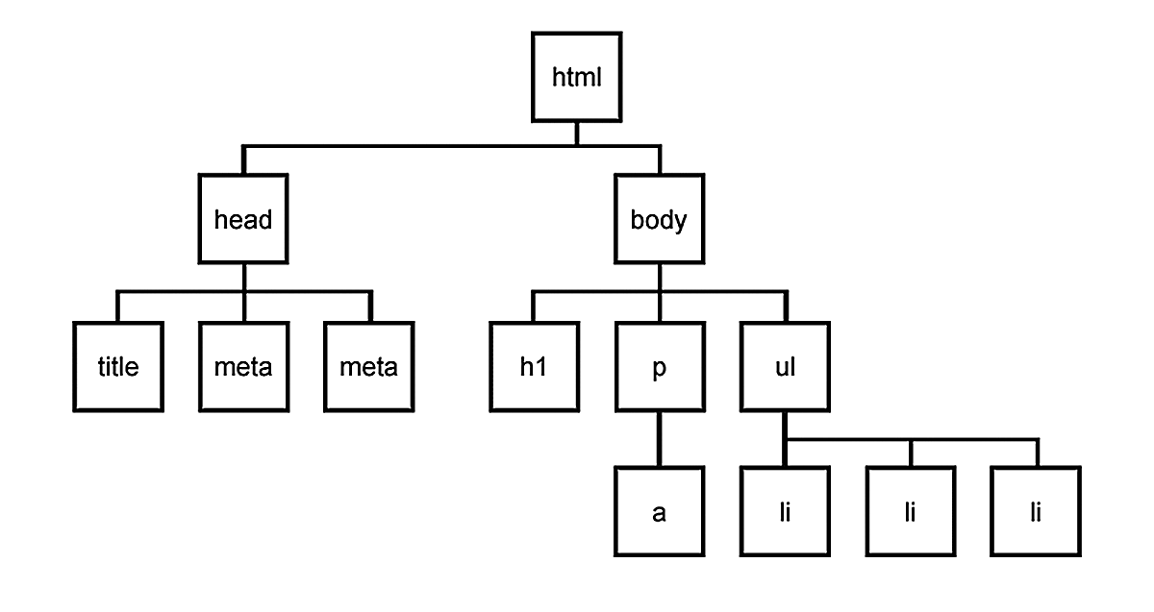
The DOM and “Cascading” Idea
The implication of the DOM is that certain styles can be applied to the child(ren) via the parent. A color set on <ul> will affect all the <li>.
*Setting color for <a> tag has to be done on the <a> tag itself.

Slide 26
The DOM and “Cascading” Idea
<head>
  <title></title>
  <meta>
</head>
<body>
  <ul>
      <li>Cascading</li>
      <li>is my <span>Style</span></li>
      <li>Sheets</li>
  </ul>
</body>
QUIZ: how will you represent the above in a DOM?,Can you style the span using the DOM structure?
SOLUTION: See the notes
Notes:
ul li span{color:red}
A tree-like structure containing each of the tags and their contents
Note the space

Slide 27
Specific class Element
Hint- you are giving a total description of the tag, naturally you want to pause as you describe… see the pause as space
The <a> tag, inside <li> inside <ul> tag. Stating this will ensure that only the specific <a> tag mentioned will be affected by the rule
ul li a{
text-align: center;
color: red;
}

Slide 28
Grouping Selectors
You can minimize your codes by grouping elements that have similar definitions
Consider:
h1, h2 and p tags that are center-aligned, text color of red and font size of 12px, rather than specifying the same rules for each of the elements, you can group them.
To group selectors, separate each selector with a comma.
h1,h2,p{
text-align:center;
color:red;
font-size:12px;
}
Notes:
Formular: you are saying “h1 and h2 and p should obey these rules”

Slide 29
Exercise
Change the color of all <p> and <h1> elements, to "red". Group the selectors to minimize code.
Try out different styles with the anchor tag

Slide 30
More Rules for the unordered list
Using custom image as bullets

Slide 31

As seen on Moat Academy Website

Slide 32
The List-style Properties
The list-style shorthand property sets all the list properties in one declaration.
The properties that can be set, are (in order):
  list-style-type: disc; /* disc | square | circle | none */
  list-style-position: inside; /* outside */
  list-style-image.
All the above can be combined in a shorthand as follows:
list-style: url("images/arrow.png") inside

Slide 33
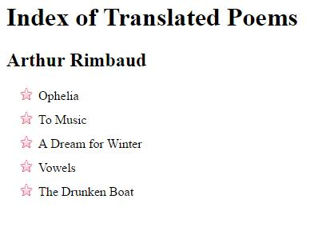
Exercise: Replicate the following (using the image given)

Slide 34
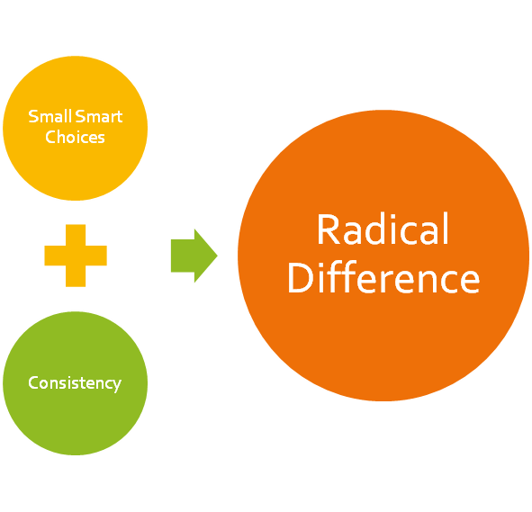
KEEP CODING!
Imagine and create…

