Slide 1
MOAT ACADEMY
WEB APPLICATION DEVELOPMENT TRAINING
INTRODUCTION TO JAVASCRIPT (ES5) - Day 1

Slide 2
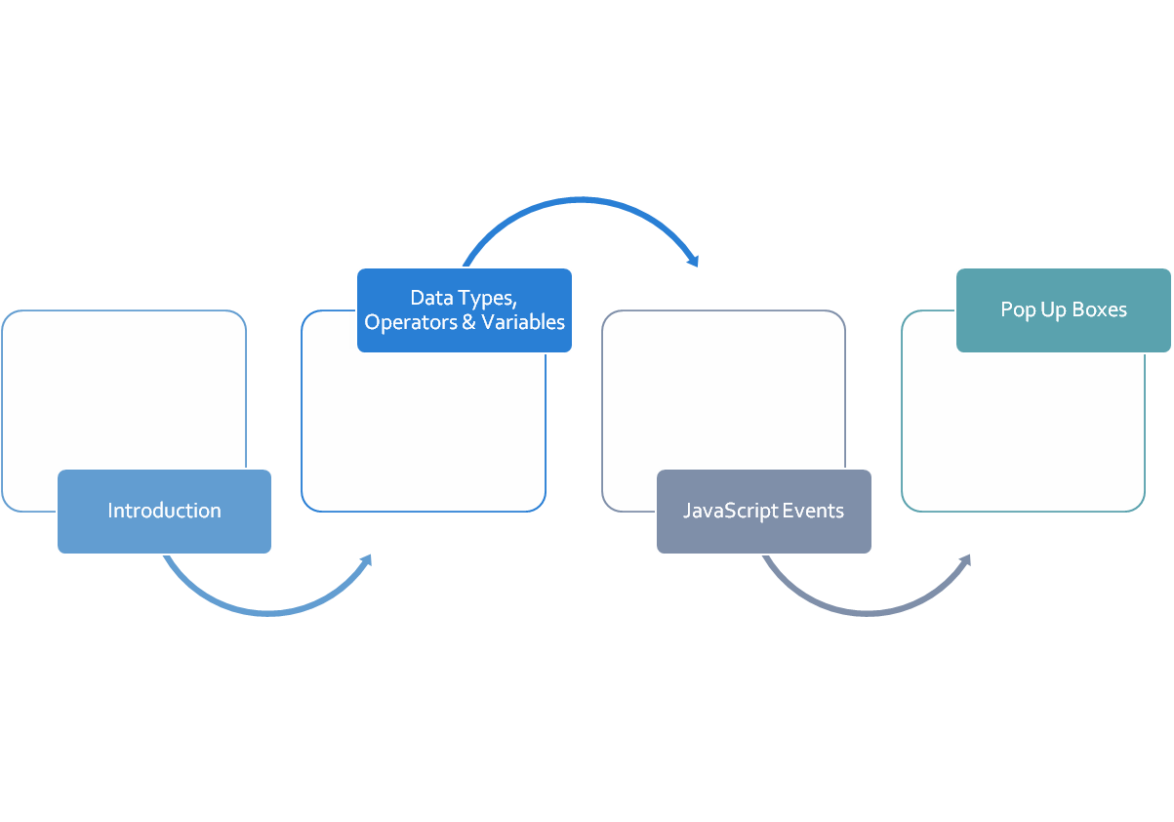
OUTLINE

Slide 3
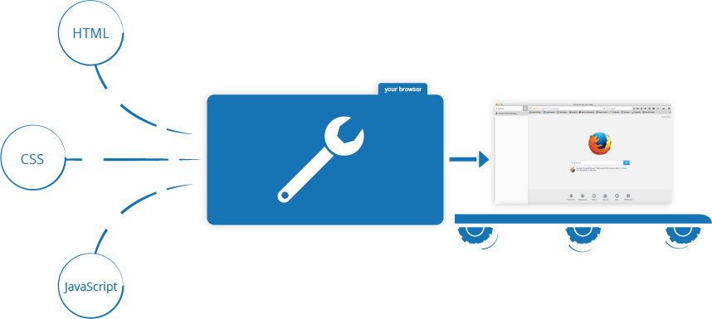
What then is this Java of a script?
Moat Academy for Developers
Notes:
While HTML is used to place web elements on the page, CSS is used to beautify the elements overwriting the default ways in which the browsers show them. Javascript adds interactivity and dynamism to the web pages.

Slide 4
What then is this Java of a script?
Javascript, (JS) is a programming language that enables you to create dynamically updating content, control multimedia, animate images on the client side (browser).
In its most common form, JavaScript resides inside HTML documents, and can provide levels of interactivity to web pages that are not achievable with simple HTML
Javascript is a programming language for instructing the browsers on what to do
In HTML, JavaScript statements are "instructions" to be "executed" by the web browser.
Moat Academy for Developers

Slide 5
Whetting Your Appetite
JavaScript and Java are completely different languages, both in concept and design.
JavaScript enables you to add powerful interactions to websites
Browsers have features that disables/enables Javascript
Understanding JS will teach the fundamental programming concepts
Programming is like writing a list of instructions to the computer so that it can do a number of things
<input type="button" value="Format My Hard Drive Now" onclick="return confirm('Are you really sure you want to do this?')";/>
Moat Academy for Developers

Slide 6
Placement of JS
Javascript can be included in any of the 3 ways namely: Inline (within the tag), internal (within the script tag), or as external file
  Inline placed within the opening tag with event.
  Internal: Included on your HTML document using the script tag <script> // JavaScript goes here </script>
  External file: <script src="script.js"></script>
Moat Academy for Developers
Notes:
More on event later

Slide 7
Placement of JS
Internal JavaScript statements are placed within the <script>... </script> HTML tags in a web page.
Has two attributes namely:
  Language − specifies the scripting language, value will be javascript.
  Type − indicates the scripting language in use and its value is set to "text/javascript“
Moat Academy for Developers

Slide 8
Things to Know in JavaScript
Javascript statement: JavaScript programs contain many JavaScript statements.
Keywords are used by the programming language for some specific things
The statements are executed, one by one, in the same order as they are written.
JS statements are separated by semicolon at the end of each executable statement
Ending statements with semicolon is not required, but highly recommended.
JavaScript ignores multiple spaces. You can add white space to your script to make it more readable.
Javascript comment is // for single line or
/*…… */ for multiple lines
Moat Academy for Developers

Slide 9
The building blocks of JavaScript
Variables: when instructing the browser on what to do, you sometimes need to store some values.
JavaScript variables are containers for storing data values.
JavaScript variables can hold numbers like 100 and text values like “Victoria". They are created using var variable name
All JavaScript variables must be identified with unique names
<script>
var academy= “Moat";
alert (academy);
</script>
Moat Academy for Developers

Slide 10


Variables – The building Block
One Statement, Many Variables
You can declare many variables in one statement.
Start the statement with var and separate the variables by comma:
A declaration can span multiple lines:

Slide 11
The building blocks of Javascript
The following restrictions apply to variable names:
  the first character must be either a letter or an underscore character ( _ )
  the remaining characters can be letters, numbers, or underscore characters
  variable names cannot contain spaces
Variable names are case-sensitive.
Moat Academy for Developers

Slide 12

Variable Name and Camel Casing
MOAT Academy for Developers
Historically, programmers have used three ways of joining multiple words into one variable name:
Hyphens: first-name, last-name, master-card, inter-city.
!! Hyphens are not allowed in JavaScript. It is reserved for subtractions.
Underscore:
first_name, last_name, master_card, inter_city.
Camel Case:
FirstName, LastName, MasterCard, InterCity.
JavaScript programmers tend to use camel case that starts
with a lowercase letter:
firstName, lastName, masterCard, interCity.

Slide 13
Are the following acceptable as variable names?
age
var
1990
products
skirt_
_age
reception^one
__
8student
lecturer1
ogun_state_lecturer
lecturerTwo
test-data
home_page
…total
user
BOY
Moat Academy for Developers
Notes:
Not acceptable- 2,3,7,9,13,15

Slide 14
The Document Object Model (DOM)
The DOM is the representation of your HTML page created by the browser when rendering the page.
JavaScript uses the DOM to access the text content and elements of the webpage (document) as objects.
The DOM can sometimes be different from your HTML page.
Exercise: create a HTML page with one or two elements, view it in the browser. Inspect element and type the following in the console:
document: displays the contents on the page
document.body: this will display everything within the body tag.
The DOM may sometimes be different from your page source code if: the browser automatically corrects errors/omission in tags or you use an interactive language like Javascript to manipulate the elements
At the console type: document.body.style.color=‘red’ to change the DOM
Moat Academy for Developers

Slide 15
Common ways to output to the Browser in Javascript
document.write()
alert()
console.log
since document.write writes exactly to the body tag, if you write tags, it will be interpreted and displayed as the tag
Example: checkout how to write a <h1> tag using document.write
Moat Academy for Developers

Slide 16
Troubleshooting
In Javascript, when your code contains errors, nothing will happen. There are no error messages, and you will get no indications where to search for errors.
The Inspect Element can be used to check the javascript error or view what is written in the console
Most browsers have debugging tools for JS
In chrome, go to the menu, select “More Tools” >>> “Developers Tools”
You will see the results of your Javascript execution in the section labelled “console”
Notes:
Not Covered in class

Slide 17
The building blocks of Javascript
In programming, text values are called text strings.
Strings are written inside double or single quotes. Numbers are written without quotes.
Operators: JavaScript operators allow us to perform tests, do maths, join strings together, and other such things.
You can also use the + operator to join two parts of a text (string) together (called concatenation in programming).
Moat Academy for Developers
Notes:
If you put a number in quotes, it will be treated as a text string.

Slide 18
Concatenation Using the ‘+’ Operator
var student1 = ‘Tom';
var student2 = ‘Jerry';
var student3 = ‘Jullie';
var allstudents = student1 + student2 + student3;
alert(allstudents);
Moat Academy for Developers

Slide 19
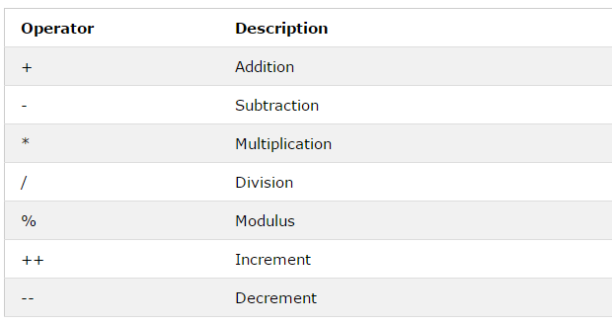
JavaScript Mathematical Operators
Moat Academy for Developers

Slide 20
Class Exercise
Use JavaScript to evaluate Circumference of a Circle using the Diameter.
Given that π = 3.14 and d = 12
The formula is simply this: C = πd.
Display the result using console.log()
Then, with an alert box.
Moat Academy for Developers

Slide 21
JavaScript Popup Boxes
JavaScript has three kind of popup boxes: Alert box, Confirm box, and Prompt box.
Alert Box: often used if you want to make sure information comes through to the user.
When an alert box pops up, the user will have to click "OK" to proceed.
Syntax: window.alert("sometext");
Exercise: Using JS alert box, add a welcome message to your website
Moat Academy for Developers
Notes:
The window.alert box can be written without the window prefix
Ponder: GTB e-banking platform alert

Slide 22
JavaScript Popup Boxes
Confirm Box: often used if you want the user to verify or accept something.
When a confirm box pops up, the user will have to click either "OK" or "Cancel" to proceed.
If the user clicks "OK", the box returns true. If the user clicks "Cancel", the box returns false.
Syntax: window.confirm("sometext");
Moat Academy for Developers
Notes:
The window.confirm() method can be written without the window prefix.
Usually used to confirm deletion

Slide 23
JavaScript Popup Boxes
A prompt box is often used if you want the user to input a value before entering a page.
When a prompt box pops up, the user will have to click either "OK" or "Cancel" to proceed after entering an input value. You can receive this inputted value via a variable.
If the user clicks "OK" the box returns the input value. If the user clicks "Cancel" the box returns null.
Syntax: window.prompt("sometext","defaultText");
Moat Academy for Developers
Notes:
The window.prompt() method can be written without the window prefix.

Slide 24
Hands-on
Based on your understanding of Javascript variables and the pop-up boxes, get the name of a visitor to your website and greet him/her mentioning their names
Hint : prompt boxes
Moat Academy for Developers

Slide 25
Javascript Events and Inline Placement
HTML events are "things" that happen to HTML elements, It can be something the browser does, or something a user does.
Example is: HTML button was clicked
When events happen, you may want to do something.
JavaScript lets you execute code when events are detected.
You can specify JavaScript codes to "react" when these events happen using the inline javascript.
Syntax : <HTML Tag on-event="some JavaScript">
Literarily interpreted as: “carry out some Javascript when this event happens to this tag”
Moat Academy for Developers

Slide 26
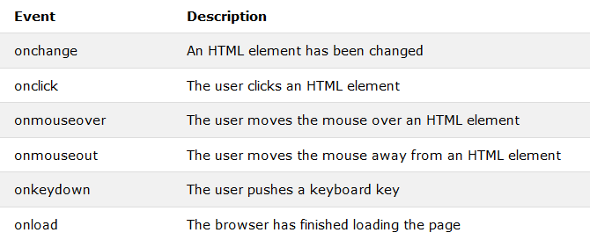
JS Events: example of events are: change, mouseover, keydown (when a user presses down any key on the keyboard while the cursor on the element etc)
Moat Academy for Developers

Slide 27
Assignment 1
We want to display an alert to say: “Hello World!” when the page loads
We want to display an alert to say: “You clicked Me!” when a user clicks a button.
Show the different behavior above using inline javascript
Which tag will receive the event? Which event?
Syntax:
<tag onevent=“ javascript codes“> content </tag>
Moat Academy for Developers
Notes:
To show Javascript placement and to also demonstrate that the inline javascript can be used to attach javascript codes to events

