Slide 1
WEB APPLICATION DEVELOPMENT TRAINING
MOAT ACADEMY FOR DEVELOPERS
LECTURE SLIDES ON
INTRODUCTION TO DATABASE – DAY 1,2

Slide 2
When do we need a database?
Anytime you desire that your ‘website’ stores data (not files) such as users’ input.
Consider: your Facebook profile contains the data you supplied during registration.
Variable names in javascript can only store data while the page lasts.
Database allows for a persistent data store
In computing, database is represented using the drum symbol

Slide 3
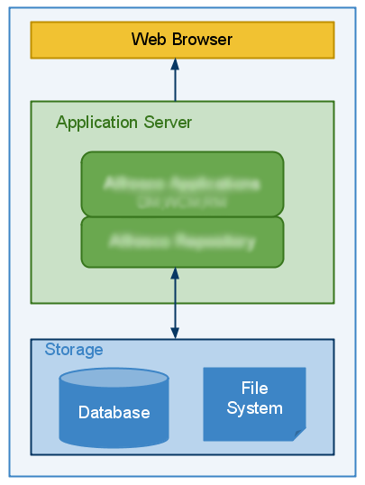

Slide 4
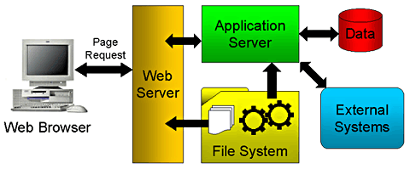
The Inner workings of web application
www.moatacademy.com
Notes:
System architectural Diagram of a dynamic website (it has database) and even communicates with external system through eg webservice

Slide 5
Introduction to Database
A database is a collection of data organized in a particular way
Physically, database servers are dedicated computers that hold the actual databases and run only the DBMS and related software
Access to database is provided by DBMS
A database management system (DBMS) is a computer software application that interacts with the user, other applications, and the database itself to capture and analyze data
Commonly used DBMS are MySQL, Oracle etc
SQL, pronounced “SeQUEL” is a standard language for accessing databases.
What is a database?

Slide 6
Common Relational DBMS
SQLite Open Source SQL database used for databases in cellphones, PDAs, MP3 players, set-top boxes, and other electronic gadgets.
MySQL :most popular open source SQL database typically used for web application development, and often accessed using PHP.
Oracle DB: owned by the Oracle corporation and the code is not open sourced. used for large applications, particularly in the banking industry. Most of the world’s top banks run Oracle applications because Oracle offers a powerful combination of technology and comprehensive, pre-integrated business applications, including key functionality built specifically for banks.

Slide 7
Common Relational DBMS
PostgreSQL: an open source SQL database that is not controlled by any corporation typically used for web application development.
SQL Server: owned by Microsoft. Like Oracle DB, the code is also close sourced.
SQL Server is mainly used by large enterprise applications. The major difference between Oracle and SQL Server is that SQL Server only supports the Windows Operating System.
Common Relational DBMS

Slide 8
Relational Database
A relational database is a database that organizes information into one or more tables.
A table is a collection of data organized into rows and columns. Tables are sometimes referred to as relations.
A column is a set of data values of a particular type.
A row is a single record in a table.
Relational Database

Slide 9

Data Type | Description
CHARACTER(n) or VARCHAR(n) | Character string. Fixed-length n
BOOLEAN | Stores TRUE or FALSE values
INTEGER(p) | Integer numerical (no decimal). Precision p
SMALLINT | Integer numerical (no decimal). Precision 5
DECIMAL(p,s) | Exact numerical, precision p, scale s. Example: decimal(5,2) is a number that has 3 digits before the decimal and 2 digits after the decimal
FLOAT(p) | Approximate numerical, mantissa precision p. A floating number in base 10 exponential notation. The size argument for this type consists of a single number specifying the minimum precision
REAL | Approximate numerical, mantissa precision 7
FLOAT | Approximate numerical, mantissa precision 16
DOUBLE PRECISION | Approximate numerical, mantissa precision 16
DATE | Stores year, month, and day values
TIME | Stores hour, minute, and second values
TIMESTAMP | Stores year, month, day, hour, minute, and second values

Slide 10
Definitions
Database: A database is a collection of tables, with related data.
Table: a matrix with data. A table in a database looks like a simple spreadsheet.
Column: One column (data element) contains data of one and the same kind, for example the column postcode.
Row: An entry or record, is a group of related data, for example the data of one subscription.
Redundancy: Storing data twice, redundantly to make the system faster.
Primary Key: A primary key is unique.
Foreign Key: A foreign key is the linking pin between two tables. (more of this in future class)
Notes:
One of the changes in MySQL version 5.0.3 included an increase to the maximum length of VARCHAR fields from 255 to 65,535 characters.(MySQL version 5.0.2 allows max length of 255 for VARCHAR)
There is a maximum limit of 4096 columns per table and a maximum row size of 65536 bytes shared among all columns. The effective number of columns is also limited by the storage engine, the data type and the character set. For example, InnoDB has a limit of 1017 columns per table.
VARCHAR can take up to 65,536 characters (provided each character is using 1byte) however utf8 character can use up to 3 bytes, so if your column is using utf8 character set, you can only store 21844 characters even with VARCHAR(65536)
Difference between VARCHAR and TEXT
The VAR in VARCHAR means that you can set the max size to anything between 1 and 65,535 while TEXT fields have a fixed max size of 65,535 bytes.

Slide 11
SQL Syntax
Most of the actions you need to perform on a database are done with SQL statements.
SQL keywords are NOT case sensitive: select is the same as SELECT
Some database systems require a semicolon at the end of each SQL statement.
Semicolon is the standard way to separate each SQL statement in database systems that allow more than one SQL statement to be executed in the same call to the server.

Slide 12
SQL Comments
Comments can be used to explain sections of SQL statements.
Comments can also be used to prevent execution, when testing alternative SQL statements.
Single line comments start with –
Multi-line comments start with /* and end with */.
Any text between /* and */ will be ignored.
Notes:
SELECT * FROM Customers -- WHERE City='Berlin';

Slide 13
Structured Query Language SQL
SQL can be primarily divided into two parts: The Data Manipulation Language (DML) and the Data Definition

Slide 14
DDL
The DDL part of SQL permits database tables to be created or deleted. It also define indexes (keys), specify links between tables, and impose constraints between tables.
CREATE DATABASE - creates a new database
ALTER DATABASE - modifies a database
CREATE TABLE - creates a new table
ALTER TABLE - modifies a table
DROP TABLE - deletes a table
CREATE INDEX - creates an index (search key)
DROP INDEX - deletes an index

Slide 15
DML part of SQL
The query and update commands form the DML part of SQL
SELECT - extracts data from a database
UPDATE - updates data in a database
DELETE - deletes data from a database
INSERT INTO - inserts new data into a database

Slide 16
CREATING DATABASE AND TABLES
The first step is to Create a database
Syntax is CREATE DATABASE database_name;
Database tables can be added with the CREATE TABLE statement.
The syntax for creating a table is:
  CREATE TABLE tablename(
  columnname data_type(size) constraints DEFAULT 'default value‘,
  columnname data_type(size) constraints DEFAULT 'default value‘,
  )
NOTE: Constraints may be multiple, constraints and DEFAULT values are optional

Slide 17
CREATING DATABASE AND TABLES
A simpler (considering the required options) syntax for creating a table is:
CREATE TABLE table_name
(
column_name1 data_type(size),
column_name2 data_type(size)
....
);
Example: Create a database called ecommerce and a table called product as follows:
CREATE DATABASE ecommerce;

Slide 18
CREATING DATABASE AND TABLES
CREATE TABLE product(
product_id INT(11),
product_name VARCHAR(30),
product_date DATE
);
Column name should start with a letter, may include number and underscore. DO NOT include space within column name

Slide 19
SQL ALTER Table Statement
The ALTER TABLE statement is used to add, delete, or modify columns in an existing table.
To add a column in a table, use the following syntax:
ALTER TABLE table_name ADD COLUMN column_name datatype (size)
Syntax to delete a column in a table:
ALTER TABLE table_name DROP COLUMN column_name

Slide 20
SQL ALTER Table Statement
To change the data type of a column in a table, use the following syntax:
ALTER TABLE tablename
CHANGE COLUMN oldcolumn newcolumn newDatatype (size); (* see notes)
To change the name of a table
RENAME TABLE oldtable TO newtable;
Notes:
If the name of the column is not changing, both oldname and newcolumn name will remain the same

Slide 21
SQL Constraints
SQL constraints are used to specify rules for the data in a table.
Example of constraints are: NOT NULL, UNIQUE, PRIMARY KEY
Constraints can be specified when the table is being created (inside the CREATE TABLE statement) or after the table is created (inside the ALTER TABLE statement).
CREATE TABLE table_name
(
column_name1 data_type(size) constraint_name,
column_name2 data_type(size) constraint_name,
....
);

Slide 22
SQL NOT NULL Constraint
The NOT NULL constraint enforces a column to NOT accept NULL values.
The NOT NULL constraint enforces a field to always contain a value. This means that you cannot insert a new record, or update a record without adding a value to this field
ALTER TABLE tablename CHANGE COLUMN oldcolumn newcolumn DataType(size) NOT NULL [DEFAULT ‘default value’]

Slide 23
Example
Consider a student table used in a kindergarten school that has the 3 columns:
student_fullname, (required)
state_oforigin ,
student_placeofbirth
CREATE TABLE student
(
student_fullname varchar(255) NOT NULL,
state_oforigin varchar(255),
student_placeofbirth varchar(255)
)

Slide 24
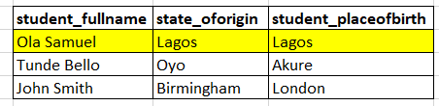
PRIMARY KEY CONSTRAINT
Now, imagine 2 students that have the same fullname ‘Ola Samuel’, they are both living in Lagos state and were both born in Lagos state
Below is the snapshot of the student table in the database;
How do we know which of the two “Ola Samuel” have registered if we don’t ask them?

Slide 25
PRIMARY KEY CONSTRAINT
A primary key is that column or columns on your table that uniquely identify each record on a table.
Would it make it better if we introduce a column ‘student_number’ on the table? This type of field is known as the PRIMARY KEY
A table can have only ONE primary key (although, we can have multiple columns combined) as a Primary Key too (later class)
Primary Key is an example of a constraint just like NOT NULL.
Primary keys must contain UNIQUE values, and cannot contain NULL values
In many cases, an AUTO Increment column can also serve as a PRIMARY KEY eg student_id

Slide 26
Creating Primary Key via GUI
Demo

Slide 27
CREATING PRIMARY KEY VIA QUERY
Fresh table creation:
CREATE table student(
student_no INT PRIMARY KEY,
student_fullname VARCHAR(50) NOT NULL,
student_state VARCHAR(50),
student_placeofbirth VARCHAR(50)
)
Adding Primary Key after table is created (no data yet)
ALTER TABLE table_name ADD PRIMARY KEY (column_name)
Syntax to DROP PRIMARY KEY constraint from a table is:
ALTER TABLE table_name DROP PRIMARY KEY;

Slide 28
UNIQUE CONSTRAINT
UNIQUE Constraint can be added to a column to force the column to store only unique data. For example email field
Syntax to ADD UNIQUE CONSTRAINT to a table is:
ALTER TABLE table_name ADD UNIQUE(column_name);
ALTER TABLE student ADD UNIQUE (email);

Slide 29
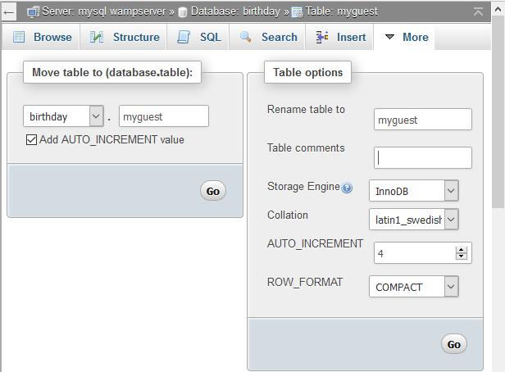
Explore PhpMyAdmin
You can set comments for a table field as follows: Select the table, go to Operations, enter the comments and save

Slide 30
Explore PhpMyAdmin
Pay attention to ENUM, TINYINT ENUM is used to define custom values. It has to be the exact option defined.

Slide 31
The INSERT Statement
The INSERT statement is used to add new data (record) to a database table.
There are 3 formats, The first does not specify the column names where the data will be inserted, only their values while the second specifies both column names and values:
INSERT INTO table_name
VALUES (‘value1’,’value2’,’value3’...);
INSERT INTO table_name (column1,column2,column3,...)
VALUES (‘value1’,’value2’,’value3’...);
INSERT INTO table_name SET column1 =‘value1’, Column2=‘value2’
!!!!! Note that each of the values is in quote but NOT the column name
Notes:
For the first one, the total values must match the numbers of columns in the table
With the second method, it is possible to add data to only specified columns on the table

Slide 32
DROP, TRUNCATE
To empty a database table, use the TRUNCATE statement.
Syntax is : TRUNCATE table_name;
To Delete the entire table (no remedy!) use the DROP statement. Syntax is:
DROP TABLE table_name

Slide 33
Exercise
Insert 3 records using each of the formats in the previous slide
The auto increment value can be left empty or at 0 , it will automatically make use of the next auto increment integer

Slide 34

Assignment
Submit your queries on a notepad or any text editor to moatacad@gmail.com

Slide 35
Assignment
We are developing an application for a RealEstate company to manage their properties online.
Create the database to use, call it estate

Slide 36
Assignment
In your database, create 2 tables namely: property and customer to help them store details about their properties and customers, respectively.
Property table should have 2 columns : property_name, property_price
Customer table should have 3 columns (add an additional primary key column, say customer_id): customer_fullname, customer_email, customer_address

Slide 37
Assignment
The company currently has 3 customers. Insert the 3 customers’ records into the customer table using each of the INSERT statement formats described on slide 33
How does your database look like when viewed from PhpMyAdmin?

