Slide 1
WEB APPLICATION DEVELOPMENT TRAINING
MOAT ACADEMY FOR DEVELOPERS
LECTURE SLIDES ON
DATABASE DESIGN AND MODELING – DAY 3

Slide 2
Database Normalization
How many tables do we need in our database?
In developing a school application, can we just create a table, say ‘school_information_table’ and store all the data we need to store therein?
Notes:
A database table must store only one type of thing/data

Slide 3
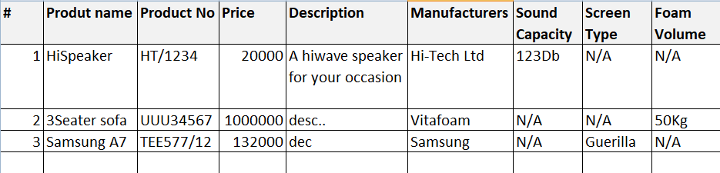
Why should we have more than one table? Each table must store only one kind of thing:
Consider Emeka who sells speakers, phones and Furniture and uses excel to keep his records as shown below: what are the problems here?
Notes:
Many empty columns depending on the product type
There are mix-ups, not easy to easily find item of a particular type

Slide 4
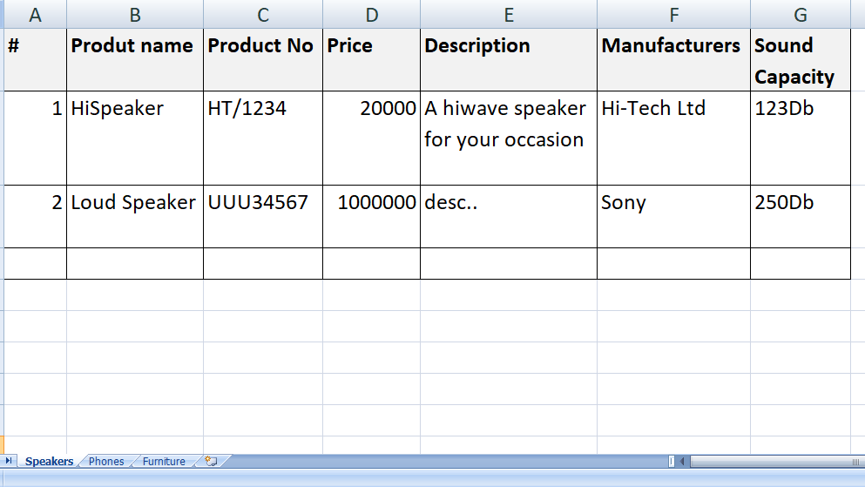
Using different worksheet for each line of product makes life easier: solves the problem of empty columns too

Slide 5
Database Normalization
Imagine a scenario where Emeka decides to also keep information about the manufacturer of the speakers.
He is interested in storing:
  The headquarters of the manufacturer
  The official phone number
  The official email address
  The contact person name
  The date his company started patronizing the manufacturer
  The discount enjoyed from the manufacturer
Notes:
A database table must store only one type of thing/data

Slide 6
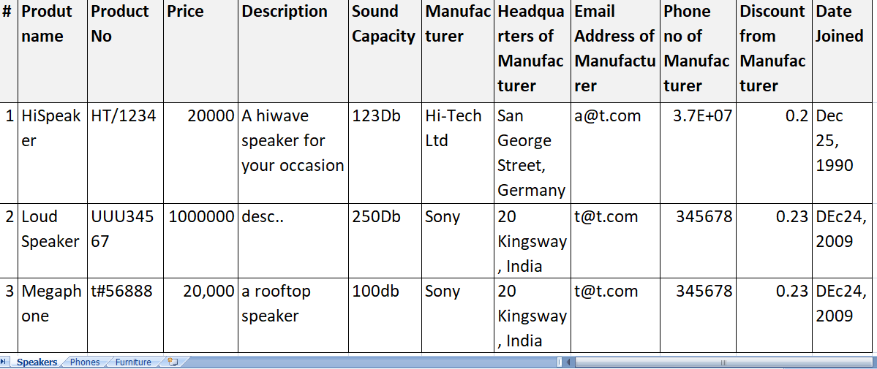
Any issues here? – storing manufacturers’ details for each product?; repetition of manufacturer info

Slide 7
What is Database Normalization? Let’s Talk about it
Check the second slides

Slide 8
Database Normalization
When do we further divide a table?
Redundant columns: when you find yourself repeating the same data in columns that have nothing to do with the subject matter
When an attribute makes us digress / lose focus from the table/entity under discuss: we should not violate the rule of making a table store data about ONE thing
In the above , we need to create a manufacturer table
Notes:
A database table must store only one type of thing/data

Slide 9
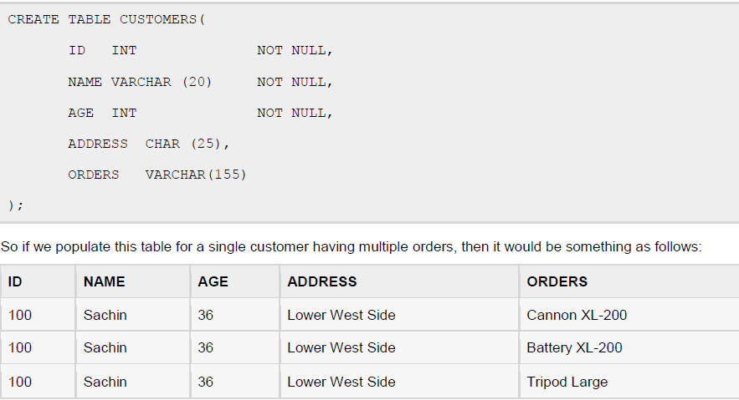
Consider this table: Is there a violation of our Normalization rule?

Slide 10
The table should be divided into two:
Customer and Customer_order

Slide 11
Steps in Designing a Database
Database design is the process of producing a detailed data model of database
Decide on what data to store in the database
Determine the categories of related data and create tables accordingly. Each table should contain ONLY related data
For each column in the table, determine the appropriate data type.
Each table should contain a field that is unique to each record in the table
Exercise: create a database for the customer registration and product information aspect of an ecommerce website . Design the database in such a way that customers can search for items by product name and also by category

Slide 12
Logical Representation of a Database
The process of logical design involves arranging data into a series of logical relationships called entities and attributes
An entity relationship model, also called an entity-relationship (ER) diagram, is a graphical representation of entities and their relationships to each other, typically used in computing in regard to the organization of data within databases or information systems.

Slide 13
Database Entity
An entity is any object in the system that we want to model and store information about.
Entities are usually recognizable concepts, either concrete or abstract, such as customer, products which have relevance to the E-commerce website database.
In other words, who are the users of the application, AND what items in this application do I want to store information about?

Slide 14
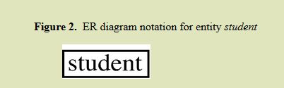
Logical Database Design Using Entity Relationship Diagram
You can design/model your database [tables] using Entity Relationship Diagram where the tables represent the entity you are modeling.
Each entity has attributes, or particular properties that describe the entity.
For example, student Emmanuel has properties of his own Student Identification number

Slide 15
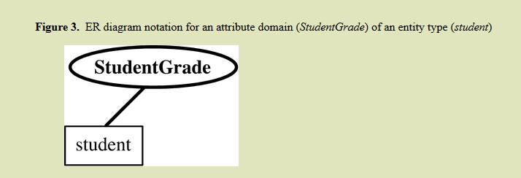
Logical Database Design Using Entity Relationship Diagram
The attributes of the entities are the columns of the database tables and are represented by ovals that connect to the entity

Slide 16
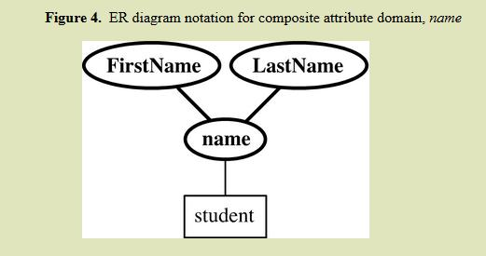
Logical Database Design Using Entity Relationship Diagram
A composite attribute is one that can have more than one part eg name can be first name and surname

Slide 17
Logical Database Design Using Entity Relationship Diagram
An attribute or set of attributes that uniquely identifies a particular entity is a [primary] key. For example, Emmanuel‘s Student Identification Number uniquely identifies him
This attribute is underlined to show that It is the Primary key attribute
Relationship: A relationship type is a set of associations among entity types.
For Example, relationship exists between student entity and Lecturer entity
If it’s important to track some data about the relationship between entities too, you need to create a table

Slide 18
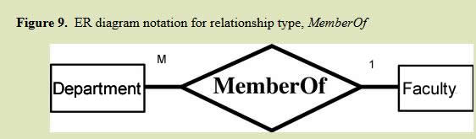
Logical Database Design Using Entity Relationship Diagram
The relationship can be one to many or many to many or one to one (If One person has only one passport – ONE to ONE)
Eg A faculty can have many departments while a department can only have one faculty. The relationship is known as one to many
Relationship is shown using a diamond shape:

Slide 19
Relationship can help in design
Exercise
As the IT consultant to Opebi University, you have recommended to the development team that they should create a form where new departments can be added to the system as they are being accredited by the NUC.
Based on the ER diagram in the previous slide and the many-to-one relationship between department and Faculty, which of the following form designs can be adopted?

Slide 20
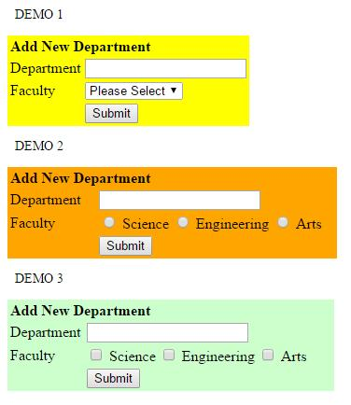

Slide 21
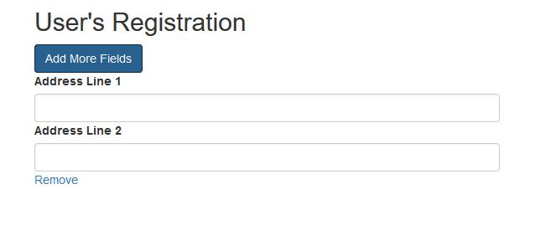
Designing GUI based on relationships between entities
The relationship between two entities affects the interface design:
A user table is used to store bio-data information of users as well as the address, the addresses can be more than one as shown above. How will you capture the one to many relationship between user and address as shown above?

Slide 22
Exercise
The role of the President is currently vacant at Lagos State Association of Chemical Engineers.
Only members who have paid their dues can vote
There are 3 contestants but there will only be one winner.
Identify the entities in the proposed e voting system for this association.
Notes:
Suggested entities; members, contestants (stores data abt the contestants like manitesto, this table will link to member table), payment
Vote is the relationship between member and the contestant.
Ponder: a member can vote for a contestant

Slide 23
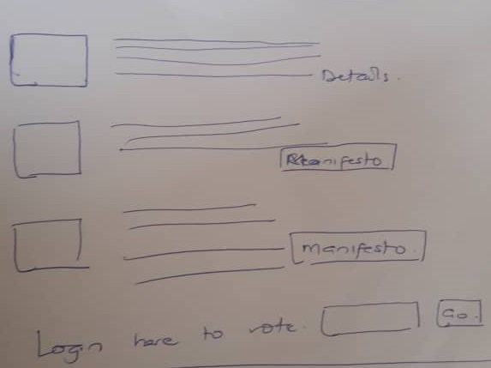
E-voting system

Slide 24
How many Tables?
Decide on the entities
Itemize the relationship among the entities
Determine the relationships

Slide 25
Creating Tables From Entity
Creating table from entities is very straight forward.
The attributes of the entity will serve as the fields of the tables with their respective data types.
Declare primary key.

Slide 26
Creating Tables From Relationship
If you have decided that you want to store some things about the relationship, create table for the relationship.
Add the primary keys of all participating Entities as fields of table with their respective data types.
If relationship has any attribute, add each attribute as field of table.
Declare a primary key composing all the primary keys of participating entities.
Declare all foreign key constraints.

Slide 27
Exercise
At a project meeting, the client has told you that he will like a platform where people can upload their picture and choose from a wide range of template to be used in the picture frame. Describe possible entities and the relationships

Slide 28
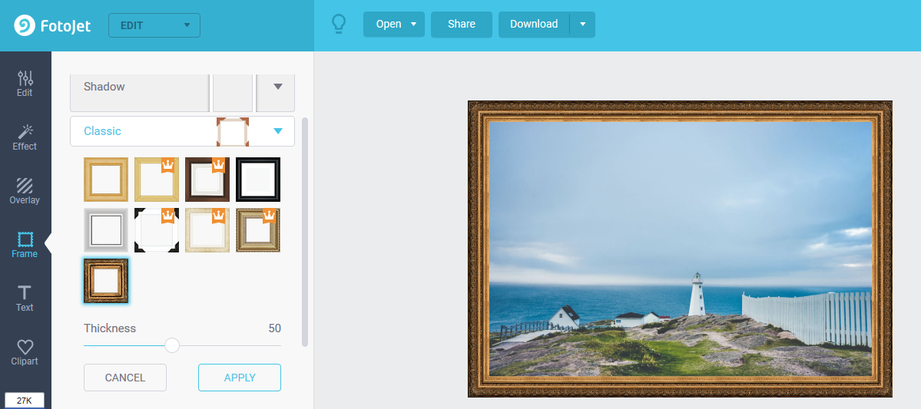
Online Picture Framing : https://www.fotojet.com allows you to upload your picture, pick a template for it… let’s say the company receives your uploaded picture, frames it and delivers to your home
Notes:
Suggestions: user, template, user_picture (which may have template id or a separate table picture_template to store the relationship btwn picture and template in a situation when we want to capture more data about the frame made from the picture/template combination. Such data includes: shippingfee, amountPaid etc)

Slide 29
Exercise:
Online Farm-Produce Listing
A platform that allows farmers list their products, buyers can browse through available products and select the one(s) they are interested in and submit in a form.
Identify the entities and relationships in this scenario. What are the possible attributes?

Slide 30
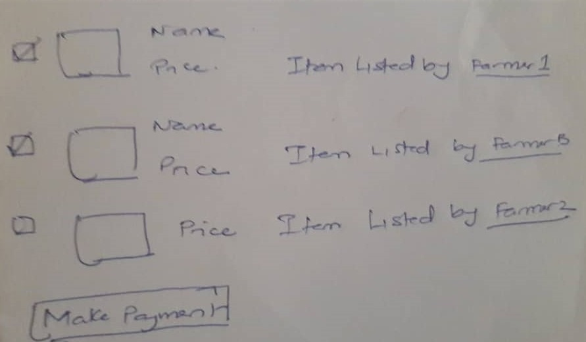
Online Farm-Produce Listing

Slide 31
Weak Entity
A weak entity is one which does not have any primary key associated with it. The table depends on another table to have meaning
Example: Having a table that stores the data of students in a school and another table that stores the details of the next of kin of the students
Note that the table that stores the next of kin of the students relies on the student’s table to exist.

Slide 32
Weak Entity
The order table and order detail table in an e-commerce application
What do you notice about order detail entity?
  It cannot be fully identified by its own attributes.
  Cannot have a primary key of its own therefore, it must use a foreign key in conjunction with its attributes to create a primary key.
The foreign key is typically a primary key of the entity it is related to.

Slide 33
Exercise
Design a database for a late-comer app. It should capture the profile of all the participants in the class.
Participants should login when they come every day, anyone who login after 9am is assumed to be late and will be due to pay 500 naira as fine.
At the end of the programme, we should be able to see all the total amount raised and know how much each person owes
We will have a small party with the money raised.

Slide 34
Database Schema
Having designed the database based on the entities and their relationship in what is known as E-R diagram, the next step is to design the database schema.
The database schema shows the organization of the tables in the database, their relationship and details such as the column name, the data type – It simply is the blueprint of how your database is organized.
See the example below:

Slide 35
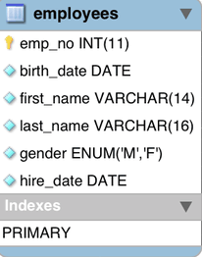
Database Schema
There are tools you can use to create database schema
Example is: Microsoft Visio,
Others are:
http://www.dbschema.com/
Visual Paradigm etc
MySQL Workbench

Slide 36
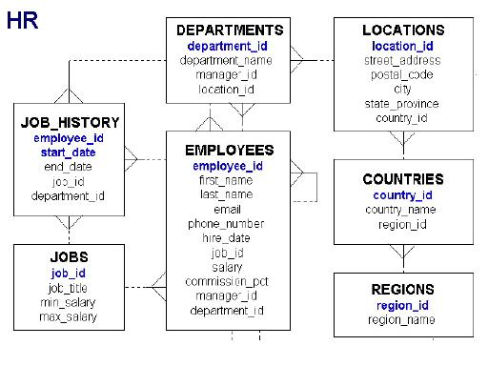
Database Schema
Notes:
Database Schema for an HR department of a company explained

Slide 37
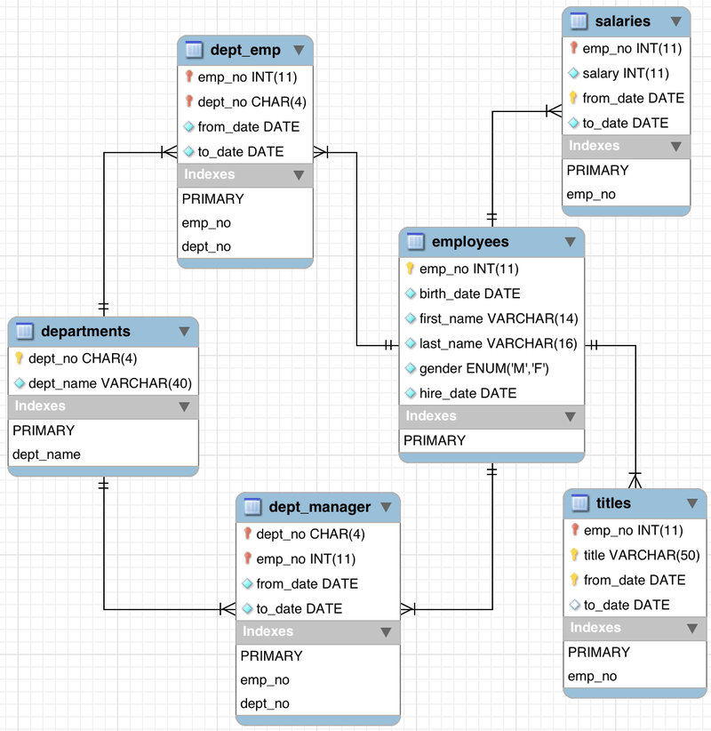
Notes:
A more detailed database schema for employee records

Slide 38
Physical Design
After the database has been modeled using ER Diagram and the database schema has been designed. The next is the creation of the Physical Database
Physical database design translates the logical data model into a set of SQL statements that define the database.
In relational Database System, entities simply become tables
When you create tables, you can set an auto increment field/column
You can set a Unique constraint to ensure that the column defines the uniqueness of the records being inserted.
Many Database modelling tools can be forward-engineer to produce the SQL query for creating the physical Database.

