Slide 1
MOAT ACADEMY
WEB APPLICATION DEVELOPMENT TRAINING
document.getElementById method, Conditional Statements
Day 2

Slide 2
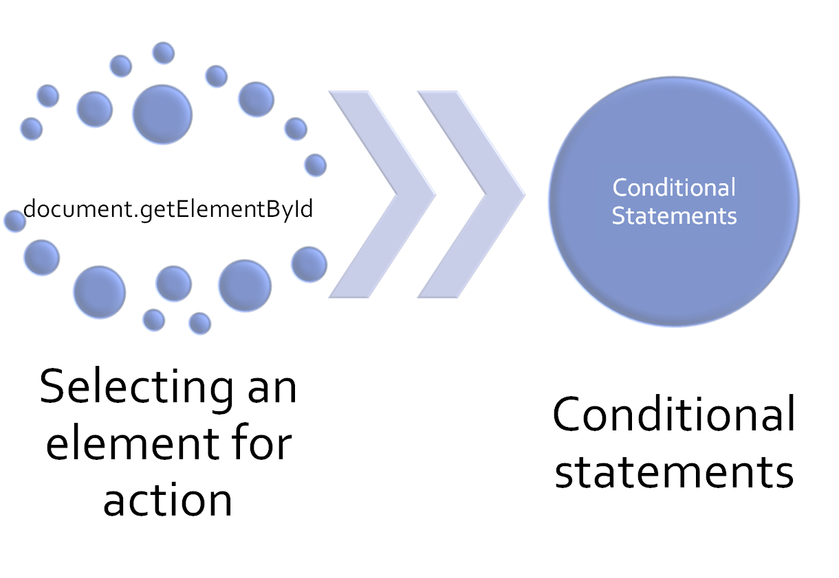
Outline

Slide 3

Radio Morning Show
On a Morning Show at Radio Lagos, callers can participate in a Quiz by calling in, the caller can pick any number, say X and the show host will respond by saying "Number X is available"

Slide 4
Radio Morning Show
Question 1
Create a html page with a button that reads 'start quiz’. When a user clicks this button, display a prompt box to receive an input from the user. Whatever number is entered by the user, say X; should then be displayed with an alert box that reads "Number X is available".
No validation is required

Slide 5
Javascript Events and Inline Placement
Recall that when events happen, you may want to do something.
JavaScript lets you execute code when events are detected.
When JavaScript is used in HTML pages, JavaScript can "react" on these events.
Syntax : <HTMLTag onevent="some JavaScript">

Slide 6
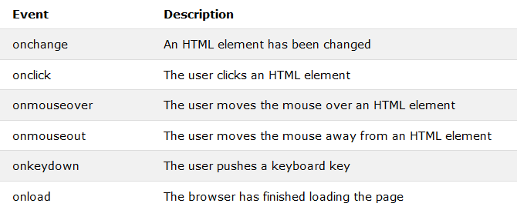
JS Events
Moat Academy for Developers

Slide 7
The getElementById Method
The getElementById Method is the most common way to access an HTML element by using the id of the element.
Notice the camel-casing, it must be written as shown.
document.getElementById(‘ID’)
The ID is a string which can be used to uniquely identify an element on a webpage.
It is an HTML attribute. There should only be one id value in a document
Id is case-sensitive

Slide 8
Things you can do when events happen
Retrieve the contents of HTML elements
Change the content of HTML elements
Change the style (CSS) of HTML elements

Slide 9
Retrieving value of an attribute of a tag using document.getElementById(‘id’)
Saying: Look for an element on this page that has id called id
After picking the element, ask: which of its attribute am I interested in?
To retrieve the value of the attribute, assign it to a variable like this:
var myref = document.getElementById(‘id’).attribute
Example, an input of type text has value attribute.
var content = document.getElementById(‘demo’).value
alert(content);
The above will display the input of the user on an element with id demo

Slide 10
Radio Morning Show (2)
Following the example above and the explanations given, rather than a prompt box, let the user type the number, say X in an input box. After clicking a submit button, it should display "Number X is available"

Slide 11
QUIZ: Describe the attribute of interest in the following scenarios:
EXAMPLE: To determine the height of an image ANSWER : Height
To determine if an input box is a radio button or not
To determine where a form will submit to
To determine the label on a button created by the <input> tag
To determine the class of a link **
To determine the inline CSS applied to an element
To determine the path of an image
To determine what a user selects in a radio button
To determine where a marquee scroll to
To determine the option selected by a user in a drop-down menu
To determine the amount of border on a table
To determine if a link will open in a new window
To determine what will be displayed if an image is missing
To determine if an ol will use 1,2,3.. Or A,B,C.. Numbering system
To determine the width of an image
Notes:
** even though the attribute name is class, but class is a keyword in Javascript (we will see this later), we use . className to refer to the class name attribute

Slide 12
Attribute when the element does not have a value attribute
How do we retrieve the contents of HTML tags such as <h1> to <h6>, <p> <button> which do not have the value attribute.
<p>This is a test paragraph </p>
How do we retrieve the contents enclosed within the opening and closing tags since there is no value attribute?
The innerHTML!
Notes:
The innerHTML property can be used to get or change any HTML element especially those that do not have the “value” attribute

Slide 13
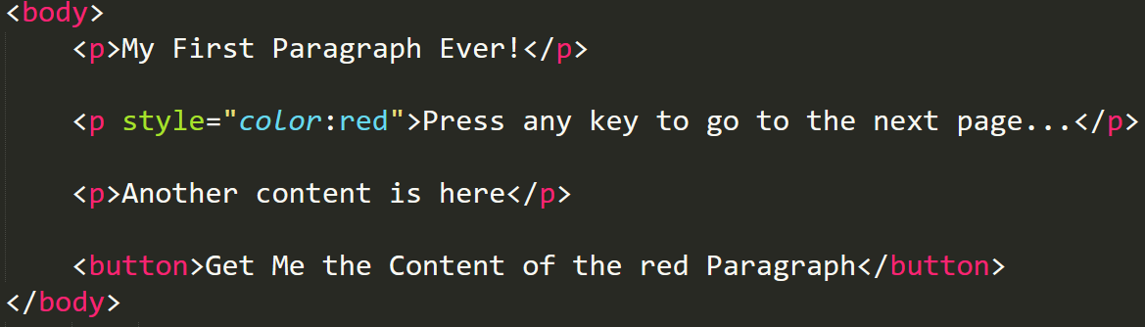
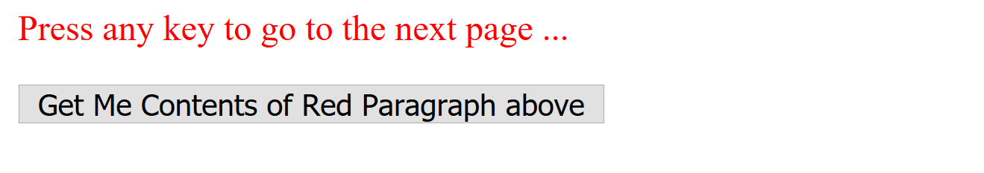
Exercise:
There are many p tags on your page, but there is one that is styled red using inline css.
If a User clicks the button, display the contents of the red paragraph using an alert() box

Slide 14
POSSIBLE SOLUTION
The first step is to give the tag you are interested in an id, so that you can make use of document.getElementById().attribute to pick it.
Then, since the event is to happen when the button is clicked… it means the button is meant to respond to a click event
See sample in the next slide:

Slide 15
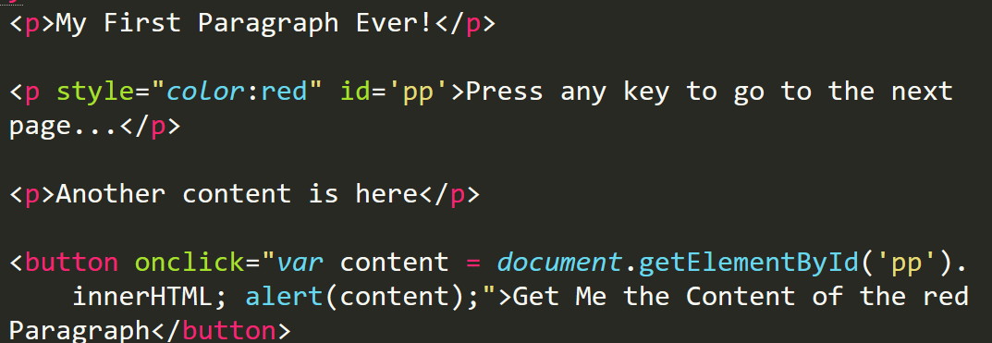
POSSIBLE SOLUTION

Slide 16
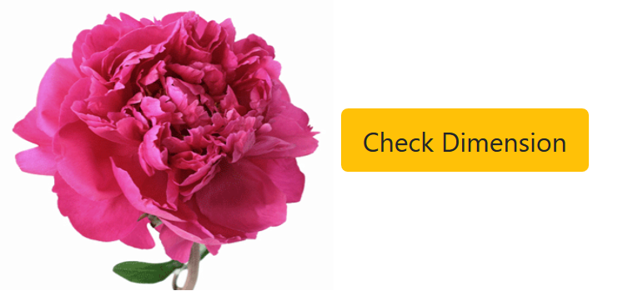
QUIZ
Using HTML tags, place an image on your page and a button such that when a user clicks on the button “Check Dimension” you will alert “The dimension of your image is w x h”
W is the width and h is the height
Notes:
The attribute may be implied and not present – compare .value of an input text field. The input text field will pick whatever the user types as the value even when we don’t explicitly write <input type=‘text’ value=‘my content’>

Slide 17
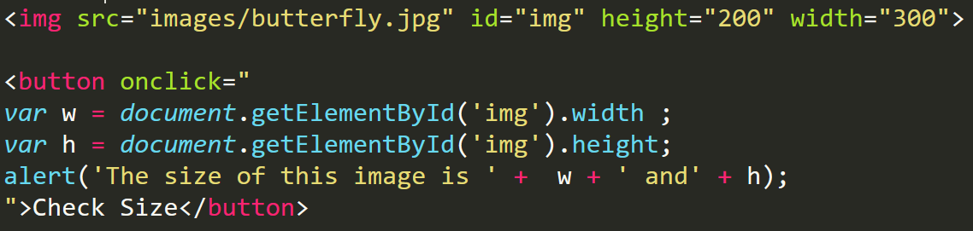
POSSIBLE SOLUTION

Slide 18
Changing the value of an attribute using document.getElementById(‘id’)
Saying: Look for an element on this page that has id called id
After picking the element, ask: which of its attribute am I interested in? .attribute
To give the attribute a new value, use the equals to sign as shown below
document.getElementById(id).attribute = new value
Remember that if new value is a text, it has to be in quote

Slide 19
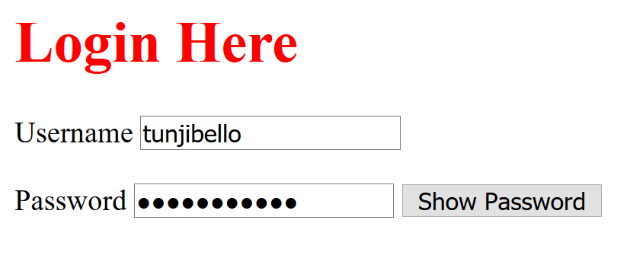
Exercise 4: Show Password button

Slide 20
Exercise 2: Image Flip
Step 1: Create a HTML document, place one of the images given to you on the page using the img tag.
Step 2: Using javascript statement, change the picture displayed and show, the second part of the image instead.
The JS code in step 2 above should be attached to a button click event.

Slide 21
Exercise 3: Image Flip
Modify the above code such that the image changes to another when the image is clicked.
The this keyword can be used to replace document.getElementById() when you are on the same element. See notes for example usage
Notes:
Subtlily introduce participants to this keyword
<img src=“new.jpg” onclick=“this.src=‘old.jpg’” id=‘image’/> rather than <img src=“new.jpg” onclick=“document.getElementBId(‘image’).src=‘old.jpg’” id=‘image’/>

Slide 22
.style attribute
You can retrieve the inline style given to an element or alter the appearance using the .style attribute as shown below:
document.getElementById().style = ‘new css rule specification’
Other ways exist to reference the style attribute has the general formular:
document.getElementById().style.cssRuleInCamelCase
See next slide for summary

Slide 23
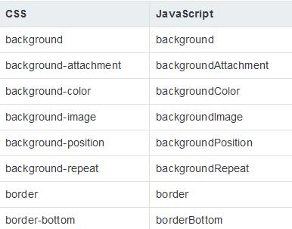
Changing the Value of an Attribute
Notes:
Formula: anywhere css would have used hyphen, camel-casing is used as is the custom of js developers

Slide 24
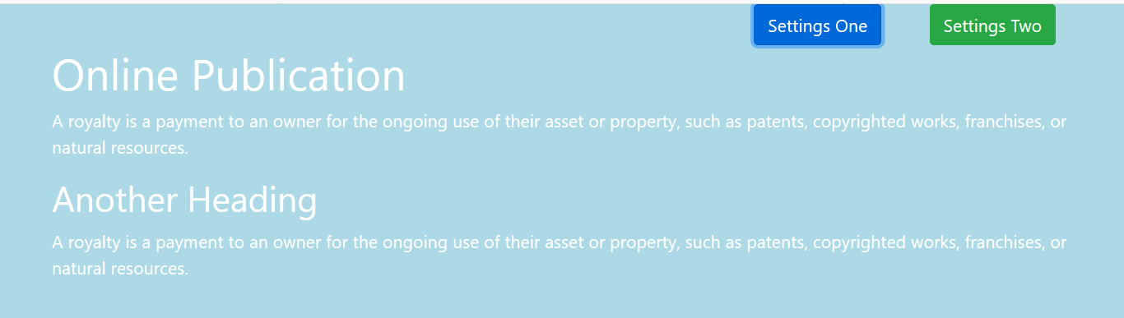
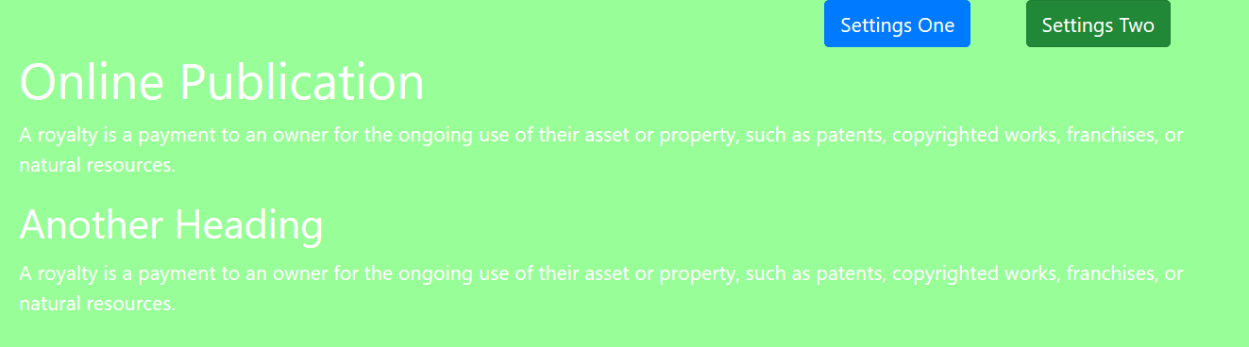
Users can select what theme they want on click of any of the buttons

Slide 25
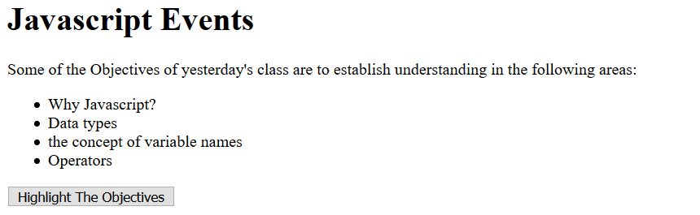
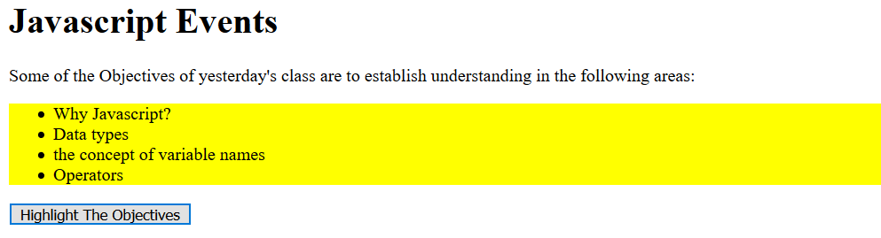
Assignment : when the user clicks the button, the contents of the <ul>.. <li> tag should be highlighted as shown

Slide 26
Pro Tip
Programming is thinking, not typing! - @codeWisdom
Moat Academy for Developers

