Slide 1

MOAT ACADEMY FOR DEVELOPERS
WEB APPLICATION DEVELOPMENT TRAINING
HTML ATTRIBUTES, HTML IMAGE AND LINKS
HTML DAY 2

Slide 2

NESTED TAGS
Tags can be placed within another tag…

Slide 3
HTML Lists
Unordered HTML List
An unordered list starts with the <ul> tag. Each list item starts with the <li> tag.
The list items will be marked with bullets (small black circles) by default:
<p>These are the software gurus in the class today:</p>
<ul>
<li>Alex</li>
<li>Peju</li>
<li>Bola</li>
</ul>

Slide 4
HTML Lists
Unordered HTML List - Choose List Item Marker using the style property. (square, disc, circle none) style="list-style-type:disc“
Ordered HTML List
An ordered list starts with the <ol> tag. Each list item starts with the <li> tag.
The list items will be marked with numbers by default

Slide 5
HTML Lists
<ol>
<li>Coffee</li>
<li>Tea</li>
<li>Milk</li>
</ol>
The start attribute <ol start=‘3’></ol>
Ordered HTML List - The Type Attribute
The type attribute of the <ol> tag, defines the type of the list item marker:

Slide 6
TYPE ATTRIBUTE FOR AN ORDERED LIST
Type Description
type="1" The list items will be numbered with numbers (default)
type="A“ The list items will be numbered with uppercase letters
type="a" The list items will be numbered with lowercase letters
type="I" The list items will be numbered with uppercase roman numbers
type="i" The list items will be numbered with lowercase roman numbers

Slide 7
Nested List
It is perfectly ok to nest one list inside another one. However, you should not nest a block level element within an inline.
You might want to have some sub-bullets sitting below a top-level bullet.
Just like any HTML tag, you can embed tags within other tags as follows:
<tagone>
<taginner> </taginner>
</tagone>
NOTICE: The inner tag must close and be wrapped by the outer tags

Slide 8
Exercise
Replicate the list of information below using HTML List.
Some of my expectations from the programme are:
Understand GUI
Develop Software Like:
  Jumia
  Facebook
Be a Pro!

Slide 9
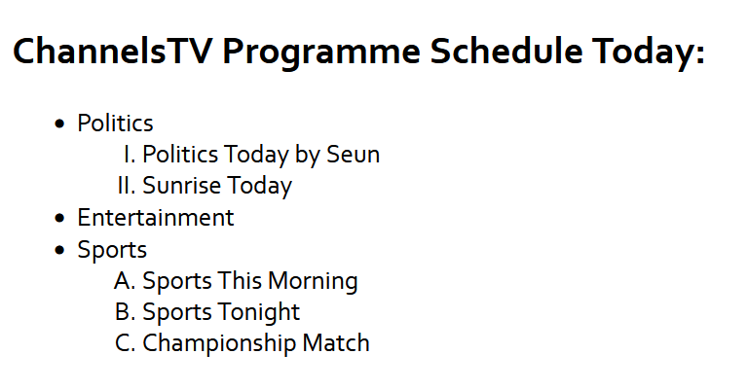
Practice This At Home

Slide 10
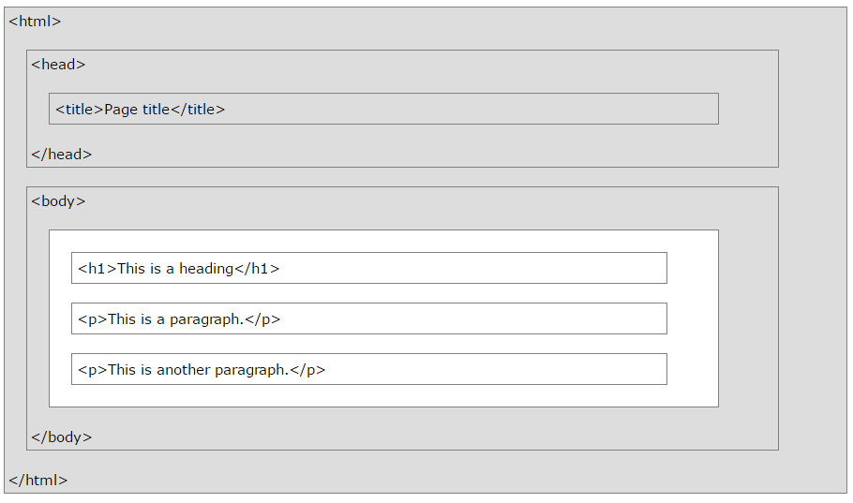
RECAP
Anatomy of an HTML Document
Common Components of a Web Page
Inline and Block Element
Closing and Non-closing Tags
HTML attributes

Slide 11
EXAMINING THE PARTS OF AN HTML DOCUMENT – THE HEAD SECTION
The <head> tag contains meta tags that give information to the browser about the document.
HTML metadata is data about the HTML document.
Metadata is not displayed.
Metadata typically define the document title, character set, styles, links, scripts, and other meta information.
Metadata by definition, is data about data. It is invisible to web users, located within the <head> tags of a page, and gives information to search engines and other websites about a site and its content

Slide 12
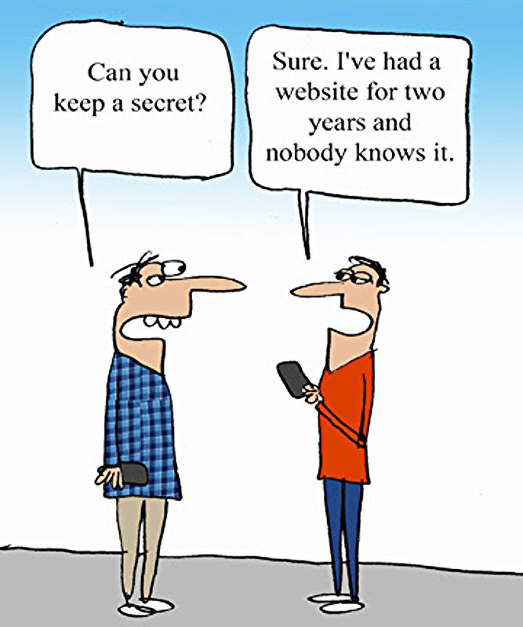
METADATA – DATA ABOUT DATA
Is this a good secret?

Slide 13
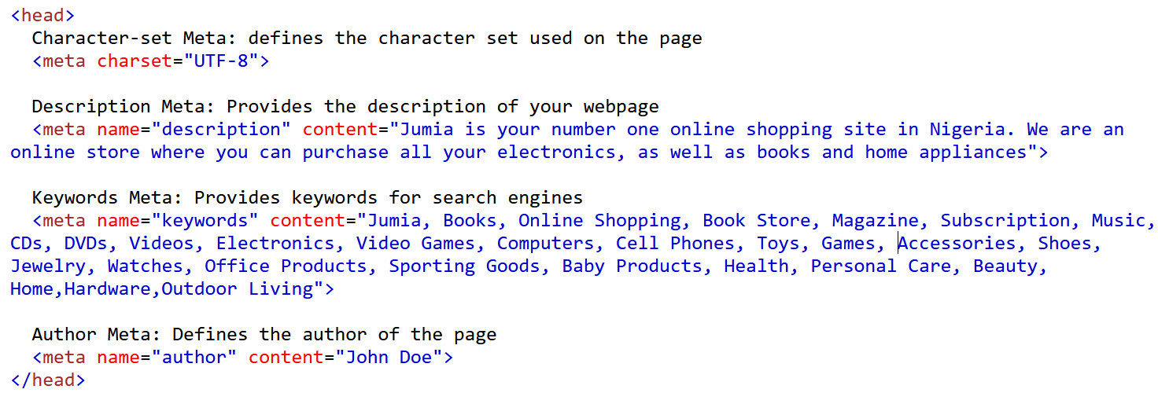
META TAG USAGE

Slide 14

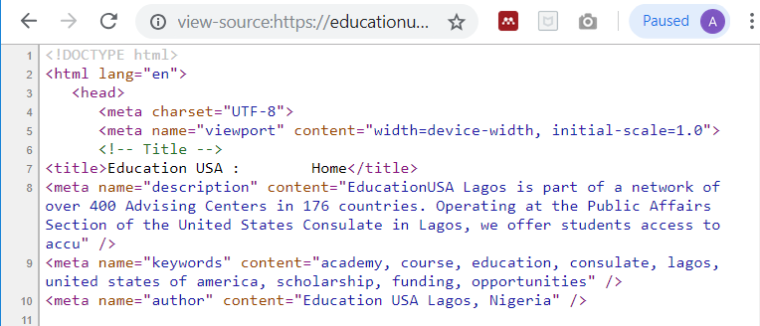
HTML Head section

Slide 15
BEST PRACTICES – META TITLES
Meta titles should be short. It is best to keep them under 60 characters inclusive of the spaces
Some School of thoughts like Websight Design. (2019) recommend to describe what the page is about in the beginning of the title and add the name of a website or company at the end.
Using keyworded meta titles is a good way to give signals of relevancy to search engines.
Only include keywords in the title if they are also included in the body content of the page.
Only optimize a page with keywords for which it is relevant.
Google relies heavily on the title of a page and its relevancy to the content on the page to determine its appropriate ranking.
Notes:
Websight Design. (2019). Social Media Metadata | Websight Design. [online] Available at: https://www.websightdesign.com/services/internet-marketing/search-engine-optimization/social-media-metadata [Accessed 16 Jan. 2019].

Slide 16
BEST PRACTICES – META DATA
Google reserves the ability to change the meta description and use content from the page in the meta description if it judges the original description non-descriptive, inappropriate or irrelevant to the actual content of the page
A meta description should not be longer than 160 characters, spaces included. It should describe what the page is about and include at least one keyword used in the corresponding title of the page
The meta keyword tag associates specific words with the content on the page. In the field where relevant keywords are inserted, WSD's recommend to only include keywords present in the specific page.
Notes:
Websight Design. (2019). Social Media Metadata | Websight Design. [online] Available at: https://www.websightdesign.com/services/internet-marketing/search-engine-optimization/social-media-metadata [Accessed 16 Jan. 2019].

Slide 17
What keywords would you give the following websites?
A website for Chrisland International Nur/Pry School located in Opebi Lagos
A website for a Non-profit organisation which is into adult literacy education
Emeka who sells phones and other gadgets at Computer Village
A wedding website for John and Mary where guests can get information about their upcoming wedding
A website for Ashley Microfinance bank
A personal website for Aminu who will be vying for the Governorship position under PDP in 2023
A job vacancy website like jobberman

Slide 18
EXERCISE
Imagine that the page you are on now is your personal webpage to be hosted at the end of the 12-weeks programme, how would your meta data look like?
<meta name="keywords" content="" >
<meta name="description" content="" >
<meta name="author" content="" >

Slide 19
SOCIAL MEDIA META DATA
Social media metadata determine how a web page is supposed to appear and what information to give to the social media websites when sharing the page on the social media. Facebook implements what is known as open graph [protocol] while Twitter implements it using twitter cards.
Open Graph protocol makes use of property and content attributes for markup while Twitter cards use name and content
Correctly worded and displayed metadata like titles and meta descriptions, can improve the click-though rate when the page is shared on social media sites
Twitter Cards allows you to attach rich photos, videos and media experiences to Tweets which in turn helps in driving traffic to your website. If you add the twitter meta tag to your webpage, users who Tweet links to your content will have a “Card” added to the Tweet that’s visible to their followers.
When the Twitter card processor looks for tags on a page, it first checks for the Twitter-specific property, and if not present, falls back to the supported Open Graph property.
Notes:
Websight Design. (2019). Social Media Metadata | Websight Design. [online] Available at: https://www.websightdesign.com/services/internet-marketing/search-engine-optimization/social-media-metadata [Accessed 16 Jan. 2019].

Slide 20

SOCIAL MEDIA META TAGS
Have you experienced this before while trying to insert a link within your post on Facebook?

Slide 21
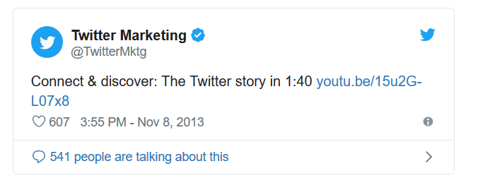
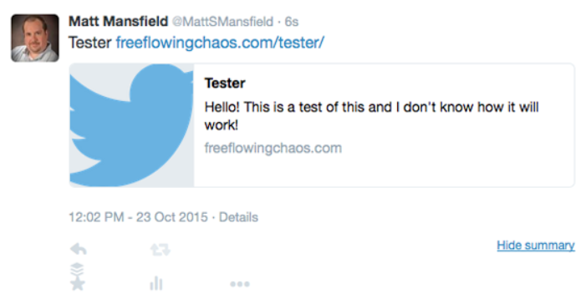
TWITTER CARDS EXAMPLE : ARTICLE AND SUMMARY CARD

Slide 22
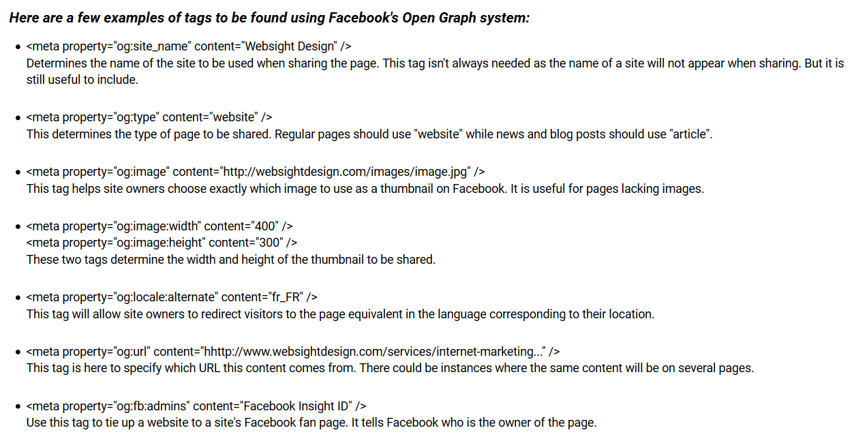
FACEBOOK META DATA (OPEN GRAPH)

Slide 23
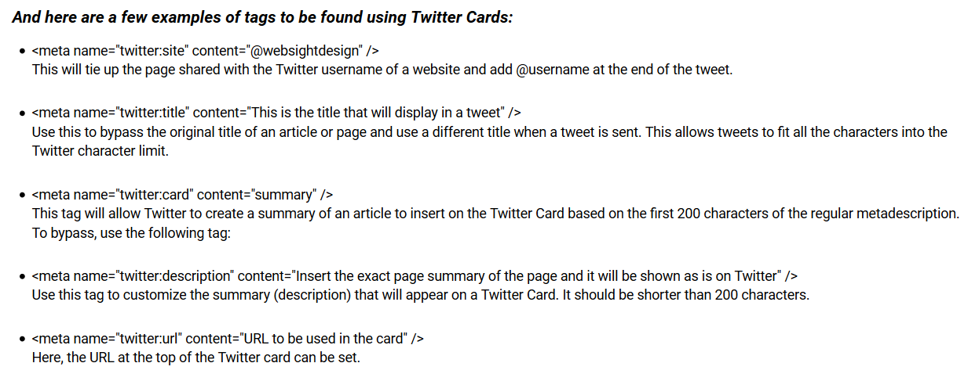
TWITTER META DATA (TWITTER CARD)

Slide 24
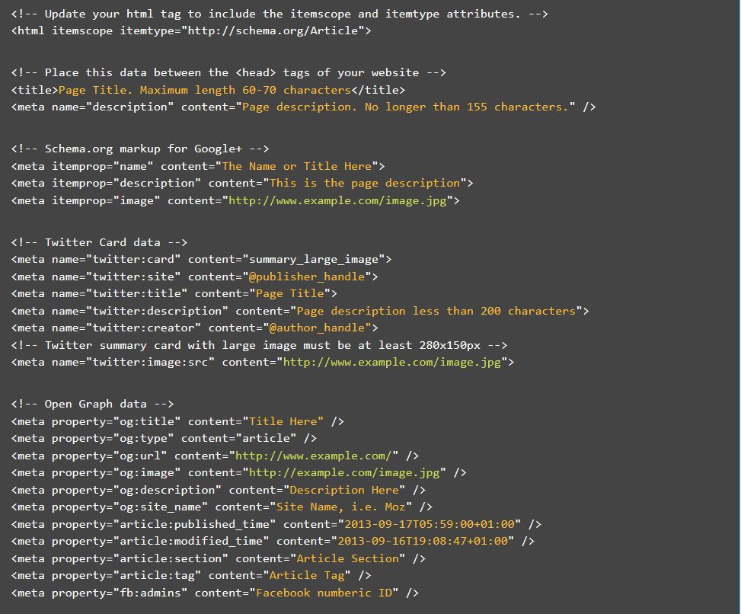
REFERENCE: FULL SOCIAL MEDIA TAG TEMPLATE

Slide 25
HTML IMAGES AND LINKS
Images on your webpage
Navigating around the website

Slide 26
HTML IMAGES
Defined by the tag <img> and does not have a closing tag. Self closing <img />
Attributes: width, height, alt
Example
<img src=“images/1st-timeline.jpg" width="100" height="216" alt=“sample image" />
If a browser cannot find an image, it will display the value of the alt attribute
The alt attribute also helps when displaying websites where pictures are turned off (maybe to save bandwidth)
QUIZ: Update your personal web page assignment to include your picture in the ‘About Me’ section.
Notes:
Image dimension is in pixel

Slide 27
HTML IMAGES
Images in another folder: expects to find in the same folder or sub folder, then specify the sub-folder name (Please See Next Slides)
Images on another server: different from where your file is – specify absolute/full website address.
QUIZ: Update your personal web page assignment to include ‘Gallery’ section, use marquee to form the photo gallery

Slide 28
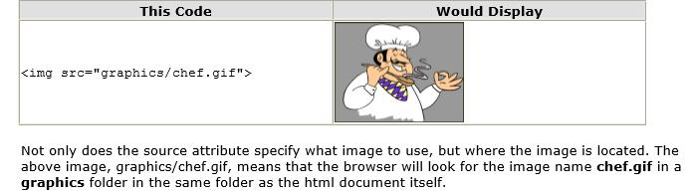
SPECIFYING IMAGE LOCATION

Slide 29
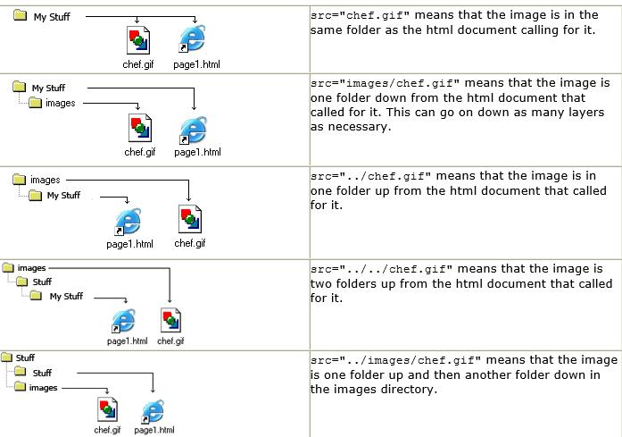
SPECIFYING IMAGE LOCATION

Slide 30

HTML LINKS

Slide 31
PLACING HTML LINKS
HTML Links are used in ‘linking’ two web pages together to form a website of many pages or to jump to specific location of the same document
When you move the mouse over a link, the mouse arrow will turn into a little hand.
Defined with the <a> tag
The syntax is <a href="url">link text</a>
<a href="http://moatacademy.com">Visit our Website</a>

Slide 32
PLACING HTML LINKS
Local Links are specified as absolute address
<a href=“index.html” target=“_blank”>Test</a>
HTML Link Colors
By default, a link will appear in all browsers :
    An unvisited link is underlined and blue
    A visited link is underlined and purple
    An active link is underlined and red
Notes:
Attributes – target (_blank, _self)

Slide 33
EXERCISE
Link two of your web pages together in a way that the user is not lost. ie He should be able to navigate to and from the two pages.
Note: use target = ‘_self’

Slide 34
HTML LINKS
You can turn just about any content into a link.
To use an image as a link, simply nest the <img> tag inside the <a> tag (wrap the img tag with <a></a>)

Slide 35
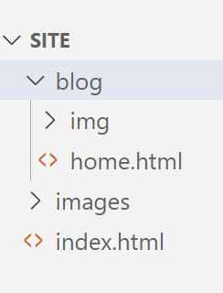
PRACTICE EXERCISE
Using the given folder structure, create a site using images from the folders

