Slide 1
WEB APPLICATION DEVELOPMENT TRAINING
MOAT ACADEMY FOR DEVELOPERS
LECTURE SLIDES ON
MORE DATABASE QUERIES Day 2

Slide 2
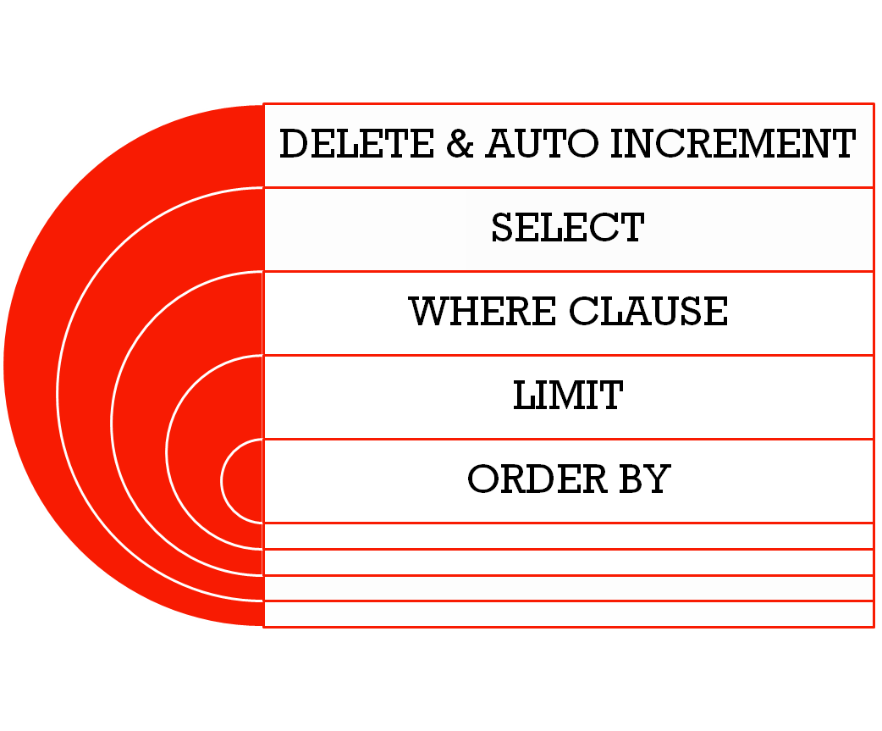
OUTLINE

Slide 3
MORE ON DELETE
To delete records from a Table, use the DELETE statement as follows:
DELETE FROM tablename WHERE column_name = ‘value’
Omitting the WHERE Clause will delete all the records in the table.
Worse than TRUNCATE as it does not reset the auto increment column

Slide 4
AUTO INCREMENT AND RESET
When you delete one or more records from a table, if there is an auto field, the increment value continues from the last record.
You can reset the auto increment before adding new records.
To do this in HeidiSQL, see the next slide:
Change the auto increment value to the desired number

Slide 5
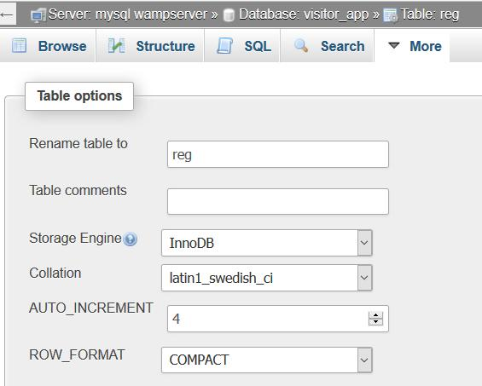

Slide 6
Importing an Existing Database
A common scenario is for a developer to set up an existing database
There are cases where you wish to replicate a complete database from one server (system) to another.
Rather than creating the database from scratch and then inserting the record one by one.
You can import the complete database with all its data

Slide 7
EXPORTING AND IMPORTING
You are a team member in the development of an app demoapp which is to be used to capture customers’ order.
The SQL dump has been given to you to generate the same database on your working system.
Using the Import method shown to you in PhpMyadmin, Import the database from the SQL dump.

Slide 8
The SELECT Statements
The essence of storing data in a database is to retrieve it at a later time.
The SELECT statement is used to select data from a database.
The result is stored in a result-set. This is an imaginary table in the memory
Syntax:
SELECT column_name,column_name
FROM table_name;
SELECT * FROM table_name;
Exercise: Using The Select Statement, select all the data from your product table, select only price and product name
Notes:
customer: firstname, surname, email, phone, password, city, dob
customer_order: custormer_id, order_id, order_date, order_amt, order_status,

Slide 9
Exercise
Using the customer table, select all the customer records.
Scenario: At the next board meeting of your organization, you as the Database Administrator are to present the above records to the management for an in-depth customer analysis
Given that they are only interested in the customer names, dob, phone number and city, run a query to fetch just the details that are required.
The ideal thing is to print this on a paper and give a copy to each person in attendance
Follow the class to see how to export records from your table

Slide 10
SQL Aliases – SELECT AS
The column headings are not okay for the MD who is so meticulous. What can you do?
You can select from tables by adding your own custom headings.

Slide 11
SQL Aliases – SELECT AS
SQL aliases are used to temporarily rename a table or a column heading.
SELECT column_name AS ‘alias_name’
FROM table_name;
SELECT column_name(s)
FROM table_name AS alias_name;
SELECT cust_lname AS ‘Name' FROM customers
Generate the customers’ list by using your own custom heading

Slide 12
SQL Aliases – SELECT AS
You can use the aliase method to concatenate columns and select under one heading using the concat statement
SELECT concat (cust_fname," ",cust_lname) AS 'info' FROM customers

Slide 13
Fetching the first n records
LIMIT
THE LIMIT

Slide 14
The LIMIT statement
The SQL SELECT LIMIT statement is used to retrieve records from one or more tables in a database and limit the number of records returned based on a limit value.
SELECT expressions FROM tables LIMIT rows
It specifies a limited number of rows in the result set to be returned based on rows.
For example, LIMIT 10 would return the first 10 rows matching the SELECT criteria*.
Notes:
* This is where sort order matters so be sure to use an ORDER BY clause appropriately.

Slide 15
The SQL SELECT DISTINCT Statement
In a table, a column may contain many duplicate values; and sometimes you only want to list the different (distinct) values.
Imagine that Festus, the sales manager mentioned during the meeting that he deserves a bonus as he has brought in customers from all the 36 states in Nigeria. How can we prove him wrong without checking the records manually ?
The DISTINCT keyword can be used to return only distinct (different) values.
Syntax is SELECT DISTINCT column1, column2
FROM table_name;
QUIZ: Using the SELECT Distinct Statement, Select all the customers living in distinct state

Slide 16
The SQL WHERE Clause
The WHERE clause is used to extract only those records that fulfill a specified criterion.
SELECT column1,column2
FROM table_name
WHERE column_name operator value;
SQL requires single quotes around text values (most database systems will also allow double quotes).
However, numeric fields should not be enclosed in quotes:
Exercise: Select only products whose prices are more than 1,000 naira

Slide 17
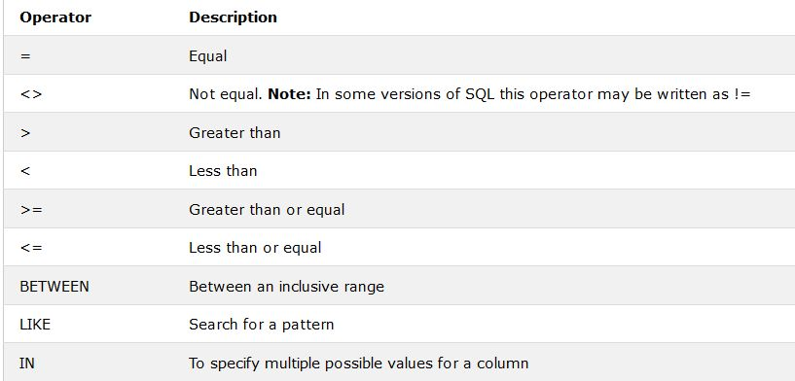
Operators and their Description

Slide 18
The SQL LIKE Operator
The SQL LIKE clause is used to compare a value to similar values using wildcard operators.
There are two wildcards used in conjunction with the LIKE operator
The percent sign (%)
The underscore (_)
A wildcard character can be used to substitute for any other character(s) in a string
The percent sign represents zero, one, or multiple “missing” characters.
The underscore represents a single number or character.
The symbols can be used in combinations.

Slide 19
The SQL LIKE Operator
The basic syntax of % and _ is as follows:
SELECT FROM table_name
WHERE column LIKE 'XXXX‘
XXXX can be preceded with % or _, it may also end with % or _

Slide 20
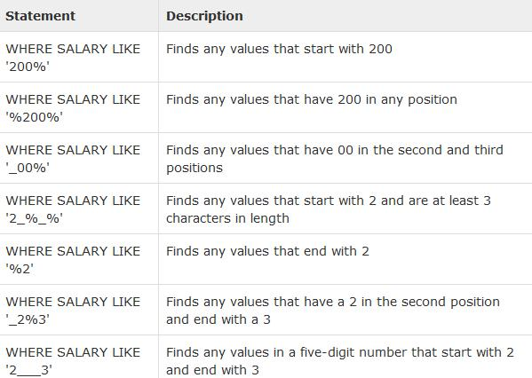
Quiz
Determine if the following records will be selected if SALARY =
200
20019
29089
1203

Slide 21
SQL LIKE Examples of Usage

Slide 22
SQL AND OPERATOR
The AND operator is used to filter records based on more than one condition
The AND operator displays a record if both the first condition AND the second condition are true.
Format is:
SELECT * FROM tablename
WHERE columname =‘value'
AND columname=‘value';
Notes:
* Is to select All

Slide 23
SQL OR OPERATOR
The OR operator displays a record if any of the conditions separated by OR is TRUE
Syntax is:
SELECT column1, column2, ...
FROM table_name
WHERE condition1 OR condition2 OR condition3 ...;

Slide 24
SQL BETWEEN OPERATOR
Syntax is as follows:
  SELECT column1, column2....columnN
  FROM table_name
  WHERE column_name BETWEEN val-1 AND val-2;

Slide 25
QUIZ
  01, June is the company’s 3rd year anniversary
  For this, the management wants to give anniversary gift to customers with id , 1, 3 and 6

Slide 26
THE IN OPERATOR
The IN operator allows you to specify multiple values in a WHERE clause.
The syntax is:
SELECT column_name(s)
FROM table_name
WHERE column_name IN (value1,value2,...);
QUIZ:Write the previous query using IN operator

Slide 27
ORDER BY Clause
The SQL ORDER BY clause is used to sort the data in ascending or descending order, based on one or more columns.
The Syntax is: SELECT column-list FROM table_name [WHERE condition] [ORDER BY column1, column2, .. columnN] [ASC | DESC];
You can use more than one column in the ORDER BY clause
You can also use ORDER BY RAND() to randomize a set of rows or values as follows:
SELECT * FROM employee_tbl ORDER BY RAND();
Notes:
Some database sorts query results in ascending order by default.

Slide 28
UPDATE Statement
Used to UPDATE existing records on the table
Syntax is as follows:
UPDATE table_name
SET column1=value1,column2=value2,...
WHERE some_column=some_value;
The update is done once (simultaneously) for all the records that satisfy the condition
If there is no condition stated, it updates all the records in the table
Exercise: For the customer table given, we want to reset all customer’s loyalty status to “0” so that each customer can build their points afresh. Write an UPDATE query to achieve this.

Slide 29
EXPORTING AND IMPORTING
You are the database admin of GTB, all banks have been mandated by the CBN new policy to produce their customer list within 6 hours.
Do you think this will be a problem in a manual system, will they meet up with the deadline?
Is this deadline fair in an automated environment where relational db is in use?
Respond to this using PHPMyadmin and HeidiSQL

Slide 30
Exercise
Using the database given, write queries to generate the following results:
All customers who have an “a” in either their first name or last name
All customers who live in Lagos
All orders above 5,000 naira
All orders except the ids 1 and 4
Help the Manager get the phone number of a customer named ‘Tola Oni’ who lives in Ondo
Notes:
CREATE DATABASE IF NOT EXISTS `demoapp` /*!40100 DEFAULT CHARACTER SET latin1 */;
USE `demoapp`;
-- Dumping structure for table demoapp.customers
CREATE TABLE IF NOT EXISTS `customers` (
`cust_id` int(11) NOT NULL AUTO_INCREMENT,
`cust_fname` varchar(50) NOT NULL,
`cust_lname` varchar(50) NOT NULL,
`cust_dob` date NOT NULL,
`cust_phone` varchar(50) NOT NULL,
`cust_city` varchar(50) NOT NULL,
PRIMARY KEY (`cust_id`)
) ENGINE=InnoDB AUTO_INCREMENT=6 DEFAULT CHARSET=latin1 COMMENT='This table stores the information about our customers';
-- Dumping data for table demoapp.customers: ~6 rows (approximately)
/*!40000 ALTER TABLE `customers` DISABLE KEYS */;
INSERT INTO `customers` (`cust_id`, `cust_fname`, `cust_lname`, `cust_dob`, `cust_phone`, `cust_city`) VALUES
(1, 'Olawole', 'Ajao', '1990-03-07', '080123456', 'Lagos'),
(2, 'Saheed', 'Balogun', '1998-03-07', '0802345687', 'Ibadan'),
(3, 'Abiola', 'Lawal', '2007-03-07', '0236789997', 'Lagos'),
(4, 'Oluwole', 'Idowu', '2009-03-07', '0803467778', 'Akure'),
(5, 'Tola', 'Oni', '1983-03-07', '0804566456', 'Ibadan'),
(6, 'Tola', 'Oni', '2000-03-07', '0803564588', 'Ondo');
/*!40000 ALTER TABLE `customers` ENABLE KEYS */;
-- Dumping structure for table demoapp.customer_orders
CREATE TABLE IF NOT EXISTS `customer_orders` (
`custord_id` int(11) NOT NULL AUTO_INCREMENT,
`custord_date` timestamp NOT NULL,
`custord_amt` float NOT NULL,
`custord_status` tinyint(4) NOT NULL DEFAULT '0' COMMENT '=1 if paid, 0 if not paid',
`custord_custid` int(11) NOT NULL,
PRIMARY KEY (`custord_id`)
) ENGINE=InnoDB AUTO_INCREMENT=9 DEFAULT CHARSET=latin1 COMMENT='This table stores the orders made by the customers';
-- Dumping data for table demoapp.customer_orders: ~9 rows (approximately)
/*!40000 ALTER TABLE `customer_orders` DISABLE KEYS */;
INSERT INTO `customer_orders` (`custord_id`, `custord_date`, `custord_amt`, `custord_status`, `custord_custid`) VALUES
(1, '2017-01-07 11:55:05', 2000, 1, 1),
(2, '2017-03-02 11:55:24', 1000, 1, 2),
(3, '2017-03-04 11:55:43', 6000, 1, 1),
(4, '2017-03-04 11:55:57', 2300, 1, 3),
(5, '2017-03-05 11:56:09', 1500, 0, 2),
(6, '2017-03-06 11:56:19', 600, 0, 4),
(7, '2017-03-07 11:57:27', 4900, 1, 5),
(8, '2017-02-07 11:57:47', 7230, 1, 3),
(9, '2017-01-07 12:12:09', 2750, 1, 6);

Slide 31
Assignment
Get all the customers whose phone number starts with 0803, we want to give them recharge card
How many orders were made between January 01, 2017 and February 20, 2017

