Slide 1
MOAT ACADEMY
WEB APPLICATION DEVELOPMENT TRAINING
document.getElementById method, Conditional Statements
Day 3

Slide 2
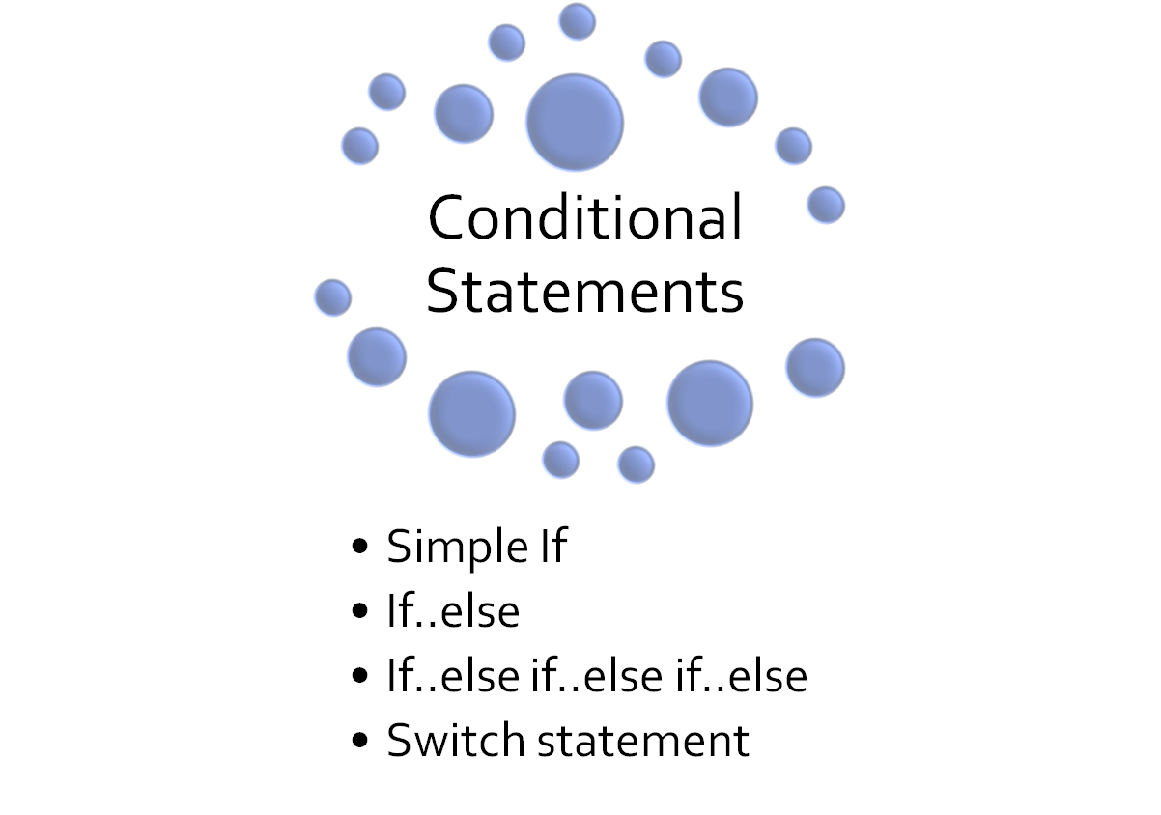
Outline

Slide 3
If -statement
Conditional statements are used to perform different actions based on different conditions. (see notes)
Use if to specify a block of code to be executed, if a specified condition is true
Use else to specify a block of code to be executed, if the same condition is false
Use else if to specify a new condition to test, if the first condition is false
Notes:
Just as in real-life situation, imagine a souvenir distribution rule at a wedding:
Anyone wearing aso-ebi : gets mug, we don’t have rule for others --- if(asoebi){//get souvenir}
Anyone wearing aso-ebi gets mug, others get plastic spoon --- if (asoebi){//get mug}else{//get plastic spoon}
Anyone wearing aso-ebi Ankara gets mug, aso ebi lace gets wall clock, others get plastic spoon – if (asoebi_ankara){//get mug}else if(asoebi_lace){//get wallclock}else{//get plastic spoon}

Slide 4
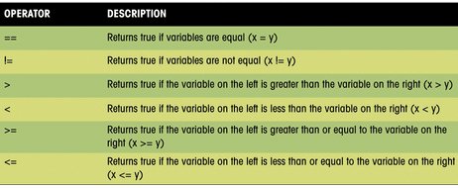
Comparism Operators – to compare two sides
Others are === which represents the two sides being equal in value and in type
Similarly !== which is ‘Not equal in value and type’
Notes:
These operators when used in conditions often generate a TRUE or FALSE result.
A == B (is A equal to B) can be True or False

Slide 5
If- Statement
if (condition) {
block of code to be executed if the condition is true
}
if (age < 18) {
statement = “You are a child";
}
if (condition) {
block of code to be executed if the condition is true
} else {
block of code to be executed if the condition is false
}
See Example of if … else in the note
Conditions are defined by comparism operators summarized in the previous slide
Notes:
if (age < 18) {
var statement = “You are a child";
} else {
var statement = “You are an adult";
}

Slide 6
Radio Morning Show
Practice Question 3 (10mins)
Create a html page with a button that reads 'start quiz’. When a user clicks this button, display a prompt box to receive an input from the user. If the number is more than 5 Display an alert that reads “Sorry, X is NOT available“, if the number is less than or equal to 5, let the alert read “X is available”

Slide 7
Exercise: if-statement and document.getElementbyId
Create a plain HTML page with a background color of say, orange.
Using a prompt box, request your user to supply their favourite color.
Based on the color supplied, use document.getElementById to set the background color of the page to the user’s response.
If the user does not supply anything, tell them “You didn’t supply any color”, then assign pink background for them.

Slide 8
If- else if-else Statement
if (condition1) {
block of code to be executed if condition1 is true
} else if (condition2) {
block of code to be executed if the condition1 is false and condition2 is true
} else {
block of code to be executed if the condition1 is false and condition2 is false
}
QUIZ : Using a prompt pop up, get the gender of your user and
set different alerts for the diff gender. Eg if your user is female, tell her : shoes and bags are available for sale. If it’s a male, display “phone is available” for gender you cannot determine,
display “Sorry, no product match found”

Slide 9
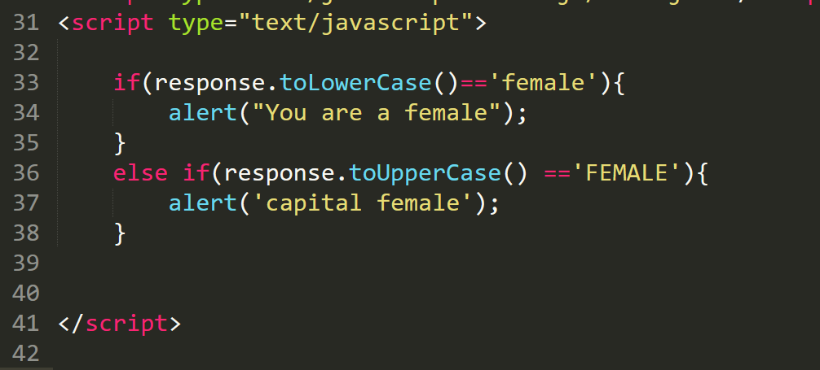
If.. Else Vs if- statement
If …else statement will not check other conditions once the first one is found to be true. In the example below; even though both conditions are true, it will only execute the alert (‘You are a female’)

Slide 10
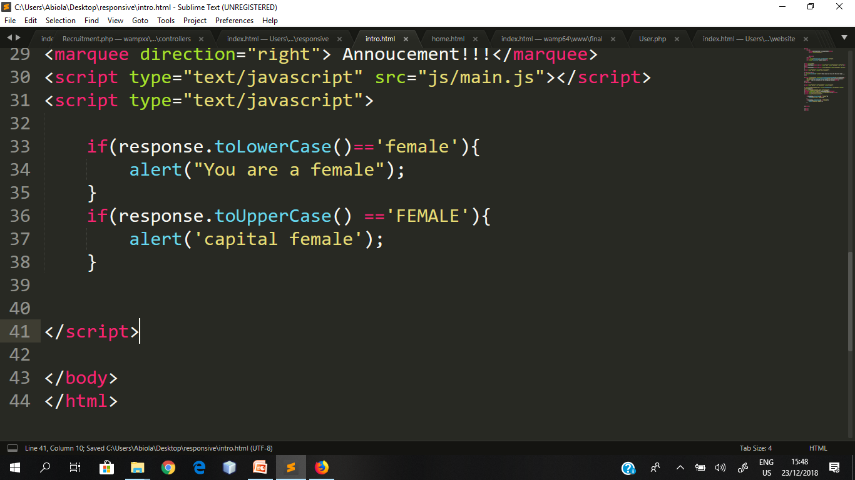
if..else vs if-statement
Try the code below, you will realise that both the alert on line 34 and line 37 will be executed as the conditions will be independently checked.
Since they are both true, they will be executed
Notes:
Also .trim() to remove space

Slide 11
Combining Multiple Conditions Using AND and OR
You can specify more than one conditions in a single IF statement or the else part as the case may be.
OR – the condition should execute if any of the condition is met
AND – all conditions must be met in order to execute
AND is represented using &&
OR is represented using ||
Best practice is to group the different parts of the conditions with ()

Slide 12
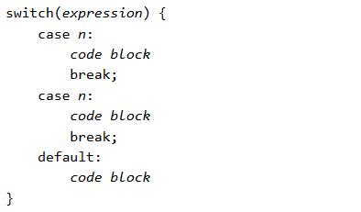
The Switch statement
Used to select one of many blocks of code to be executed

Slide 13
Switch statement
The switch expression is evaluated once.
The value of the expression is compared with the values of each case.
If there is a match, the associated block of code is executed.
When JavaScript reaches a break keyword, it breaks out of the switch block.
The default keyword specifies the code to run if there is no case match
The default case does not have to be the last case in a switch block:
More than one case can share the same code block
Notes:
To share a code block among more than one case statement, just leave it empty

Slide 14
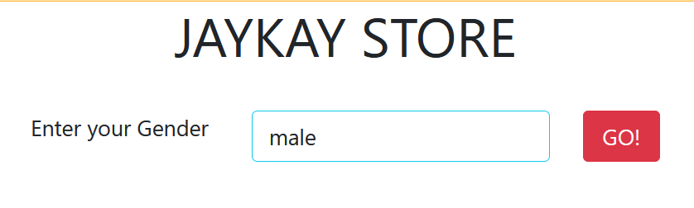
Building on the previous solution :
Receive the gender through a form input.
At the click of the button, you should display the usual message

Slide 15
Assignment
Conditional statements, Combining multiple conditions

Slide 16
Assignment
In Nigeria, assume that the only eligibility condition for voting are:
  A user who is from Nigeria can vote regardless of their age
  A user must be older than 18 if he/she is not a Nigerian
Write a javascript code that accepts the age, and country of any user (using the prompt box) one after the other.
If the user is eligible to vote based on the stated condition, alert(“You can vote”)
If the user does not satisfy the eligibility condition, alert(“You cannot vote”);

Slide 17
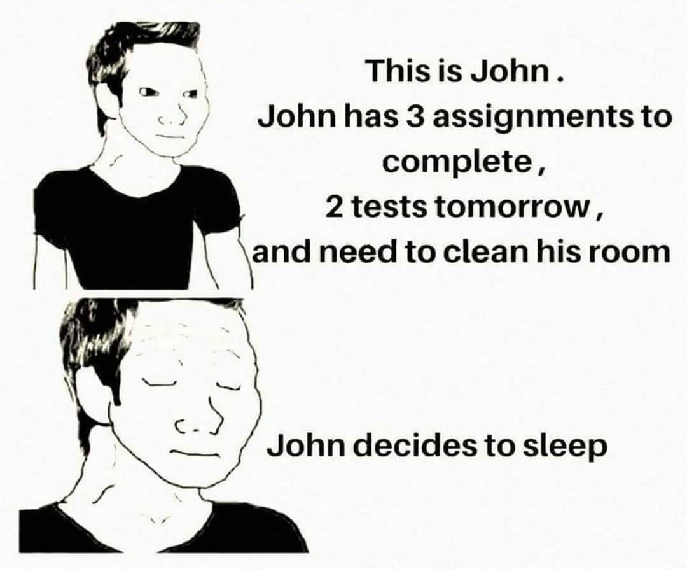
Don’t be like John
Moat Academy for Developers

