Slide 1
MOAT ACADEMY
WEB APPLICATION DEVELOPMENT TRAINING
Javascript Function
Day 4

Slide 2
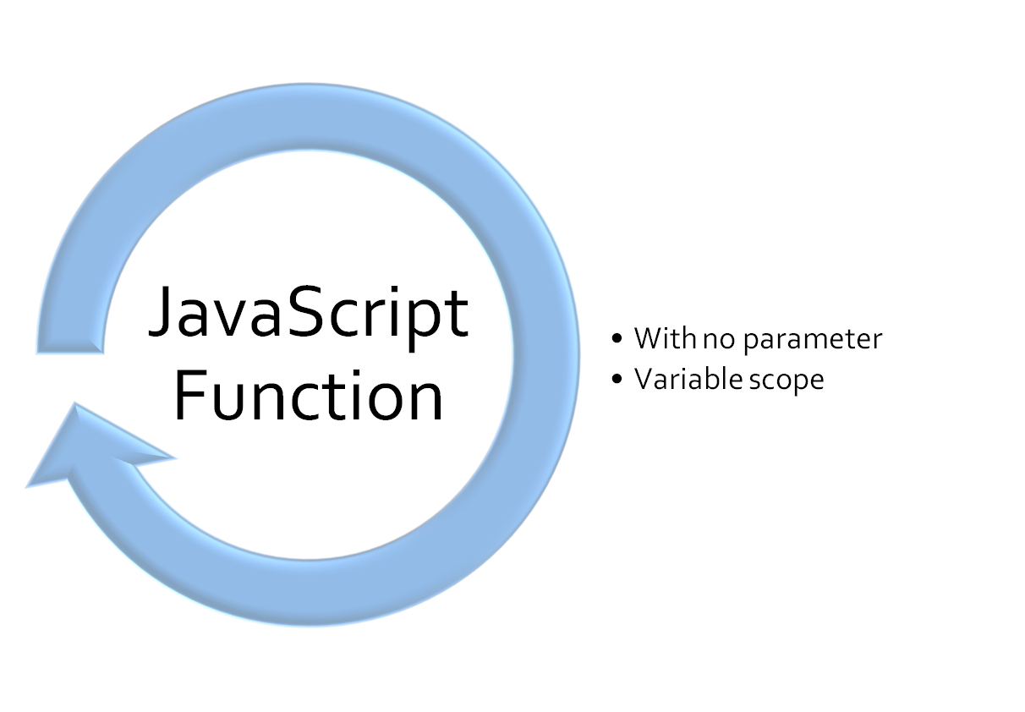
Outline

Slide 3
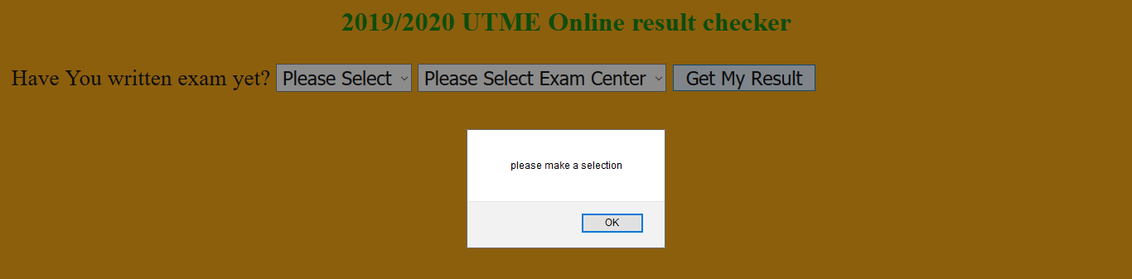
Exercise: Design a demo online result checker.
Everybody gets 320, but this is only displayed if the user answers “Yes” to the question ‘have you written exam yet’ AND also selects Lagos as their exam center
Notes:
Provided participants got the voting assignment right.

Slide 4
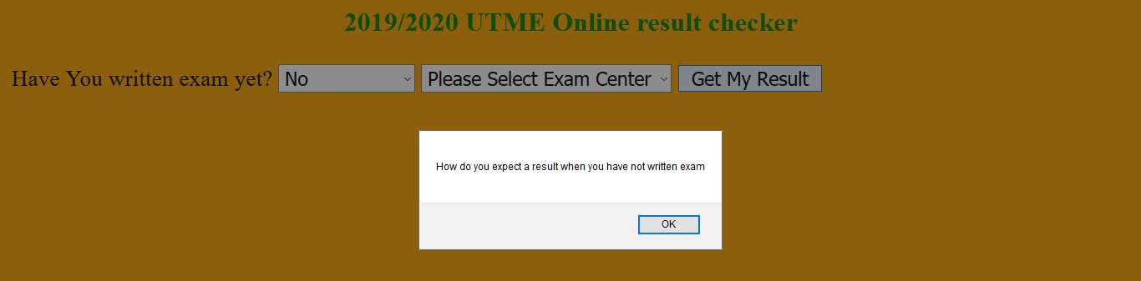
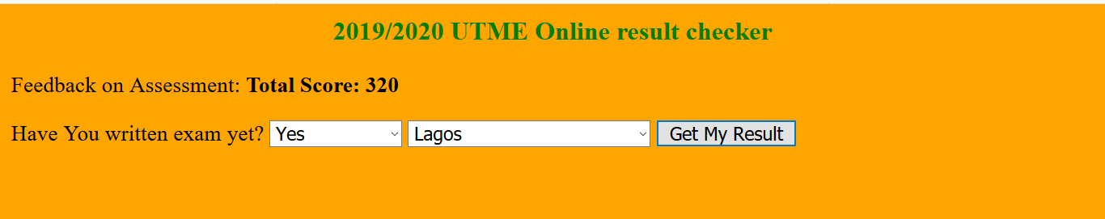
b) User who hasn’t written exam gets a scold c) User who has written exam and exam center is Lagos gets the result displayed

Slide 5
CORRECTION

Slide 6
Javascript Functions
A JavaScript function is a block of code designed to perform a particular task.
You can reuse code: Define the code once and use it many times.
You can use the same code many times with different arguments, to produce different results. (later)
A JavaScript function is executed when "something" invokes it (calls it). Otherwise it lies fallow forever!
A JavaScript function is defined with the function keyword, followed by a name, followed by parentheses ().

Slide 7
Javascript Functions
Function names can contain letters, digits, underscores, and dollar signs (same rules as variables).
The code to be executed, by the function, is placed inside curly brackets: { }
See example:
function test(){
alert(‘hello’);
}

Slide 8
Basic Syntax of Javascript Function
function functionName(optionalParameters){
//javascript statements
}
Remember, to use the function, you have to call it (from anywhere)
The code inside the function will execute when "something" invokes (calls) the function:
How do we call a function? Mention its name followed by (). example functionName()

Slide 9
Basic Syntax of Javascript Function
function test(){
alert(‘hello’);
}
The above function can be called anywhere, when called inline, it helps you have a tidier page. See:
<button onclick=‘test()’></button>
Design and Implement the calculator shown in the next slide using JS function. Display result using alert() or otherwise

Slide 10
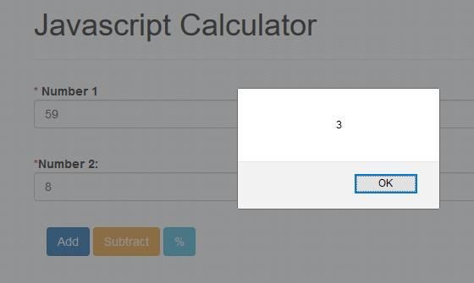
Notes:
Objective: use of parseInt(), parseFloat(), Number() functions understanding of Mathematical operation like modulus, function syntax, document.getElementById.

Slide 11
Variable Scope
A variable declared within the script is global (available to all javascript code on that page, whether inline or internal)
A variable declared inside a function is local to that function
A variable used without being defined (use of the var keyword)is automatically treated like a global variable : It means if you declare a variable inside a function without the var Keyword, it is automatically global(ponder: we are not just creating a new memory space)

Slide 12
Variable Scope
Local variables are destroyed when the function ends while global variables persists throughout the lifetime of the script (until the window is closed)
<head><script type=“text/javascript”>
var username = “teacher”;
</script></head>
<body>
// the variable name called username can be used here on any element
</body>
See the notes for more
Notes:
The fact that there is the var keyword before “username” means the variable is just being created at that time and its immediately assigned a value “teacher”. - It will be seen inside body
If we omit the var keyword, it is assumed username existed somewhere and now, we are overwriting the value in it by assigning a new value called “teacher”. It will still be seen inside body
Exercise: execute alert(username) anywhere on the page, you should see “teacher”

Slide 13
Variable Scope
<head><script type=“text/javascript”>
function test(){
var username = “teacher”;
}
</script></head>
<body>
// the variable called username is only available in the function test, it can not be used outside the function (see the notes)
</body>
Notes:
To make the variable usable outside the function, omit the var keyword.

Slide 14
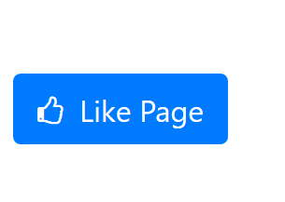
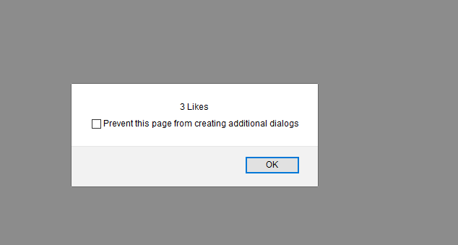
Exercise: the first time the button is clicked, user sees an alert that says ‘1 Like’ subsequent times, user sees: ‘2 likes’ … ‘3 Likes’ etc
Notes:
Similar exercise: check the file global_local_variable.html

Slide 15
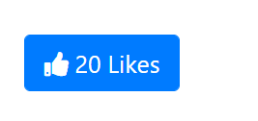
Go Further: Display the number in the button itself
At every click, increase the likes written on the button, rather than in an alert box
Remember to pluralize when it is more than 1.
Notes:
Similar exercise: check the file global_local_variable.html

Slide 16
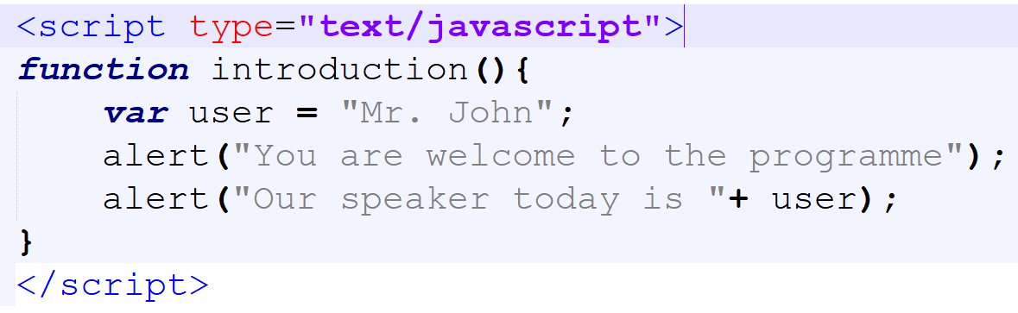
Variables within a function (local variable)
In the function below, we are creating a local variable user :

Slide 17
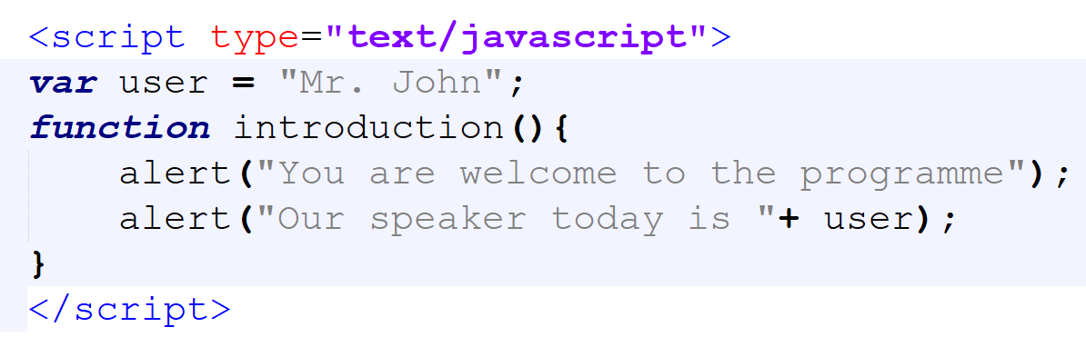
Sending value to a function from outside the function
Sometimes, you want your function to receive value from the outside world (that is; a value coming from outside the function)
As we know, this can come through a variable with a global scope: See below

Slide 18
Assignment – Form Validation
Implement a form validation using Javascript Function. Your form should contain username, password and password confirmation. Use JS to ensure that the user completes all the fields and uses the same password in the two password fields.
Hint: If the conditions are correct, display “Registration Successful” else display the validation error(s)
Use alert() to show the validation error

Slide 19
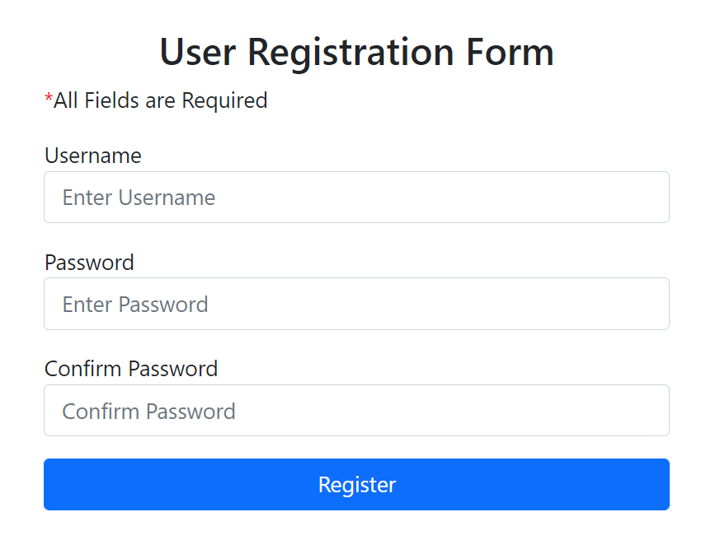
Assignment: Form Validation

Slide 20
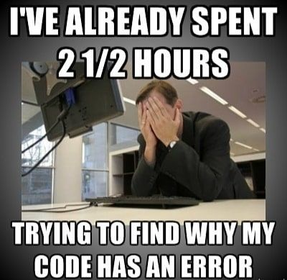
Pro Tip:
This is James, don’t be like James, get on Slack!
Moat Academy for Developers
Notes:
Source: techindustan

Slide 21
Challenge Accepted?
Go Further
Continue to the next slide if you want to go further!

Slide 22
Go Further with form Validation
Improve on the validation form by implementing:
Highlight empty fields with red. (.style attribute can be set with border color)
Go Further by displaying the error message(s) within a <p> tag above the form or a <span> beside the element.
Go Even Further by displaying highlighting the elements that are empty with red border.

Slide 23
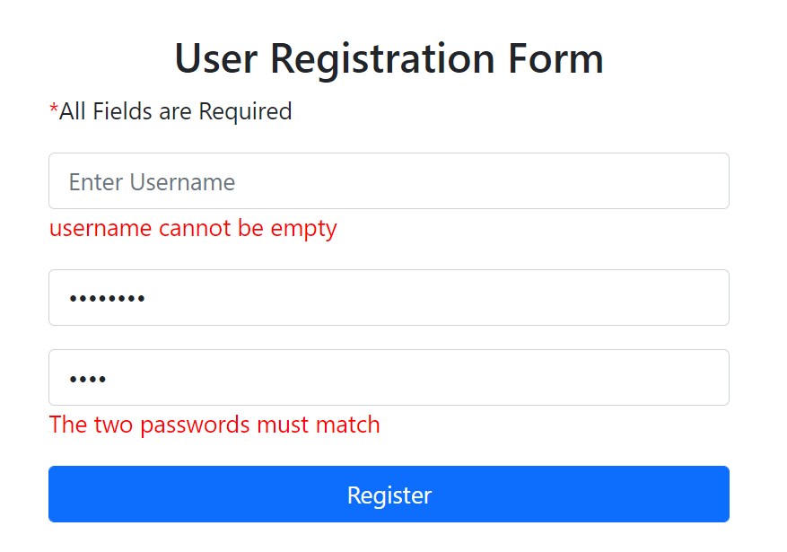
Go Further with form Validation

