Slide 1
MOAT ACADEMY
WEB APPLICATION DEVELOPMENT TRAINING
CSS Positioning and Practical Applications – Day 4

Slide 2
CSS GRADIENT PROPERTY

Slide 3
CSS GRADIENT
In place of background image, CSS gradients let you display smooth transitions between two or more specified colors.
CSS defines three types of gradients:
Linear Gradients (goes down/up/left/right/diagonally)
Radial Gradients (defined by their center)
Conic Gradients

Slide 4
CSS LINEAR GRADIENT
To create a linear gradient you must define at least two color stops. Color stops are the colors you want to render smooth transitions among. You can also set a starting point and a direction (or an angle) along with the gradient effect.
Syntax:
background: linear-gradient(direction, color-stop1, color-stop2, ...);
background: radial-gradient(shape, color1 N%, color2 Y%,...)
Example:
#grad {
background: linear-gradient(to right, red , yellow); /*left to right*/
}
background: linear-gradient(to bottom right, red, yellow); /*diagonal*/
background: linear-gradient(45deg, red, yellow); /*angle*/ (may be –ve)
background: linear-gradient(to right, rgba(255,0,0,0), rgba(255,0,0,1)); /*transparent colors*/
background: radial-gradient(circle | ellipse, red, blue, yellow );

Slide 5
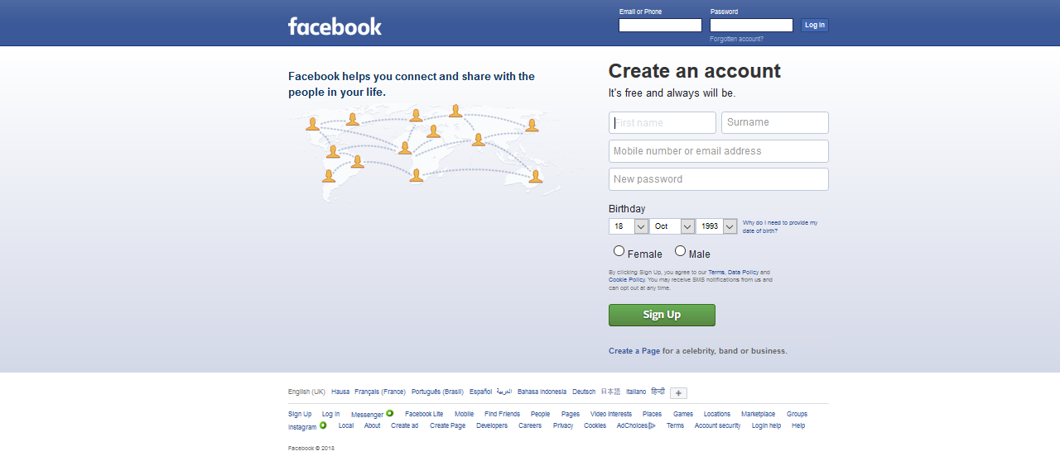
See Facebook background: a solid blue div on top of a bluish-white div, linear gradient can be used to achieve the bluish white bg, linear-gradient(to top, blue,white)*
Notes:
Example of Linear Gradient Applied
* Note: The right shade of blue

Slide 6
Other Applications of Linear Gradient: Adding gradient on top of a background image
To add a semi opaque/semi transparent colour gradient that goes on top of the background image, you need not introduce a second div. Simply add linear gradient to the same div carrying the background image as follows:
A simpler method is to use background image with gradient.
#banner{
background-image: linear-gradient(to bottom, rgba(0,0,0, 0.52), rgba(10,10,30, 0.73)),url('banner.jpg');
height: 300px;
background-size: cover;
}

Slide 7
CSS DIV and Other Semantic Elements
Elements whose functions are self-explanatory

Slide 8
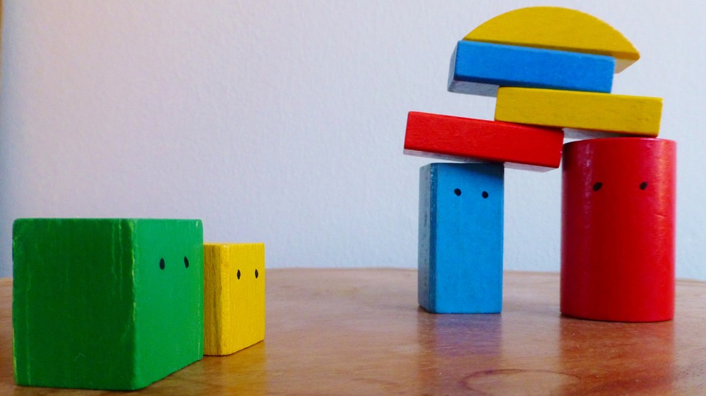
CSS DIV

Slide 9
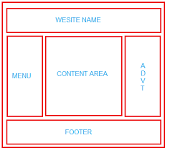
CSS DIV
Consider the layout shown:
The boxes, just like lego blocks can be put together to form a complete website.
The parents of boxes which sit side by side are flex’ed.
This layout is also known as the wireframe for your website.
It is a good idea to use meaningful names for your classes and id”s for better SEO

Slide 10
Semantic Elements
The div is a generic block-level element that can be used to group web contents
A semantic element describes its meaning to both the browser and the developer. They describe the structure of a web document in a standard way thus making browsers and assistive technologies understand the page better.

Slide 11
HTML Navigational Element (<nav>) | defines a section that contains navigation links that appear often on a site. You can have primary and secondary menus, but you never nest, or put a <nav> element inside a <nav> element.
HTML Article Element (<article>) | defines a piece of self-contained content. It does not refer to the main content alone and can be used for comments and widgets.
HTML Section Element (<section>) | defines a section of a document to indicate a related grouping of semantic meaning.
NOTE: Articles can be nested inside of sections and sections can be nested inside of articles.
HTML Aside Element (<aside>) | defines a section that, though related to the main element, but has a different placement than the main content , like an explanation box, definition or an advertisement. It has its own outline, but doesn't belong to the main one. The <aside> element is often used for sidebars containing extra, but relevant, information
HTML Header Element (<header>) | defines the part of a page which typically contains the logo, title, and navigation. The header can also be used in other semantic elements such as <article> or <section> — or section header, containing perhaps the section's heading, author name, etc. <article>, <section>, <aside>, and <nav> can have their own <header>. Despite its name, it is not necessarily positioned at the beginning of the page or section.
HTML Footer Element (<footer>) | defines a page footer which typically contains the copyright, legal notices and sometimes some links — or section footer, containing perhaps the section's publication date, license information, etc. <article>, <section>, <aside>, and <nav> can have their own <footer>. Despite its name, it is not necessarily positioned at the end of the page or section.
HTML Blockquote | Indicates that the enclosed text is an extended quotation.

Slide 12
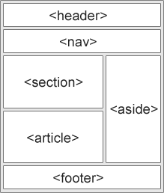
Semantic Elements

Slide 13
Designing for older browsers
Unknown elements are styled as display: inline by default, so you'll want to set them to display: block:
See example:
article, aside, footer, header, nav, section {
display: block;
}

Slide 14
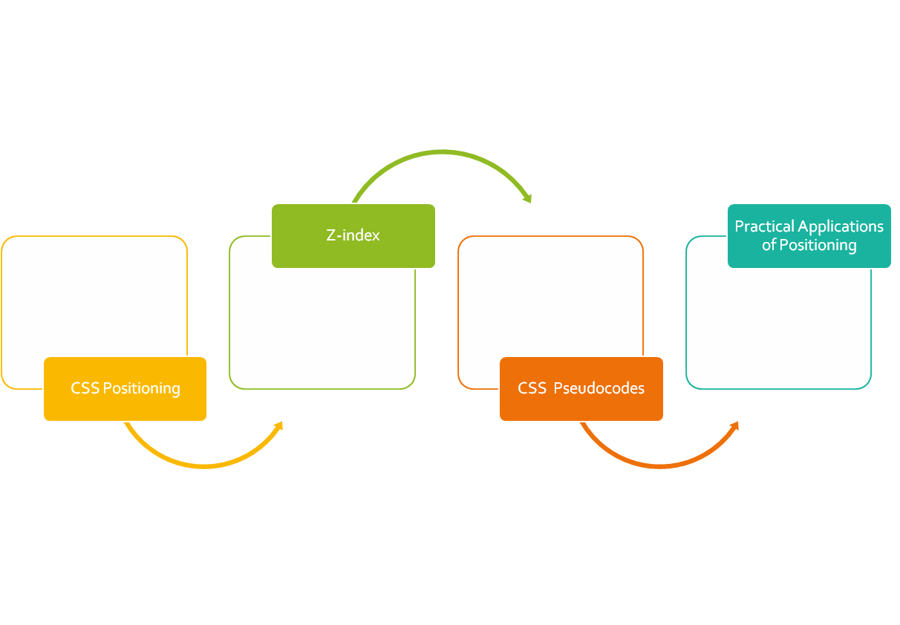
CLASS
OUTLINE

Slide 15
CSS POSITIONING

Slide 16
Positioning rules
Sometimes you just want an element to appear at a particular distance from the edges.
You can then specify to the elements where on the page they should appear. (top, bottom, left, or right)
But first, you determine the kind of positioning rule the element(s) should obey through the positioning property**
This specifies how the elements of the webpage should be placed, values may be fixed, static, relative, absolute or sticky
Notes:
Top, right, left or bottom will not work if positioning is not set. These will not have effect on statically positioned elements

Slide 17
Setting the Positioning
Static : This is the default, if an element is not positioned explicitly, then its statically positioned.
Relative: relative to its “normal” position, other contents will not take any gap left by it.
Fixed: relative to the viewport, which means it always stays in the same place even if the page is scrolled. Does not leave gap in the page where it would have been created.
Absolute: positioned relative to the nearest positioned parent, if no parent, uses the body

Slide 18

Sticky Positioning
A stickily positioned element is treated as relatively positioned until it crosses a specified threshold, at which point it is treated as fixed until it reaches the boundary of its parent.
Sticky positioning can be thought of as a hybrid of relative and fixed positioning.
You must specify a threshold* with at least one of top, right, bottom, or left for sticky positioning to behave as expected. Otherwise, it will be indistinguishable from relative positioning.
Notes:
The threshold is concerned about: as we scroll the page… and the element in question scrolls up at what distance from the top should it become fixed? Same thing applies to other edges

Slide 19
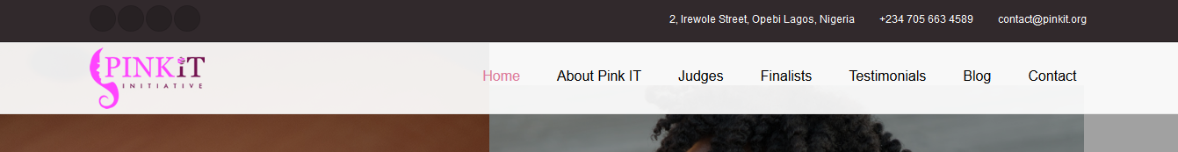
Sticky Positioning in Practice
Notice the black background before the sticky menu, it ensures that we scroll the page up to the point specified before the menu becomes fixed
Notes:
You must specify a threshold with at least one of top, right, bottom, or left for sticky positioning to behave as expected. Otherwise, it will be indistinguishable from relative positioning.

Slide 20

Sticky Positioning in Practice
Notice that the search box is at some distance from the top of the page

Slide 21
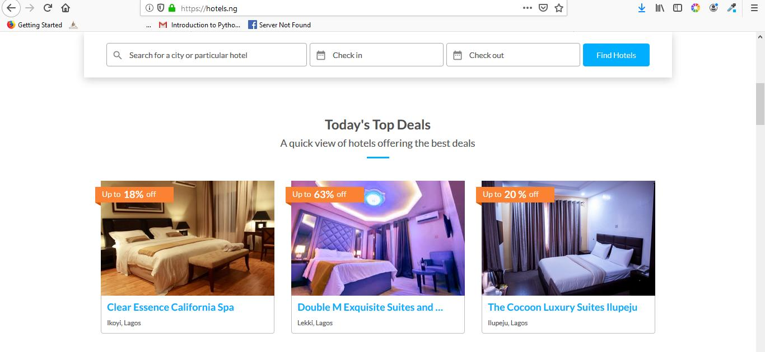
Sticky Positioning in Practice
On scrolling the page, when the search box gets to a distance of 0p from the top
From the viewport, it becomes fixed

Slide 22
Notes on Positioning
If both top and bottom are specified (technically, not auto), top wins.
If both left and right are specified, left wins when direction is ltr (English, horizontal Japanese, etc.) and right wins when direction is rtl (Persian, Arabic, Hebrew, etc.)

Slide 23
The z-index
Specifies the stack order of an element (when placed on top of each other)
! Remember that an element is placed on top of each other by positioning them so
An element can have negative or positive z-index value.
The element with a higher z-index comes on top of the others
The element must be positioned before it can respond to z-index;
Practical Application: Drop-down menu.

Slide 24
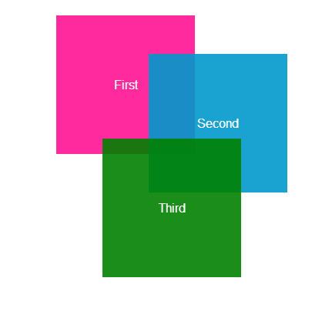
Achieve the stack shown using positioning:
Hint: z-index, positioning
Hint: Position the elements such that they almost appear in the same location. Then use z-index to arrange them, baby pink: rgb(244,194,194)

Slide 25
HANDSON

Slide 26
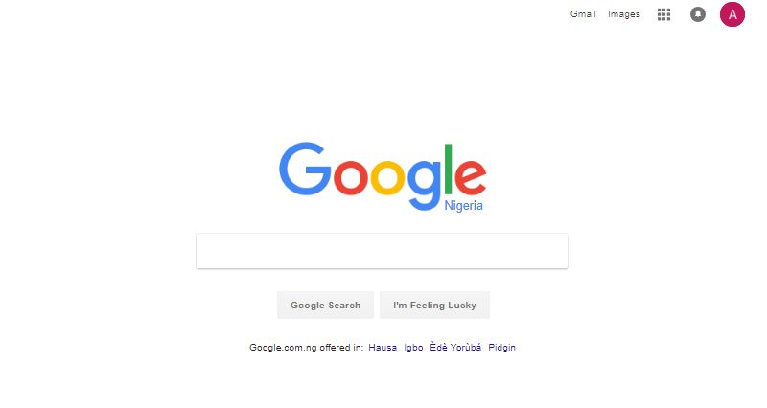
Assignment:
Google Interface

Slide 27

Search Bar with Background

Slide 28

Fixed Social Media Side Bar

Slide 29
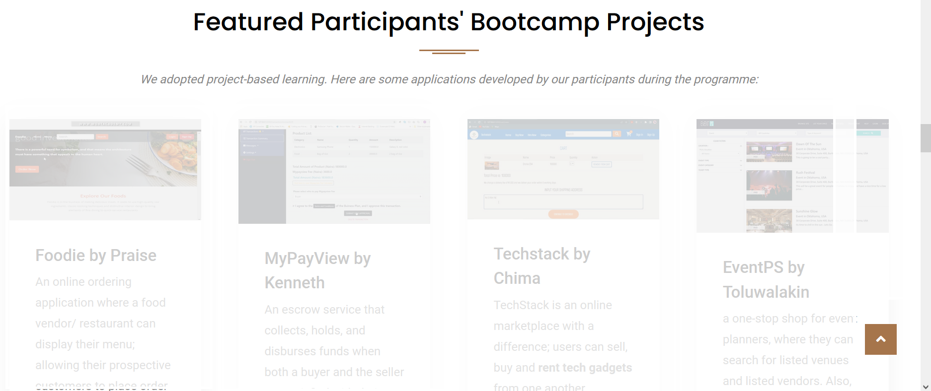
Fixed Navigation : “Go To Top” as seen on Moat Academy Website

Slide 30

The LiveChat Icon is not moving with the page as it scrolls….

Slide 31

The social media div is not moving with the page as it scrolls….

Slide 32

Collapsible Header
Notes:
A div positioned absolutely in another div that has background image.
Step two: turn to a collapsible header by giving the background-attachment: fixed

Slide 33

ASSIGNMENT: Replicate something similar to the banner below: Let the menu be stick’ily positioned, set height of the body to 1000px to achieve scrolling

Slide 34
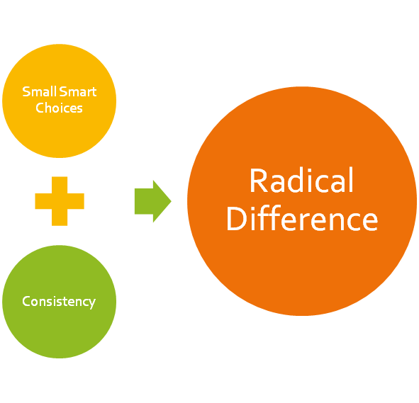
Catch up with all outstanding!
Start by doing what’s necessary, then what’s possible, and suddenly you are doing the impossible. ~ Francis of Assisi

