Slide 1
MOAT ACADEMY
WEB APPLICATION DEVELOPMENT TRAINING
Javascript Function
Day 5

Slide 2
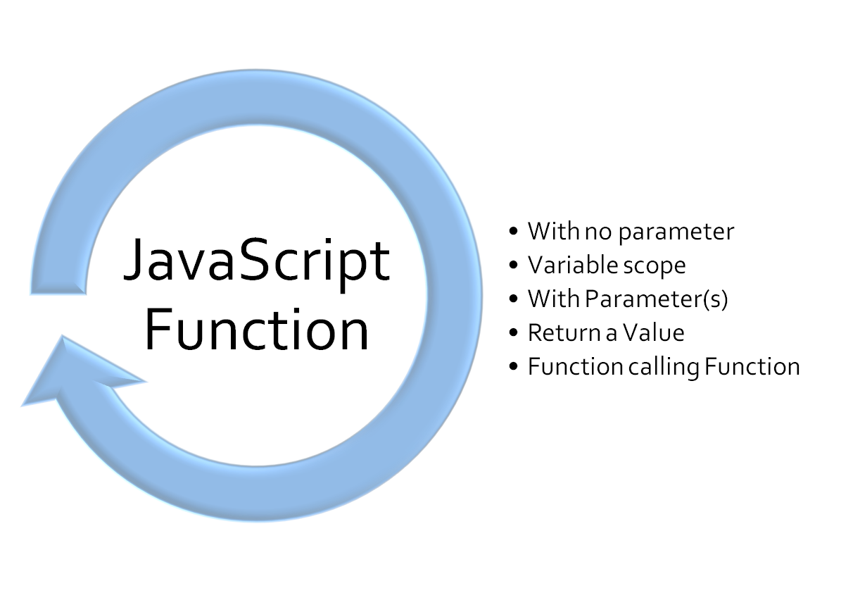
Outline

Slide 3
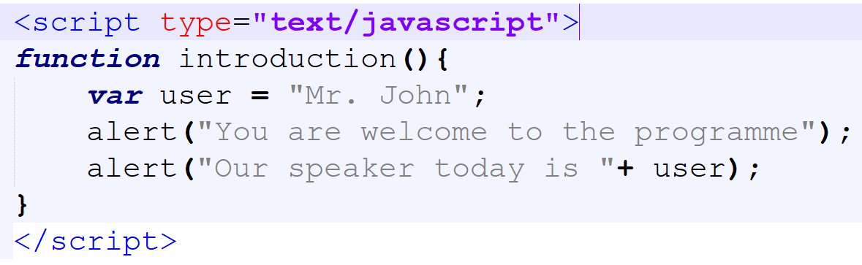
Variables within a function (local variable)
In the function below, we are creating a local variable user :

Slide 4
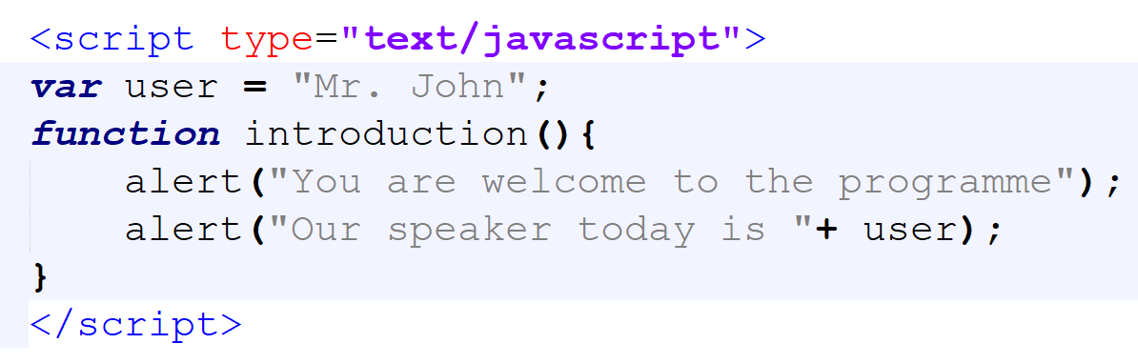
Sending value to a function from outside the function
Sometimes, you want your function to receive value from the outside world (that is; a value coming from outside the function)
As we know, this can come through a variable with a global scope: See below

Slide 5
Function Parameters
Function may also receive value from outside through what is known as Parameter
Function parameters are the names listed in the function definition.
The parentheses may include parameter names separated by commas:
(parameter1, parameter2, ...)
Function arguments are the real values received by the function when it is invoked.
Inside the function, the arguments (the parameters) behave as local variables.

Slide 6

Syntax of Javascript Function with Parameters

Slide 7
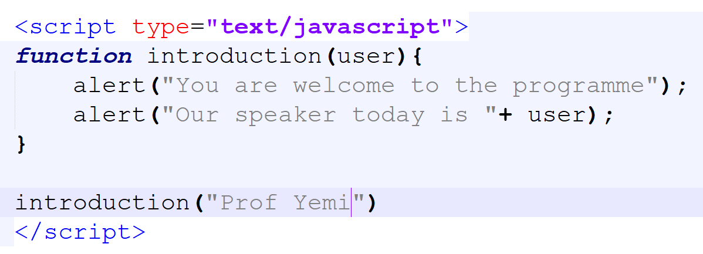
Sending values to a Function using parameter(s)
In the below snippet, when we call the function introduction() we supplied any value such as ‘Prof Yemi’ .
The function has a variable user which it uses to store whatever value is coming with the function call.

Slide 8
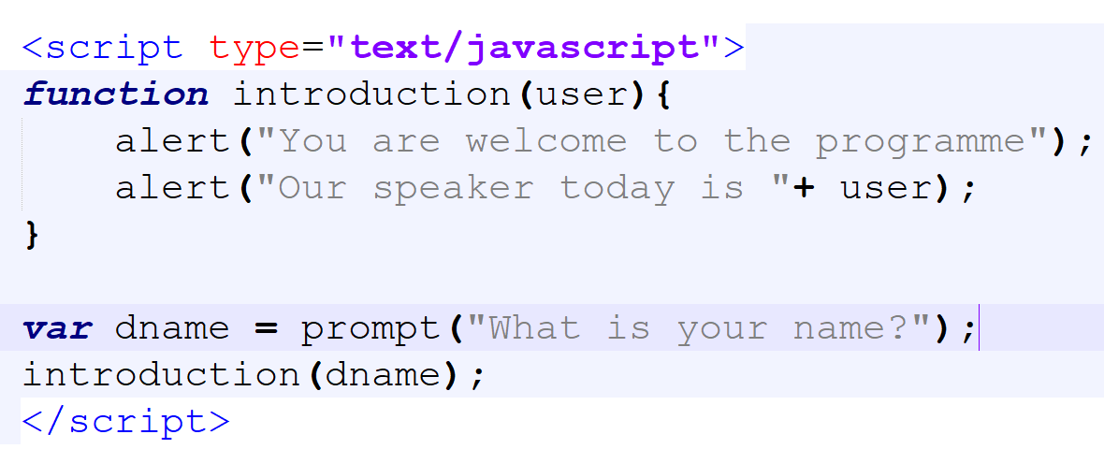
Sending values to a Function using parameter(s)
In the below snippet, when we call introduction() we supplied a variable dname which can be anything. The function has a variable user which it uses to store whatever value is coming with the function call.

Slide 9
Function with parameter(s)
Using parameter in your function definition allows you to re-use the same function while making some parts of the function dynamic (changeable)
In the above example, when the function had no parameter, it would always display the message “.. Our speaker today is Mr John”
When parameter was introduced, we are able to influence the value that would be used within the function.
NOTE: Without parameters, the function would be the one to source for /or create its own variable but with parameter, the function is not concerned about how the variables would have values.

Slide 10
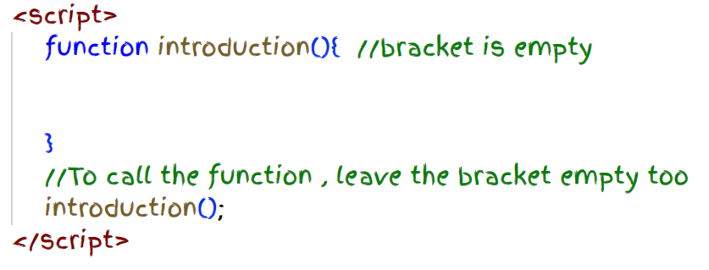
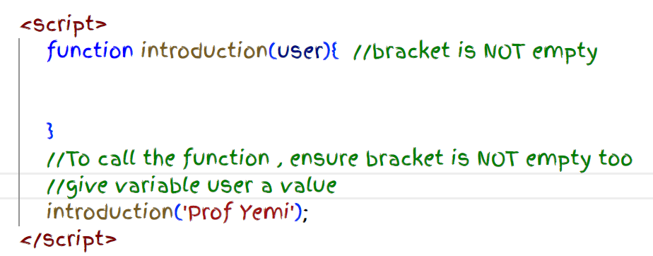
Calling function with and without parameter(s)

Slide 11
Convert this to a function that uses parameter to receive the user’s gender
Exercise : Rather than using a prompt pop up to get the gender of your user, let the function receive the value through a parameter.
Display different messages accordingly, For example; if your user is female, tell her : shoes and bags are available for sale, if male, display ‘Phones are available’

Slide 12
Question
At the last 103rd birthday celebration of Chief Akintola Williams, there was a special sitting area for the elderly ones, you are only allowed to the special area if you are:
  A woman of 65 years and above OR
  A man of 70 years and above
Write a function that accepts the age and gender of any user as parameters and tells them if they are allowed in the special area or not

Slide 13
Function with default Parameter(s)
if a function is called with missing arguments (or less than declared), the missing values are set to: undefined
Sometimes this is acceptable, but sometimes it is better to assign a default value to the parameter:
function checkGrade(score=50){
if(score>70){
alert(“Excellent!”);
}else{
alert(“You can do better”);
}
}

Slide 14
QUIZ
Do you realize that the following are also [in-built] functions: alert(), confirm() and they take parameters!
Do you remember you have to supply what should be displayed by the alert when you call it?

Slide 15
QUIZ
The prompt box can be used in any of the two ways:
  prompt(“What is your name?”,”John”)
  prompt(“What is your name?”)
How will you describe the prompt box? How many parameters does it have? Is there any default parameter?

Slide 16
Exercise
Write a Function say multiply,that receives any two numbers and multiplies them,
You can display the result using any of : alert box, document.write(), console.log or document.getElementById().innerHTML

Slide 17
Javascript Function and Return Statement
Functions can also send back values to the calling code; this is done using the ‘return’ statement
Such functions can be used as values for variables. See var sum = add(6,8);
The above will save the value returned by the function add in the variable sum.
See the notes
Notes:
function add(a,b){
var total = a + b;
return total;
}

Slide 18
Functions calling other functions
A function can call another just like any other javascript statement.
newfunction() calls add() below:
function newfunction(){
var no1 = prompt (“enter first number”);
var no2 = prompt (“enter 2nd number”);
var x = add(no1, no2) + 50;
alert(“I added 50 to the number returned by add function ” + x);
}

Slide 19
External Javascript Files
You can include an external javascript file using the script tag
<script src=“external.js”></script>
Note that there is nothing within the script tag when using the script tag to include external javascript files.

Slide 20
Week 4 Mini Project
Gradesheet

Slide 21
Week Three Mini-project
Design a Grade sheet using JavaScript… (see next slide for GUI).
A user should be able to enter a number (Score) and your webpage must automatically generate the grade letter in the space (under the Grade section)
  Score < 40 should generate F
  Score >=40 and score < 45 should generate E
  Score >= 45 and Score < 50 should generate D
  Score >= 50 and Score < 60 should generate C
  Score >=60 and Score <=69 should generate B
  Score >= 70 should generate A
Finally, on the click of the button ‘Get Result’ : calculate and displat the total score and average score respectively
If average > 50 : Remark could be: ‘Passed’, else remark could be: ‘Failed’
The design is yours ; you can be creative by including the relevant emojis/pictures, make it as user-friendly as possible
Notes:
Score < 40 should generate F
Score >=40 and score < 45 should generate E
Score >= 45 and Score < 50 should generate D
Score >= 50 and Score < 60 should generate C
Score >=60 and Score <=69 should generate B
Score >= 70 should generate A

Slide 22
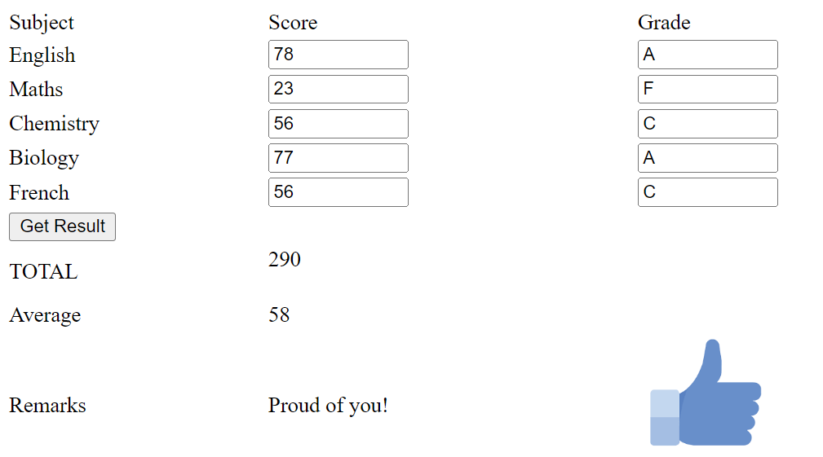
Notes:
Score < 40 should generate F
Score >=40 and score < 45 should generate E
Score >= 45 and Score < 50 should generate D
Score >= 50 and Score < 60 should generate C
Score >=60 and Score <=69 should generate B
Score >= 70 should generate A

Slide 23
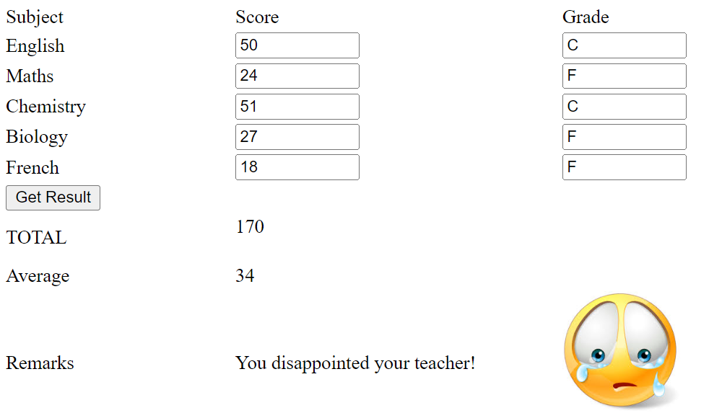
Notes:
Score < 40 should generate F
Score >=40 and score < 45 should generate E
Score >= 45 and Score < 50 should generate D
Score >= 50 and Score < 60 should generate C
Score >=60 and Score <=69 should generate B
Score >= 70 should generate A

Slide 24
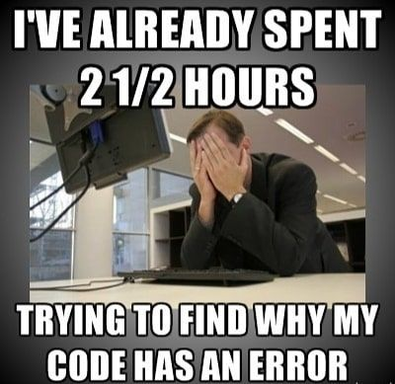
Pro Tip:
This is James, don’t be like James, get on Slack!
Moat Academy for Developers
Notes:
Source: techindustan

