Slide 1
BCI - Motor Imagery Classification
D.S.ARCHANA

Slide 2
Problem Statement & System Model
Explore various methods for efficient classification of EEG time series data.
Model :
Pre Processing
artifact removal
Filtering
ICA
Feature Extraction
CSP
Spiking Model
Optimization of weights for spiking model
PSO
DE
Classifier
KNN
SVM
Spiking Neuron

Slide 3
Literary survey
Carlos D. Virgilio G., Juan H. Sossa A., Javier M. Antelis, Luis E. Falcón, Spiking Neural Networks applied to the classification of motor tasks in EEG signals, Neural Networks, Volume 122,2020, Pages 130-143, ISSN 0893-6080,https://doi.org/10.1016/j.neunet.2019.09.037
Izhikevich, E. M. (2004). Which model to use for cortical spiking neurons? IEEE Transactions on Neural Networks, [ISSN: 1045-9227] 15(5), 1063–1070.http://dx.doi.org/10.1109/TNN.2004.832719.
Kai Keng Ang, Zheng Yang Chin, Haihong Zhang, and Cuntai Guan, "Filter Bank Common Spatial Pattern (FBCSP) in Brain-Computer Interface," 2008 IEEE International Joint Conference on Neural Networks (IEEE World Congress on Computational Intelligence), Hong Kong, 2008, pp. 2390-2397.doi: 10.1109/IJCNN.2008.4634130
EEG-Based Brain-Controlled Mobile Robots:A Survey,IEEE TRANSACTIONS ON HUMAN-MACHINE SYSTEMS, VOL. 43, NO. 2, MARCH 2013
Vazquez, Roberto. “Izhikevich Neuron Model and its Application in Pattern Recognition.” Aust. J. Intell. Inf. Process. Syst. 11 (2010): n. pag.

Slide 4
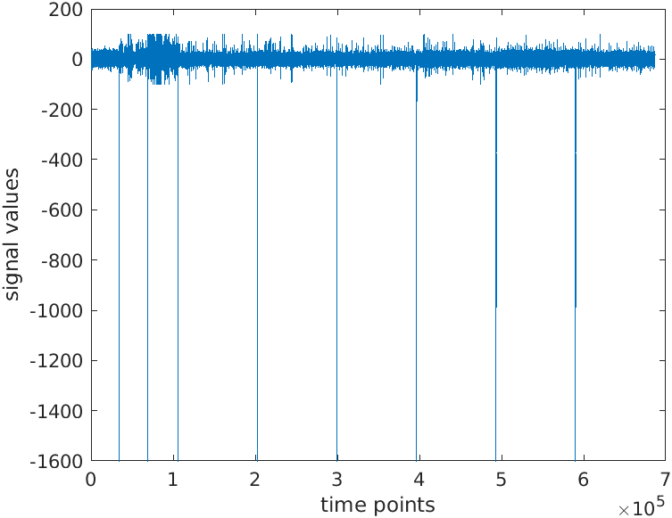
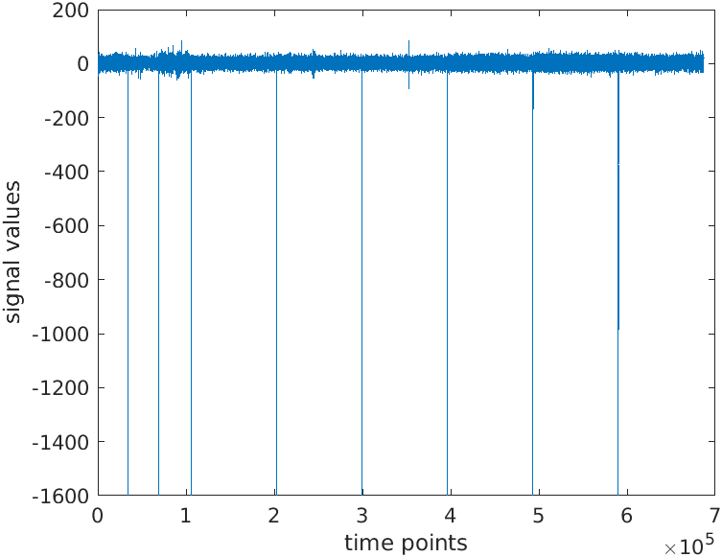
Pre Processing
Artifact Removal
Regress EOG
Filtering
8-30 Hz band filter ( Alpha and beta bands which have main motor imagery signals)
ICA - dimensionality reduction
22 channels reduced to 13 channels.

Slide 5
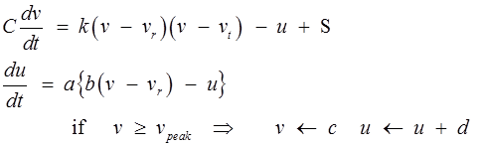
Feature Extraction
CSP
Orthogonalizes the points of two classes
One vs Rest
Izhikevich Neuron Model
Good in terms of computational complexity as well as biological similarity.
v-membrane potential, u-recovery variable

Slide 6
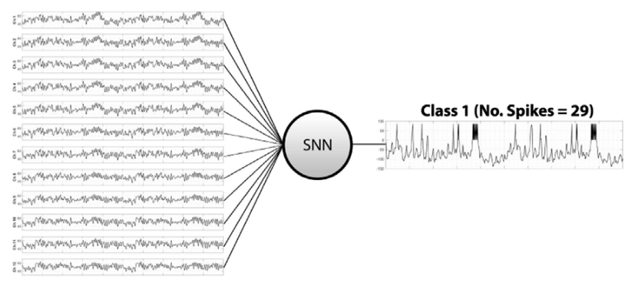
Why Spiking Neuron model?
In traditional neural network models, we do not consider the temporal features in the trails.
Spiking model capture temporal information.
Biologically,Neuron fires as a consequence of the membrane potential crossing a threshold.
Firing of the neuron is modeled as a differential equation.

Slide 7
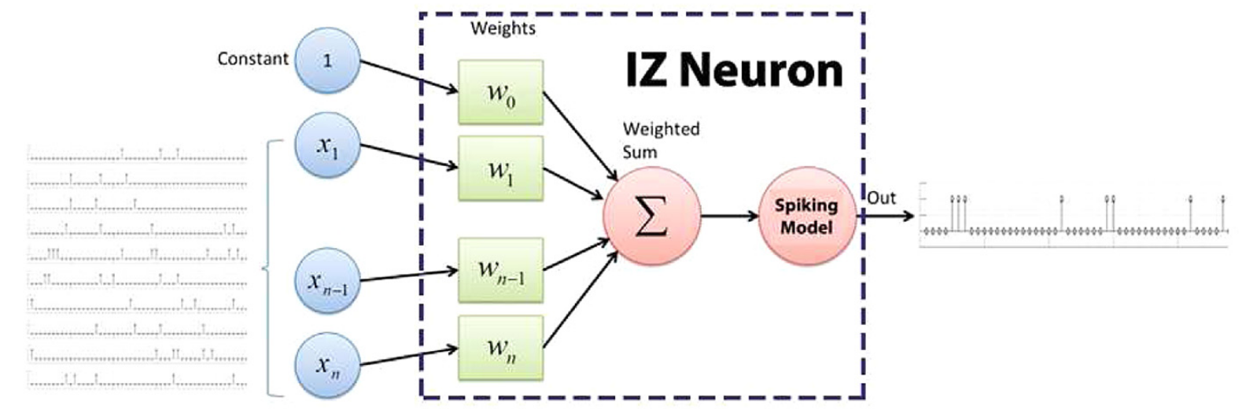
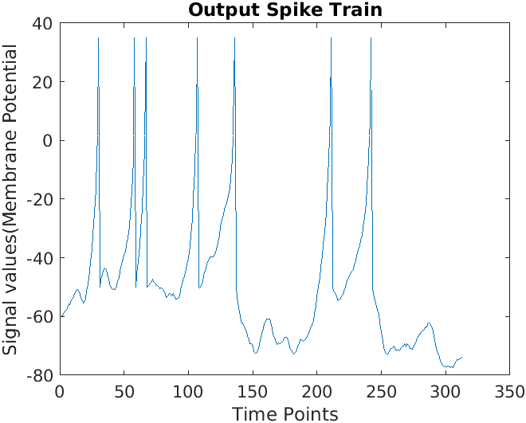
Spiking Model Architecture
Input : Weighted sum of the features
Output : Spike train Sample output spike train

Slide 8
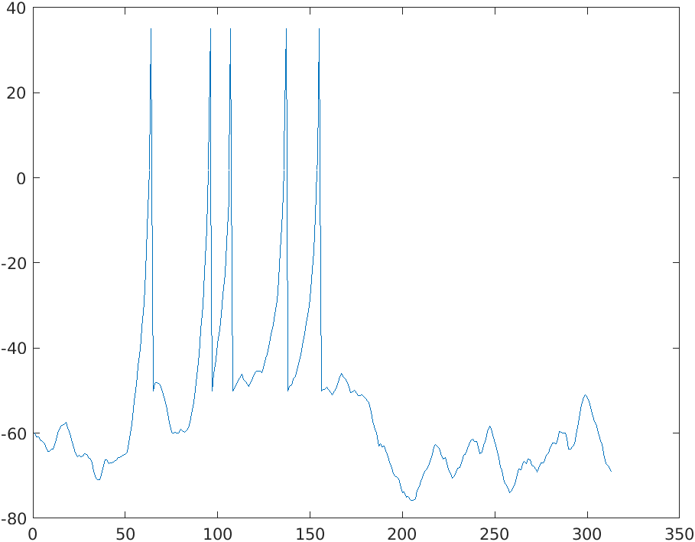
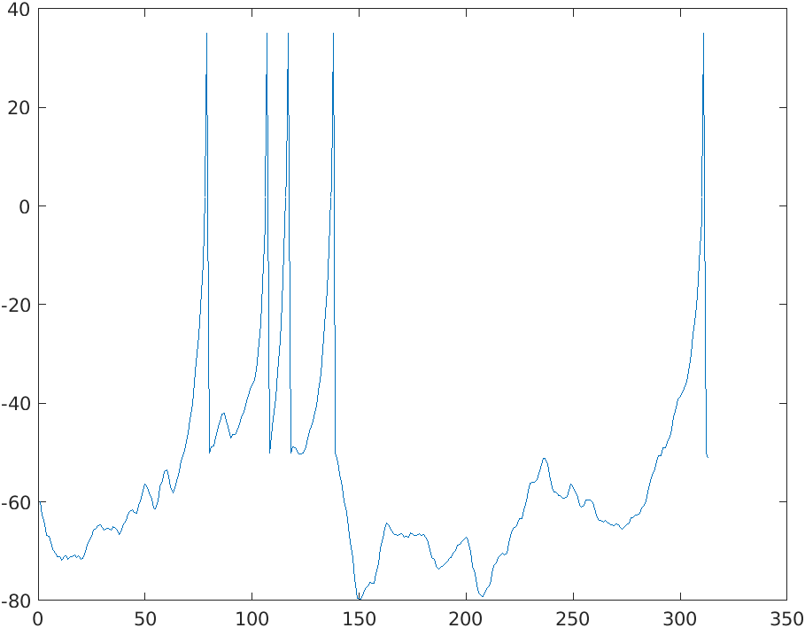
Feature Extraction- Spike train coding
Firing rate/spike count
Event=Tongue, Trail 1, firing rate= 5. Event=foot, Trail 1, firing rate=5

Slide 9
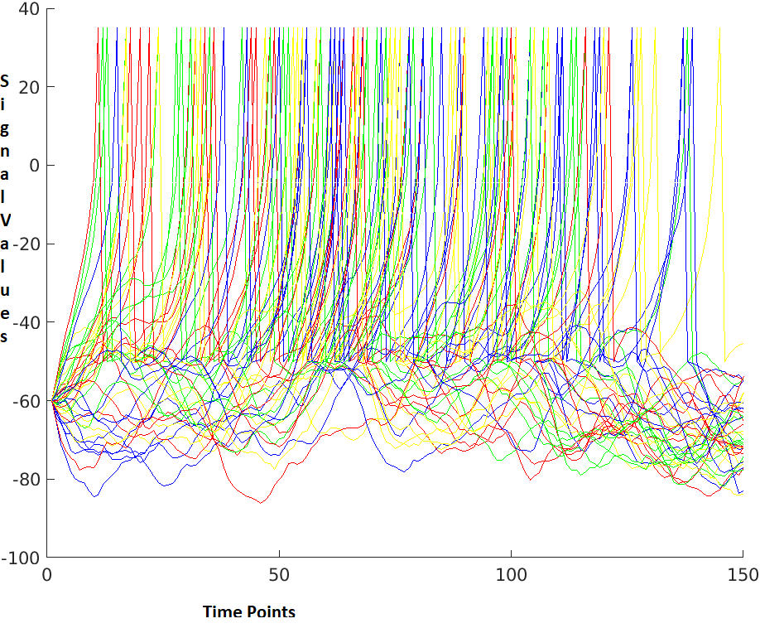
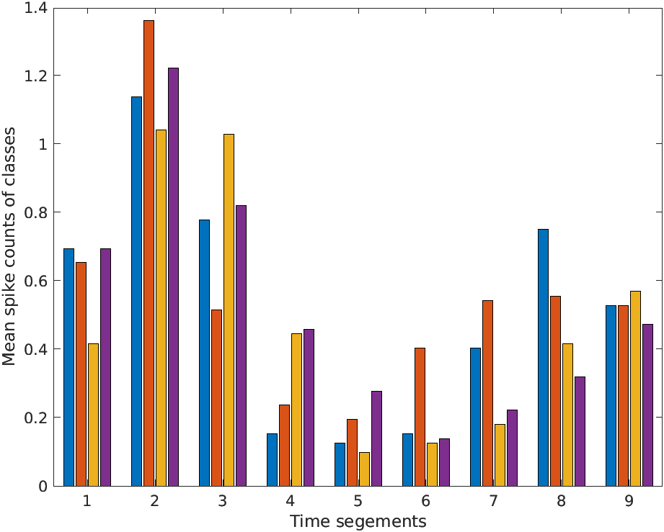
Spike frequency in time intervals

Slide 10
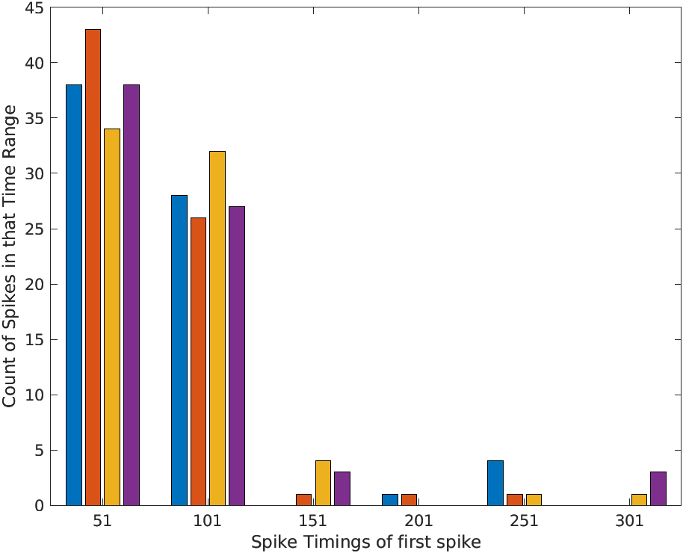
First Spike arrival time

Slide 11
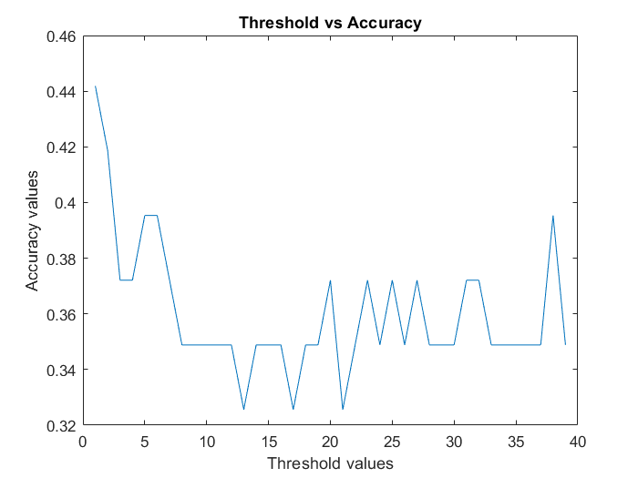
Other coding schemes
Group spikes timings - maximum accuracy 52%
Complete spike trains - maximum accuracy 40%
First spike timing- maximum accuracy 29%
Parameter Tuning
Firing Threshold
Single threshold
Two thresholds

Slide 12
Classification
KNN
SVM
Spiking Neuron model
Training : PSO and Differential Evolution
Fitness/Objective function: SVM accuracy & simpler fitness function

Slide 13
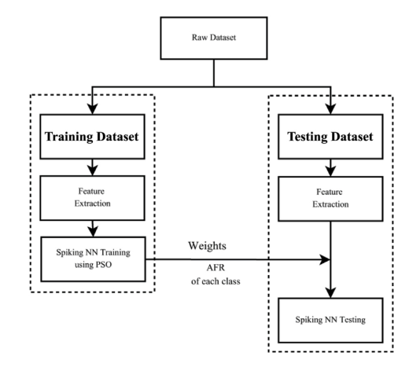
Spiking Neuron model

Slide 14
Fitness Functions
SVM accuracy
Computationally intensive and takes long time
Maximum accuracy 53.49%
Simpler fitness function
Quicker and requires less computation
AFR -mean firing rate
SDFR -standard deviation of firing rate.
K - number of classes
dist(AFR) - summation of the euclidean distances among the average firing rate of each class.

Slide 15
Training spiking model
PSO
Use global and local best values after each iteration to proceed with search
DE
Evolve candidate solutions randomly and replace based on fitness function
Computationally less intensive

Slide 16
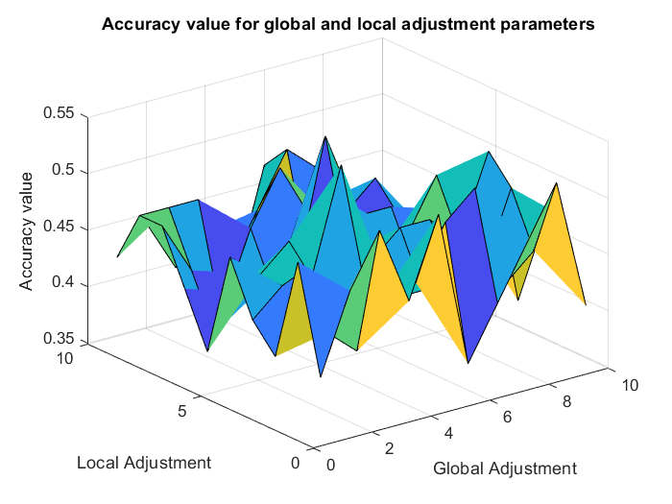
￼
Parameter tuning PSO
Global & self adjustment
Global adjustment =4
Local adjustment=6

Slide 17
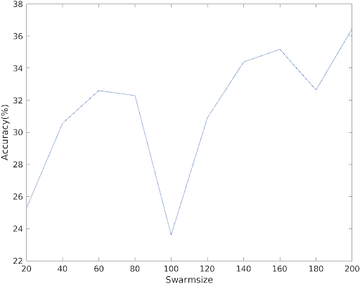
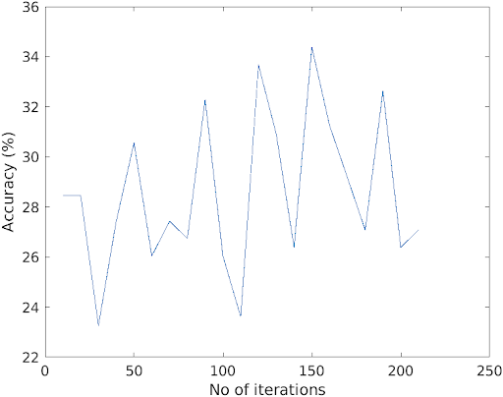
Swarm size
Iterations

Slide 18
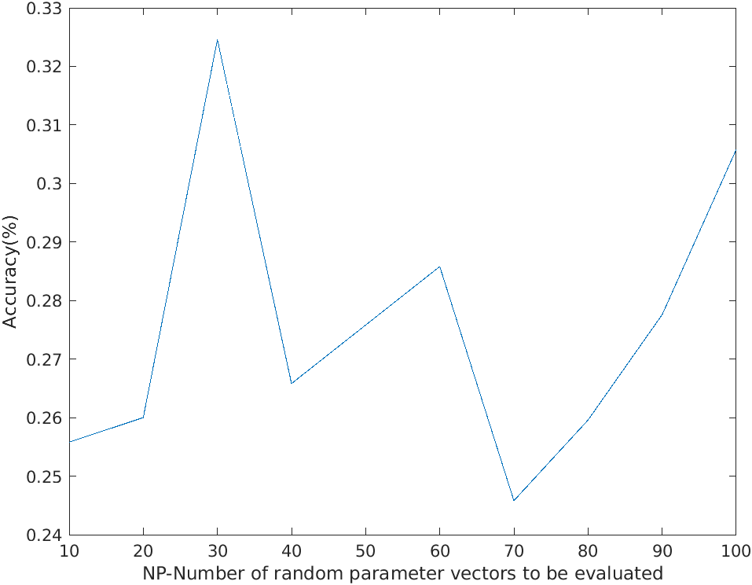
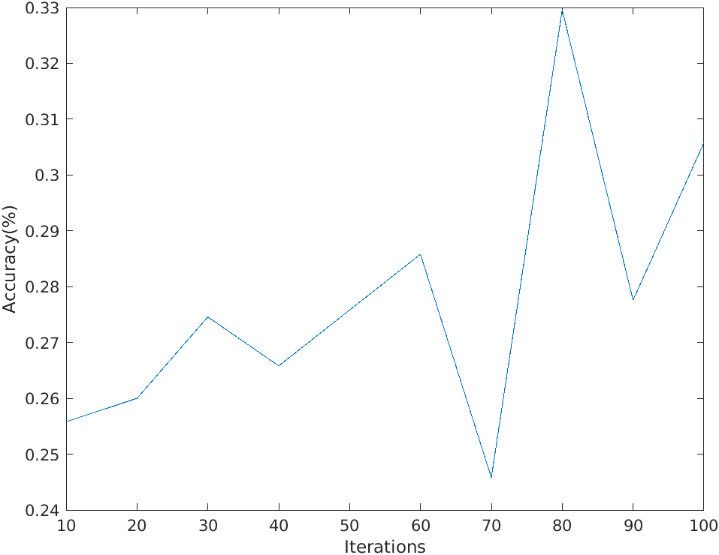
Parameter Tuning DE
NP- number of parameters to
evaluate randomly.
Iterations

Slide 19
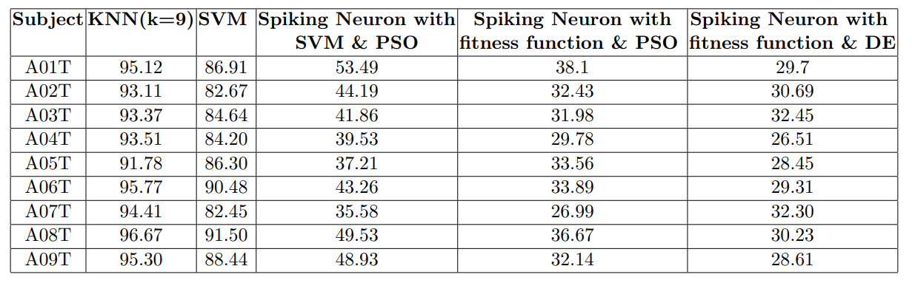
Results

Slide 20
Future Scope
Improve fitness function.
Different coding of features in spiking model.
Use Spiking neural network instead of single spiking neuron.

Slide 21
Thank You!!!

