Slide 1

An investigation into unsupervised machine Learning for predicting customer segment: Autoencoder method
Name: Adewale James Ilesanmi
Student ID: BI52QF
Date: 12th August, 2024.
MSc COMPUTING

Slide 2

INTRODUCTION
The increasing complexity of customer behavior and preferences in today's competitive business landscape necessitates the development of advanced customer segmentation techniques. Traditional clustering methods often struggle to capture the distinctions of customer data, sometimes leading to inaccurate segmentation and ineffective marketing strategies.
This thesis investigate the use of autoencoders and variational autoencoders (VAEs), which offer promising solutions to better clustering.
Furthermore, dimensionality reduction through Principal Component Analysis (PCA) is investigated as a performance enhancer, exploring its potential to augment the clustering performance of autoencoders and provide a more comprehensive understanding of customer behavior.

Slide 3
Objectives
To identify key factors for effectively building an autoencoder model by conducting a comprehensive literature review of peer-reviewed articles published within the last five years, completing the review within two months to improve clustering performance using autoencoder models.
To investigate and compare the performance of Autoencoders, Variational Autoencoders (VAE) and classic clustering algorithm in customer segmentation model using silhouette score, and Calinski-Harabasz index through training, and testing of demographic and customer behavioural data.
To assess the impact of PCA as an additional dimension reduction technique on clustering results by analyzing the performance change using silhouette scores and Calinski-Harabasz indices before and after applying PCA, to determine the effectiveness of PCA in improving clustering performance.
To investigate and provide actionable recommendations on the comparison of VAE, and traditional clustering algorithms for customer segmentation practices, through detailed reports on performance metrics and practical insights to enhance customer segmentation strategies in businesses.

Slide 4

BACKGROUND/CONTEXT
Literature Review
Informed Decision
Review on Customer segmentation and practices
The customer segmentation best practise and limitation of this approach
Review of Machine and Learning Approach & Existing methods and methodology.
The selection of deep learning and classical machine learning model for clustering
Autoencoder and identification of
key factor for model improvement
Identify key factors in training of a good performing autoencoder model
Investigation of the use of AE, VAE and classical ML model with and without further dimensions reduction
Research Gaps and Opportunities

Slide 5

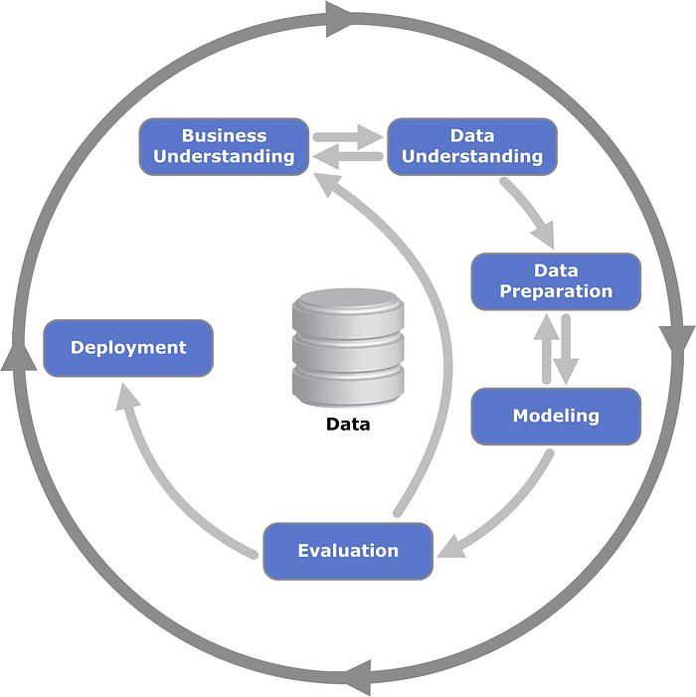
STUDY METHODOLOGY FOLLOWED
CRISP-DM (Cross-Industry Standard Process for Data Mining) Framework

Slide 6

PRACTICAL ELEMENT (Implementation)
Data Preprocessing
Missing values and outliers' detection
Feature Engineering and selection
Data Scaling and PCA
Modelling and Model Architecture
Customer Personality Analysis Data Collection
EDA
Kmean, DBSCAN
Hierarchical
Model Evaluation
Silhouette Score
Calinski-Harabasz Index
Autoencoder
Variational Autoencoder
Training Process
Loss Functions
Optimization Algorithms
Model Training and Validation
Clustering with and
Without PCA

Slide 7

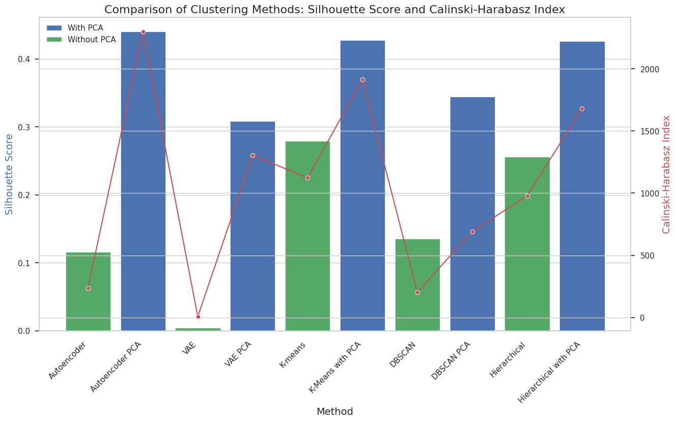
OUTCOMES AND RESULTS (Model Result)

Slide 8

OUTCOMES AND RESULTS (Comparison)
Existing Papers
Study results
Paper | Methods | Silhouette Score | Calinski-Harabasz Index
Li et al., 2021 | KM | 0.352 | 1316.942
 | KM-PSO (particle swam optimasation) | 0.370 | 3392.283
Wu and Wang, (2022) | Autoencoder | -- | 506
Method | Silhouette Score | Calinski-Harabasz Index
Autoencoder | 0.115328 | 238.210063
Autoencoder PCA | 0.439293 | 2299.436458
VAE | 0.003647 | 8.008472
VAE PCA | 0.307383 | 1305.442805
K-means | 0.278314 | 1123.890273
K-Means with PCA | 0.4268 | 1913.4799
DBSCAN | 0.134897 | 203.678912
DBSCAN PCA | 0.34334 | 692.4556
Hierarchical | 0.255103 | 978.564782
Hierarchical with PCA | 0.4253 | 1680.6086

Slide 9

DISCUSSION
OBJ 1
Conducted literature review on autoencoders and customer segmentation.
Identified key factors affecting autoencoder performance: Model architecture, activation functions, Hyperparameters, Regularization techniques, Training strategies, Data preprocessing and augmentation
Informed the development of base autoencoder and VAE models.
Implemented and evaluated autoencoder and VAE models using customer data.
Used silhouette scores and Calinski-Harabasz index for performance assessment.
Found that base autoencoder outperformed VAE in customer segmentation tasks.
OBJ 2
Compared autoencoder models (with and without PCA) to traditional clustering methods (K-means, DBSCAN, hierarchical clustering).
Autoencoder with PCA outperformed all other methods in cluster quality and separation.
Provided actionable recommendations for businesses on using advanced segmentation techniques.
OBJ 4
OBJ 3
Applied PCA to encoded data from autoencoder and VAE models.
Improved clustering performance with higher silhouette scores and Calinski-Harabasz index.
Highlighted the effectiveness of c ombining PCA with autoencoders for better customer segmentation.

Slide 10


Limitation
Dataset and Generalization Constraints: The study relied on a single Kaggle dataset, limiting generalizability across different customer segments, industries, and unseen data.
Practical and Optimization Challenges: The models' real-time performance and interpretability were not assessed, and exhaustive hyperparameter optimization was constrained by computational and time limits.
Future Research
Investigating the application of transformer models, such as BERT, Gemma, Llama 3 and GPT, for customer segmentation could also yield valuable insights.
Utilise the finding to create real time application using the Ensemble methods for supervised classification and customer profiling.

Slide 11

Q&A/REFERENCES
Li, Y., Chu, X., Tian, D., Feng, J. and Mu, W. (2021). Customer segmentation using K-means clustering and the adaptive particle swarm optimization algorithm. Applied Soft Computing, 113, p.107924. doi:https://doi.org/10.1016/j.asoc.2021.107924.
‌Wu, H. and Wang, Q. (2022). GEAE: Gated Enhanced Autoencoder based Feature Extraction and Clustering for Customer Segmentation. 2022 International Joint Conference on Neural Networks (IJCNN). doi:https://doi.org/10.1109/ijcnn55064.2022.9892475.

