Slide 1

GreenTech Manufacturing
Downtime Analysis Dashboard
Data Analysis & Insights Presentation

Slide 2
Objective
Analyze downtime impact in relation to time lost, identify key factors affecting production, and provide data-driven recommendations.

Slide 3

Dashboard Overview
Three dashboards were created:
Downtime Factor Overview
Downtime Duration Analysis
Operator Scheduling
These provide insights into downtime causes, duration, and operator performance.

Slide 4
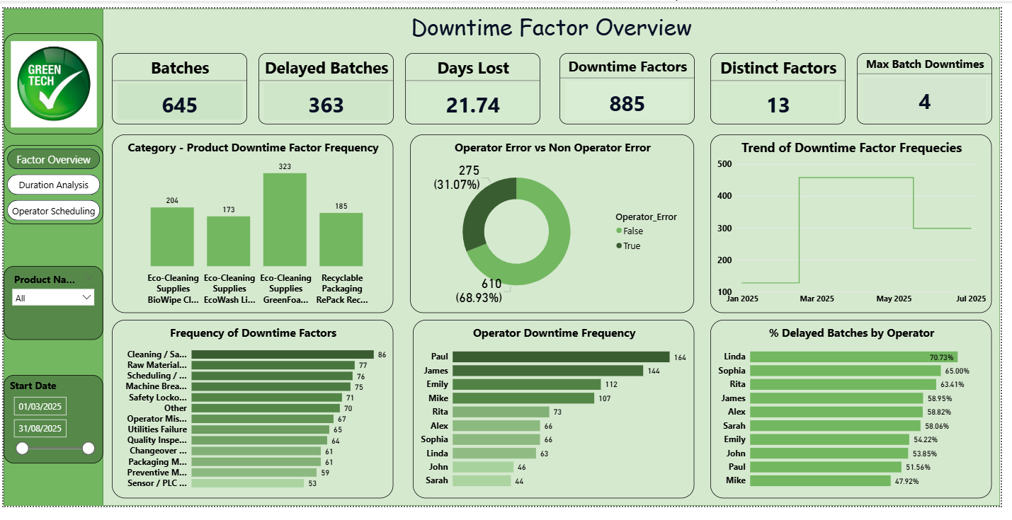
DOWNTIME FACTOR OVERVIEW

Slide 5
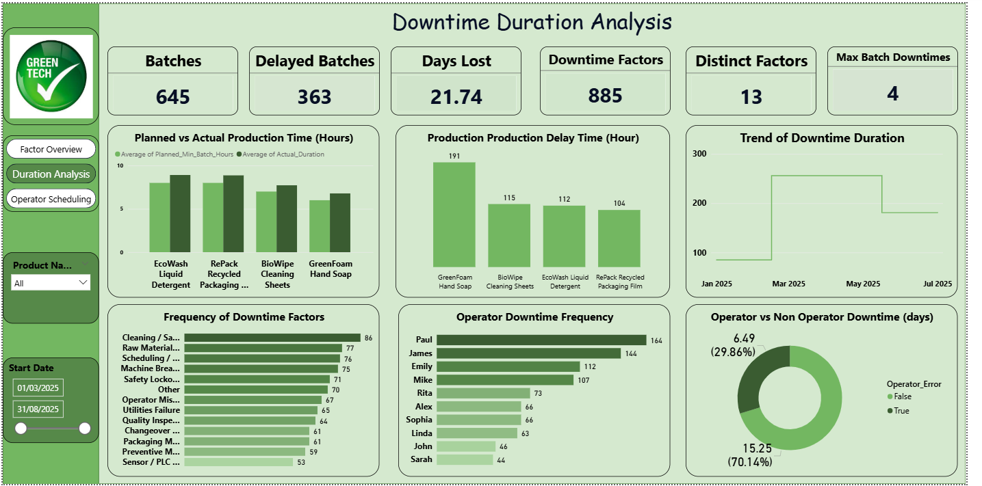
DOWNTIME DURATION ANALYSIS

Slide 6
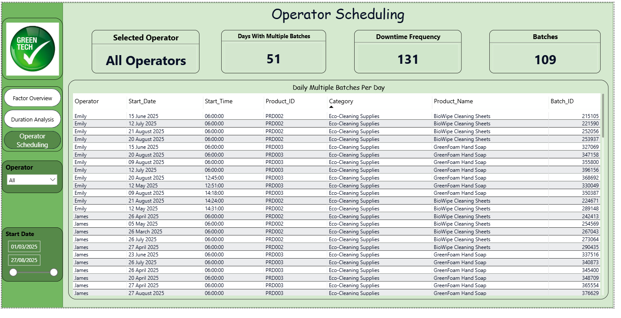
OPERATOR SCHEDULING

Slide 7
Key Metrics
• Total Batches: 645
• Delayed Batches: 363
• Days Lost: 21.74
• Downtime Factors: 885
• Distinct Factors: 13
Indicates significant production inefficiencies.

Slide 8
Key Insights - Downtime Factors
Cleaning/Sanitation and Raw Materials are top causes
Machine breakdown and scheduling also major contributors
Eco-cleaning products show highest downtime frequency

Slide 9
Key Insights - Time Lost
Actual production time exceeds planned time across products
GreenFoam Hand Soap has highest delay duration
Downtime trend peaked around March–May

Slide 10
Operator Performance Insights
Paul and James have highest downtime frequency
Linda has highest % delayed batches (~70%)
Some operators handle multiple batches per day, increasing workload risk

Slide 11
Business Impact
Increased production delays
Loss of productivity (21+ days lost)
Higher operational costs
Risk of failing customer demand timelines

Slide 12
Recommendations
Improve preventive maintenance for machines
Optimize production scheduling
Provide operator training and workload balancing
Focus on high-impact products for process improvement
Monitor downtime trends continuously

Slide 13

Conclusion
The analysis highlights key inefficiencies in downtime factors and operator performance. Addressing these areas will improve productivity, reduce delays, and enhance operational efficiency.

Slide 14
Thank you
THANK YOU

