Slide 1

BAAL ARJUN
PRESENTERS:
ANUJ SHRESTHA (078BCT014)
ARISHA PRASAIN (078BCT019)
AYUSH ADHIKARI (078BCT024)
SUBMMITTED TO:
Department of Electronics and Computer Engineering

Slide 2

AGENDA
INRODUCTION
TECHNICAL ARCHITECTURE
GAME CONCEPT AND STORYLINE
PROGRAM EXECUTION FLOWCHART
GAME MECHANICS AND GAMEPLAY
PLAYER INTERACTIONS AND CONTROLS
BOT ENEMY AND BEHAVIOR
LEVEL DESIGN AND PROGRESSION
DEVELOPMENT CHALLENGES
FUTURE ENHANCEMENTS
REFERENCES
CONCLUSION

Slide 3
INTRODUCTION
Baal Arjun is a 2-D single player arrow shooting game .
There are 3 chapters that showcase evolution of archery of Arjun from Practice to War.
There are 10 levels where the first two levels are unlocked by default.
To unlock the next level , player should win the current level.
Our game features another deadly weapon called Sudarshan along with arrows.

Slide 4
Operating System:
Windows 10 (64-bit)
Minimum RAM Requirement:
2 GB
Development Environment:
Compiler : Visual C++
IDE : Visual Studio 2022
Library
SFML 2.6.0 for Visual C++ 17 (2022) - 64-bit
Graphics Editor
Adobe Illustrator
Adobe Photoshop
TECHNICAL REQUIREMENTS

Slide 5

GAME CONCEPT AND STORYLINE
In "Baal Arjun," players step into the shoes of Arjun, a skilled archer and warrior, who finds himself practicing and fighting through the three chapters.
The 3 chapters in the game include :
Chapter 1: Practice
Arjun begins as a skilled but untested archer. Players guide him through training sessions and quests that hone his abilities.
The enemy objects are moving and player has to shoot his arrows and kill them with arrows available in order to win the game.
This chapter serves as an introduction to the game's mechanics, allowing players to master Arjun's basic skills such as aiming, shooting, and movement.
Chapter 2: Fights
Players face increasingly formidable enemies that require precise shooting.
This chapter makes player accustomed to shooting and dodging the arrows thrown at them.
Chapter 3: War
Arjun confronts more formidable adversaries such as Dronacharya, Bhishma Pitamah, Ashwathama, and others.
The challenging part of this chapter is that all enemies must be killed with given number of arrows.
Only through complete mastery of accurate targeting, shooting, and dodging skills can victory be assured in this chapter

Slide 6
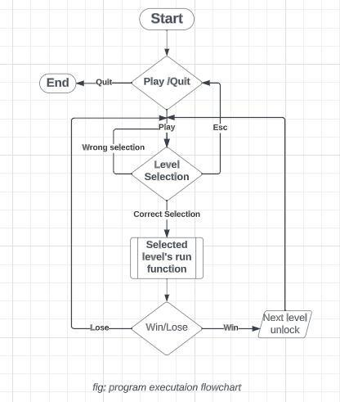
PROGRAM FLOW architecture

Slide 7


Game Mechanics and Gameplay
Arrow Shooting(using left mouse click)
In the game, you'll come across two types of arrows:
Normal Black Arrows (Used by Enemies):
Enemies mainly use these regular black arrows.
Deadly enemies shoot arrows towards player and others shoot straight.
Function definition looks like this:
void shoot(float startX, float startY, float targetX, float targetY);
Flaming Arrows (Used by Arjun):
Arjun, our main character, uses special flaming arrows.
These arrows are on fire and deal more damage to enemies.
We have used function overloading for the flaming arrow whose definition looks like this:
void shoot(float startX, float startY, float targetX, float targetY, int f);
Additionally, the right click on mouse unleashes Sudarshan .
t

Slide 8

SHTOOT
MOVEMENTS
Player
Player can move in 2-D up to one-fourth of the screen using W,S,A,D keys.
The enemies are also made to come towards player for more deadly shooting.
Enemy Formation
The army that throws linear arrows come towards player and shoot straight ahead.
Enemy of greater strength are made to stand little far and shoot towards player.

Slide 9
PLAYER INTERACTIONS
EVENT HANDLING
This is done using window.pollevent(event) of SFML for responsiveness of the GUI.
When input is taken from keyboard to escape out of the window, the window is automatically closed.
The event handling using mouse pointer for rendering the Level Selection screen is based on the screen coordinates of the 'Play' and 'Quit' button in the Menu Screen.
Likewise, keyboard and mouse pointer event handling are coded for each consecutive levels.

Slide 10
PLAYER CONTROLS
The input from keyboard calls methods defined for player movements. Those methods include:
METHODS
void moveLeft(); // make the player go left (when 'A' is pressed )
void moveRight(); // make the player go right (when 'D' is pressed )
void moveUp(); // make the player go up (when 'W' is pressed )
void moveDown(); // make the player go down (when 'S' is pressed )
void stopLeft(); // Stop the player moving in the left direction
void stopRight(); // Stop the player moving in the right direction
void stopUp(); // Stop the player moving in the upward direction
void stopDown(); // Stop the player moving in the downward direction
//function call for shooting when left mouse button is pressed
arrow[currentArrow].shoot(player.getCenter().x, player.getCenter().y, mouseWorldPosition.x, mouseWorldPosition.y,1);
Here, we have used overloaded shoot() function for flaming arrow for the player's arrow.

Slide 11

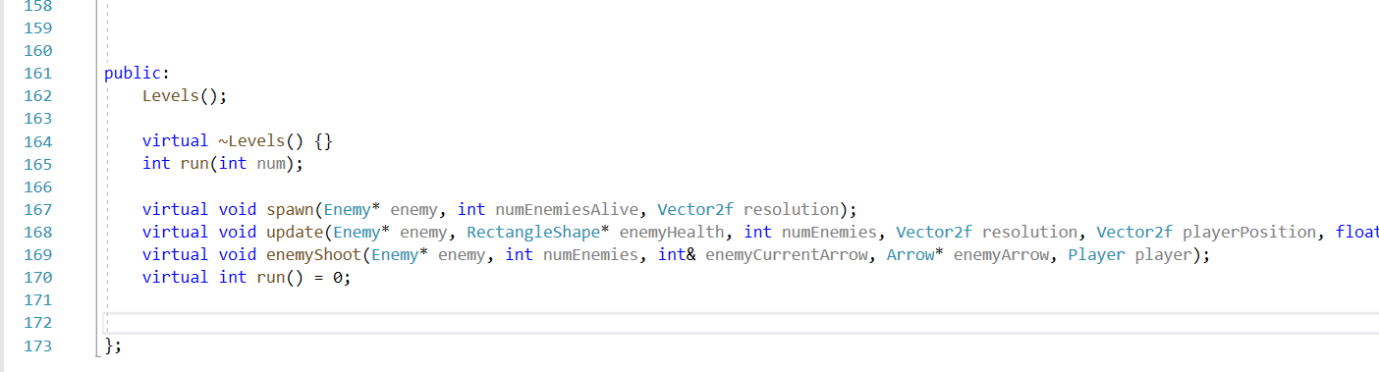
BOT ENEMY AND BEHAVIOUR
The concept of polymorphism is used in the implementation of bot enemy's movements and shooting.
We have made various enemy formations in the game. So, the virtual functions declared in the levels base class are overridden for each derived class of levels.
Below is the code written for the behavior of bot using virtual functions in the base class.

Slide 12
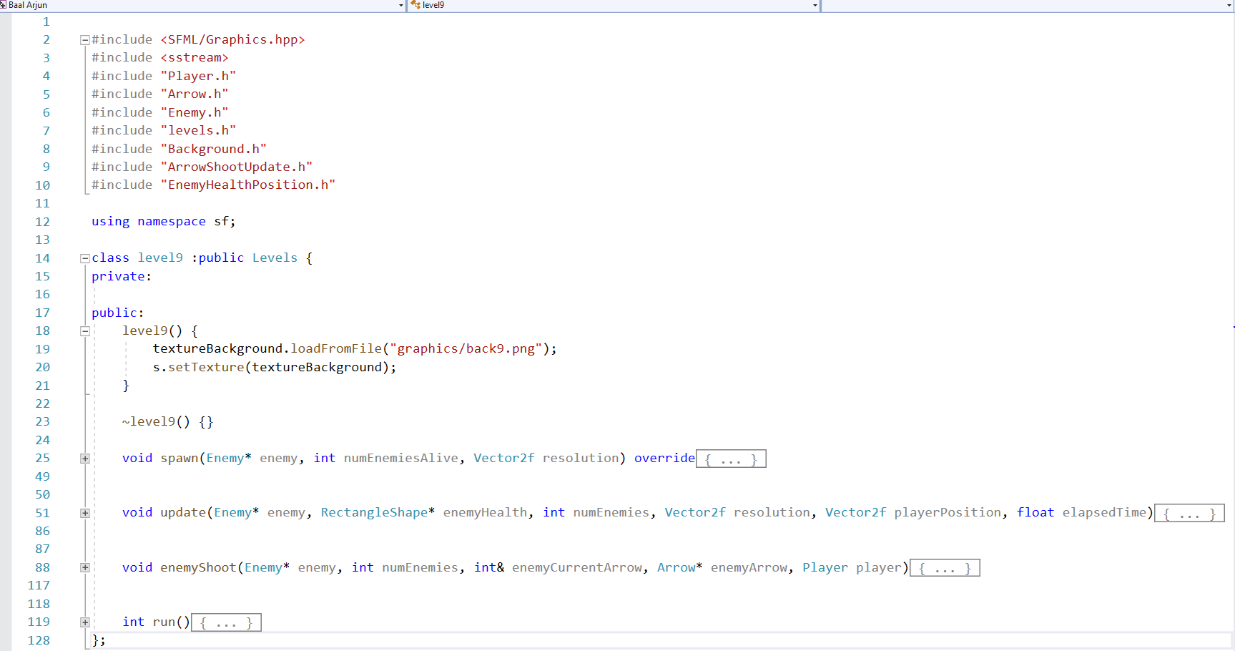
Below is the sample code for the overridden enemy bot movements and shoot functions of level 9 in our code.

Slide 13
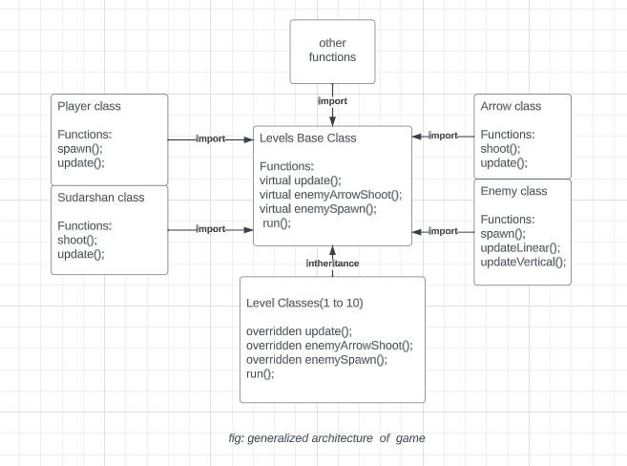
LEVEL DESIGN AND PROGRESSION
The concept of inheritance is applied to make all the 10 levels which inherits from the 'levels' base class

Slide 14
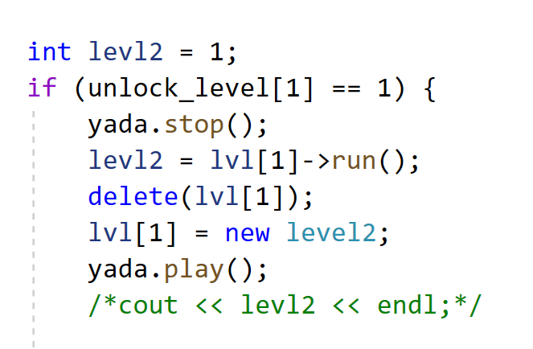
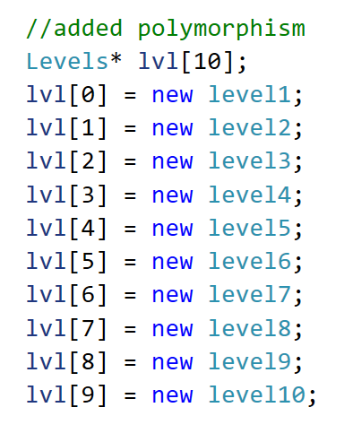
Below is the block of code that showcases the combination of polymorphism and inheritance implemented in our game.
Levels is the base class and level1, level2 , … level10 are the derived classes of it.
The objects of each base classes are stored in the pointer of the base class dynamically.
We override the run() (virtual function of the base class) in each level as shown in the right.

Slide 15
DEVELOPMENT CHALLENGES
No display of score and high score
Equal no. of arrows in easy as well as hard levels
Lack of proper storytelling and tutorial/guide
Lack of shields/ protections to the player
Lack of ways to regain health and arrows
Lack of bow update and arrow update
Lack of proper Graphical Interface

Slide 16
FUTURE ENHANCEMENTS
New types of arrow can be added
Graphics can be improved
More difficult levels can be added
Avtar changing features can be added
In game health increment mechanism can be added
Shield type new features can be added
Enriched Story telling mechanism can be added

Slide 17
REFERENCES
Baral, D S.(2018).Secrets of Object Oriented Programming in C++
https://www.sfml-dev.org/documentation/2.6.0/
Stroustrup, B.(2013).The C++ Programming Language, 4th edition
Several AI Tools

Slide 18
QUESTIONS ?

Slide 19

THANK YOU!

