Slide 1
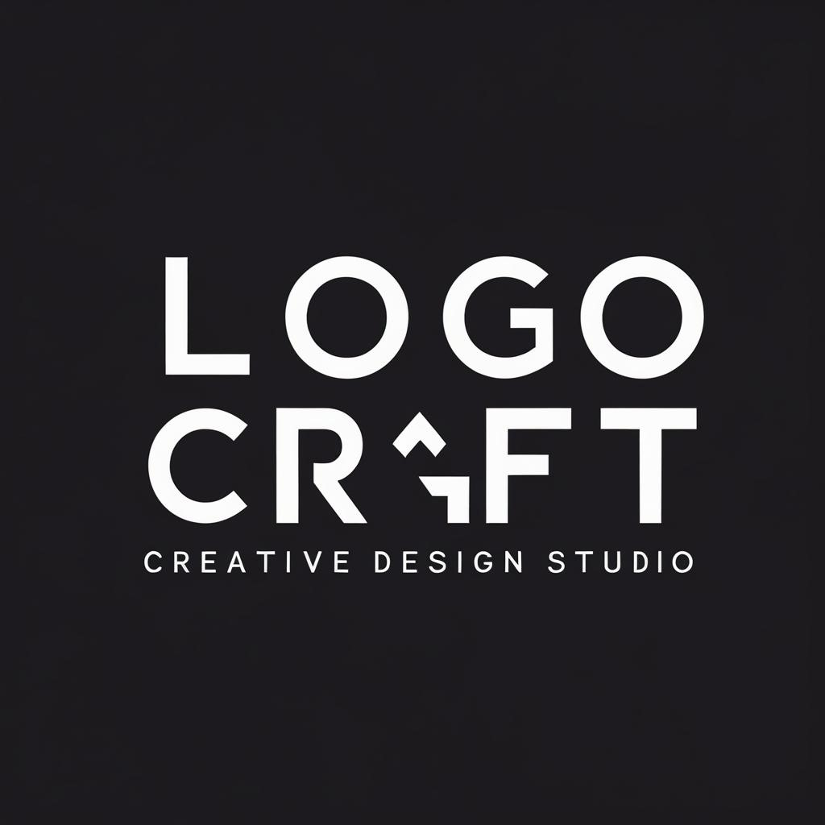
Zotex logo
Designed by LOGOCRAFT

Slide 2
Table of contents
01
02
03
Who are we
Client view
1st design

Slide 3
Table of contents
04
05
2nd design
Timeline

Slide 4
01
Who we are

Slide 5
In 2020
We started during the coronavirus period, and we faced many challenges to make this company a success
Our objective:
Create simple, memorable, and timeless logos.
Capture the true story and personality of each brand.
Help businesses stand out and be recognized.

Slide 6
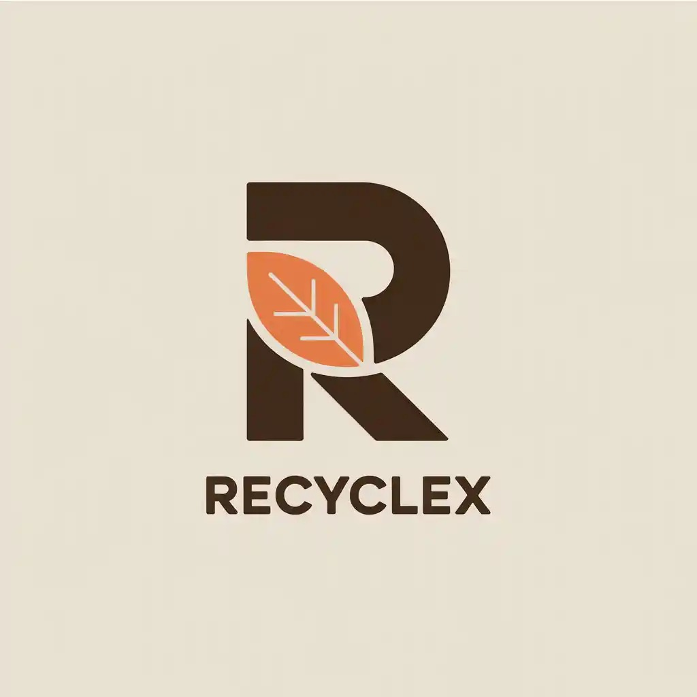


Three old logos
Recyle
Nutration
Soft drink

Slide 7
02
Client view

Slide 8
Package | Price | Concepts | Includes | Deliverables | Timeline | Free Bonus
Basic | 1000 EGP | 2 | Main logo + minimal icon | PNG, JPG, PDF | 7 days | Social media profile picture set (Facebook, Instagram, LinkedIn)
Standard | 1500 EGP | 3 | Main logo + minimal iconColor palette + font selectionMockups (website + social media) | AI, PSD, PNG, SVG, PDF, JPG | 10 days | 1 branded social media post template (Canva or PSD)
Premium | 2000 EGP | 4 | Full logo system (main logo + icon + submark)Complete brand guidelinesMockups (website, business card, social media, mini brandbook) | AI, PSD, PNG, SVG, PDF, JPG (all formats) | 12 days | Business card design (front & back) + Email signature design

Slide 9
03
Frist design

Slide 10

Our first design

Slide 11
04
2nd design

Slide 12

2nd design

Slide 13
05
Timeline

Slide 14
Timeline of our work
Day 1 Days 2–3 Day 4 Days 5–6 Days 7–8 Days 9–10 Day 10
|--------------|--------------------------|---------------|------------------------|--------------|--------------------------|
Brand Moodboard & Initial Logo Revisions Final Logo & Mockups & Final Files &
Vision Research Concepts (3) (Client Input) Variations Applications Guidelines

Slide 15
Thanks!
Contact us at
LogoCraftteam@gmail.Com
+34 654 321 432
LogoCraft.com

