Slide 1
CNN Part
Ali Elneklawy
Nada Tarek
Nada Gamal El-Dien

Slide 2
Analysis of Confusion Matrix

Slide 3
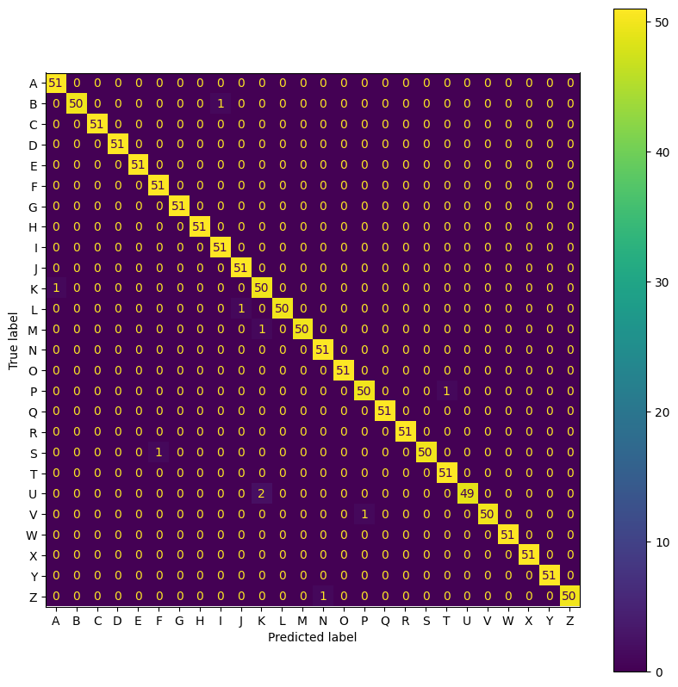
Confusion Matrix to Work On

Slide 4
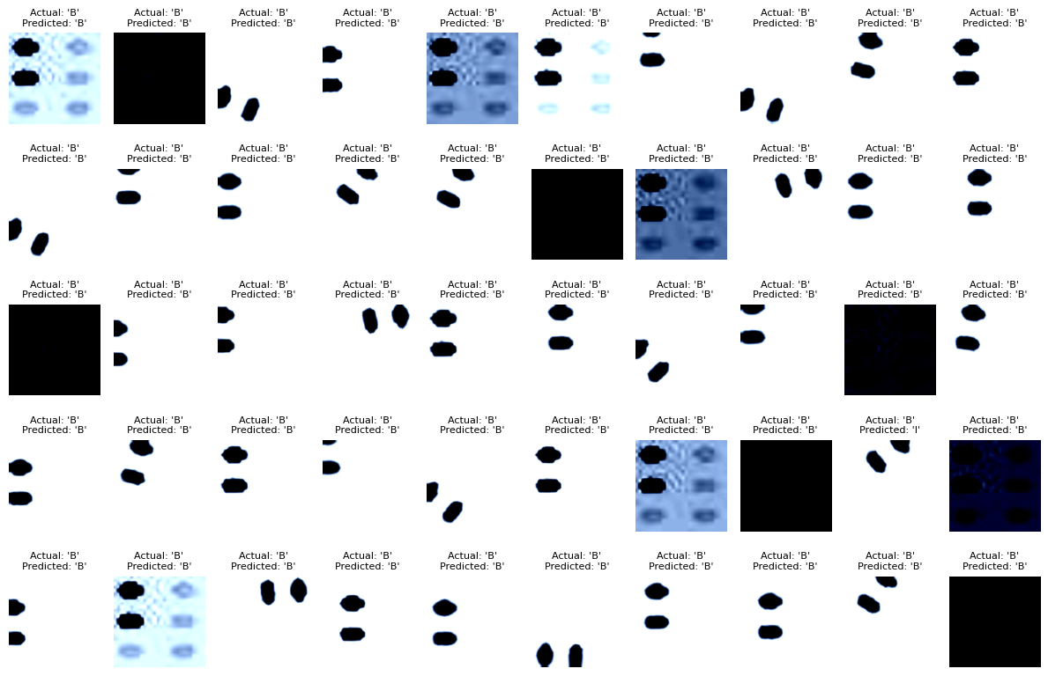
Mistakes in Letter B

Slide 5


B-I Example

Slide 6
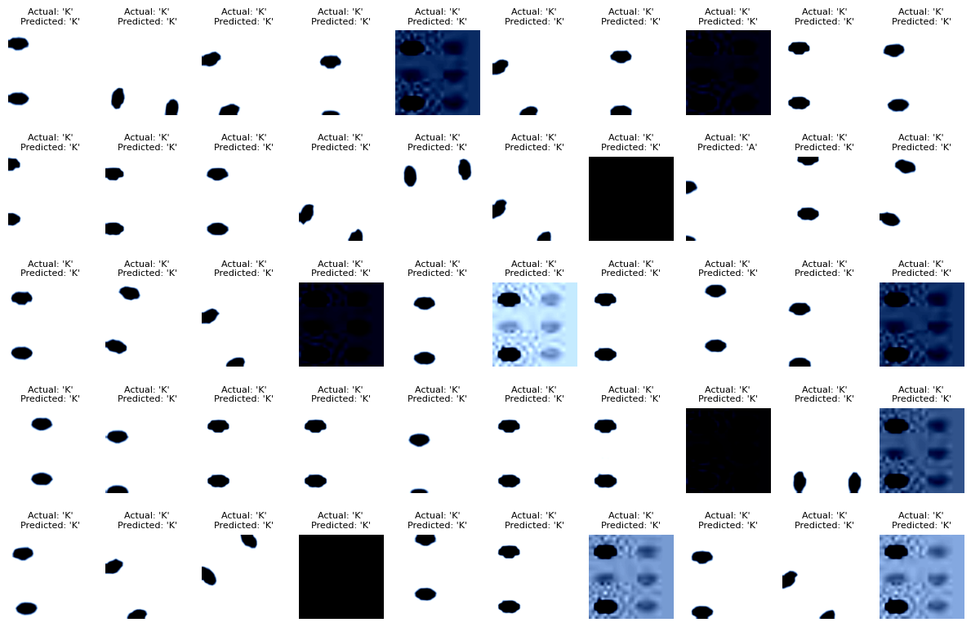
Mistakes in Letter K

Slide 7


K-A Example

Slide 8
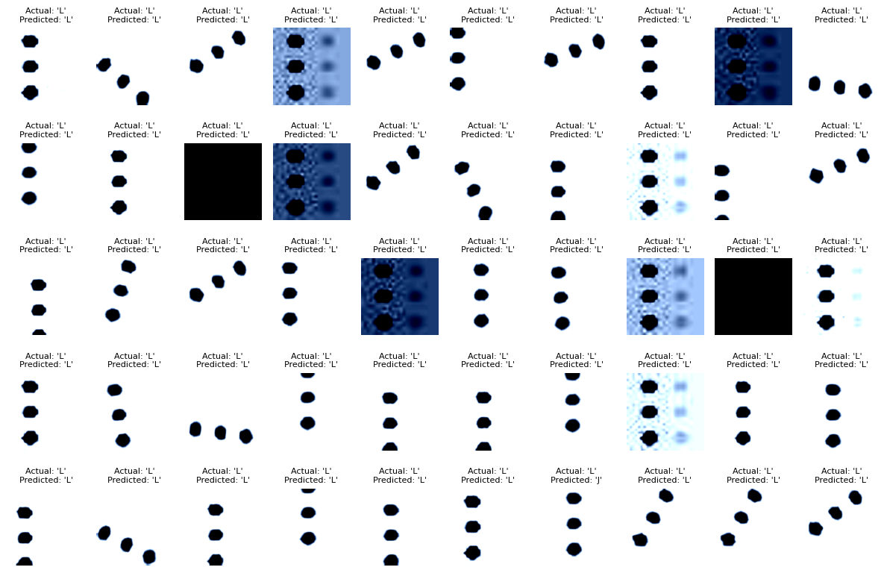
Mistakes in Letter L

Slide 9


L-J Example

Slide 10
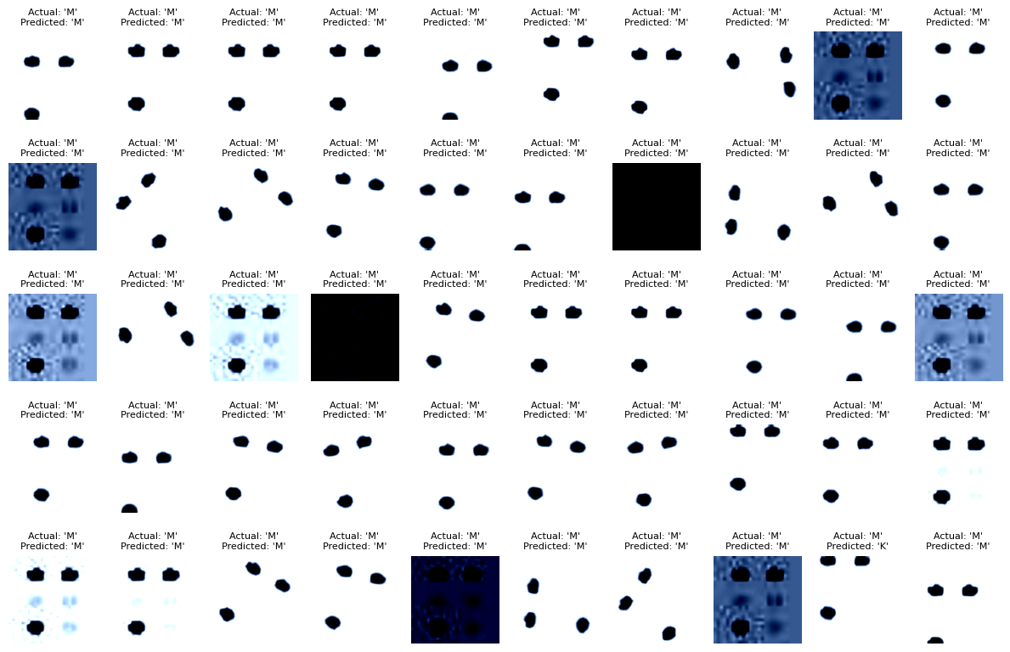
Mistakes in Letter M

Slide 11
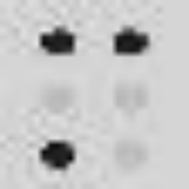
M-K Example

Slide 12
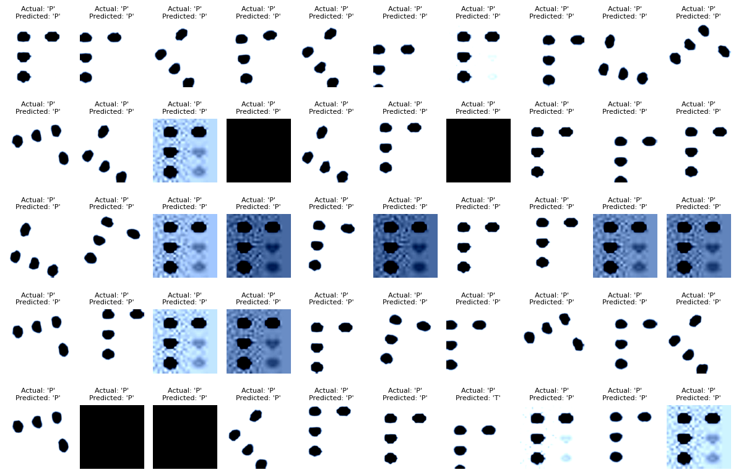
Mistakes in Letter P

Slide 13


P-T Example

Slide 14
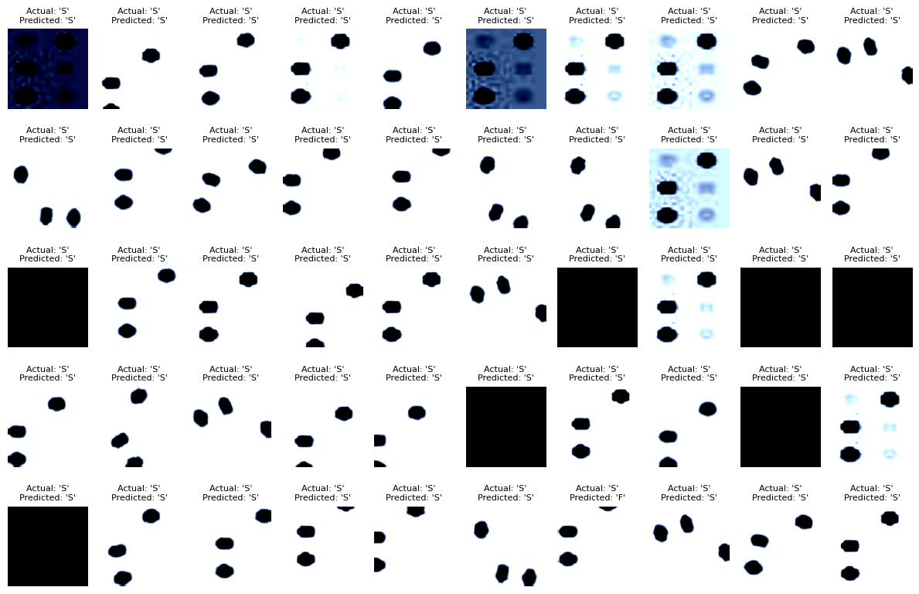
Mistakes in Letter S

Slide 15
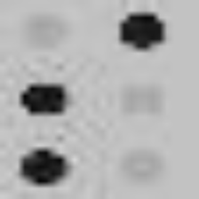

S-F Example

Slide 16
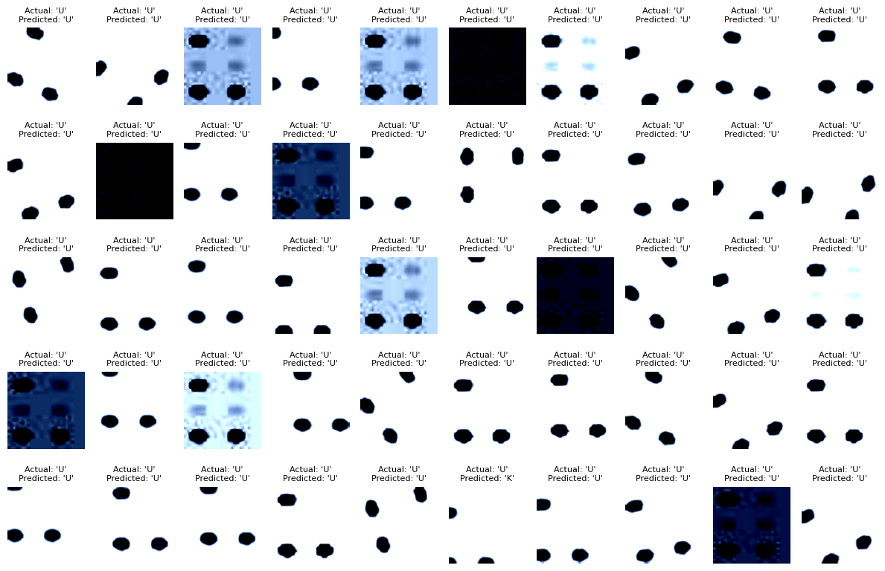
Mistakes in Letter U

Slide 17

U-K Example

Slide 18
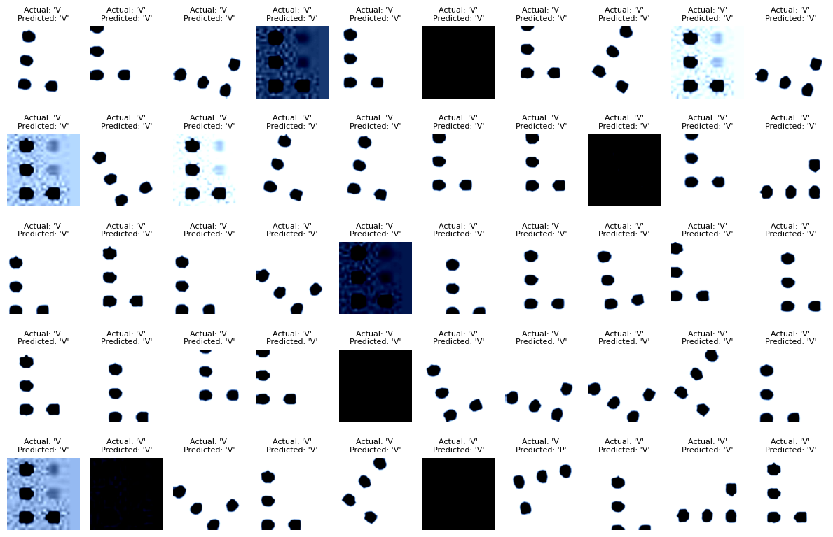
Mistakes in Letter V

Slide 19

V-P Example

Slide 20
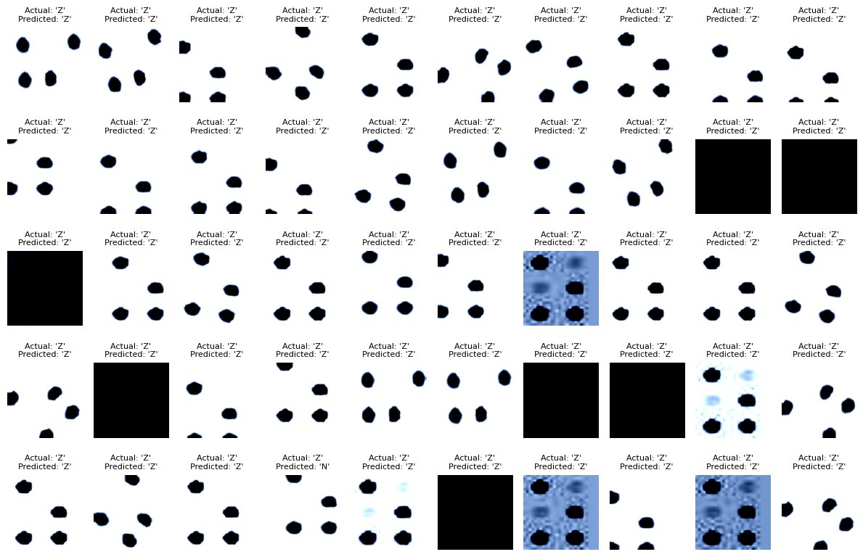
Mistakes in Letter Z

Slide 21


Z-N Example

