Slide 1

NREGA DATA ANALYSIS
Presented by:
Adham Ashraf Salah

Slide 2
INTRODUCTION
This project delves into the analysis of data related to the National Rural Employment Guarantee Act (NREGA), a transformative government scheme aimed at providing rural households with guaranteed wage employment opportunities.
The dataset used for this analysis encompasses a wide range of parameters, including the number of job cards issued, the workforce engaged, budget allocation, work completion statistics, and much more.
Through the application of data analytics techniques, we aim to gain valuable insights into the implementation and impact of NREGA across different states and districts in India.

Slide 3
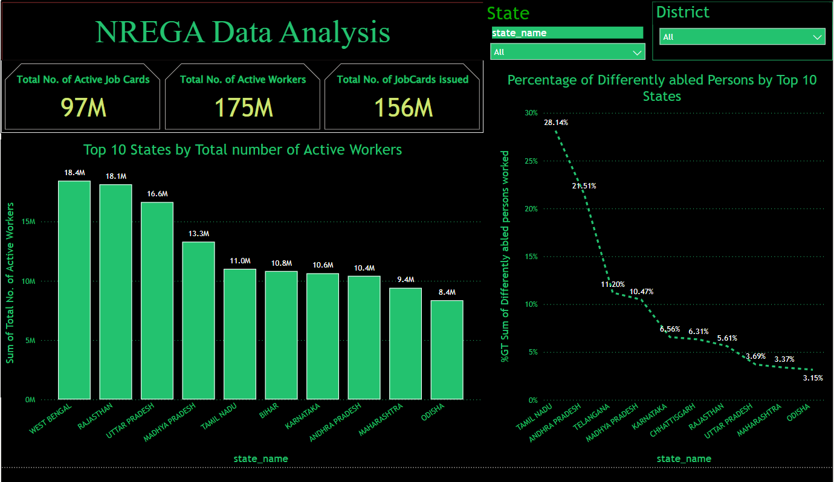
Effectiveness of NREGA in providing employment opportunities to rural households

Slide 4
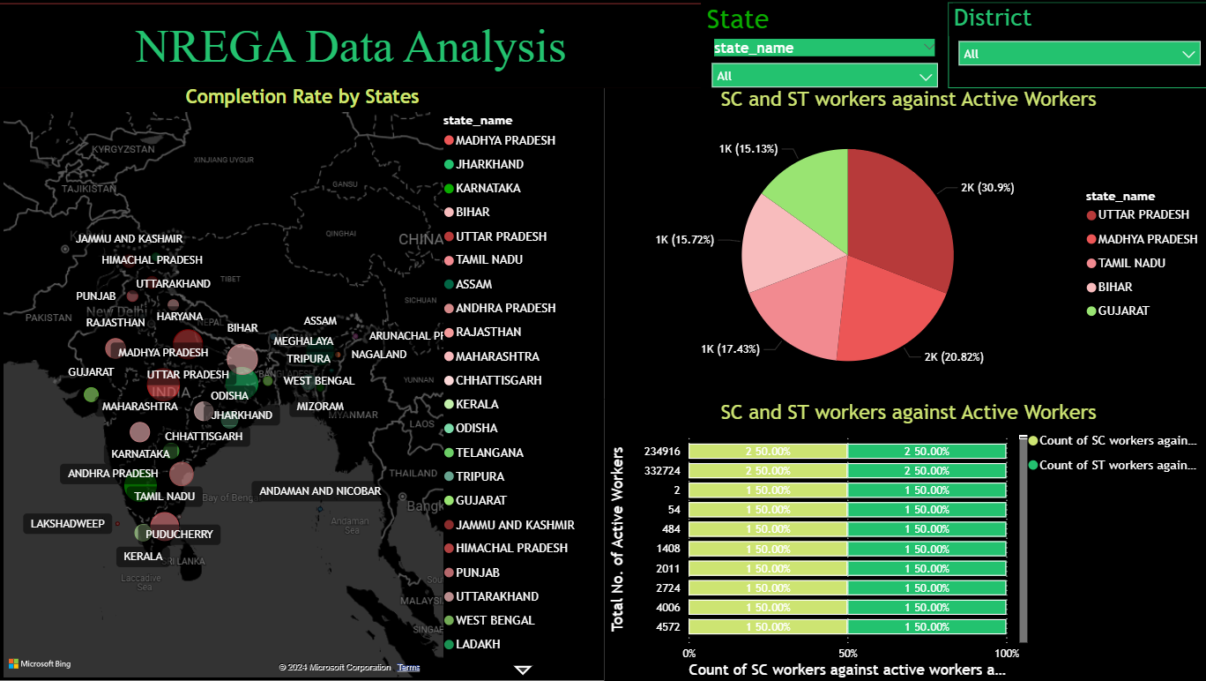
Regional disparities in the implementation and outcomes of the scheme

Slide 5
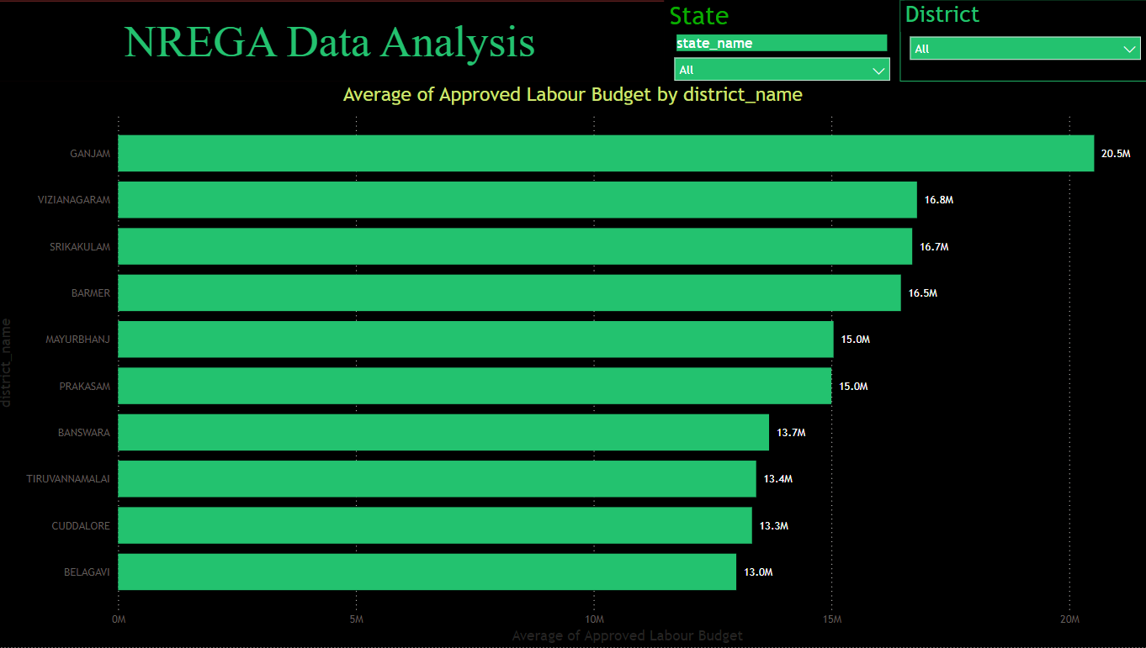
Utilization of the allocated budget

Slide 6
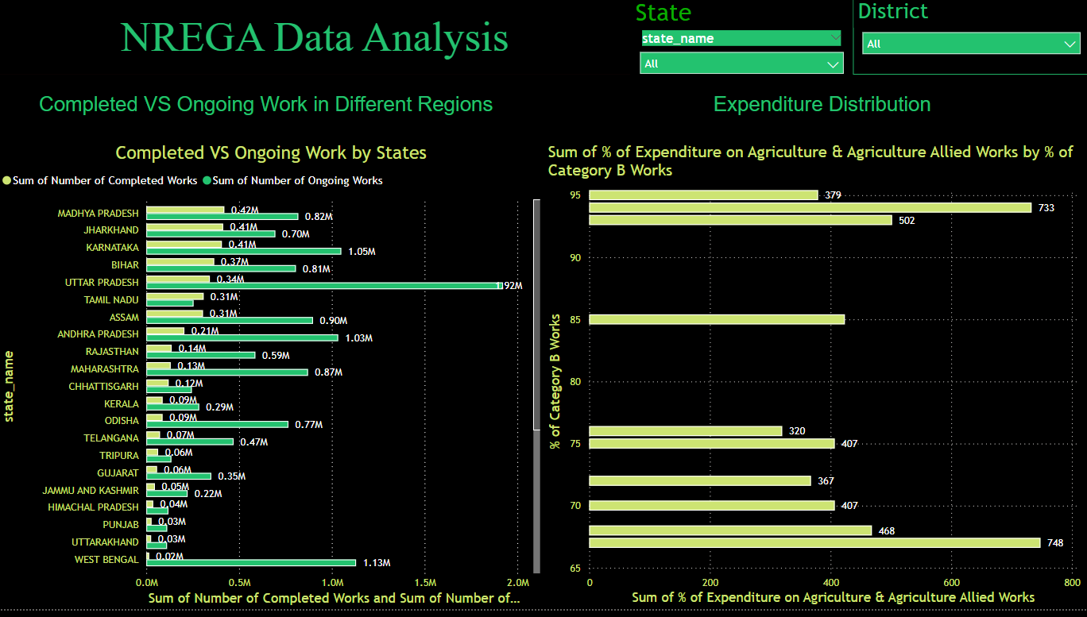
The key factors contributing to the completion of NREGA works

Slide 7
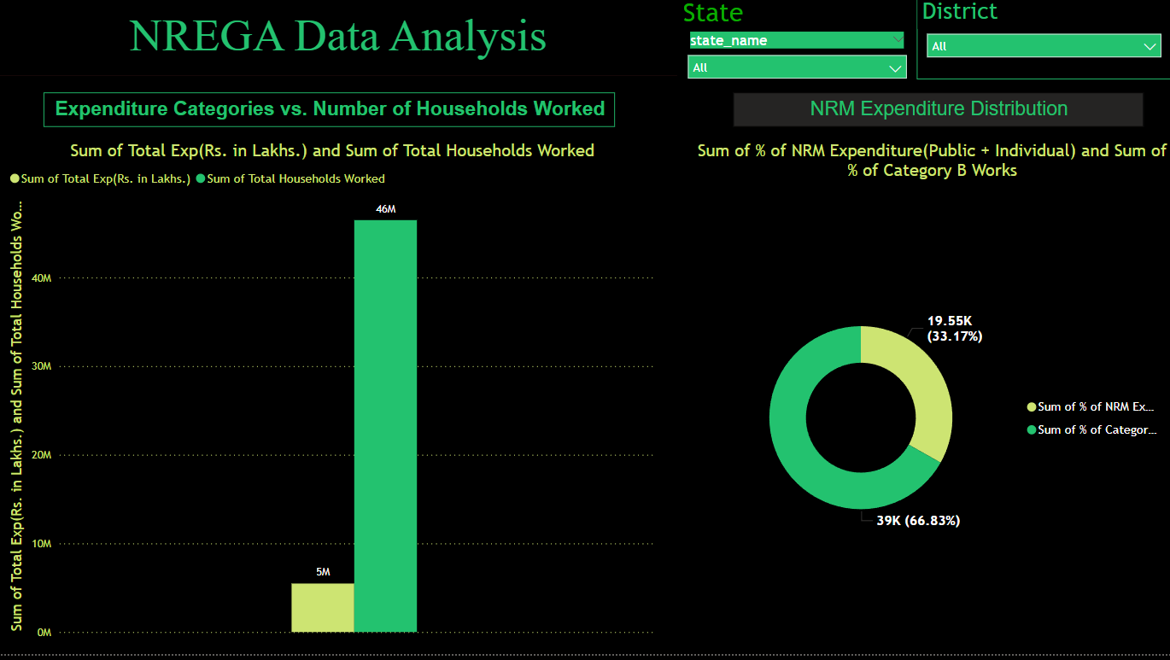
Scheme's impact

Slide 8
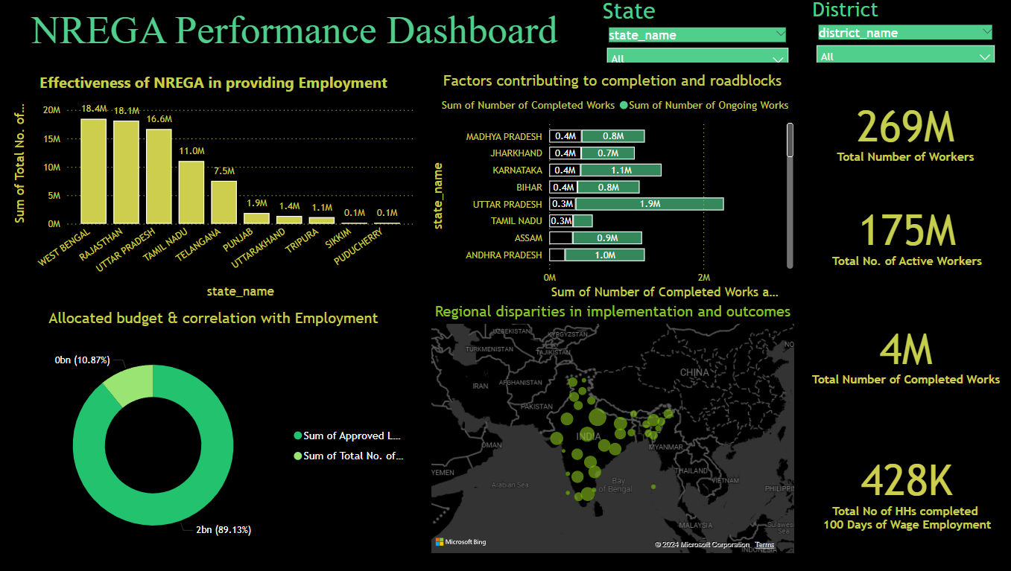
Final Dashboard

Slide 9
Summary
Across all 10 district names, the Average of SC workers against active workers ranged from 1,52,685.00 to 5,87,213.00 and the Average of ST workers against active workers ranged from 2,644.00 to 1,66,056.00.
Across all 10 district names, the Average Total No. of Active Job Cards ranged from 5,14,439.00 to 7,78,650.00 and the Average Total No. of Job Cards issued ranged from 6,42,006.00 to 12,35,377.00.﻿
Across all 10 district names, the Average Number of Ongoing Works ranged from 25,704.00 to 93,729.00 and the Average Total No. of Active Workers ranged from 1,74,860.00 to 11,59,592.00.

Slide 10


