Slide 1



K-means and KNN

Slide 2
Our team
Adham Ali
Abdelrahman Hamza
supervised by/ Prof. Dina Tantawy and Eng. Mohamed Abdallah

Slide 3
01
K-means

Slide 4
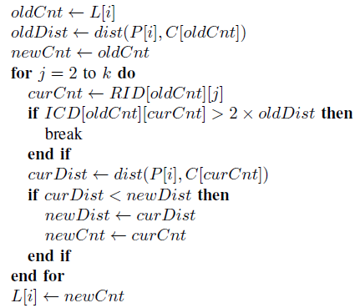
K-means
Triangle inequality.
Accelerating k-means clustering algorithm(optimize labeling).
Pseudocode of K-means labeling kernel.

Slide 5
02
GPU Implementation

Slide 6
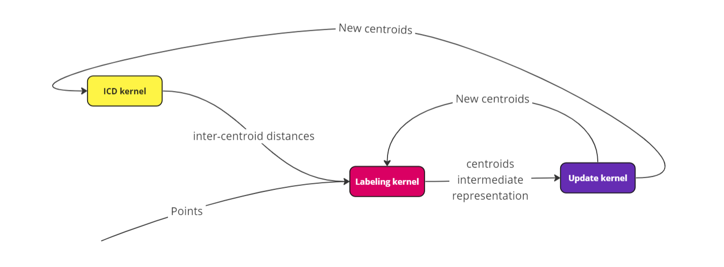
Kernels

Slide 7
Kernels
ICD kernel.
  Only 1 block.
  Tiling to load centroids.
Labeling kernel
  Tiling to load centroids in each block.
  Histogram problem and privatization.

Slide 8
Kernels
Update kernel
  Use reduction to accumulate errors in the same block (reduction problem).
  Use privatization to add all blocks error to the global memory location of error.

Slide 9
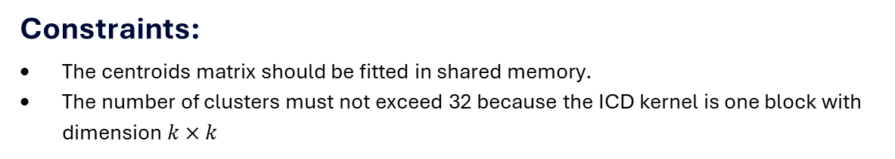
Constraints
Constraints:
The centroids matrix should be fitted in shared memory.
The number of clusters must not exceed 32 because the ICD kernel is one block with dimension $k×k$

Slide 10
03
Performance analysis

Slide 11
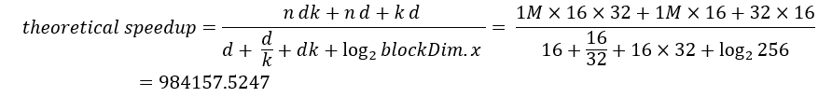
Theoretical speedup

Slide 12

Actual speedup

Slide 13
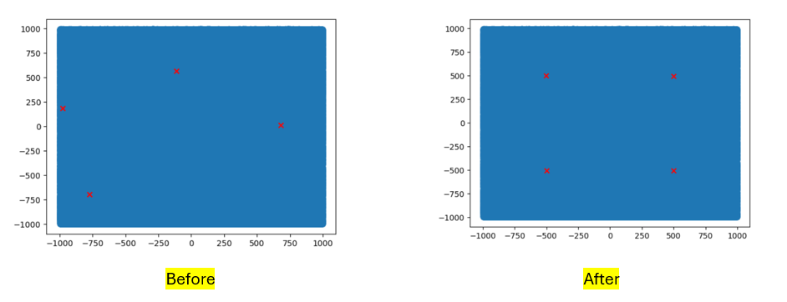
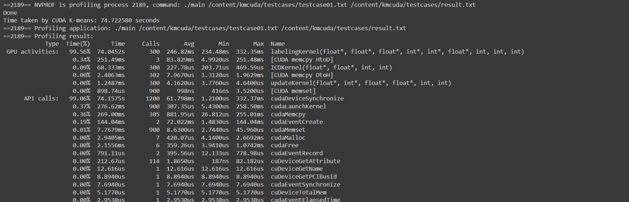
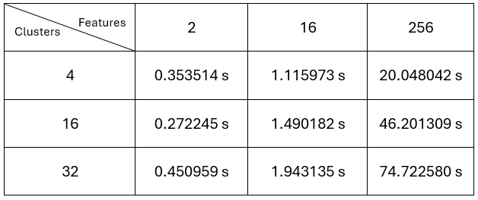
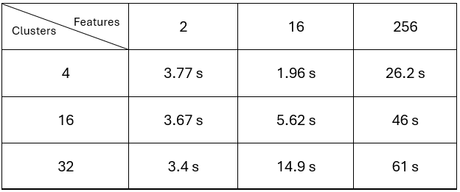
Measurements

Slide 14
04
KNN

Slide 15
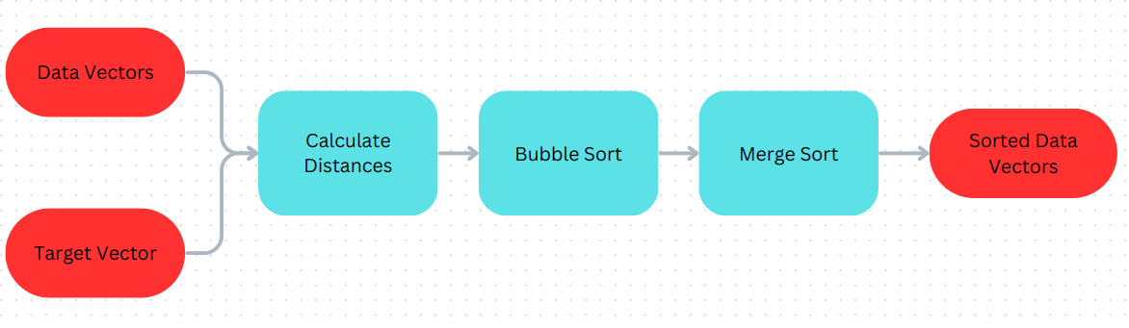
KNN

Slide 16
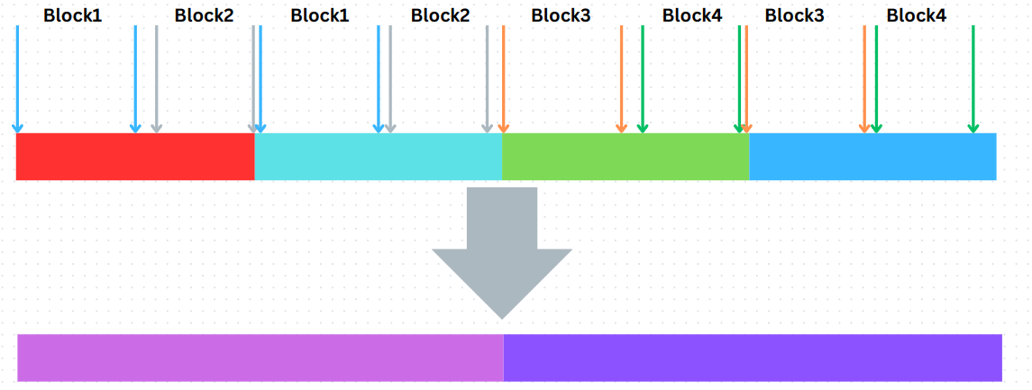
KNN

Slide 17
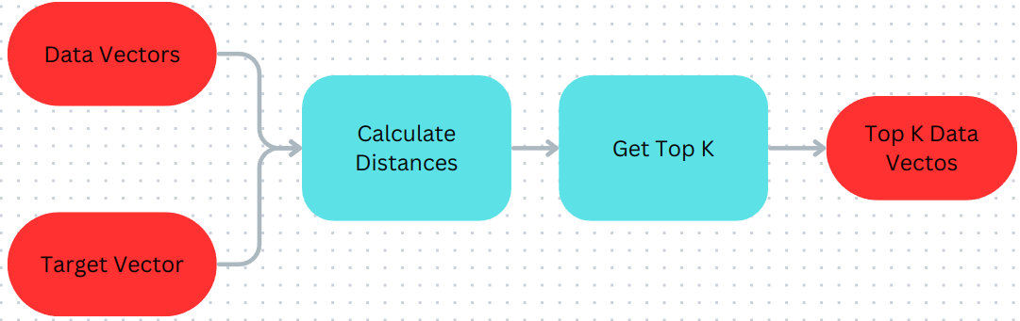
KNN

Slide 18
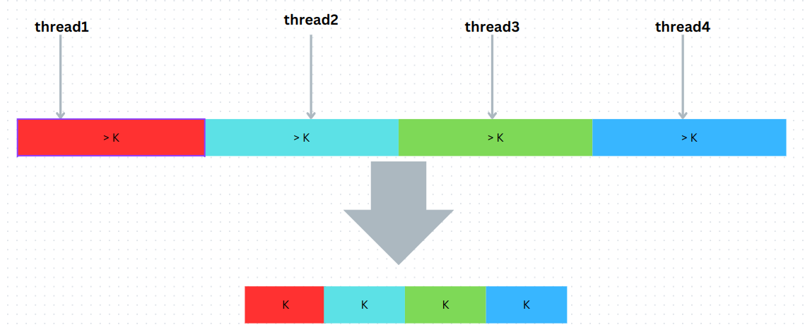
KNN

Slide 19
05
KNN performance analysis

Slide 20
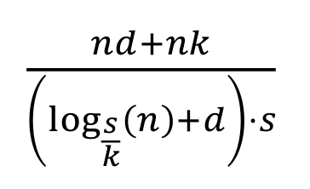
Speed Up
Theoretical
451080.3827

Slide 21
Question?

Slide 22
Thanks!

