Slide 1
Ex. 6.5.2 - World War II ships
Classes(class, type, country, numGuns, bore, displacement)
Ships(name, class, launched)
Battles (name, date)
Outcomes (ship, battle, result)
Bore is diameter of the gun barrel, in inches) of the main guns,
Displacement is weight, in tons.

Slide 2
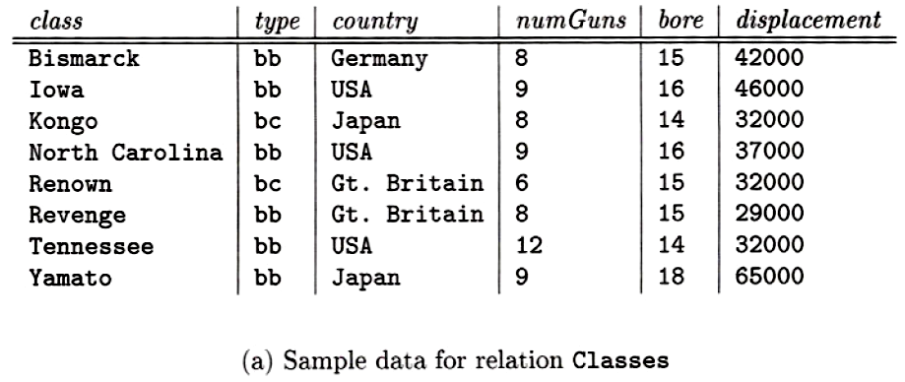
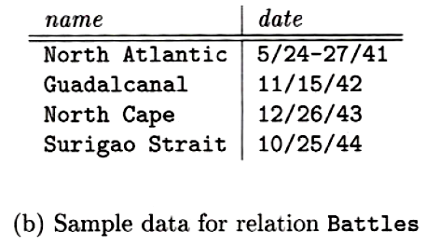

Slide 3
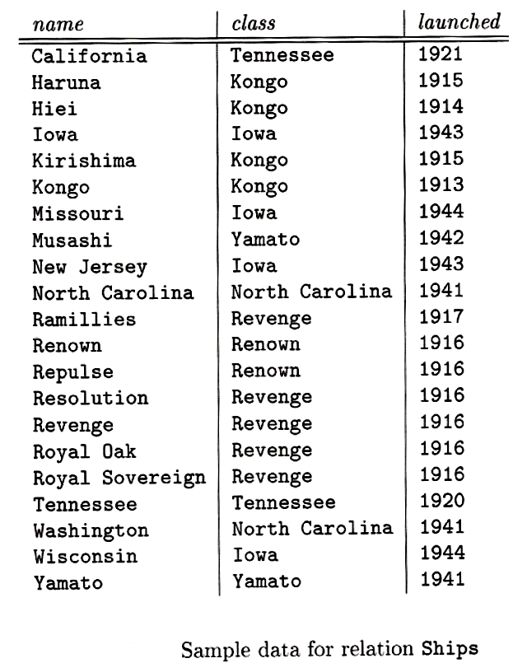
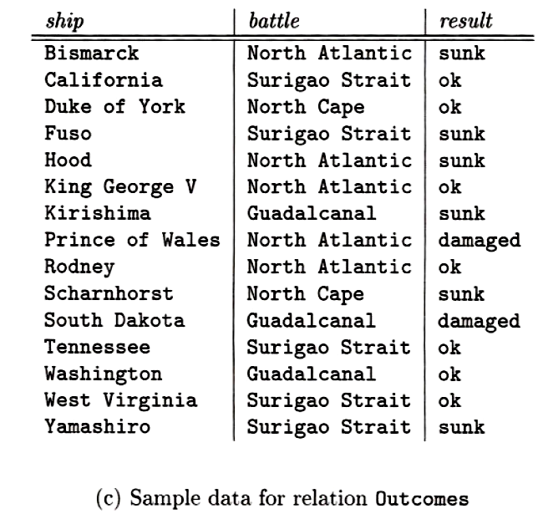

Slide 4
Queries
a) Give the class names and countries of the classes that carried guns of at least 16-inch bore.
SELECT class, country
FROM classes
WHERE bore>=16;
b) Find the ships launched prior to 1921.
SELECT *
FROM ships
WHERE launched<1921;
c) Find the ships sunk in the battle of the North Atlantic.
SELECT ship
FROM outcomes
WHERE battle='North Atlantic' AND result='sunk';

Slide 5
Queries
d) The treaty of Washington in 1921 prohibited capital ships heavier than 35,000 tons. List the ships that violated the treaty of Washington.
SELECT ships.name
FROM ships NATURAL JOIN classes
WHERE displacement>35000;

Slide 6
Queries
e) List the name, displacement, and number of guns of the ships engaged in the battle of Guadalcanal.
SELECT name, displacement, numguns
FROM
(SELECT * FROM
(SELECT ship AS name, battle, result FROM outcomes)
NATURAL JOIN
Ships
NATURAL JOIN
Classes)
WHERE battle='Guadalcanal';
Or
SELECT name, displacement, numguns
FROM classes, ships, outcomes
WHERE classes.class = ships.class AND
ships.name = outcomes.ship AND
battle='Guadalcanal';

Slide 7
Queries
f) List all the capital ships mentioned in the database. (Remember that all these ships may not appear in the Ships relation.)
SELECT name AS shipname
FROM ships
UNION
SELECT ship AS shipname
FROM outcomes;

Slide 8
Queries
!g) Find the classes that had only one ship as a member of that class.
SELECT class
FROM ships
GROUP BY class
HAVING COUNT(name)=1;

Slide 9
Queries
!h) Find those countries that had both battleships and battlecruisers.
SELECT country
FROM classes
WHERE type='bb'
INTERSECT
SELECT country
FROM classes
WHERE type='bc';

Slide 10
Queries
!i) Find those ships that "lived to fight another day"; they were damaged in one battle, but later fought in another.
First let’s create view DamagedShips of all ships that were damaged in battle
CREATE VIEW DamagedShips AS
SELECT ship AS name, battledate AS damagedate
FROM battles, outcomes
WHERE battles.name=outcomes.battle AND outcomes.result='damaged';
SELECT DamagedShips.name
FROM DamagedShips, battles, outcomes
WHERE DamagedShips.name = outcomes.ship AND
battles.name = outcomes.battle AND
battles.battledate > DamagedShips.damagedate;

