Slide 1
Computer Vision Project
Adham Mohamed Gamal
Sec:1
Dr. Hala Zayed, P.A. Hisahm Gamil

Slide 2
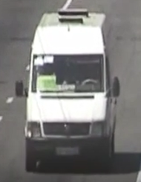
Problem
Finding car in highway
Car Recognition
Search for all similar cars and report that it has reached a specific point (where camera is positioned).

Slide 3
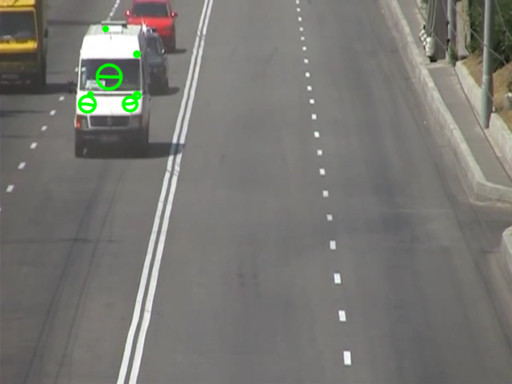
Solution (Intro To Code)
Using SIFT Algorithm for extracting Features and matching frames with the car we are searching for.
Using image processing techniques to enhance image like im2binary, and dilation and erosion for better results and reduce errors.

Slide 4
Code
Read Toolbox
if exist('vl_sift' , 'file' )==0
run( 'vlfeat\toolbox\vl_setup' );
end

Slide 5
Code
Set Constants
th=.9;
ESE =[1 0 0; 0 1 0; 0 0 1];
DSE =[0 0 1; 0 1 0; 1 0 0];
optimalMatches=18;

Slide 6
Code
Read Video
videoObj = VideoReader('video.MP4');
nFrames = videoObj.NumberOfFrames;

Slide 7
Code
Read Image that We Search For and extract its features
Ia = imread('car5.png');
I1 = im2bw(Ia,th);
I1 = imerode(I1,ESE);
I1 = imdilate(I1,DSE);
I1 = single(I1);
[f1,d1] = vl_sift(I1);
figure(1), imshow(Ia,[]);

Slide 8
Code
Read Run Algorithm
for j=14875:25:nFrames
Ib = read(videoObj,j);
I2 = im2bw(Ib,th);
I2 = imerode(I2,ESE);
I2 = imdilate(I2,DSE);
figure(2),imshow(Ib, []);
I2 = single(I2);
[f2,d2] = vl_sift(I2);
[matches,scores] = vl_ubcmatch(d1, d2);
[~,nom]=size(matches);
if nom > optimalMatches
vl_plotframe(f2(:,matches(2,:))) ;
pause
end
end

