Slide 1

Recomind:
Mindful Session Recommendations

Slide 2



Agenda
Introduction.
Motivation.
Dataset Statistics.
Methodology.
Experiment results.
Discussion.
Conclusion.

Slide 3
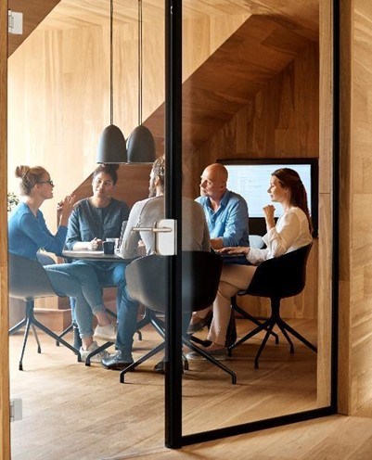
Team Members
Adham Mokhtar
Manar Elghobashy
Yara Hassan
Yara Elzahy

Slide 4




Introduction
Develop an effective session-based recommendation system for videos to predict the next items in a session, using the sbr_data_1M dataset. The system will leverage user items in sequence for personalized recommendations.

Slide 5

Motivation
Personalized Recommendations.
Adaptation to Changing Preferences.
Enhanced User Engagement.
Relevance for Multiple Industries.

Slide 6

Dataset
The sbr_data_1M dataset is a preprocessed version of the Tenrec dataset, specifically derived from Qk_video which was filtered upon clicked items.
Notes:
Qk_video 490M->filter by items that had been clicked and converted to a file named sbr_data_1M and its size exceeding 94M.

Slide 7
Dataset Statistics

Slide 8

Methodology
We explore and compare four SOTA recommender system models:
Gru4Rec
SasRec
NextItNet
Bert4Rec

Slide 9
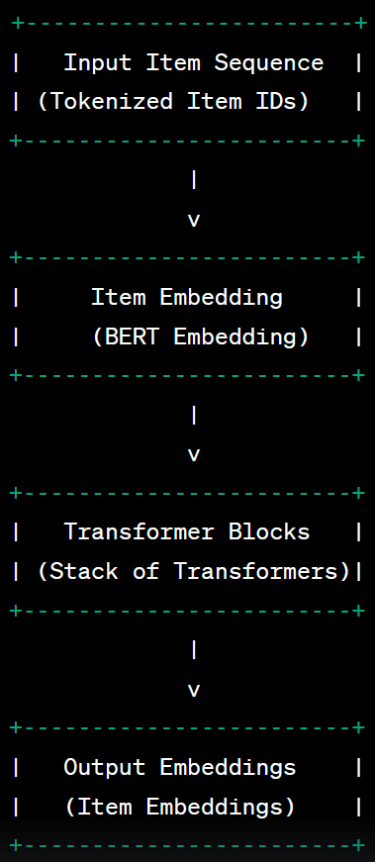
SasRec
SASRec is a sequential recommendation model that uses self-attention mechanisms to capture long-range dependencies. It excels in providing accurate recommendations for sequential data.

Slide 10
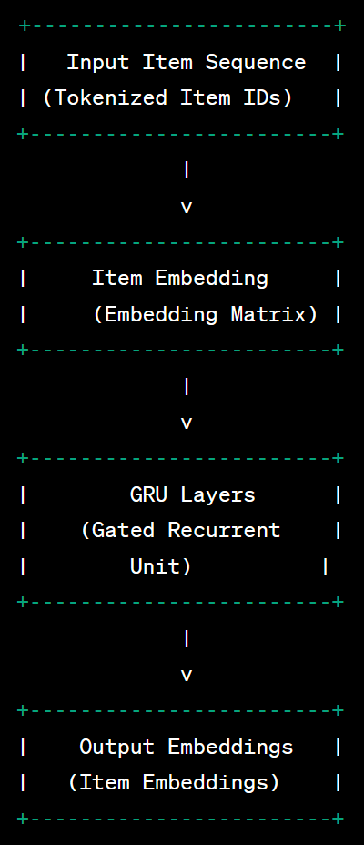
Gru4Rec
GRU4Rec is a powerful recurrent neural network-based model designed for sequential recommendation tasks. It effectively models user preferences over time, making it suitable for personalized and dynamic recommendations.

Slide 11
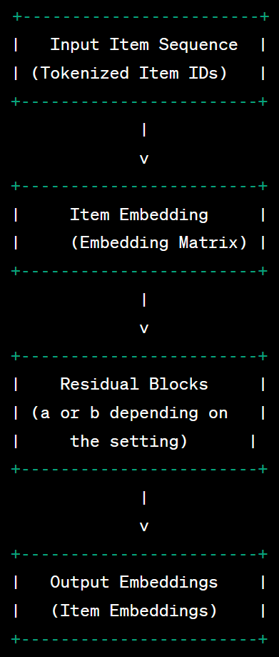
NextItNet
NextItNet is a state-of-the-art model for session-based recommendation scenarios. Using dilated convolutions and residual blocks, it accurately predicts the next item a user is likely to interact with, showing promise for session-based recommendation tasks.

Slide 12
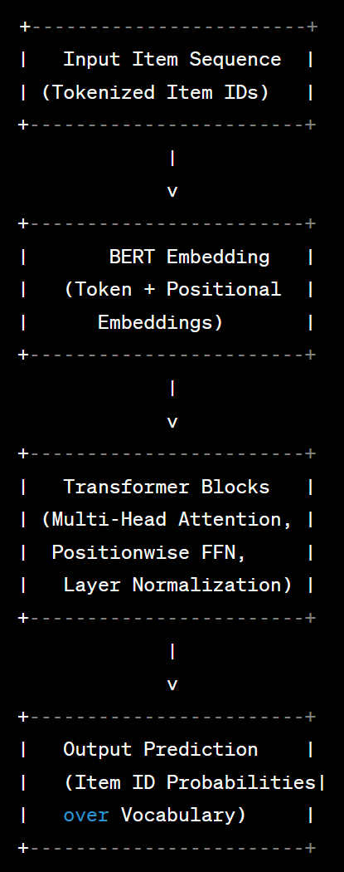
Bert4Rec
BERT4Rec is a recommender system model inspired by BERT, which captures item-item and user-item relationships effectively. It generates contextually rich recommendations considering historical and current user interactions.

Slide 13
Experiment results

Slide 14
Table
 | Category 1 | Category 2 | Category 3 | Category 4
Item 1 | 4.5 | 2.3 | 1.7 | 5
Item 2 | 3.2 | 5.1 | 4.4 | 3
Item 3 | 2.1 | 1.7 | 2.5 | 2.8
Item 4 | 4.5 | 2.2 | 1.7 | 7

Slide 15

Discussion

Slide 16
Conclusion
With PowerPoint, you can create presentations and share your work with others, wherever they are. Type the text you want here to get started. You can also add images, art, and videos on this template. Save to OneDrive and access your presentations from your computer, tablet, or phone.

Slide 17
Thank You 😊

