Slide 1

Real Estate AI Agent Module Documentation
An end-to-end, autonomous concierge designed to revolutionize how users search for, evaluate, and book properties — powered by conversational AI, machine learning, and deterministic market analysis.
REAL ESTATE AI AGENT MODULE DOCUMENTATION
AUTONOMOUS CONCIERGE
SEARCH ENGINE
MARKET ANALYST
CUSTOMER SERVICE

Slide 2

Executive Summary
Instead of forcing users to navigate complex web filters or talk to pushy human agents, this system allows users to simply describe what they want in natural language. Behind the scenes, the system translates conversational text into rigorous mathematical constraints, searches through thousands of properties, calculates live market statistics, and formulates high-end, personalized advice.
Search Engine: Finds the best properties based on hidden patterns and semantic understanding.
Market Analyst: Calculates whether a property is actually a good deal using live market statistics.
Customer Service Rep: Delivers polished, professional responses in a concierge-style tone.

Slide 3
System Architecture at a Glance
The system is divided into four highly specialized, decoupled modules. This modular design ensures that the AI can converse naturally while the underlying math remains strictly deterministic and hallucination-free.
1
2
1. The Agent — Conversational Brain: Understands the user and speaks to them in natural language.
2. The Recommender — Search Engine: Finds the best properties based on hidden patterns.
3
4
3. The Analyzer — Statistical Engine: Calculates whether a property is actually a good deal.
4. The Data Pipeline — The Foundation: Ensures all modules are looking at pristine, synchronized information.

Slide 4




Module 1: The AI Agent — The Concierge
Goal: To provide a flawless, human-like conversational interface. A user can say, "I want a 3-bedroom apartment in Zayed under 15 million, but it must have a pool." The Agent handles this using a State Machine workflow with four distinct roles.
The Brain: Intent Parsing — reads text, identifies the goal (buy/sell), and extracts budget, location, and amenity constraints.
The Hands: Tool Execution — routes constraints to the Recommender and Analyzer to fetch actual database results.
The Tongue: Narrative Generation — weaves raw numbers into a polite, professional, concierge-style response.
The Auditor: Quality Assurance — an internal AI catches hallucinations or data misreads and forces a rewrite before the user sees the message.

Slide 5
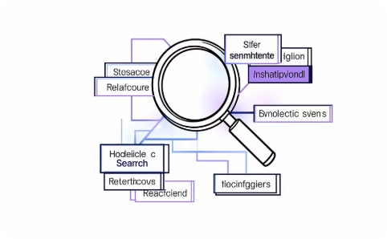

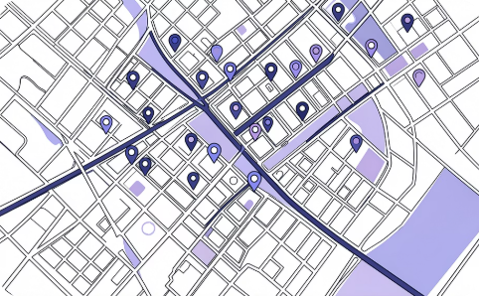
Module 2: The Recommender — The Discovery Engine
Goal: To find the perfect property, even if the user doesn't know exactly how to describe it. Traditional search engines fail if a user misspells a word or asks for something slightly out of budget. The Recommender uses advanced Machine Learning (FAISS and XGBoost) to search "smarter."
Semantic Search: Actually reads property descriptions. If a user asks for a "quiet place," it knows which properties match that vibe.
Behavioral Personas: Trained by simulating different types of human buyers (e.g., "The Bargain Hunter" vs "The Luxury Elite"). Ranks properties based on what the specific user cares about most.
Diversity Checks: Actively prevents showing the user 10 identical apartments in the exact same building, ensuring a geographically diverse set of options.

Slide 6
Module 3: The Analyzer — The Truth Engine
Goal: To protect the user from bad investments and provide objective market intelligence. Large Language Models are terrible at math — therefore, the Agent never guesses if a property is a good deal. It asks the Analyzer.
Fair Price Estimator: Analyzes the micro-market (e.g., specifically 3-bedroom apartments in New Cairo) and calculates the exact mathematical median. Verdicts whether the asking price is Highly Competitive, Fair, Premium, or Overpriced.
Investment Gems: Actively scans the database to find properties priced 15%+ below their true market value.
Trade-off Advisor: Tells the user what happens if they compromise. For example: "If you increase your budget by just 10%, you unlock 45 more premium properties."

Slide 7

Module 4: The Data Pipeline — The Foundation
Goal: To prevent logical drift across the system. If the Recommender is looking at data from Tuesday, but the Analyzer is looking at data from Monday, the system will output conflicting advice.
Raw Ingestion
Contract Enforcement
Module Consumption
The Data Pipeline enforces a Data Contract. It cleans the raw catalog (removing fake prices and deduplicating listings) and exports a pristine, locked file. Both the Recommender and Analyzer are forced to read from this exact same file, ensuring 100% synchronization.

Slide 8

The User Journey — Steps 1–3
Here is how all four modules work together in a real-world scenario, from the moment a user types a request to the system delivering a personalized response.
1
1. The Request: A user types: "Find me a luxury villa in Maadi, is 20 million enough?"
2
2. Understanding: The Agent's Brain extracts: Category: Buy, Type: Villa, Town: Maadi, Max Price: 20M.
3
3. Searching: The Recommender pulls the top 10 Villas in Maadi that match the luxury vibe, ensuring they aren't all on the exact same street.

Slide 9

The User Journey — Steps 4–6
1
4. Analyzing: For those 10 Villas, the Analyzer calculates the market median in Maadi to see if 20M is actually enough, determining that 20M is highly competitive for that area.
2
5. Responding: The Agent's Tongue writes: "Yes, 20 million is a highly competitive budget for Maadi! Here are three stunning premium villas I found for you..."
3
6. Action: The user likes the second option and asks to see it. The system automatically inserts a booking request into the CRM Database for a human broker to follow up on.

Slide 10

Key Takeaways
The Real Estate AI Agent Module is a unified system that combines natural language understanding, machine learning search, deterministic market analysis, and rigorous data governance into a single autonomous concierge experience.
Natural Language First: Users describe what they want in plain English — no complex filters required.
Smarter Search: FAISS + XGBoost semantic search finds properties even when users can't perfectly describe them.
Hallucination-Free Math: The Analyzer handles all pricing logic deterministically — the LLM never guesses numbers.
100% Data Sync: The Data Pipeline's contract ensures all modules operate on the exact same pristine dataset.

