Slide 1


The Magic Kitchen: Understanding Node.js
Learn how Node.js works using a fast-food kitchen analogy. Build a todo list app step by step.
by Adham Magdy

Slide 2
Node.js Architecture Explained
V8 Engine
libuv
Event Loop
The chef's brain that executes JavaScript and processes orders.
Kitchen staff handling file reads and network requests simultaneously.
Head chef assigning tasks and ensuring smooth operation.

Slide 3
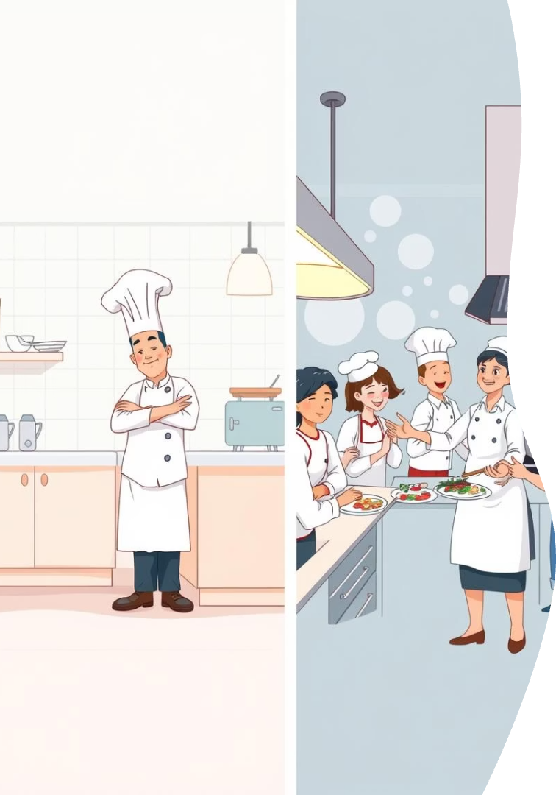
Blocking vs Non-Blocking Code
Blocking Code
Chef waits for fries before taking next order, causing delays.
Non-Blocking Code
Chef delegates fries prep and continues making burgers without waiting.

Slide 4
Todo App Structure Overview
src/
prisma/
Controllers, routes, services, middleware, and utilities.
Database schema and models mapping to tables.
tests/ & Config
Test files and environment variables for setup.

Slide 5

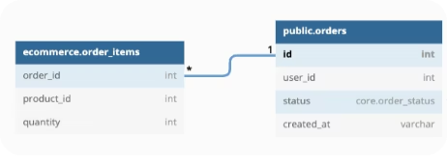
Prisma Todo
Model Explained
Database Mapping
Relationships
Constraints & Defaults
Models map directly to database tables with strong typing.
User linked to todos via @relation for data integrity.
Fields have defaults and validations like @id and @unique.

Slide 6



Todo Services, Controllers & Routes
Services
Applies business logic and deals with database (through ORM models)
Controllers
Handles requests like viewing, adding, updating, and deleting todos.
Routes
Defines API endpoints for todo operations.

Slide 7
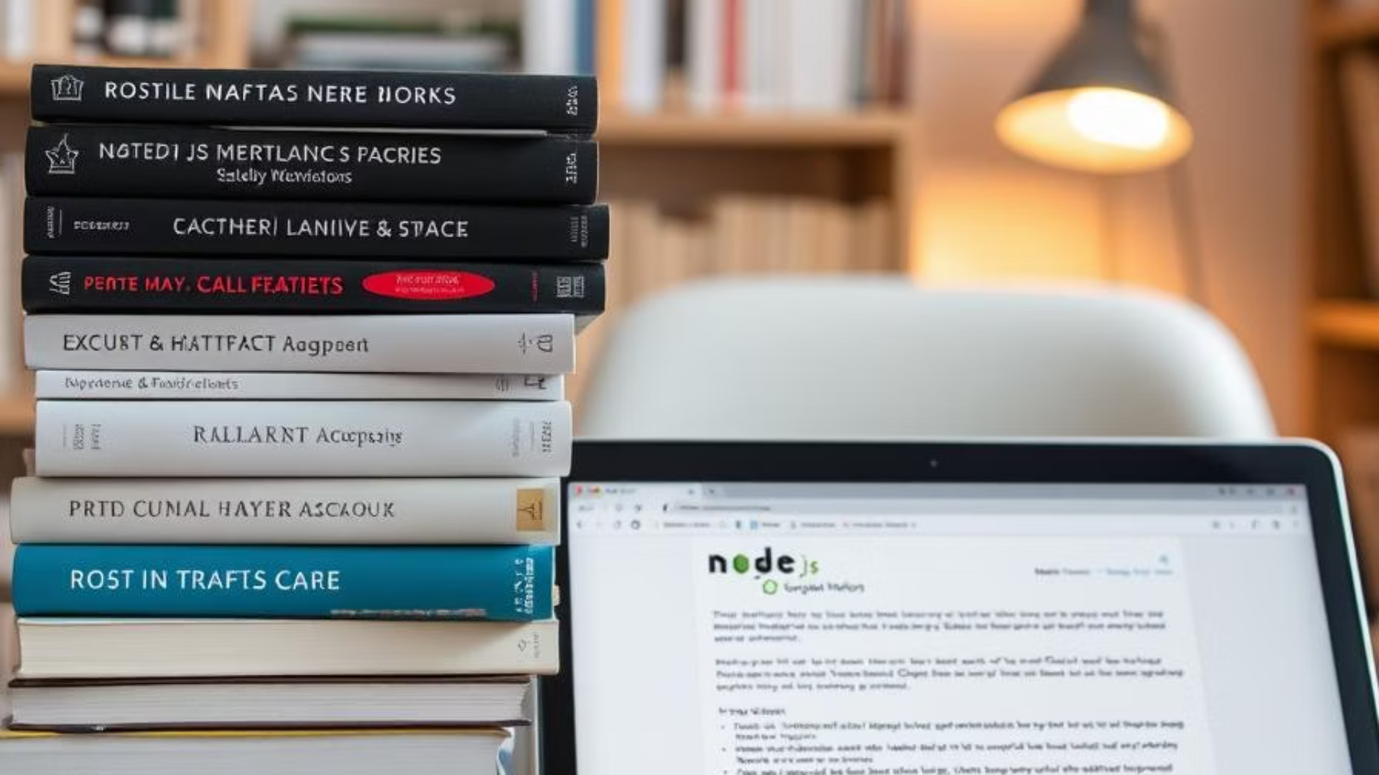
Thank you
there are no dumb questions

