Slide 1

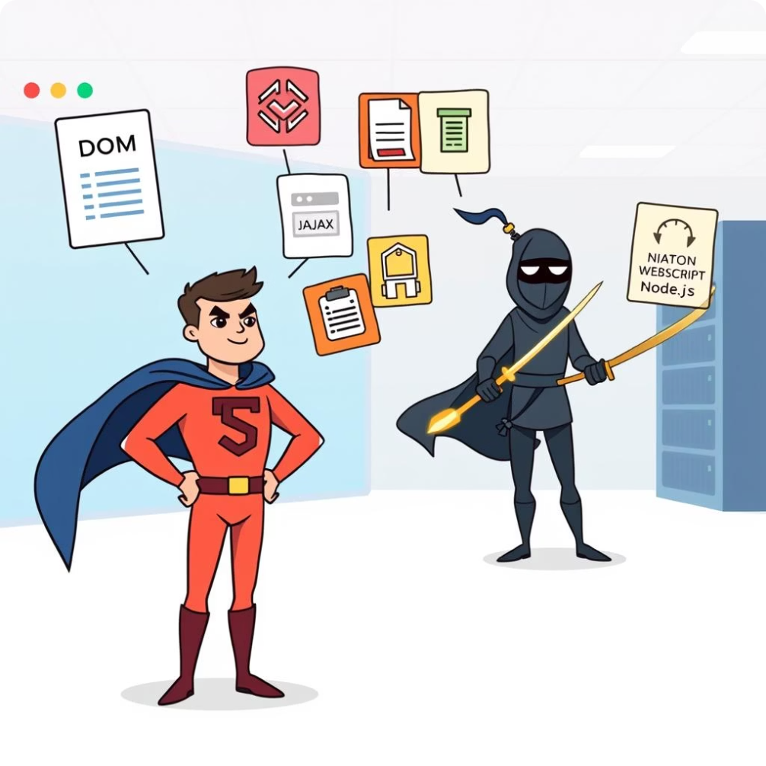

JavaScript's Adventure: From Browser to Server! 🚀
Welcome to an exciting journey exploring how JavaScript transforms from a browser superhero to a powerful server ninja! This lesson covers JavaScript's main concepts, differences between browser and Node.js environments, asynchronous programming, and error handling techniques.
Get ready to master JavaScript's powers in both worlds and learn how to handle tasks like a pro with fun activities and practical examples.
by Adham Magdy

Slide 2

JavaScript Fundamentals Review 🔄
Variables & Data Types
Functions
JavaScript uses let, const, and var to declare variables. Data types include numbers, strings, booleans, arrays, and objects for storing collections and labeled data.
Functions are like recipes. Regular and arrow functions define reusable code blocks, with default parameters for flexibility.
Control Flow
If statements and loops control decision-making and repetition, enabling dynamic program behavior.

Slide 3

Modern JavaScript Features & Fun Activity
Template Literals & Destructuring
Spread Operator & Array Methods
Make strings easier and unpack object values efficiently.
Copy and manipulate arrays and objects with map and filter for powerful data handling.
JavaScript Treasure Hunt
Create objects, write functions, use loops, and explore asynchronous programming like callbacks, promises, and async/await.

Slide 4
JavaScript's Two Homes 🏠: Browser vs Node.js
Browser JavaScript
Node.js JavaScript
Uses window and document objects to interact with web pages and browser features.
Uses global and process objects, supports file system access, and modular code sharing with require and module.exports.
// The browser's main toolboxconsole.log(window);
// For working with web pages
console.log(document);
// Node's main toolbox
console.log(global);
// Information about our program
console.log(process);
// Where our files are located
console.log(__dirname);

Slide 5



Making Things Happen in Order 📝: Callbacks, Promises, Async/Await
Callbacks
Old way: wait for a task to finish by passing a function to be called later.
Promises
Like getting a buzzer that notifies when a task completes, improving readability and error handling.
Async/Await
Modern way: write asynchronous code that looks synchronous, making it easier to manage.

Slide 6



Catching Problems Like a Superhero! 🦸‍♂️ Error Handling in JavaScript
Promise Error Handling
2
Use .catch() to handle errors cleanly in promise chains.
Callback Error Handling
1
Errors passed as arguments to callbacks, requiring manual checks.
Async/Await Error Handling
Try/catch blocks catch errors in asynchronous functions for clearer code.
3

Slide 7
Exercises: Exploring JavaScript Environments & Async Code
Feature
Browser
Node.js
Run JavaScript code
Read and write files
Access the DOM
Use the fetch API
Run in the background
Create a web server

Slide 8

Async Time Machine & Error Catcher Game
1
Convert Callback Code
Rewrite callback-based file reading into promises and async/await.
2
Error Handling Scenarios
Practice handling errors with callbacks, promises, and async/await try/catch.

Slide 9

Thank you
there are no dumb questions

