Slide 1

Intro To Database (Database Fundamental using MySQL)
Mohamed ELshafei

Slide 2

Agenda
Data & Information.
File Based System.
What is Database, Database System?
DBMS & its functions.
Database Properties.
Advantages and Disadvantages of Database Systems.
DB Architecture.
Who Deals with Database.
Data Models.

Slide 3

HELLO!

Slide 4
Data & Information
Data is the raw input (numbers, characters, images…) which when processed or arranged makes meaningful output (Information).
Data is the lowest level of knowledge and information is the second level.
Data by itself alone is not significant. Information is significant by itself.
Observations and recordings are done to obtain data, while analysis and processing are done to obtain information.

Slide 5

File Based System
Early attempt to computerize the manual filling system , each Program defines and manages its own data.
Separation & Isolation Of data (each user has a copy)
Data Redundancy (Duplication of data)
No Database integrity
All programs maintain metadata for each file they use
Incompatible File Formats
Non-standard way to query

Slide 6

What is a database?
A database is an organized collection of related data.”
The data is typically organized to model relevant aspects of reality in a way that supports processes requiring this information

Slide 7

Database Management System(DBMS)
It is the intermediate layer between the database and the programs that access the data.
It is collection of programs that enables users to create and maintain a database.

Slide 8

DBMS Functions
Constructing Database.
Manipulating Database.
Data Security
Data Integrity.
Concurrency.
Backup & Recovery.
Data Dictionary (Meta Data).
Performance.

Slide 9
Advantages of Database
Redundancy can be reduced.
Inconsistency can be avoided.
Data can be shared.
Security restrictions can be applied.
Enforcing Integrity Constraints.
Providing Backup and Recovery

Slide 10
Disadvantages of Database
It needs expertise to use.
DBMS itself is expensive.
DBMS may be incompatible with any other available DBMS.

Slide 11
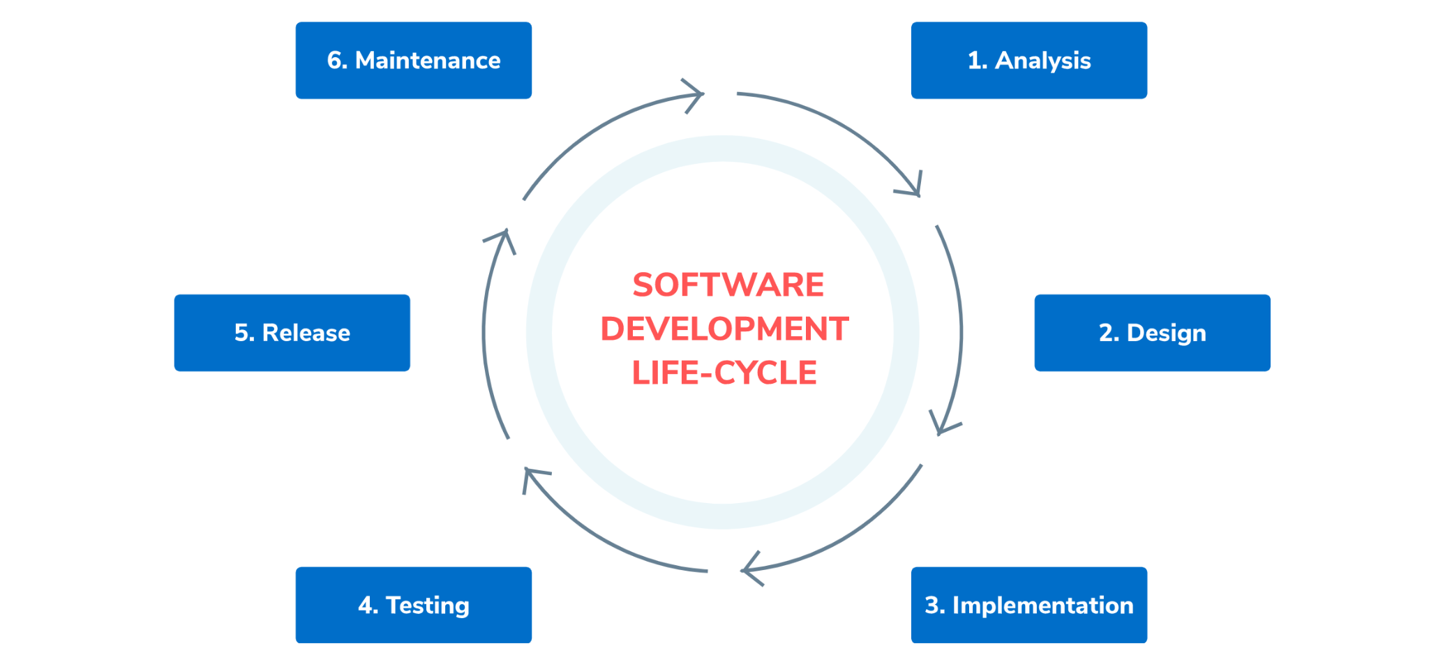
Software Development-lifecycle

Slide 12
Database System
Users
Database System
Application Programs
Software to process
Queries
DBMS Software
Software to access Stored Data
Stored DB
Definition
(Metadata)
Stored
Database

Slide 13
Database System
A database system is composed of :
The database.
The Software.
Application Program
DBMS

Slide 14
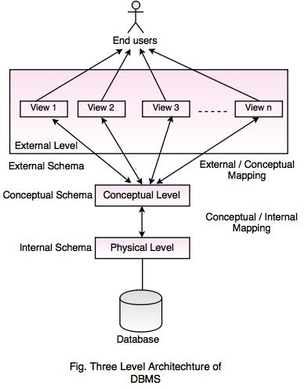
Three Level/Schema Architecture
The three levels of database architecture
1. Physical Level
2. Conceptual Level
3. External Level

Slide 15
Physical Level
Physical level describes the physical storage structure of data in database.
It is also known as Internal Level.
At lowest level, it is stored in the form of bits with the physical addresses on the secondary storage device.
At highest level, it can be viewed in the form of files.
The internal schema defines the various stored data types. It uses a physical data model.

Slide 16
Conceptual Level
Conceptual level describes the structure of the whole database for a group of users.
It is also called as the data model.
Conceptual schema is a representation of the entire content of the database.
These schema contains all the information to build relevant external records.
It hides the internal details of physical storage.

Slide 17
External Level
External level is related to the data which is viewed by individual end users.
This level includes a no. of user views or external schemas.
This level is closest to the user.
External view describes the segment of the database that is required for a particular user group and hides the rest of the database from that user group.

Slide 18

Database Users
Database Administrator (DBA)
Architect / Database Designer
Database Developer
Application programmers
End users

Slide 19
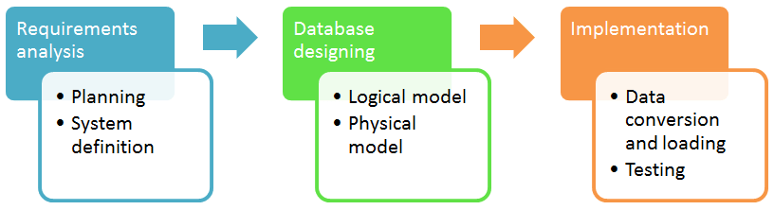
Database development life cycle

Slide 20
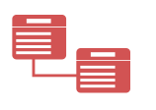
Entity Relationship Diagram
ER Model
Concepts

Slide 21
ER Model
ER Model is a high-level data model, developed by Chen in 1976. This model defines the data elements and relationships for a specified system. It is useful in developing a conceptual design for the database & is very simple and easy to design logical view of data.

Slide 22
Importance of ER Model
ERD stands for Entity Relationship diagram.
ER diagram shows the relationship between objects, places, people, events etc. within that system.
ER Model is a graphical representation for designing the structure.
Without ER diagrams you cannot make a database structure & write production code.
It displays the clear picture of the database structure.

Slide 23
Basic constructs of the E-R model
Entities - person, place, object, event, concept (often corresponds to a real time object that is distinguishable from any other object)
Attributes - property or characteristic of an entity type (often corresponds to a field in a table)
Relationships – link between entities (corresponds to primary key-foreign key equivalencies in related tables)

Slide 24
ER Diagram: Starting Example
access-date
cust-name
number
cust-id
has
customer
account
cust-street
cust-city
balance
Rectangles: entity sets
Diamonds: relationship sets
Ellipses: attributes

Slide 25

Entity
A definable thing—such as a person, object, concept or event—that can have data stored about it.
Think of entities as nouns.
Examples: a customer, student, car or product.
Typically shown as a rectangle.

Slide 26
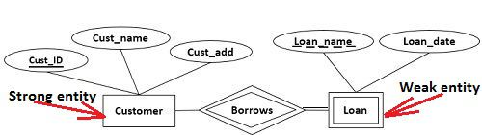
Entity categories
strong entity can be defined solely by its own attributes.
weak entity cannot defined solely by its own attributes, An entity set that do not have sufficient attributes to form a primary key.

Slide 27
Entity keys
Candidate Key
Primary Key
Foreign Key
Composite Key
Partial Key
Alternate key
Super Key

Slide 28
Primary Key
Identifier used to uniquely identify one particular instance of an entity.
Can be one or more attributes.
Must be unique .
Value should not change over time.
Must always have a value .

Slide 29
Entity keys
Candidate Key :
when multiple possible identifiers exist, each is a candidate key.
Foreign Keys :
Foreign keys reference a related table through the primary key of that related table.
Referential Integrity Constraint:
For every value of a foreign key there is a primary key with that value in the referenced table e.g. if student name is to be used in a dormitory table then that name must exist in the student table.

Slide 30
Attribute
A property or characteristic of an entity. Often shown as an oval or circle.
Attribute categories:
Simple (Scalars) Attribute
Composite Attribute
Derived Attribute
Multi-valued Attribute
Complex Attribute

Slide 31
Simple Attribute
Means the attribute value is atomic and can’t be further divided, such as a phone number.
access-date
cust-name
number
cust-id
has
customer
account
cust-street
cust-city
balance

Slide 32
Composite Attribute
Sub-attributes spring from an attribute
First
Last
Name
year
day
date-of-birth
customer
month

Slide 33
Derived Attribute
Attributed is calculated or otherwise derived from another attribute, such as age from a birthdate.
age
date-of-birth
Emp
Salary
Deduction
Net Salary

Slide 34
Multi-valued
More than one attribute value is denoted, such as multiple phone numbers for a person.
address
customer
phone no.

Slide 35
Complex Attribute
multi-valued + Composite
Street
City
Country
address
customer

Slide 36
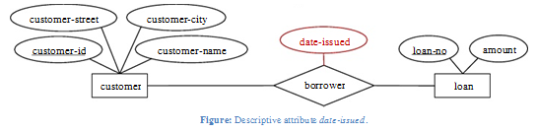
Relationship
A Relationship is an association among several entities.
A relationship may also have attributes
For example, consider the entity sets customer and loan and the relationship set borrower. We could associate the attribute date-issued to that relationship to specify the date when the loan was issued.

Slide 37
Relation Properties
Relation has three Properties:
Degree of Relationships
Cardinality Constraint
Participation Constraint

Slide 38
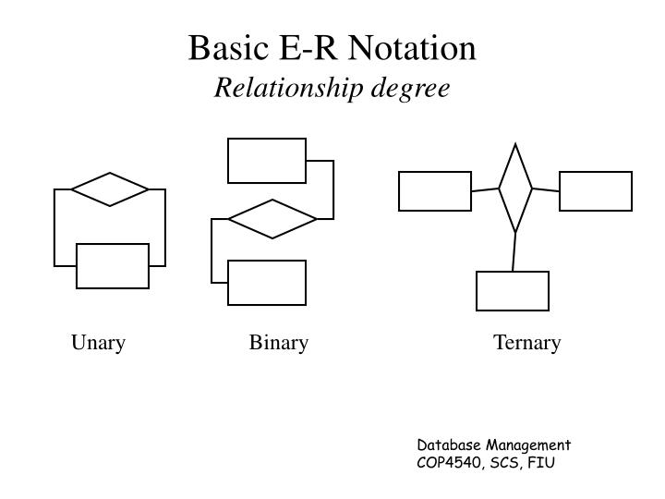
Degree of Relationships
number of entity types that participate in a relationship
Three cases:
Unary: between two instances of one entity type
Binary: between the instances of two entity types
Ternary: among the instances of three entity types

Slide 39
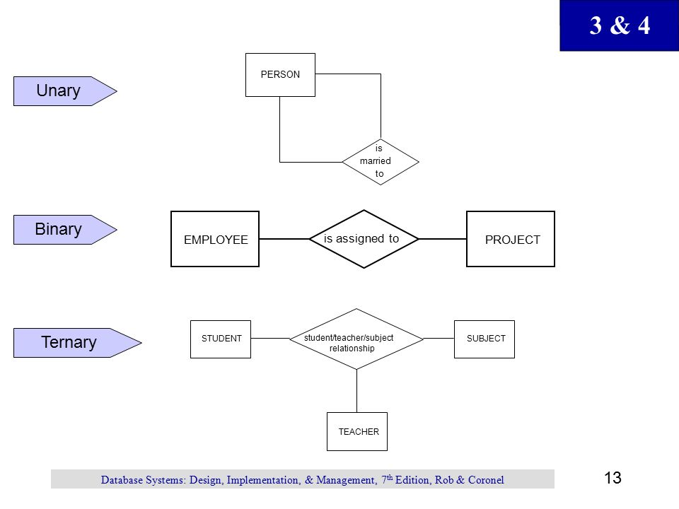
Degree of Relationships

Slide 40
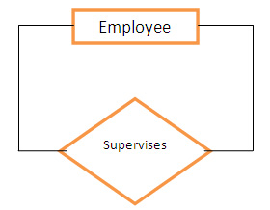
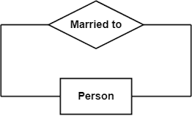
Recursive Relationship (Unary)
Recursive Relationships - A relationship in which the same entity participates more than once.

Slide 41
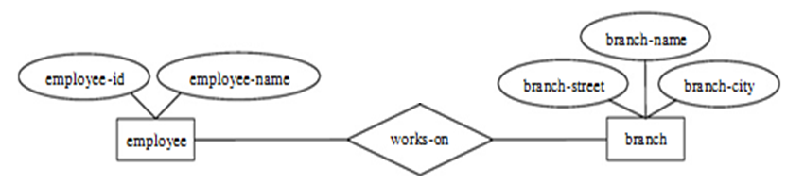
Binary Relationship
A binary relationship set is of degree 2.

Slide 42
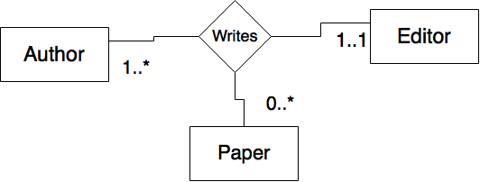
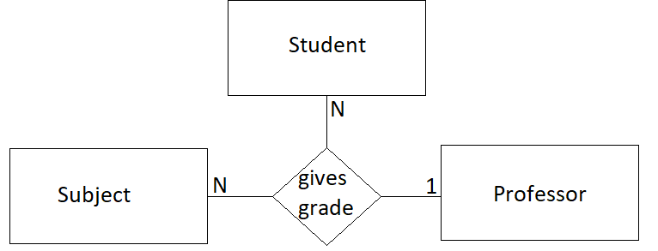
Ternary Relationship
Ternary relationship set is of degree 3.

Slide 43
Cardinality
How many instances of one entity will or must be connected to a single instance from the other entities.
One-One Relationship
One-Many Relationship
Many- Many Relationship

Slide 44
Mapping Cardinalities
1
own
1
One-to-One
One-to-Many
Many-to-Many
Employee
Car
1
has
M
Department
Employee
M
take
M
Course
Student

Slide 45
PARTICIPATION CONSTRAINT
An employee MUST work for a department An employee entity can exist only if it participates in a WORKS_FOR relationship instance So this participation is TOTAL
Only some employees manage departments The participation is PARTIAL

Slide 46
PARTICIPATION CONSTRAINT
Has
Employee
Car
An Employee may have a car.
A Car must be assigned to particular employee

Slide 47
PARTICIPATION CONSTRAINT
Hire
Department
Employee
- A department may hire many employees ( Zero or more)
An employee must be employed by a department
(Department membership is Optional, Employee membership is Mandatory)

Slide 48
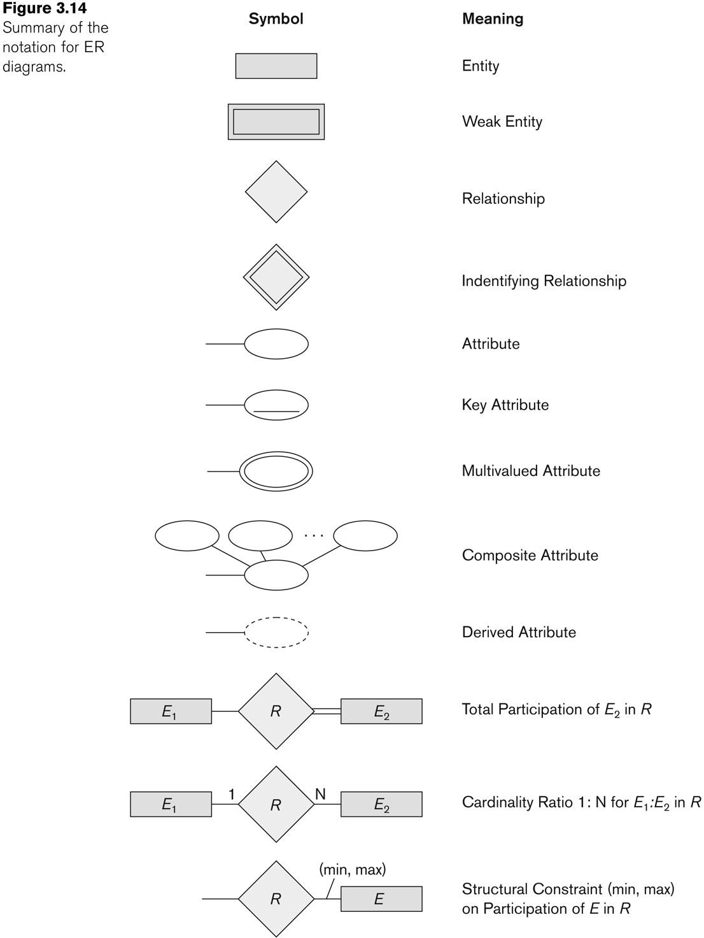
Summary of notation for ERD

Slide 49

Case Study
Company

Slide 50
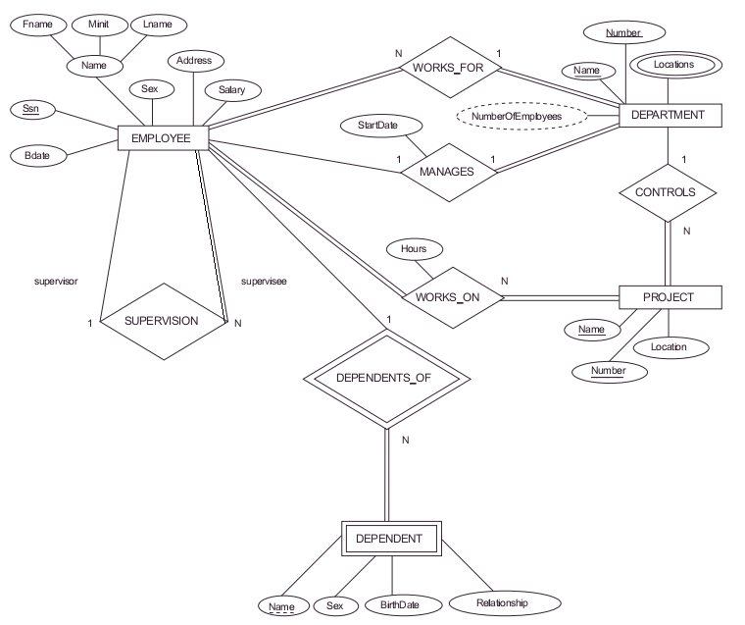
Result

Slide 51
THANKS!
Any questions?

