Slide 1
CSE488:Ontologies and Semantic Web
Submitted To:
Dr. Ensaf Hussein Mohamed
TA. Eman Khaled
Submitted By:
Ahmed Tarek Abdellatif 20p8417
Mazen Tayseer Ahmed 20p7460
Mariam Sameh Mohamed 20p1599
Adham Amr Abdelaty 20p5249

Slide 2
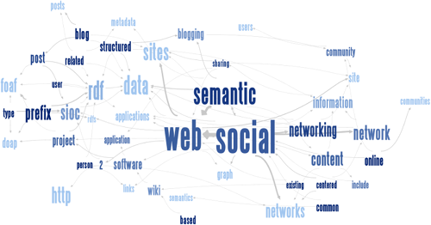
Project Milestone 1

Slide 3
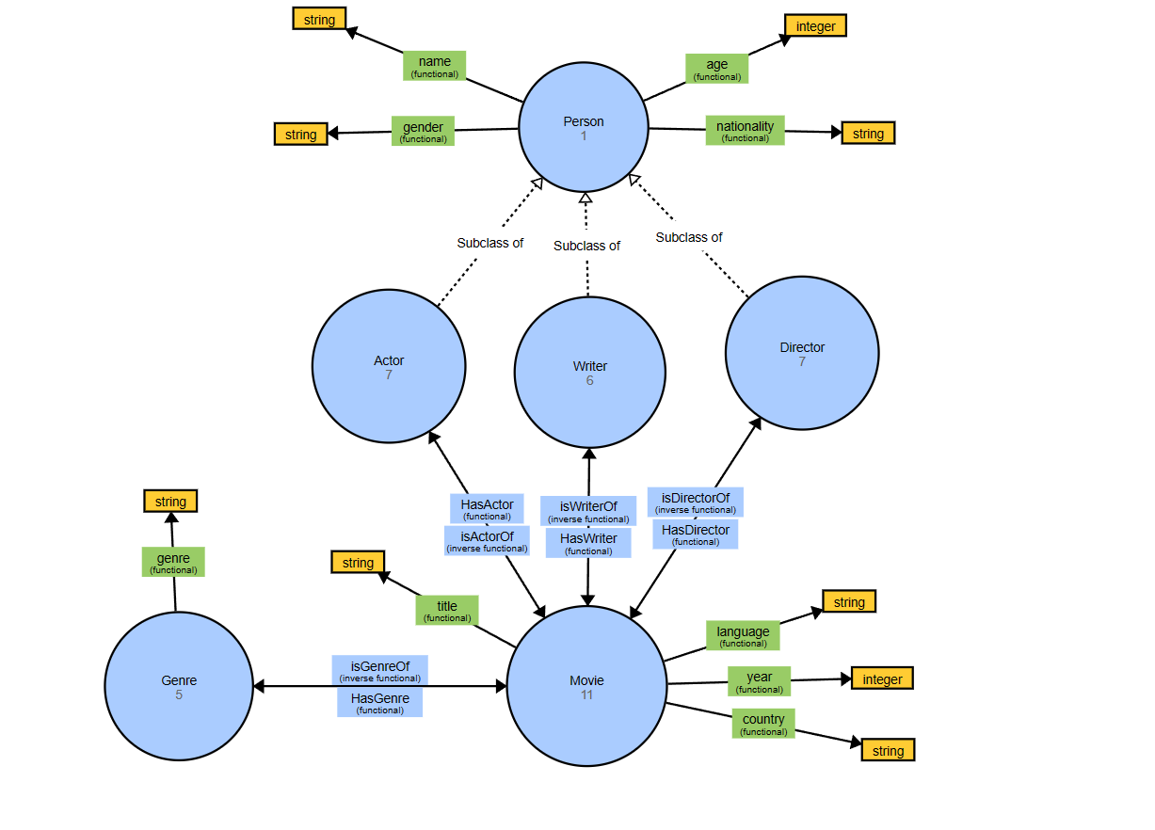
Modeling the Ontology

Slide 4
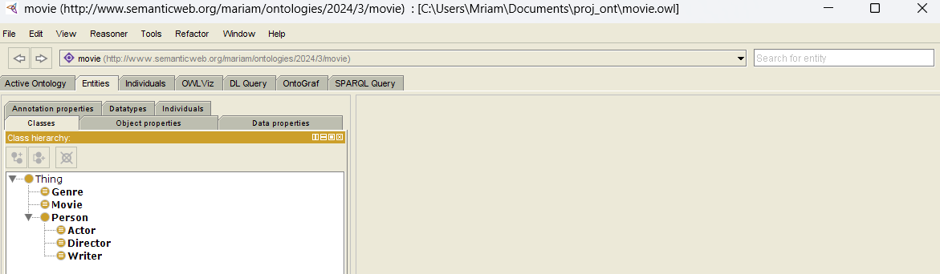
Classes

Slide 5
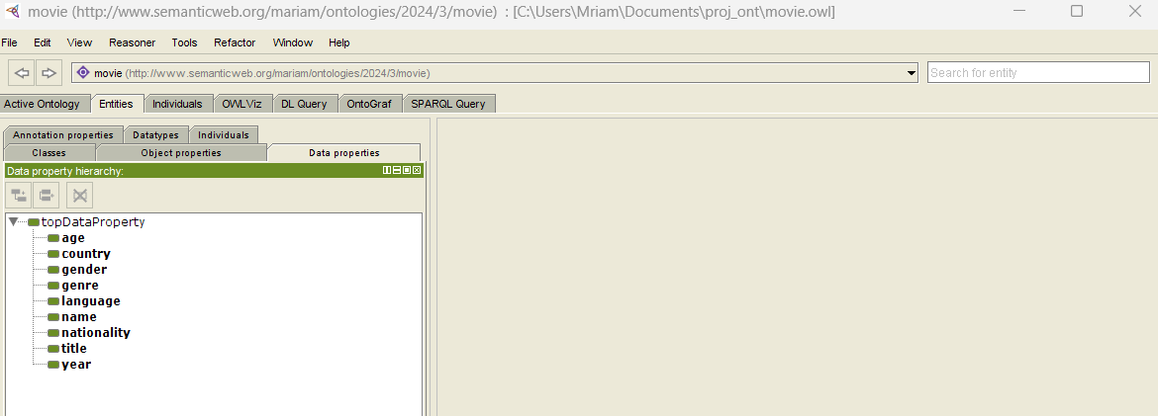
Data Properties
Age ,Name ,Gender ,Nationality (for person)
Country ,Language ,Title ,Year ,Genre (for Movie)

Slide 6
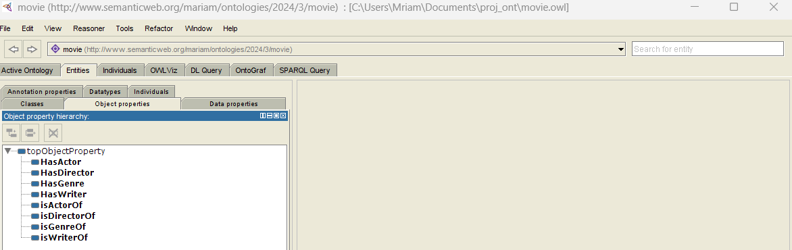
Object Properties

Slide 7
Constraints
Class Movie, Genre, and Person are disjoint classes.
Class Actor, Movie, and Genre are disjoint classes.
Class Director, Movie, and Genre are disjoint classes.
Class Writer, Movie, and Genre are disjoint classes.
A movie must have at least one actor (min 1 HasActor).
A movie must have at least one director (min 1 HasDirector).
A movie must have at least one writer (min 1 HasWriter).
An actor must have acted in at least one movie (min 1 isActorOf).
A director must have directed at least one movie (min 1 isDirectorOf).
A writer must have written for at least one movie (min 1 isWriterOf).
A movie must have at least one genre (min 1 genre).
A genre must have at least one movie (min 1 movie)
year some xsd:integer [>0<= 2024]
(gender value "female") or (gender value "male")
age some xsd:integer [> 0]

Slide 8
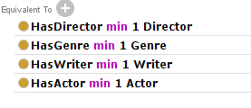
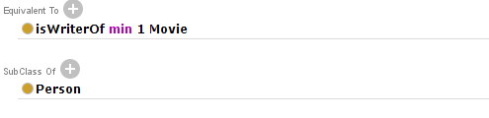

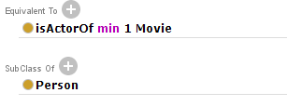

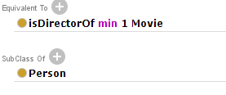


Constraints (Screenshots)

Slide 9
Populating The Ontology

Slide 10
Individuals
For Genre Class: Thriller, Crime, Action, Comedy, Drama.
For Movie Class:
Pulp Fiction, Genre: Crime Thriller, 1994, USA, English.
Kill Bill (volume 1), Genre: Action Crime Thriller, 2003, USA, English.
Inception, Genre = Action Drama, 2010, USA, English.
Joker, Genre = Crime Drama, 2019, USA, English.
Baby Driver, Genre=Drama Comedy Action,2017,UK,English.
Jojo Rabbit, Genre= Drama Comedy,2019,USA,English.
Masgoon Tranzait,Genre=Action,2008,Egypt,Arabic.
Shaun of the Dead, Genre=Comedy Thriller,2004,USA,English.
There will be Blood, Genre= Drama Thriller,2007,USA,English.
Thor:Rangnarok, Genre=Action Drama,2017,USA,English.
El Rahina, Genre=Comedy Action,2006,Egypt,Arabic.

Slide 11
Individuals (cont’d)
For Person Class:
Quentin Tarantino, American, 53 years old, writer and director of Pulp Fiction and Kill Bill (volume1). He also played a role in that movie.
John Travolta, American, 59 years old, actor in Pulp Fiction.
Uma Thurman, American, 43 years old, actress in Pulp Fiction. She also participated as a writer in Kill Bill (volume1).
Christopher Nolan, British-American, 52 years old, writer and director of Inception.
Leonardo DiCaprio, American, 47 years old, actor in Inception.
Edgar Wright,British,48 years old,Director and writer of baby driver and shaun of the dead and also he played a role in shaun of the dead.
Taika Waititi, a New Zealand director, 47 years old, known for his work on "Thor: Ragnarok" and "Jojo Rabbit". Waititi not only directs but also frequently appears in his own films, showcasing his versatility as both a filmmaker and actor.
Paul Thomas Anderson, an American filmmaker, aged 51, known for writing and directing "There Will Be Blood" He often includes himself in small acting roles within his films.
Sandra Nashaat, Female Egyptian Director,54 years old, director of elRahina and Masgoon Tranzait.
Todd Philips , American , 51 years old, director and writer of the Joker Movie.

Slide 12
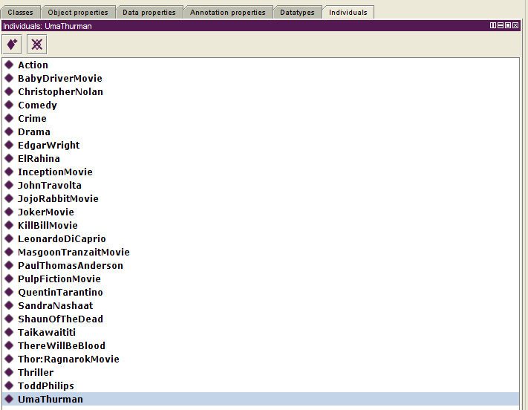
Individuals (Screenshots)

Slide 13
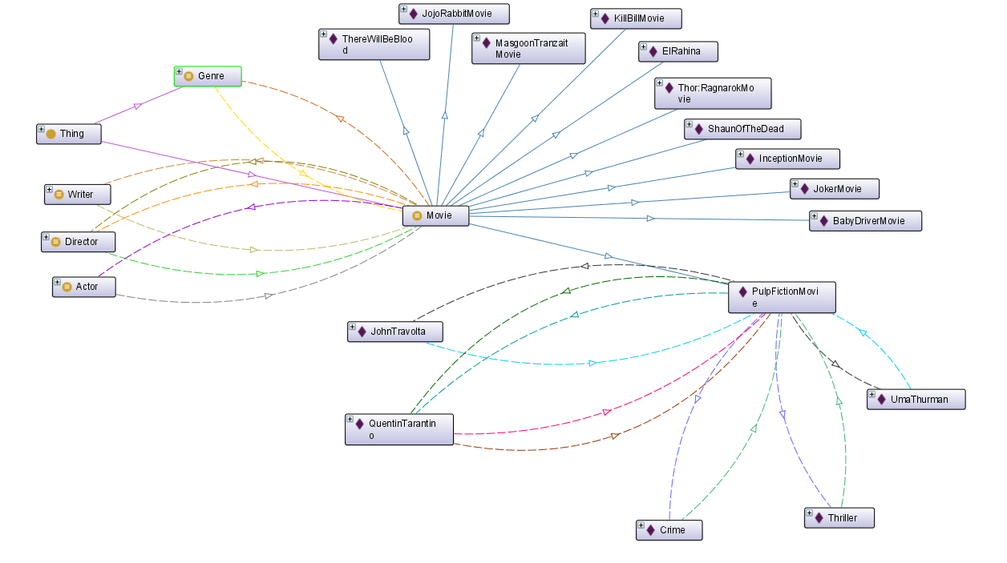
Ontology Graph (Movie Instances)
- Example Pulp Fiction Movie

Slide 14
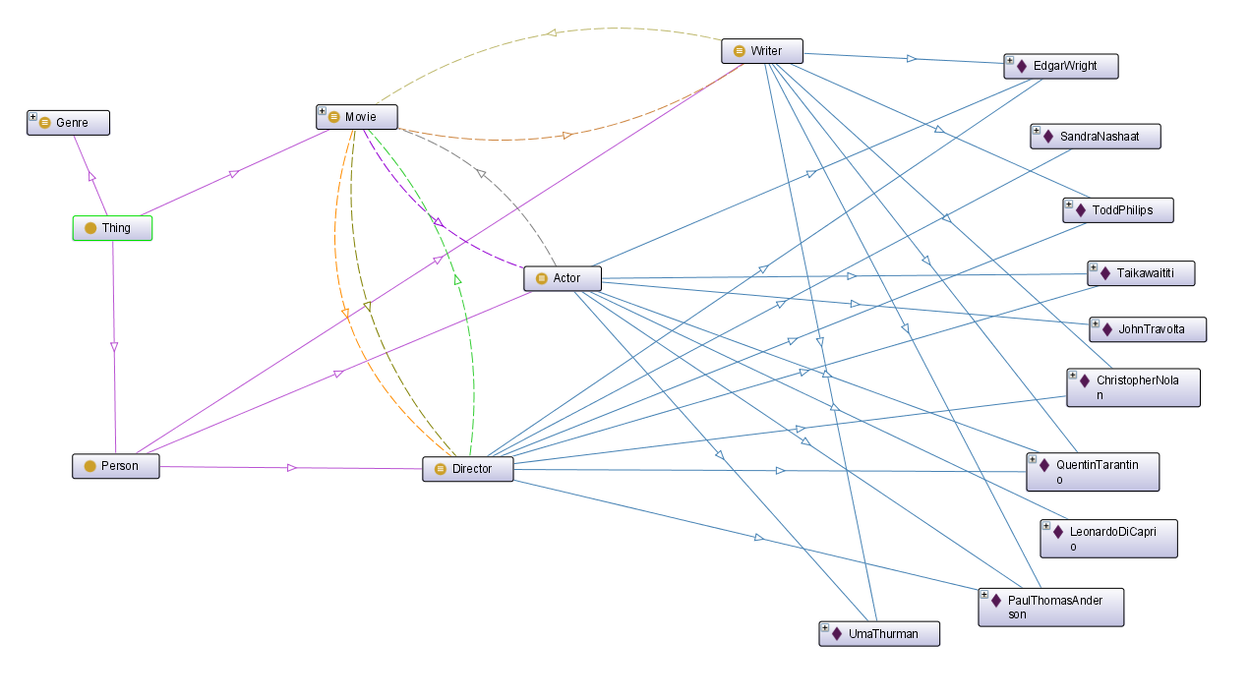
Ontology Graph (Person Instances)

Slide 15
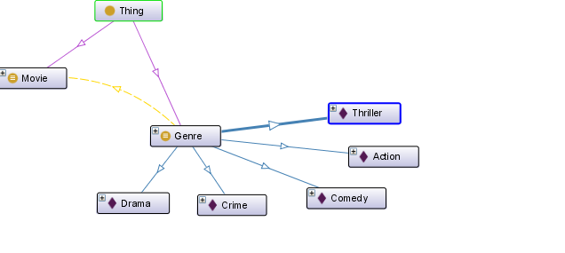
Ontology Graph (Genre Instances)

Slide 16
Querying The Ontology

Slide 17

List The Query

Slide 18
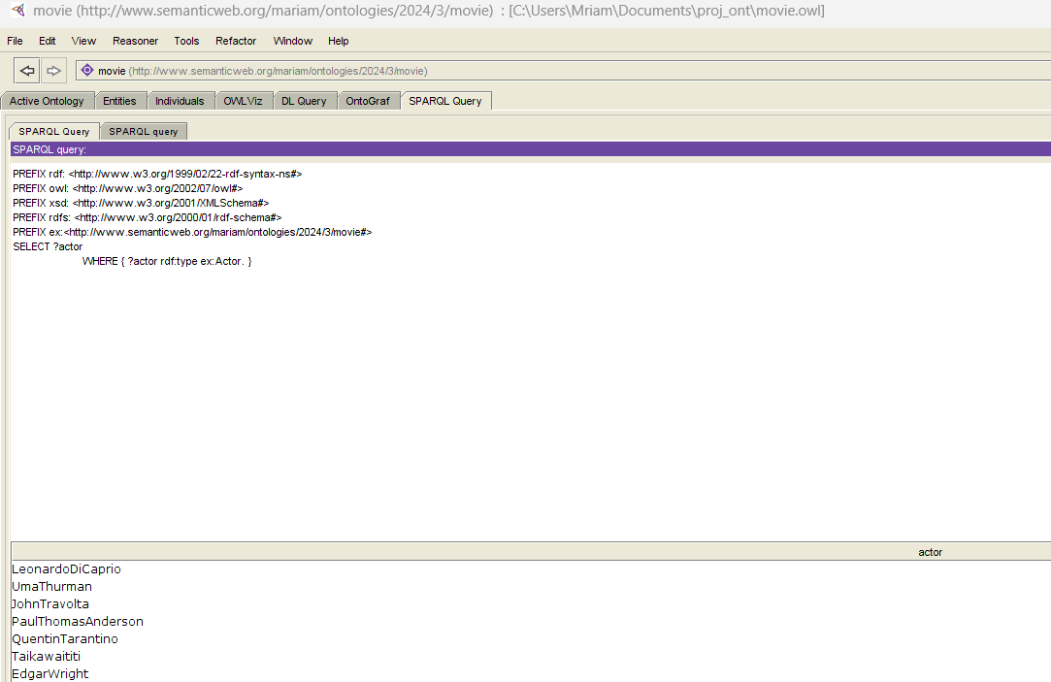
1. List the instances of the class Actor

Slide 19
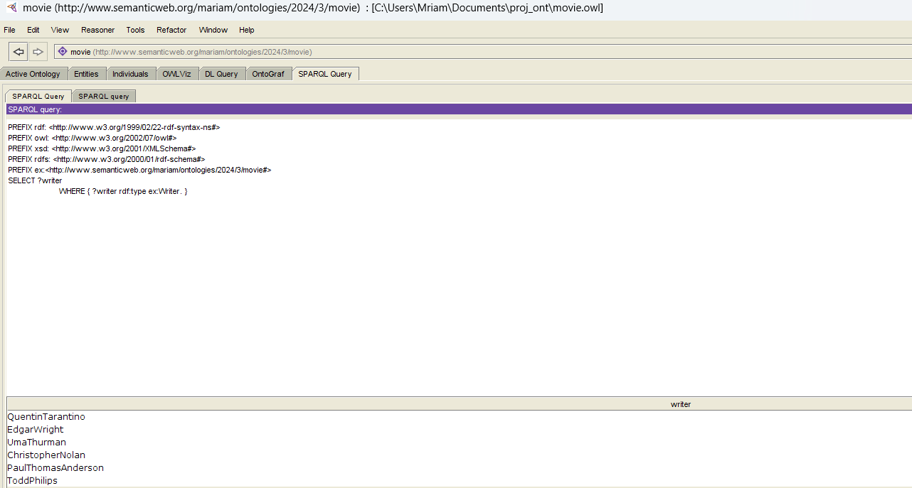
2. List the instances of the class writer

Slide 20
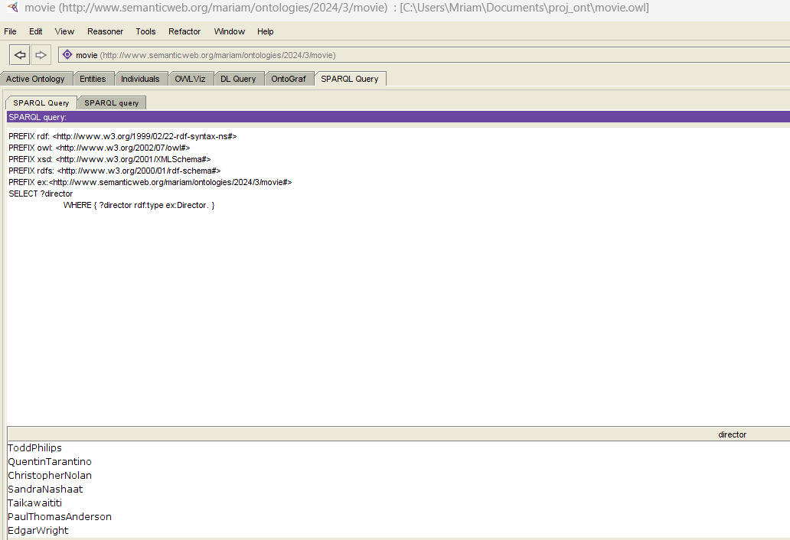
3. List the instances of the class director

Slide 21
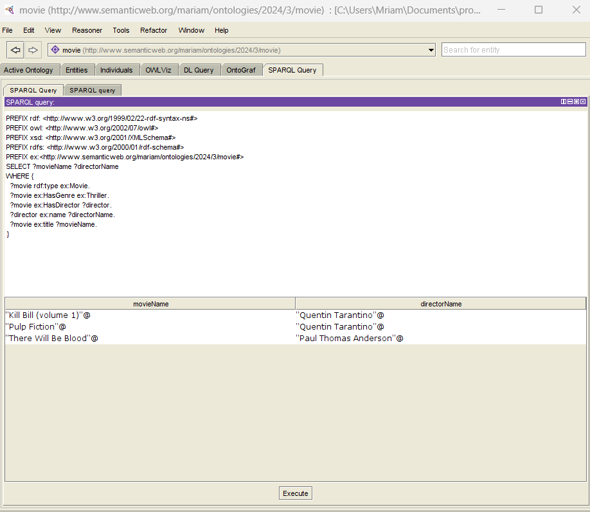
4. List the name of all Thriller movies. For each one, display its director

Slide 22
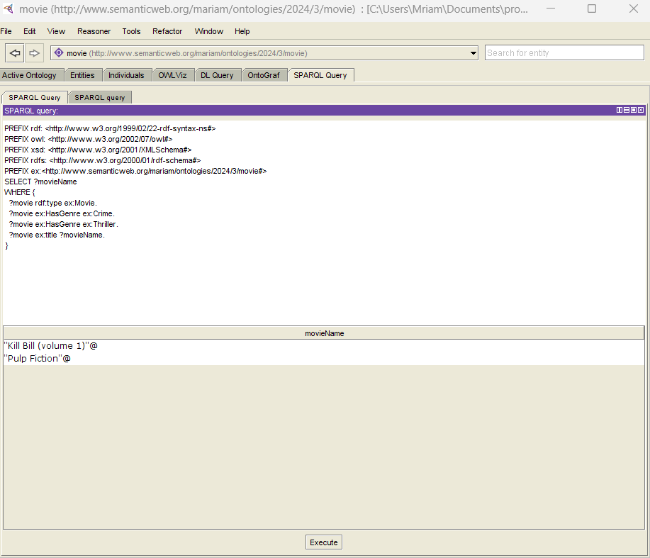
5. List the name of all Crime Thriller movies

Slide 23
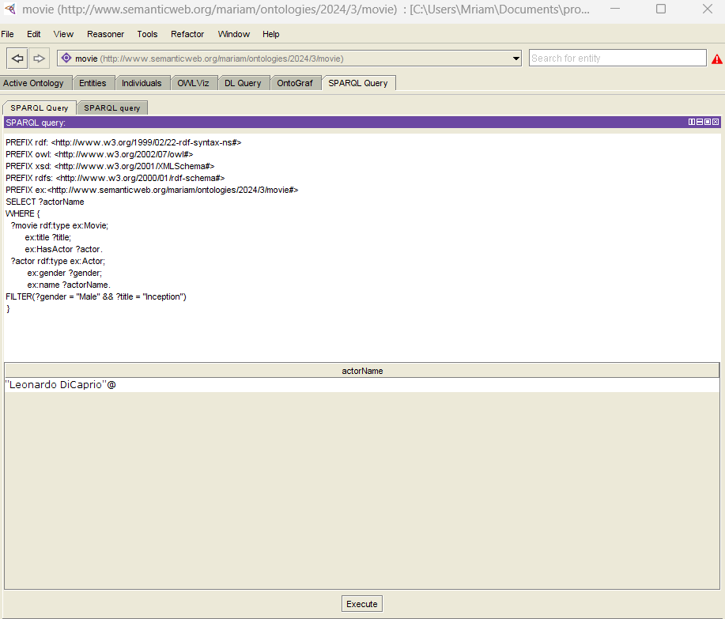
6. list the male actors in the movie in specific film

Slide 24
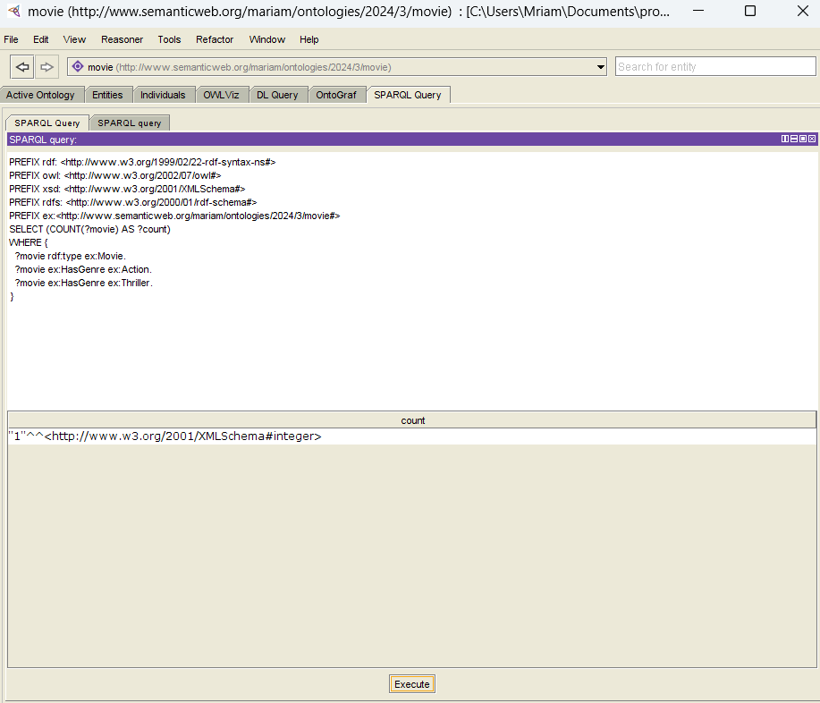
7. How many movies have both "Action" and "Thriller" as genres?

Slide 25
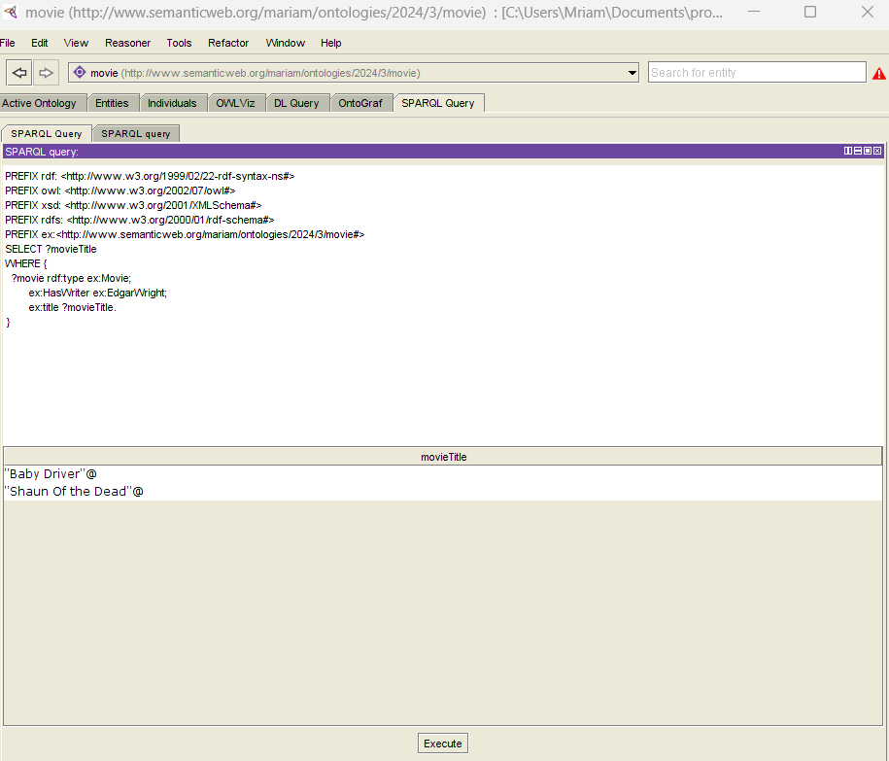
8. List all the movies written by a specific writer

Slide 26
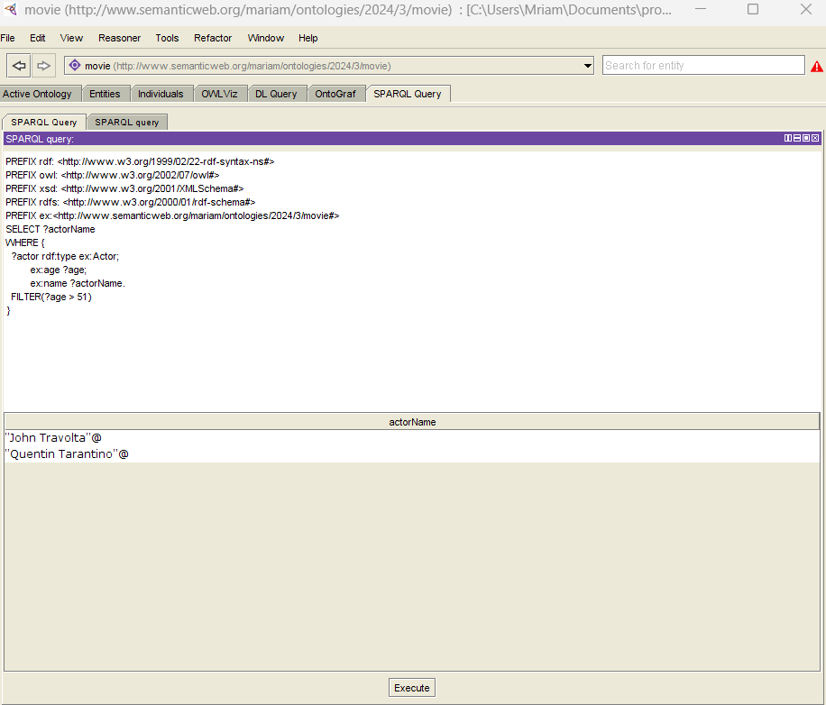
9. Find movies with a certain language.

Slide 27
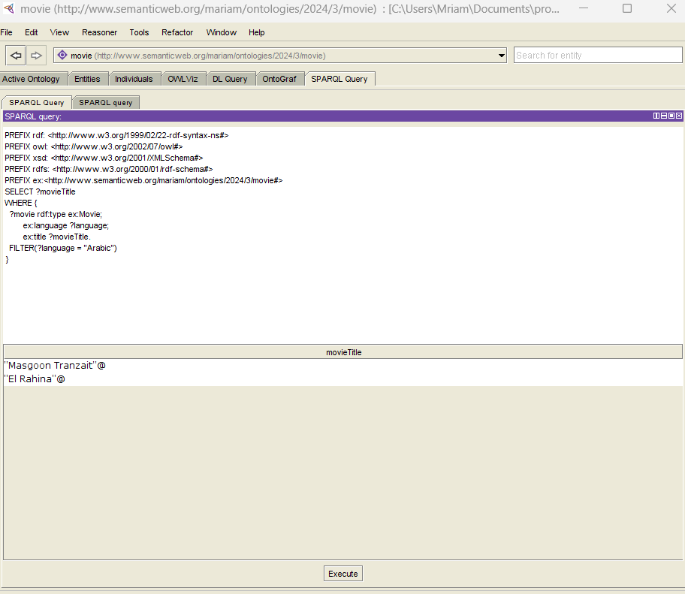
10. List the name of Actors older than 51 years.

Slide 28
Propose a Query

Slide 29
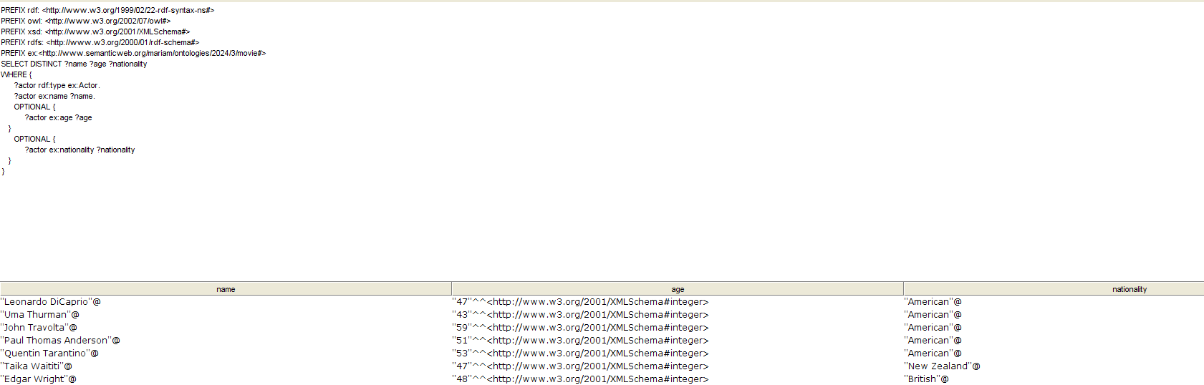
1. Propose a query that contains at least 2 Optional Graph Patterns

Slide 30
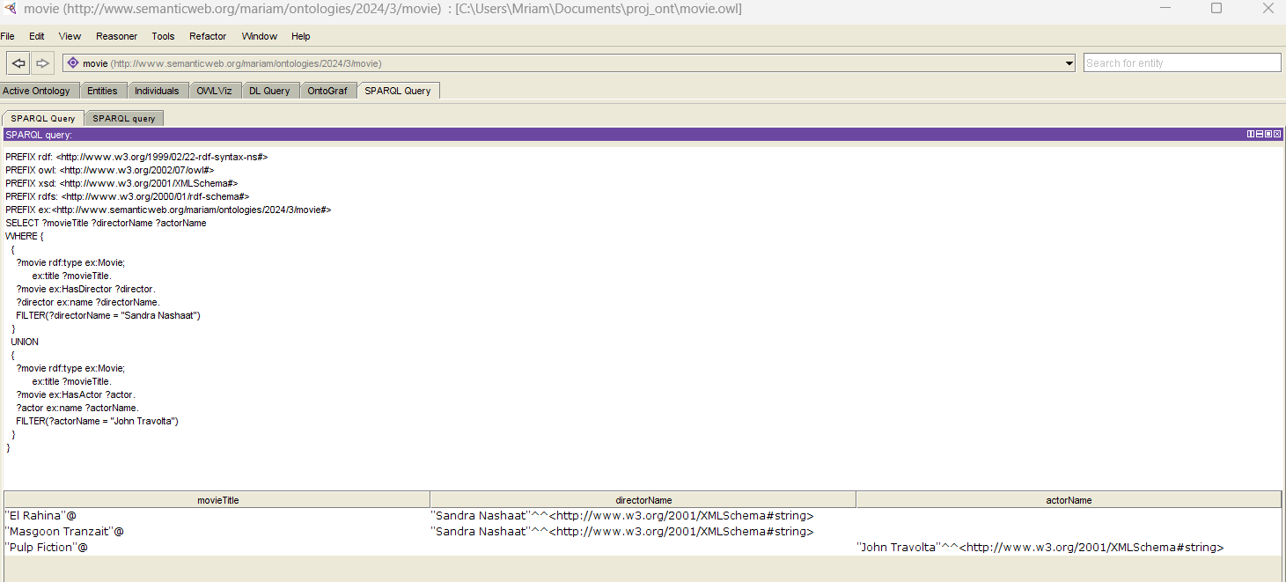
2. Propose a query that contains at least 2 alternatives and conjunctions

Slide 31
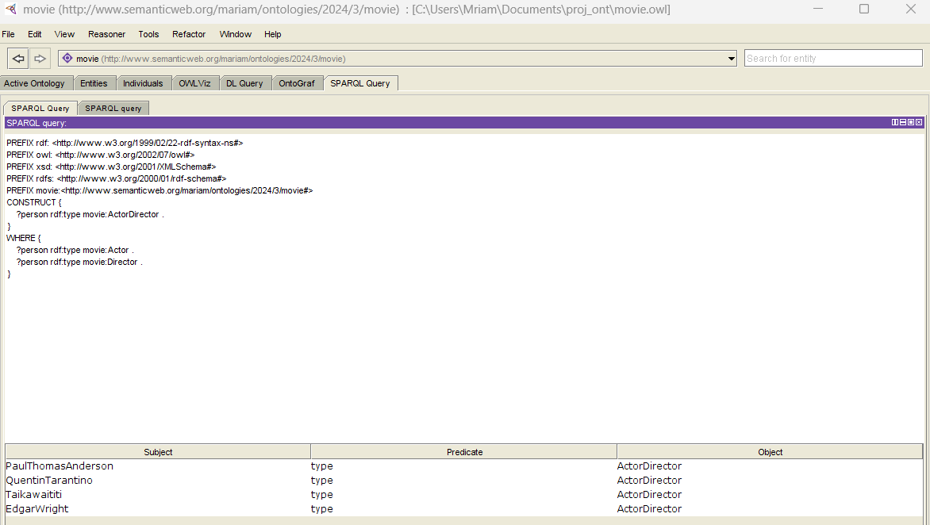
3. Propose a query that contains a CONSTRUCT query form

Slide 32
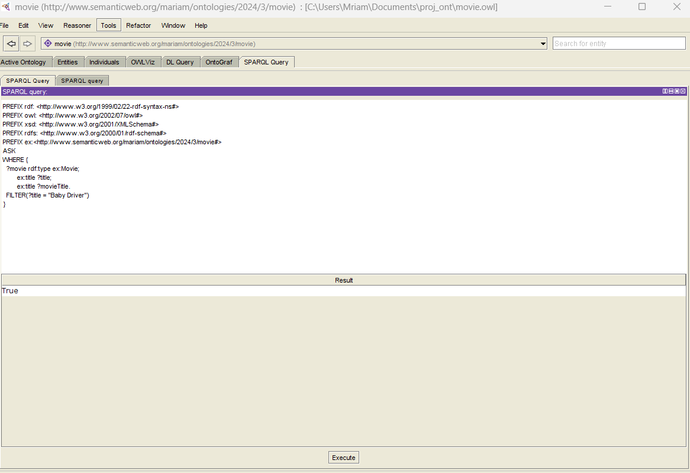
4. Propose a query that contains an ASK query form

Slide 33
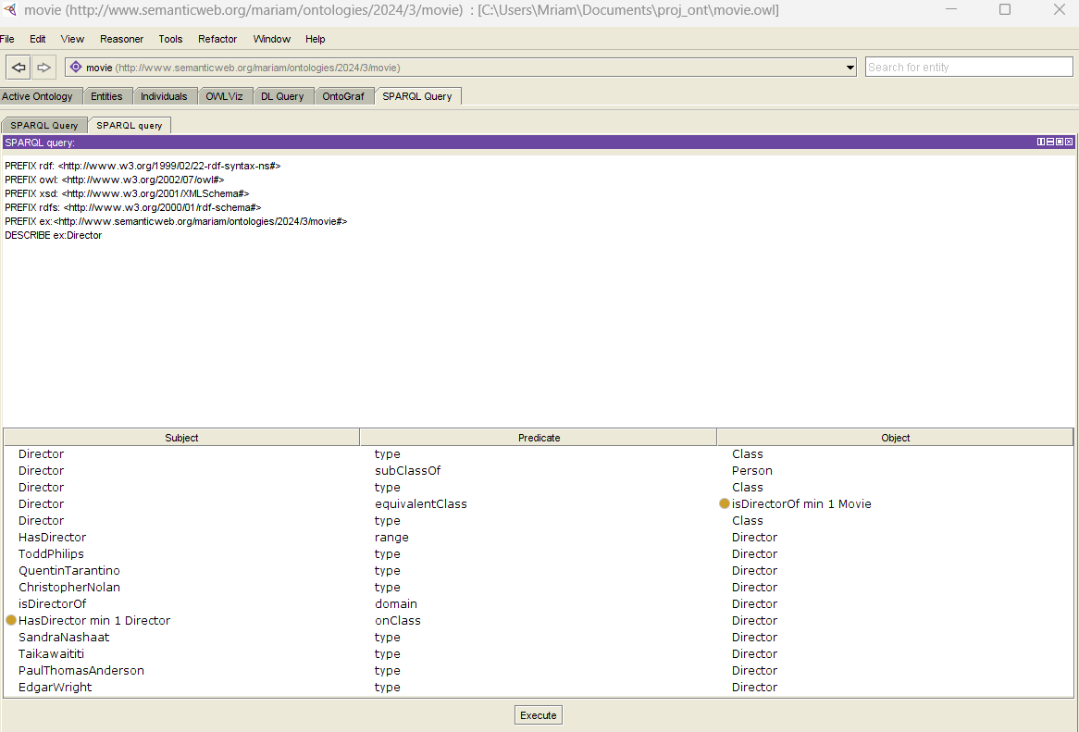
5. Propose a query that contains a DESCRIBE query form

Slide 34
Manipulating the ontology using Jena Outputs

Slide 35
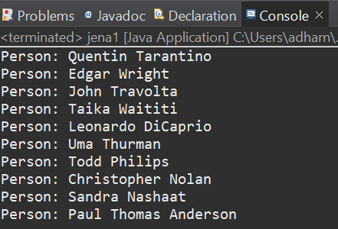
1. Create a java program (Jena1.java) that loads the ontology and displays all the Persons (without using queries, without inference).

Slide 36
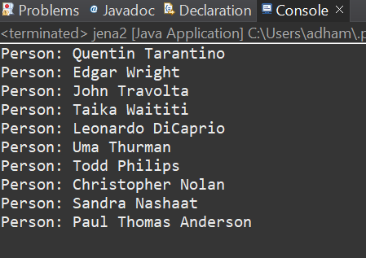
2. Create a java program (Jena2.java) that loads the ontology and displays all the Persons (using a query, without inference). Create the used query in text file under the data folder.

Slide 37
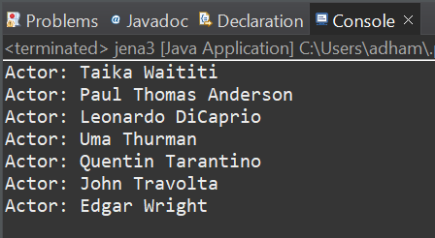
3. Create a java program (Jena3.java) that loads the ontology and displays all the Actors (without using queries, using inference).

Slide 38
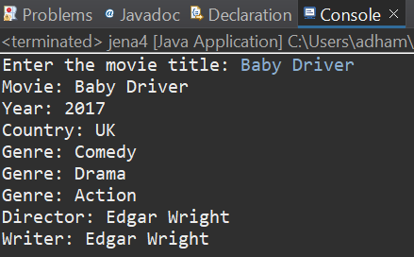
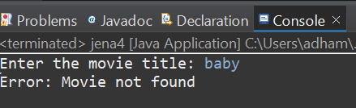
4. Create a java program (Jena4.java) that: a. Reads a name of a movie b. If it doesn’t exist displays an error message c. Else, display its year, country, genres and actors
Movie not found
Movie found

Slide 39
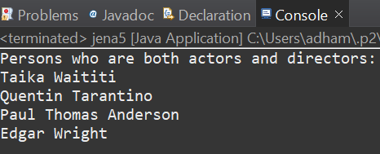
5. Create a java program (Jena5.java) that displays all persons that are actors and directors. Do this using a rule that defines a new class ActorDirector. The rule file must be saved in the data folder.

Slide 40
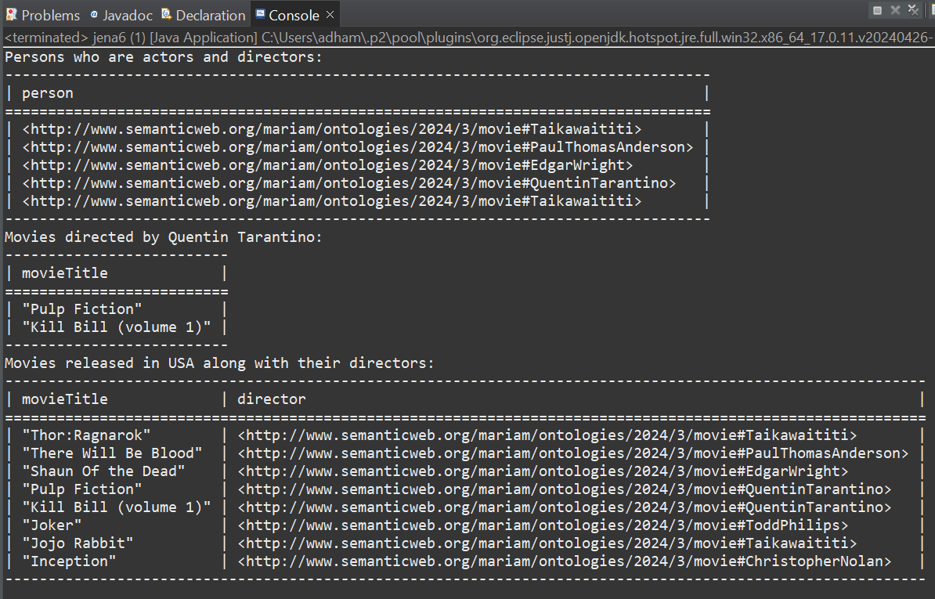
6. Specify 3 different rules and implement them in a java program (Jena6.java)

Slide 41
Java Application snapshots

Slide 42
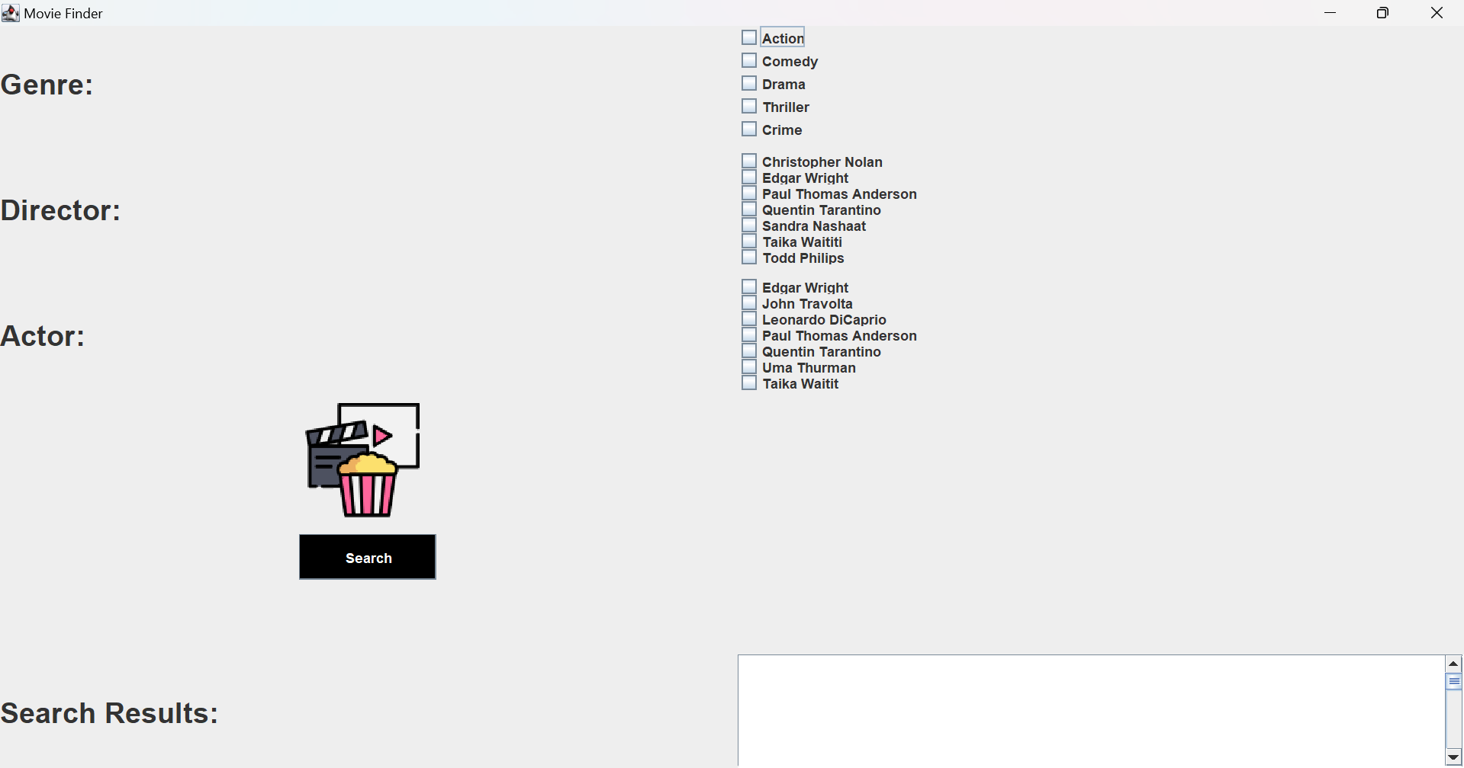
GUI

Slide 43
Test Case Samples

Slide 44
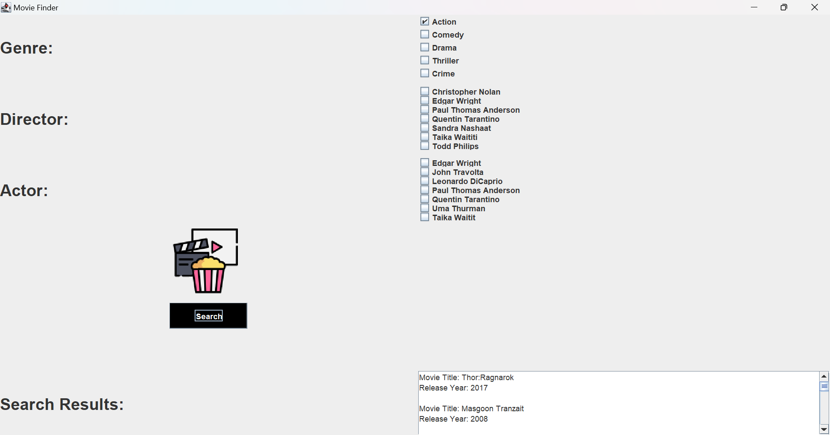

Slide 45
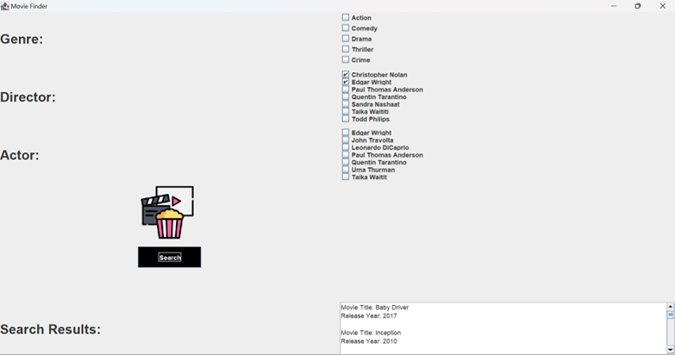

Slide 46
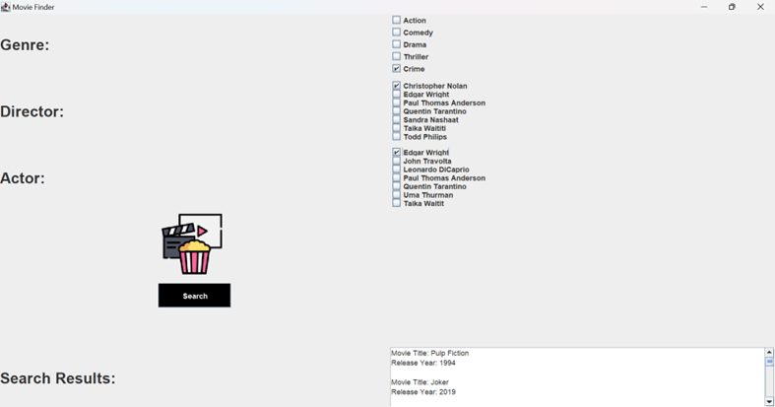

Slide 47

Thank You!

