Slide 1

Customer Shopping Behavior Analysis
Uncovering spending patterns, customer segments, and product preferences from 3,900 transactions to guide strategic business decisions.

Slide 2
Dataset at a Glance
3,900
18
37
Transactions
Features
Missing Values
Total purchases analyzed
Columns per record
In Review Rating column only
Demographics
Purchase Details
Behavior
Age, Gender, Location, Subscription Status
Item, Category, Amount, Season, Size, Color
Discounts, Promo Codes, Frequency, Ratings, Shipping

Slide 3

Data Preparation in Python
01
Load & Explore
Imported with pandas; used df.info() and .describe() for structure checks.
02
Clean & Standardize
Imputed missing Review Ratings with category median; renamed columns to snake_case.
03
Feature Engineering
Created age_group bins and purchase_frequency_days; dropped redundant promo_code_used.
04
Database Integration
Loaded cleaned DataFrame into PostgreSQL for SQL analysis.

Slide 4
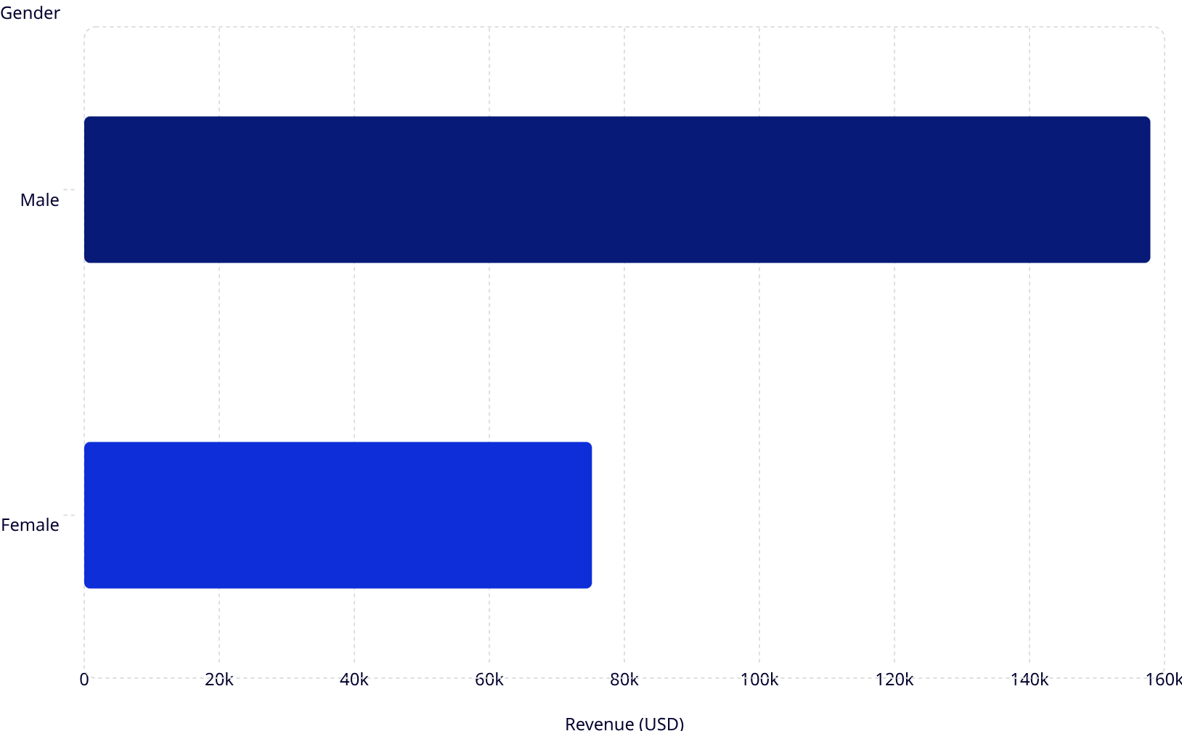
Revenue by Gender & Subscription
Key Findings
Male customers generated $157,890 in revenue — more than 2× female customers at $75,191.
158k
Subscription status shows no difference in average spend ($59 each), though non-subscribers (2,847) vastly outnumber subscribers (1,053).
75.2k
Status
Customers
Avg Spend
Revenue
No
2,847
$59
$170,436
Yes
1,053
$59
$62,645

Slide 5
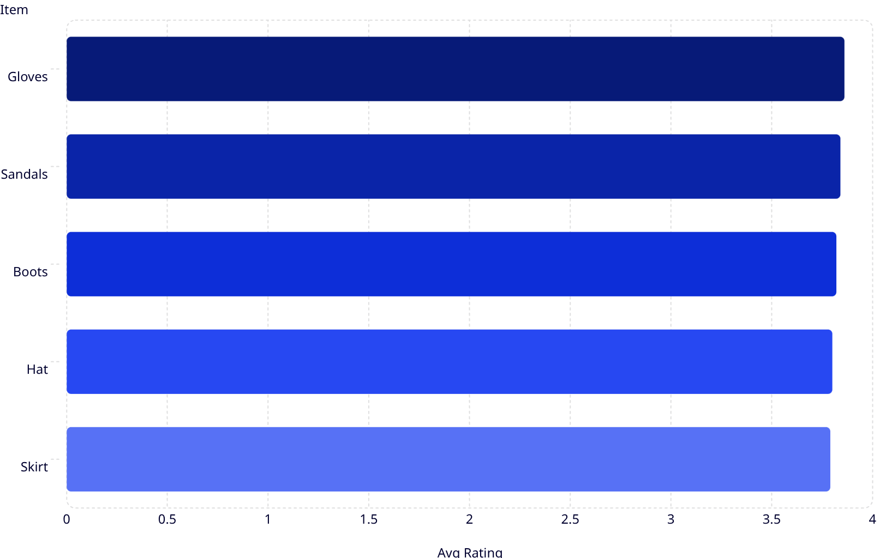

Top-Rated Products
Top 5 by Average Review Rating
3.86
Gloves lead with a 3.86 average rating, followed closely by Sandals (3.84) and Boots (3.82).
3.84
Ratings are tightly clustered, suggesting consistently positive customer satisfaction across top products.
3.82
3.8
Overall average review rating across all products: 3.75
3.79

Slide 6
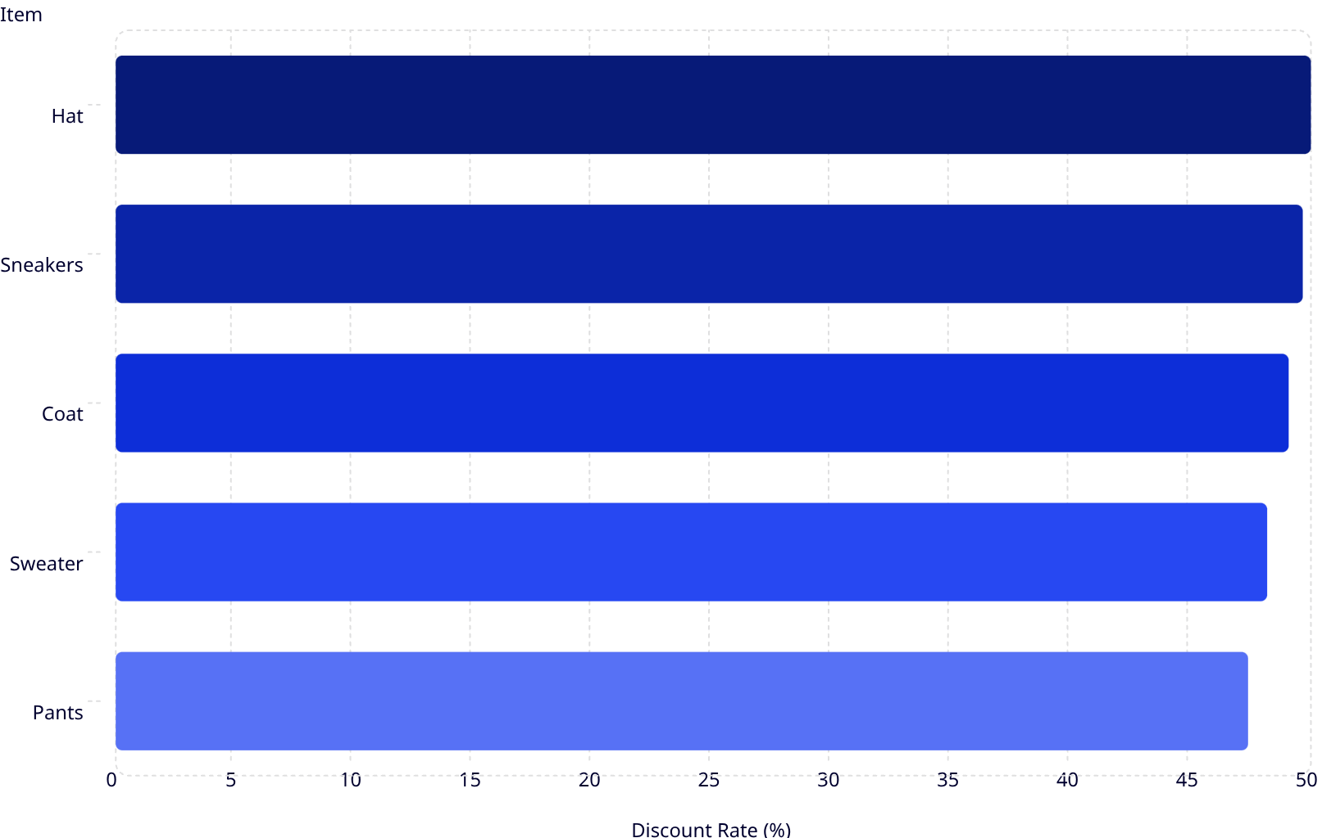

Discount Usage by Product
Top 5 Discounted Products
50
Hats top the list with exactly 50% of purchases using a discount — nearly half of all transactions for these items involve a discount.
49.7
49.1
All top 5 items hover between 47–50%, indicating widespread discount dependency across key categories.
48.2
47.4
High discount rates may signal price sensitivity — review margin impact.

Slide 7
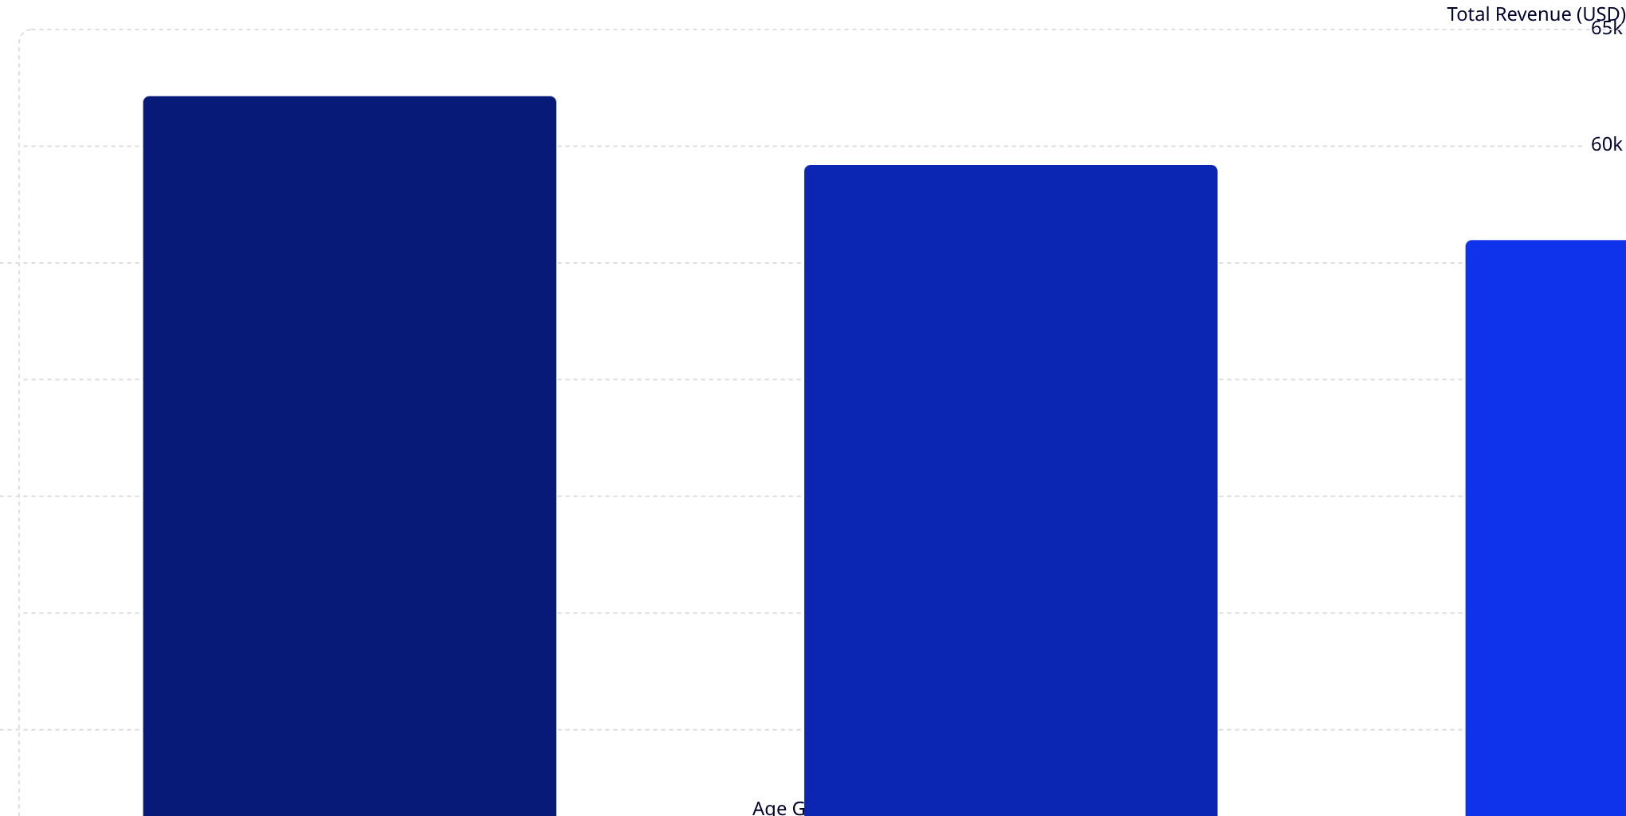
Revenue by Age Group
62.1k
59.2k
56k
55.8k
Young Adults are the top revenue contributors at $62,143, but revenue is remarkably balanced across all age groups — a spread of only ~$6,400 from top to bottom.

Slide 8
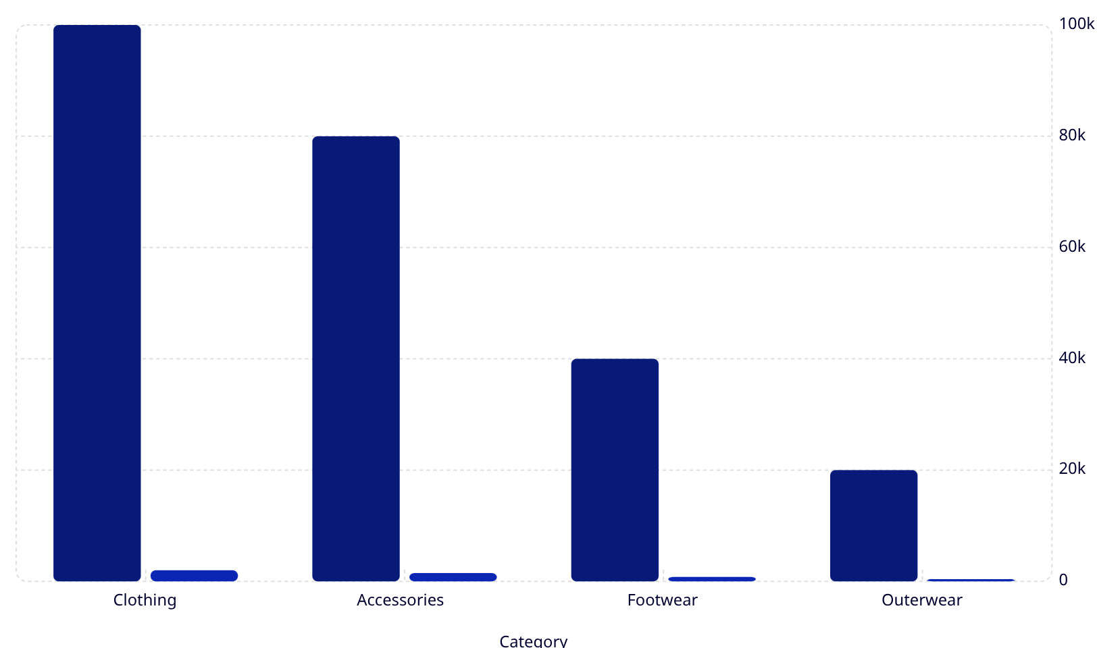
Revenue & Sales by Category
Revenue
Sales (units)
Category Breakdown
Clothing dominates both revenue (~$0.1M) and sales (~2K units), followed by Accessories.
Outerwear is the smallest category in both revenue and volume — a potential growth opportunity.
🥇 Clothing
🥈 Accessories
$0.1M · 2K units
$0.08M · 1.5K units

Slide 9
Power BI Dashboard
An interactive dashboard consolidates all insights — filtering by subscription status, gender, category, and shipping type — with KPIs, category breakdowns, and age group analysis at a glance.

Slide 10
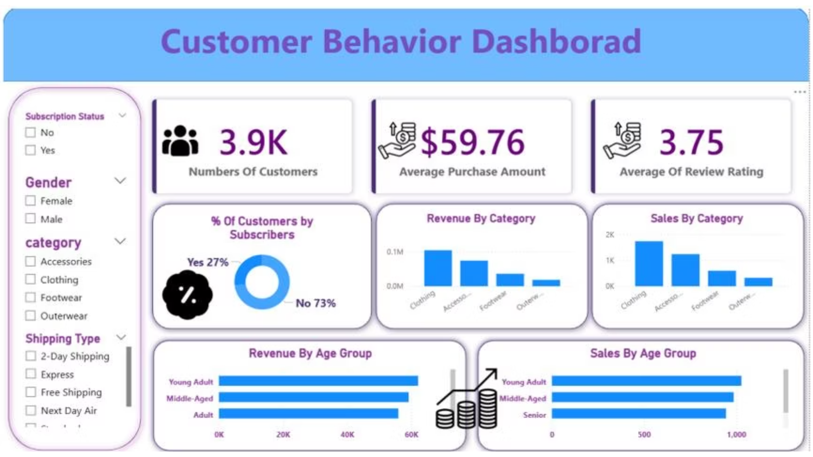

Slide 11

Key Takeaways
Gender Gap
Subscription Parity
Clothing Leads
Male customers drive 2× more revenue than female customers.
Subscribers and non-subscribers spend equally (~$59 avg), but non-subscribers are 73% of the base.
Clothing dominates revenue and sales across all categories.
Discount Dependency
Balanced Age Spend
Top items see ~47–50% discount rates — margin risk to monitor.
Young Adults lead revenue, but all age groups contribute nearly equally.

