Slide 1
Evaluating Different Machine Learning Models for Malicious URL Detection by Employing Natural Language Processing Techniques
Project Title
Group:27
BM Anjum Ul Mukset 20301223
Abid Rehman Rafi 23341063
Adhara Labannya 20101181

Slide 2
Table of Contents:
Topic | Page Number
Introduction | 1
Purpose | 2
What Is New In Our Research | 3
Methodology | 4
Data Analysis | 5
Result Analysis | 6-11
Limitation & Future Work | 12
Conclusion | 13

Slide 3
Introduction
Leveraging Machine Learning for Malicious URL Detection
The exponential growth of online activity necessitates robust and adaptable cybersecurity measures.
Malicious URLs, disguised and multifaceted, pose a significant threat, demanding effective detection and classification.
This research combines natural language processing and machine learning techniques for URL classification.
1

Slide 4
Purpose
Advancing URL Classification Accuracy and Adaptability
Existing URL classification methods face challenges with evolving threats.
This research aims to:
Improve accuracy in classifying URLs as benign, phishing, malware, or defacement.
Train models with a greater dataset to resolve diversity issues.
Enhance model adaptability to new threats and diverse URL types.
2

Slide 5
What's New in Our Research?
Breaking New Ground in URL Classification
We explore a comprehensive feature engineering approach for URL analysis.
We evaluate diverse machine learning models, including ensemble methods like Random Forest.
We address data imbalance and limitations of existing research.
Our research contributes to the development of more robust and adaptable URL classification systems.
3

Slide 6
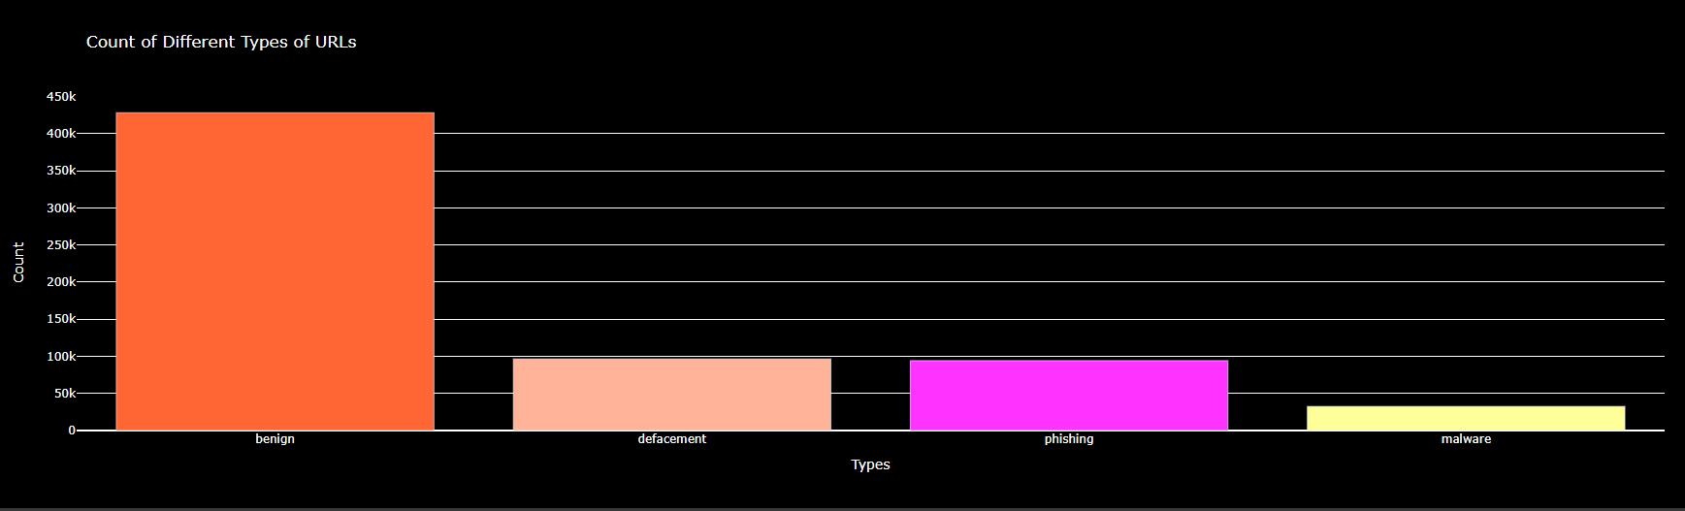
Methodology
Collecting a huge dataset consisting of 651,191 URLs
Visualizing distribution of different types of data:
Benign: 428,103. Defacement: 96,457. Phishing: 94,111. Malware: 32,520
Initial features: url and types.
4

Slide 7
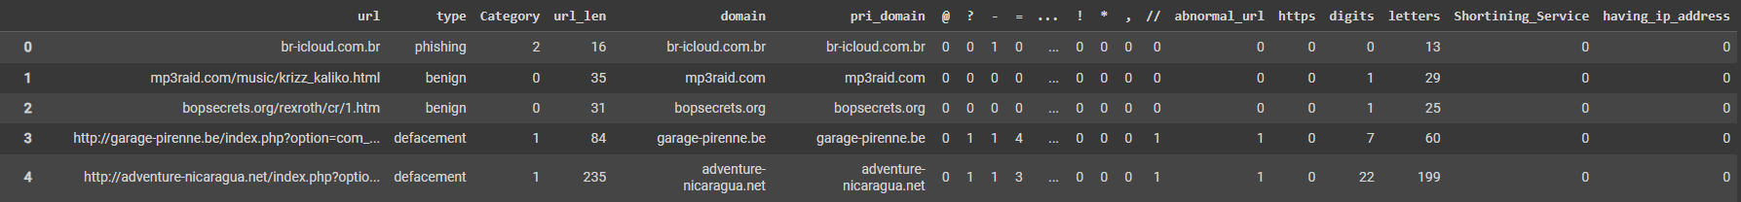
Data preprocessing:
Removing ‘www.’
Creating ‘category’ column
Extracting features: url length, primary domain etc.
Feature Engineering (create new features):
Special characters, digits, letters
Shortened URL
Ip address, https
5

Slide 8
Model selection:
Decision Tree
Random Forest
Ada Boost
KNeighbors
SGD
Extra Trees Classifier
Gaussian Naive Bayes
Evaluation metrics (Accuracy, Precision, recall, F1-score)
6

Slide 9
Training and Testing
Data splitting (80%, 20%)
Each model trained with the training data
Model performance evaluated with the test set
Classification metrics: accuracy, precision, recall, f1-score
Diverse models ensure comprehensive exploration of different approaches.
7

Slide 10
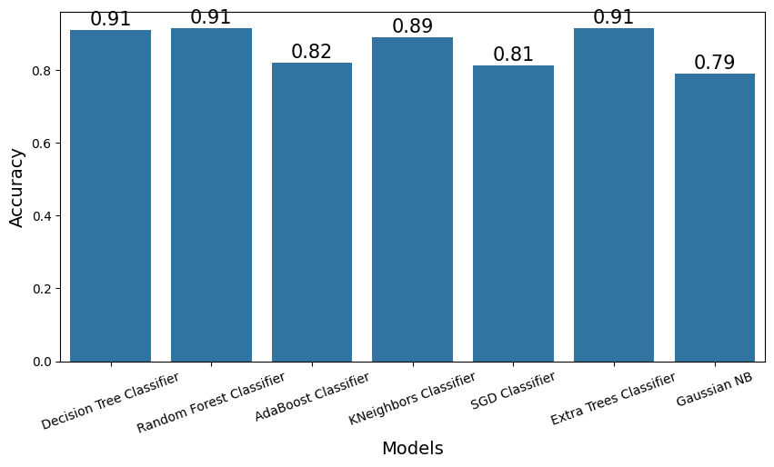
Results:
Decision Tree Classifier: 90.94%
Random Forest Classifier: 91.47%
AdaBoost Classifier: 82.01%
KNeighbors Classifier: 89.04%
SGD Classifier: 81.31%
Extra Trees Classifier: 91.48%
Gaussian Naive Bayes: 78.95%
Fig: Result Analysis
8

Slide 11
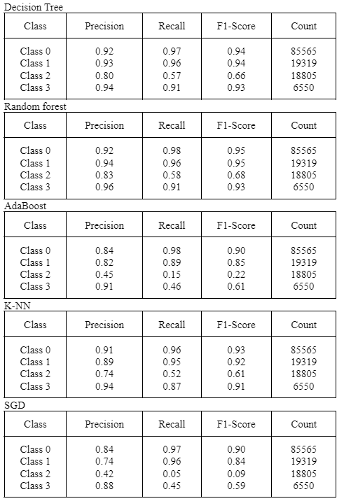
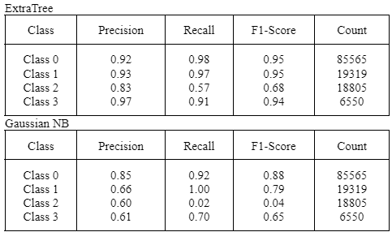
Classification Metrics Scores
9

Slide 12
Model Selection:
In between these, the Extra Trees Classifier and the Random Forest Classifier emerges as the most suitable choices, striking a balance between accuracy and the ability to effectively classify each URL type. Furthermore, The collective nature of these models contributes to its resilience against overfitting and improves generalization to new data. A special consideration can be given to the Decision Trees Classifier as along with its good accuracy, it takes significantly lesser time for training and prediction.
10

Slide 13
LIMITATION:
Generalization of evolving threats
Feature engineering complexity
FUTURE WORK:
Enhanced feature engineering
Dynamic Model updating
11

Slide 14
CONCLUSION
In conclusion, this research adds to the continuous endeavors in the realm of cybersecurity to create reliable and strong mechanisms for URL classification. The results of this investigation can help in choosing suitable models and functionalities for practical uses. To stay ahead of emerging threats and maintain the security of online environments, ongoing research and model refinement are essential as the cybersecurity landscape changes.
12

